Slide 1

ITC 6000 Database Management Systems Final Project Presentation “DRUG MISUSE CASE STUDY” Group Name – HUSKY 3
Team Members : Iti Rohilla (Leader)
Kareena Ramrakhya
Monika Gundecha
Shachi Dwivedi
Ratnesh Mishra

Slide 2
OVERVIEW
Project Overview
Persona’s
Business Rules
ER Diagram
Solution Architecture and HA
Analytical SQL Quries
Security & Privacy Concerns
Conclusion

Slide 3
PROJECT OVERVIEW
Data source of the project – https://corgis-edu.github.io//corgis/csv/drugs/
Our team has obtained a large dataset from our research source that contains raw and unprocessed data. In order to gain valuable insights from this data, we plan to use the Python programming language and its powerful data analysis library, pandas.
The process of transforming the raw data into a more structured and organized format using pandas will allow us to perform various data analysis techniques, such as data cleaning, data manipulation, and data visualization.
Through these techniques, we aim to uncover patterns, trends, and relationships within the data that can help us achieve our research objectives.
We are confident that by using pandas, we will be able to extract valuable insights and make informed decisions based on the data, which will ultimately contribute to the success of our research project.

Slide 4
PERSONA’S
1. The primary purpose of the study is to have an in-depth understanding of how the patterns of substance misuse have altered throughout time. The study examines data from 2002 to 2018 to seek for patterns, movements, and changes in the prevalence of substance use and addiction.
2. This study is required in order for treatments and policies to be adapted to certain age groups.
3. The effort also investigates how substance addiction can affect one's health. This includes investigating the health risks associated with various substances, learning how substance addiction affects different age groups, and assessing the efficacy of therapy.
4. The study focus of the project is on thoroughly examining data on drug addiction, with an emphasis on age group dynamics, regional disparities, health repercussions, and the development of evidence-based policies and remedies. Through these research activities, the project intends to improve public health outcomes by contributing to a better understanding of substance addiction.
5. Based on data pertaining to age groups, government agencies can establish customized educational programs and preventative actions.
6. Healthcare practitioners can examine the impact of aging on substance use-related health problems and treatment outcomes.

Slide 5
BUSINESS RULES
When dealing with data on substance abuse among various age groups and states, it's essential to apply some business rules to ensure accuracy and consistency. Here are five such rules to consider:
Data Validation: To ensure data accuracy and integrity, validate all entries for the number of people using substances (cigarettes, marijuana, cocaine, alcohol), checking for plausible ranges, non-negative values, and values below the total population for that state and year.
Consistency in Age Groups: To make age group data comparable and meaningful, standardize age groupings across all states and years, flagging any inconsistencies for review.
Rate Calculation: Accurately calculate substance abuse rates (percentages) based on the number of people using substances and the total population for each state and year, ensuring consistency and eliminating discrepancies.
Temporal Data Consistency: Check that data for each state is available for every year between 2002 and 2018, flagging any missing data points for documentation. This ensures there are no gaps in the dataset, making it suitable for trend analysis over time.
Outlier Detection: Identify and flag any substance usage data points that deviate significantly from expected distribution, requiring further investigation
It is crucial to adhere to these business rules as they ensure the accuracy and consistency of data, making the dataset reliable for analyzing and reporting on substance abuse trends across different age groups and states from 2002 to 2018. These rules play a significant role in maintaining data consistency, quality, and reliability, ultimately leading to more precise analysis and reporting of substance abuse trends among various age groups and states.

Slide 6
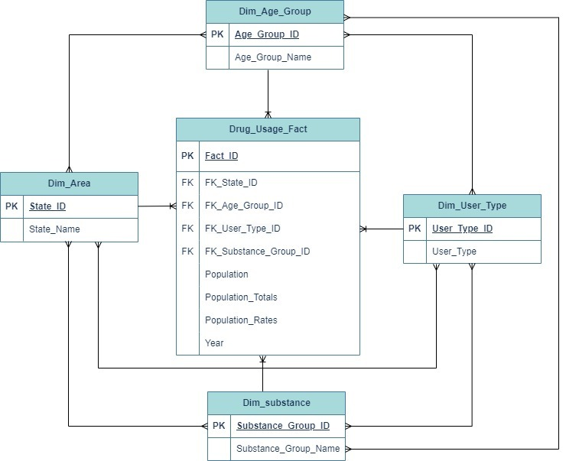
ER DIAGRAM

Slide 7
PROJECT ARCHITECTURE
Architecture: Azure Data Studio is the client-side, while Azure SQL Database is the server-side of your solution, following the common client-server model.
Cloud Hosting: Both Azure Data Studio and Azure SQL Database are hosted in the cloud, providing benefits such as scalability, high availability, and easy management without the need for physical hardware or on-premises infrastructure.
Storage Requirements: The well-structured and optimized database design efficiently manages the fact table with 20,808 rows and four dimension tables with a total of 62 rows, resulting in a total database size of 3.4 MB. Azure automatically manages and scales the storage as needed, making it a cost-effective solution for your storage needs.

Slide 8
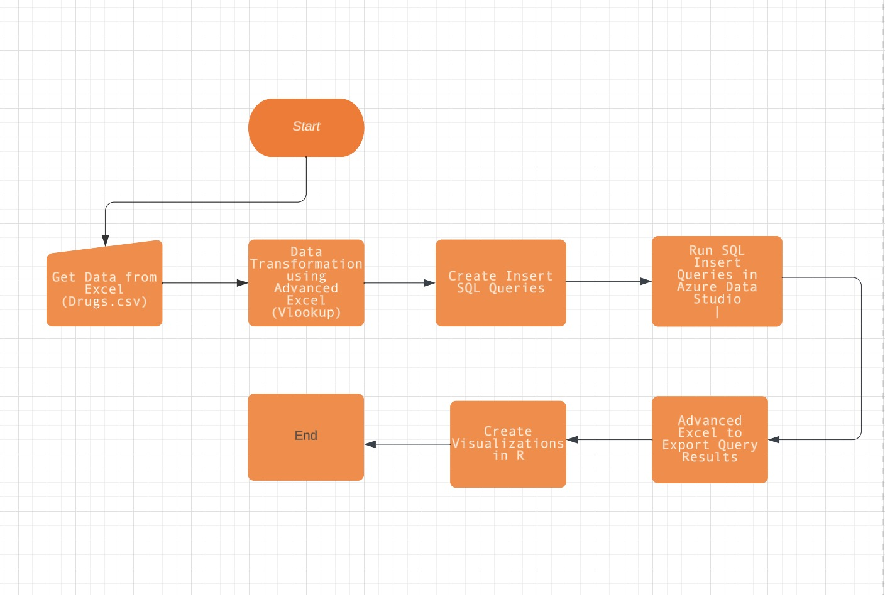
PROJECT ARCHITECTURE

Slide 9
ANALYTICAL SQL QUERIES
Inquiry/Overview/Basic Insight of our dataset:
1. Finding the total number of drug usage records for each year.
--Finding the total number of drug usage for each year: SELECT Year, sum(Population_Totals) AS Total_Usage FROM Drug_Usage_Fact GROUP BY Year;
2. Breakdown of the number of users for each substance group.
-- Breakdown of the number of users for each substance group:SELECT ds.Substance_Group_Name, sum(Population_Totals) AS Total_UsersFROM Drug_Usage_Fact fJOIN Dim_Substance ds ON f.FK_Substance_Group_ID = ds.Substance_Group_IDGROUP BY ds.Substance_Group_Name;
3. Determining the year with the highest drug usage rate.
-- Determining the year with the highest drug usage rate:SELECT Year, SUM(Population_Totals) AS Total_UsageFROM Drug_Usage_FactGROUP BY YearORDER BY Total_Usage DESCLIMIT 1;
4. Identifying the substance group with the highest usage.
-- Identifing the substance group with the highest usage:SELECT ds.Substance_Group_Name, SUM(Population_Totals) AS Total_UsageFROM Drug_Usage_Fact fJOIN Dim_Substance ds ON f.FK_Substance_Group_ID = ds.Substance_Group_IDGROUP BY ds.Substance_Group_NameORDER BY Total_Usage DESCLIMIT 1;
5. Finding the age group with the highest drug usage.
-- Finding the age group with the highest drug usage:SELECT da.Age_Group_Name, SUM(Population_Totals) AS Total_UsageFROM Drug_Usage_Fact fJOIN Dim_Age_Group da ON f.FK_Age_Group_ID = da.Age_Group_IDGROUP BY da.Age_Group_NameORDER BY Total_Usage DESCLIMIT 1;

Slide 10
ANALYTICAL SQL QUERIES
Please find below a list of questions related to the usage of various substances among different age groups over the years:
1. What is the average rate of usage of various substances among different age groups over the years?
SELECT ds.Substance_Group_Name, dag.Age_Group_Name, AVG(Population_Rates) AS Avg_RateFROM Drug_Usage_Fact fJOIN Dim_Age_Group dag ON f.FK_Age_Group_ID = dag.Age_Group_IDJOIN Dim_Substance ds ON f.FK_Substance_Group_ID = ds.Substance_Group_IDGROUP BY ds.Substance_Group_Name, dag.Age_Group_NameORDER BY ds.Substance_Group_Name, dag.Age_Group_Name;
2. Among different age groups, which state has the highest number of new users for various substance usage over the years?
SELECT dag.Age_Group_Name, da.State_Name, SUM(Population_Totals) AS Total_New_Users FROM Drug_Usage_Fact f JOIN Dim_Age_Group dag ON f.FK_Age_Group_ID = dag.Age_Group_ID JOIN Dim_Area da ON f.FK_State_ID = da.State_ID JOIN Dim_Substance ds ON f.FK_Substance_Group_ID = ds.Substance_Group_ID WHERE f.FK_User_Type_ID = 3003 GROUP BY dag.Age_Group_Name, da.State_Name ORDER BY dag.Age_Group_Name, Total_New_Users DESC;
3. What are the most and least common drug types used for various substances?
SELECT ds.Substance_Group_Name, ds.Substance_Group_ID, SUM(Population_Totals) AS Total_UsersFROM Drug_Usage_Fact fJOIN Dim_Substance ds ON f.FK_Substance_Group_ID = ds.Substance_Group_IDGROUP BY ds.Substance_Group_Name, ds.Substance_Group_IDORDER BY Total_Users DESC;
4. What is the percentage difference in substance usage over the years among different age groups?
--SELECT ds.Substance_Group_Name, dag.Age_Group_Name, Year, Population_Totals, (Population_Totals - LAG(Population_Totals) OVER (PARTITION BY ds.Substance_Group_Name, dag.Age_Group_Name ORDER BY Year)) AS User_Difference, ROUND( (Population_Totals - LAG(Population_Totals) OVER (PARTITION BY ds.Substance_Group_Name, dag.Age_Group_Name ORDER BY Year)) * 100.0 / LAG(Population_Totals) OVER (PARTITION BY ds.Substance_Group_Name, dag.Age_Group_Name ORDER BY Year), 2 ) AS Percentage_DifferenceFROM Drug_Usage_Fact fJOIN Dim_Age_Group dag ON f.FK_Age_Group_ID = dag.Age_Group_IDJOIN Dim_Substance ds ON f.FK_Substance_Group_ID = ds.Substance_Group_IDORDER BY ds.Substance_Group_Name, dag.Age_Group_Name, Year;
5. What is the trend of usage for different user types for each substance over the years?
-- SELECT ds.Substance_Group_Name, du.User_Type, Year, SUM(Population_Totals) AS Total_UsersFROM Drug_Usage_Fact fJOIN Dim_Substance ds ON f.FK_Substance_Group_ID = ds.Substance_Group_IDJOIN Dim_User_Type du ON f.FK_User_Type_ID = du.User_Type_IDGROUP BY ds.Substance_Group_Name, du.User_Type, YearORDER BY ds.Substance_Group_Name, du.User_Type, Year;

Slide 11
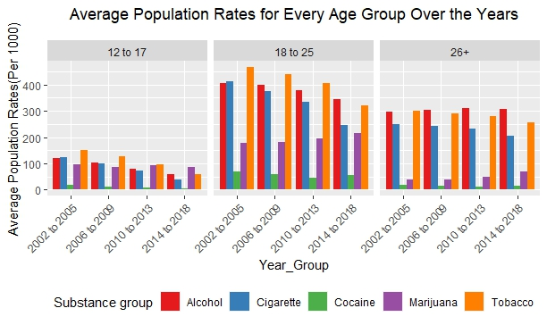
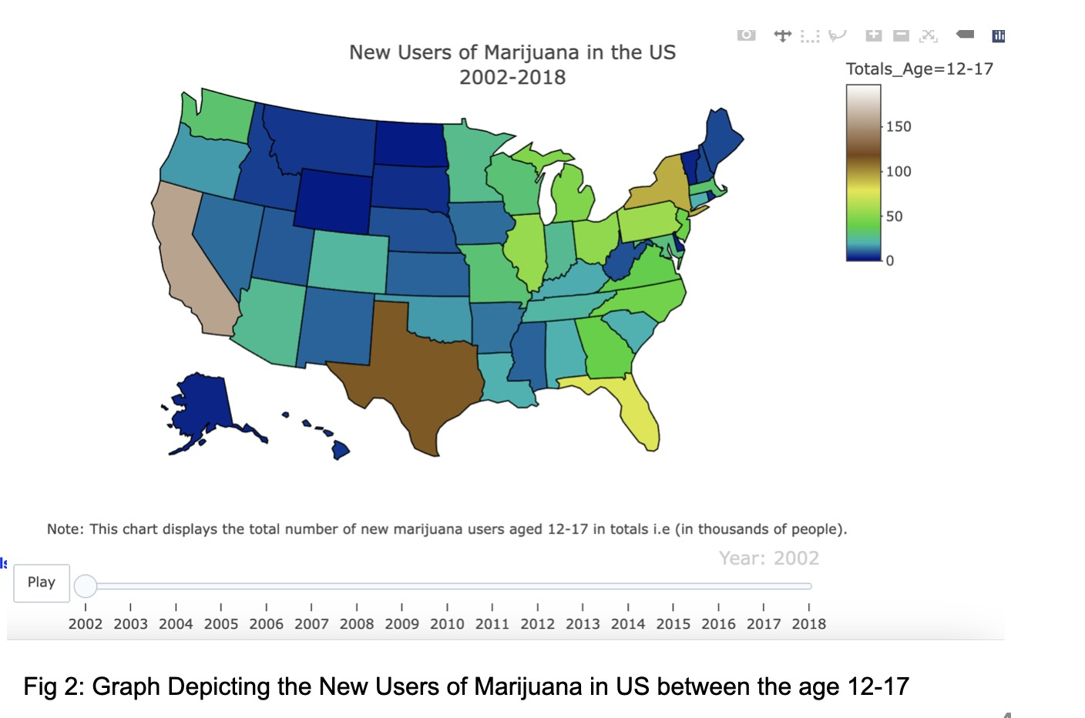
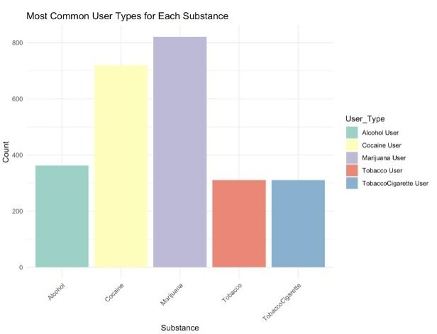
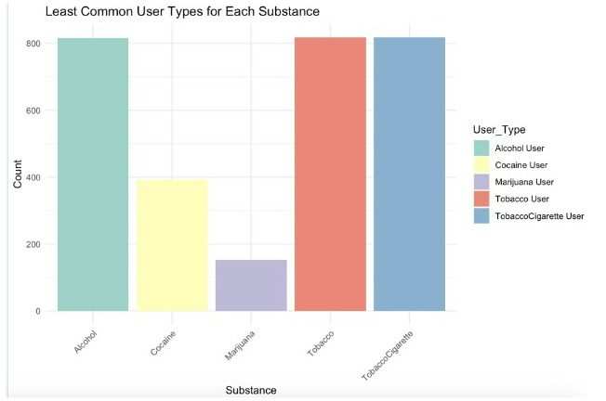
ANALYTICAL SQL QUERIES
Please find below a list of questions related to the usage of various substances among different age groups over the years:
1. What is the average rate of usage of various substances among different age groups over the years?
2. Among different age groups, which state has the highest number of new users for various substance usage over the years?
3. What are the most and least common drug types used for various substances?

Slide 12
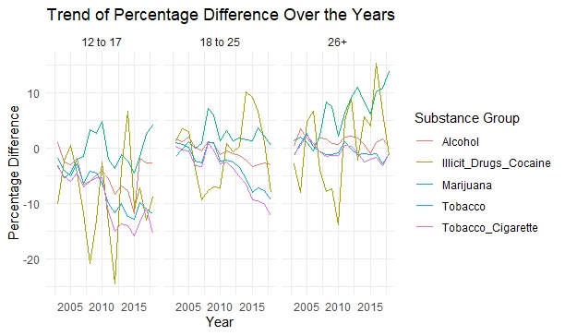
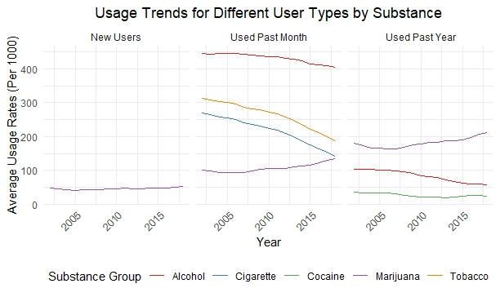
ANALYTICAL SQL QUERIES
4. What is the percentage difference in substance usage over the years among different age groups?
5. What is the trend of usage for different user types for each substance over the years?

Slide 13
SECURITY & PRIVACY CONCERNS
Given that our dataset is not user-specific, we can confidently state that there are no specific security and privacy concerns, including user privacy, authentication, data encryption, and access control.

Slide 14
CONCLUSION
In our studies, we learned advanced database concepts such as data normalization to store data more efficiently.
We also learned how to model data for better visualization. Our experience has given us the knowledge to navigate the world of data management and analytics.
Our database project aims to improve public health and well-being in our country by enabling evidence-based decision-making and addressing the complex issue of substance addiction.
Our work will result in a more profound understanding of substance addiction trends, which will pave the way for more effective interventions and policies.

