Slide 1
SKYTRAX AIRLINE REVIEW ANALYSIS
BY KENECHUKWU AKUJIEZE

Slide 2
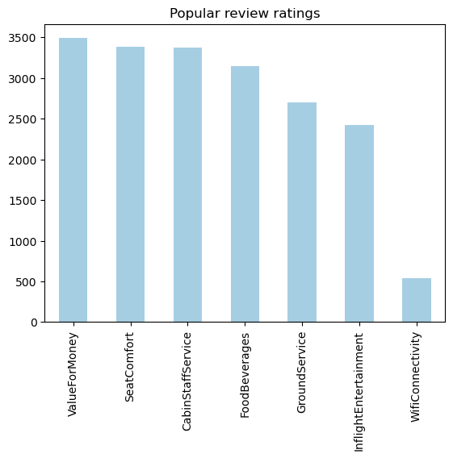
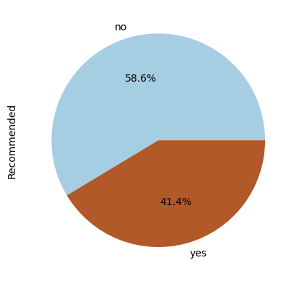
According to the frequency chart, customers tend to provide more feedback on the ratings of the value for money, seat comfort, and cabin staff service when reviewing the subjects.
Recommend
The majority of the 3490 reviews indicated that they would not recommend British Airways.

