Slide 1


FinanceAI
- By QuadSquad Coders
Hackathon Project:
Problem Statement 1 – “Let AI Speak to Your Money”
Notes:
1

Slide 2
QuadSquad Coders
Pratham Shah – Team Leader, Backend & Architecture
Bhoomi Shah – Frontend
Jaiveer Trivedi – AI & API Integration
Ridham Kothari – UI/UX & Presentation Design
Notes:
1

Slide 3
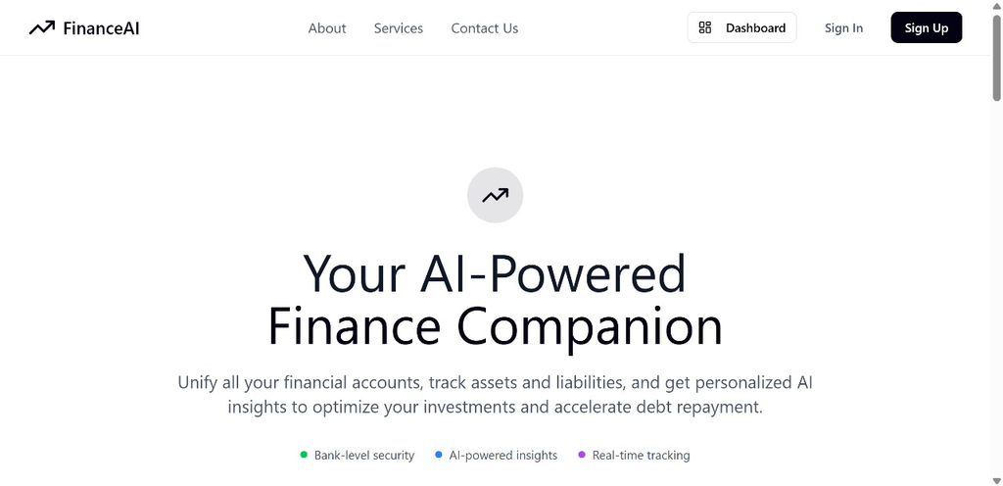
Why FinanceAI?
Managing money is complex & time-consuming.
Existing tools are either too generic or too technical.
Lack of personalized insights for day-to-day finance.
Users need a secure, AI-driven assistant that speaks in plain language.
Notes:
2

Slide 4
FinanceAI – Your AI-Powered Finance Companion
Conversational platform for personal finance
Unified view of accounts, assets, and liabilities
Detects unusual activity & spending patterns
Provides personalized budget & investment advice
Built with security, privacy & trust at the core
Notes:
3

Slide 5





What FinanceAI Offers
AI-Powered Conversations
Real-Time Financial Dashboard
Privacy-First Controls
Ask financial questions in natural language
Assets, liabilities, savings & net worth
User decides which data categories AI can access
Smart Recommendations
Context Awareness
Budget, savings, and debt repayment advice
Maintains conversation history for deeper insights
Notes:
4

Slide 6
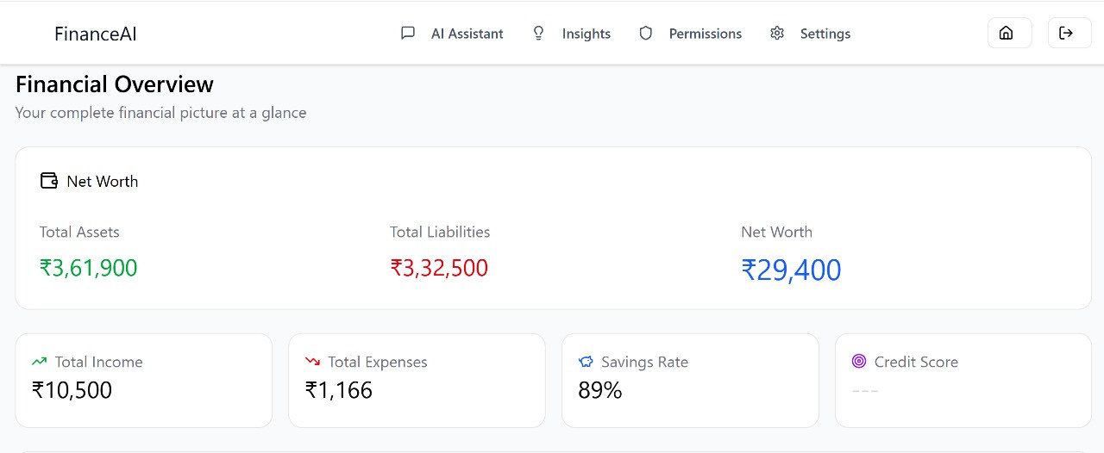
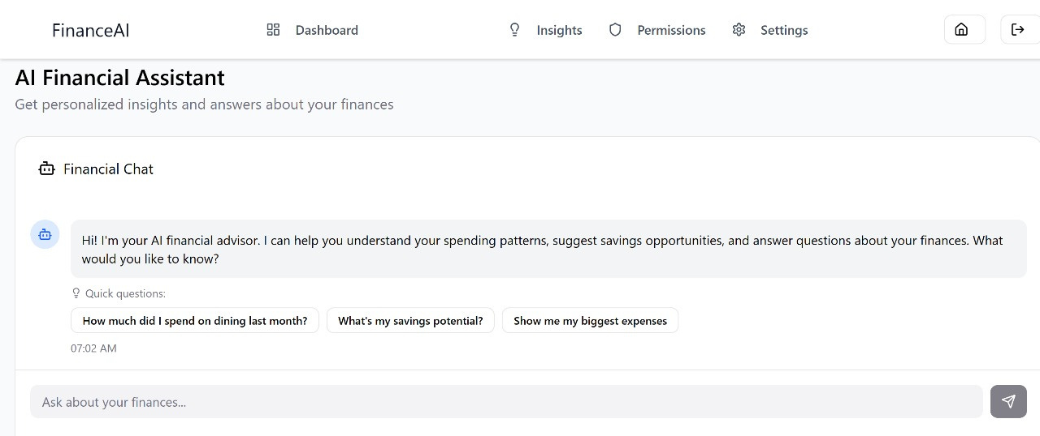

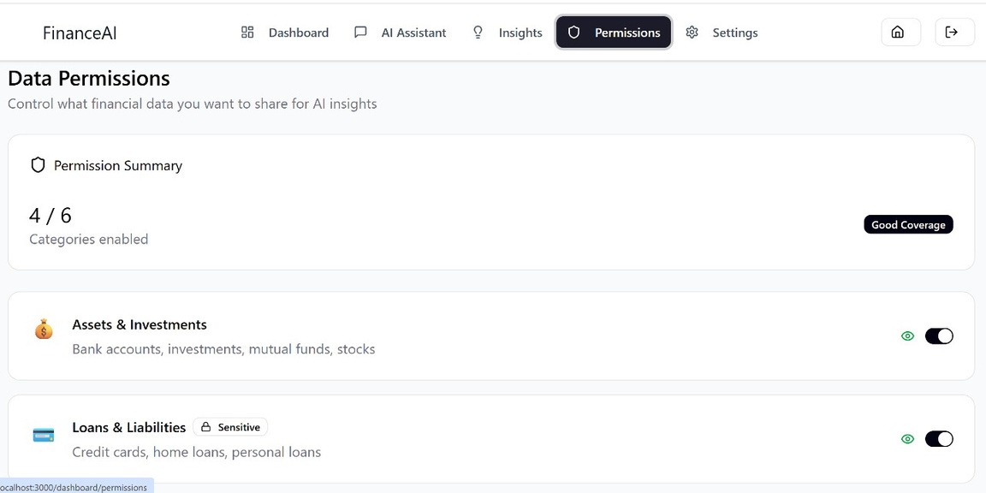
Notes:
4

Slide 7




Next-Level Intelligence
Anomaly Detection
Spending Forecasts
Trend Analysis
Flags unusual or suspicious spending
Predicts future expenses based on history
Breaks down category-wise spending behavior
Budget Optimization
Financial Health Score
Personalized advice using 50/30/20 rule
Quick assessment of overall financial well-being
Notes:
5

Slide 8
How We Handle Data
Multi-category data support: Assets, Liabilities, Transactions, Investments, Credit Score, EPF
Permission-Based Access – Full control over what data AI can read
Session Management – Secure sessions with history preservation
Data Validation – Ensures clean, accurate, and reliable financial input
Notes:
6

Slide 9
Robust Tech Behind FinanceAI
Backend Framework
Security
Flask + Flask-RESTX
Session-based authentication & UUID management
AI Engine
APIs
Google Gemini API for NLP & intelligence
Swagger/OpenAPI documentation for developers
Data Handling
Analytics
JSON-based storage (demo) with validation
Python statistical models for anomaly detection & trends
Performance
Flask-CORS + in-memory caching
Notes:
7

Slide 10
FinanceAI APIs
🔐 Permissions
📊 Financial Data
🤖 AI Query
Grant or revoke data access categories
Fetch summaries or drill into specific data types
Natural language questions → instant answers
📈 Analytics
🔄 Sessions & Conversations
Detect anomalies, predict trends, optimize budgets
Track history, enable context-aware insights
Notes:
8

Slide 11
How Users Interact
“What’s my net worth today?”
“Why did expenses rise last month?”
“Can I afford a new laptop next week?”
“Show unusual transactions this month.”
“Compare my investment returns vs. market trends.”
Notes:
9

Slide 12
Reliable & Scalable
Health Check endpoint (/health).
Structured logging for system monitoring.
Response caching for faster user experience.
Error recovery & fallback logic for service stability.
Built for scaling to real-world finance apps.
Notes:
10

Slide 13
Acknowledgments
Google Gemini AI – powering the conversational interface.
Flask Community – backend framework support.
Hackathon Organizers – challenging & inspiring problem statement.
Notes:
10

Slide 14
Thank You
https://github.com/ItisPratham/finance-hackovate/tree/dev
Notes:
10

