Slide 1
Autonomous Navigation with SLAM Toolbox and Nav2 in ROS 2
Enabling Robots to Navigate Autonomously
ROBOTIC SYSTEMS(UE22EC342BC2) : AHP 4

Slide 2
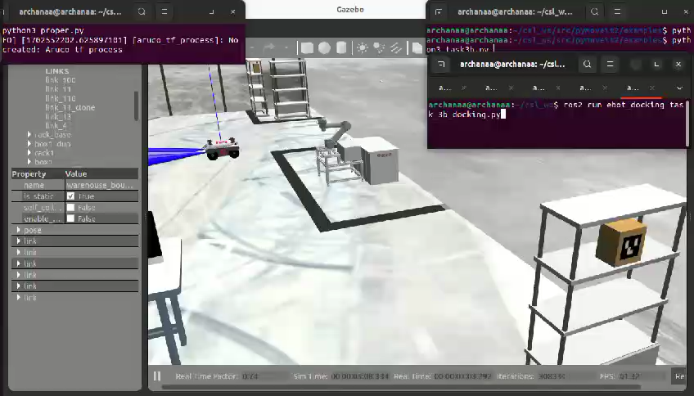

Slide 3
What is Autonomous Navigation?
Autonomous navigation allows robots to move from one point to another without human intervention.
Key components:
Perception: Sensing the environment (e.g., LiDAR, cameras).
Localization: Determining the robot's position in the environment.
Mapping: Building a representation of the environment.
Path Planning: Calculating a safe and efficient path.
Control: Executing the planned path.

Slide 4
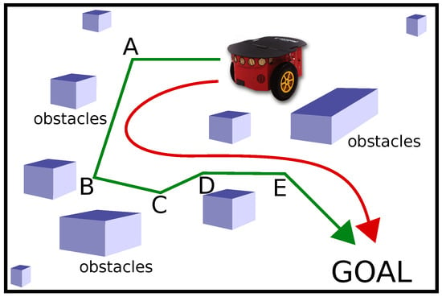

Slide 5
Role of SLAM in Autonomous Navigation SLAM (Simultaneous Localization and Mapping)
SLAM is the process of building a map of an unknown environment while simultaneously tracking the robot's location within it.
SLAM Toolbox in ROS 2:
Provides tools for 2D SLAM.
Works with sensor data (e.g., LiDAR, odometry) to create maps.
Supports both online (real-time) and offline mapping.

Slide 6
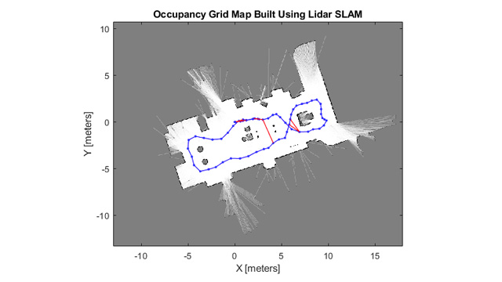

Slide 7
Role of Nav2 in Autonomous Navigation
Nav2 is the ROS 2 navigation stack for autonomous navigation.
Key features:
Path Planning: Uses global and local planners to find collision-free paths.
Obstacle Avoidance: Dynamically avoids obstacles using sensor data.
Recovery Behaviours: Handles failures (e.g., getting stuck).
Integration with SLAM: Uses maps generated by SLAM Toolbox for navigation.

Slide 8
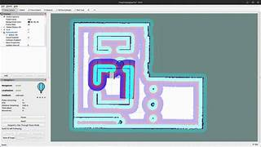

Slide 9
How SLAM Toolbox and Nav2 Work Together
Mapping Phase:
SLAM Toolbox creates a map of the environment using sensor data.
Localization Phase:
The robot localizes itself within the map using AMCL (Adaptive Monte Carlo Localization).
Navigation Phase:
Nav2 uses the map and localization data to plan and execute paths.
Combines global planning (long-term path) with local planning (obstacle avoidance).

Slide 10
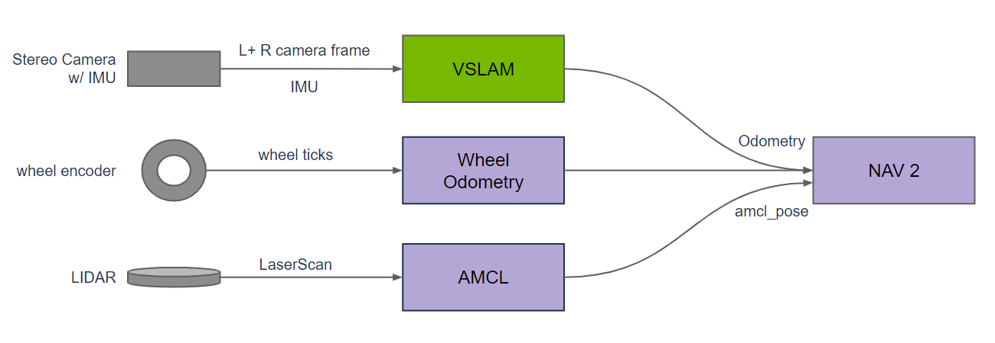

Slide 11
How Autonomous Navigation Works with These Tools Autonomous Navigation Workflow
Environment Mapping:
SLAM Toolbox builds a map using LiDAR/odometry data.
Robot Localization:
AMCL localizes the robot within the map.
Path Planning:
Nav2 calculates a global path to the goal.
Obstacle Avoidance:
Nav2 adjusts the path dynamically to avoid obstacles.
Motion Control:
Nav2 sends velocity commands to the robot's motors.

Slide 12
Benefits of Using SLAM Toolbox and Nav2
Open Source: Freely available and customizable.
Modular: Easy to integrate with other ROS 2 packages.
Scalable: Works for small and large environments.
Community Support: Active ROS 2 community for troubleshooting and updates.

Slide 13
Applications of Autonomous Navigation
Warehouse Robots: Automated material handling.
Service Robots: Cleaning, delivery, and assistance.
Autonomous Vehicles: Self-driving cars and drones.
Exploration Robots: Mapping unknown environments (e.g., Mars rovers).

Slide 14
Conclusion
SLAM Toolbox and Nav2 are powerful tools for enabling autonomous navigation in ROS 2.
Together, they provide mapping, localization, path planning, and obstacle avoidance capabilities.
These tools are essential for building intelligent, autonomous robots.

Slide 15
Assignment
https://www.youtube.com/watch?v=idQb2pB-h2Q
https://www.youtube.com/watch?v=QB7lOKp3ZDQ
Check out nav2 and slamtoolbox for ros2 documentation

