Slide 1

BlinkIT Sales & Outlet Analysis

Slide 2
Project Objective
Analyze BlinkIT outlet sales and product performance using Excel.
Identify the major factors influencing total sales and average sales.
Compare performance across item categories, fat content, outlet size, location and establishment year.
Build a dashboard that converts raw data into clear business insights.
Use the analysis to suggest practical actions for improving outlet performance.

Slide 3
Dataset Overview
Source : - https://drive.google.com/drive/folders/1Mlc_fvIrK793HedcpwbEpv13LdAs4yBg
Primary worksheet: BlinkIT Data.
The workbook also contains Reports and Dashboard sheets for analysis and presentation.
The data captures product attributes, outlet characteristics, sales and ratings.
Excel was used for data organization, aggregation, KPI reporting and visualization.

Slide 4
Key Performance Indicators
1.20M
Total Sales
140.99
Average Sales
8,523
Number of Items
3.97
Average Rating
These KPIs provide a high-level view of overall business performance.
The dashboard can be used to monitor the same indicators while drilling into outlet and product dimensions.

Slide 5
Analysis Dimensions
Item Type — compare sales contribution across product categories.
Fat Content — understand sales patterns for low-fat versus regular products.
Outlet Size — compare small, medium and large outlet performance.
Outlet Location — evaluate Tier 1, Tier 2 and Tier 3 market performance.
Outlet Type — compare grocery/supermarket formats.
Establishment Year — examine how outlet age relates to sales.

Slide 6
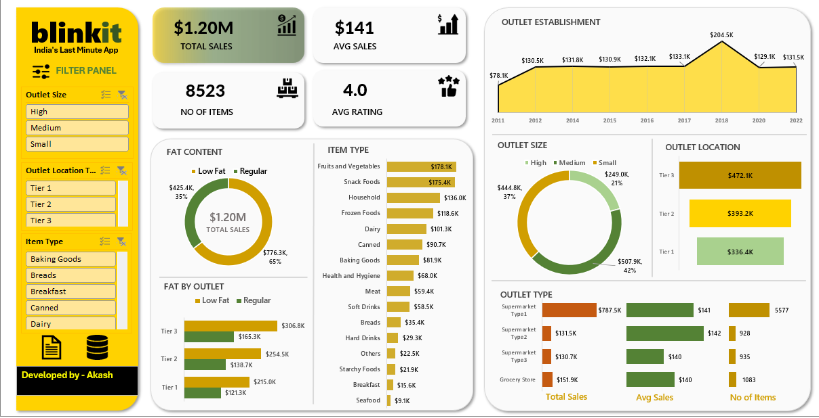
Excel Dashboard

Slide 7
1.20M
Total Sales
140.99
Avg Sales
8,523
Items
3.97
Rating
Product Analysis
Item type and fat-content comparisons
Outlet Analysis
Size, type and establishment-year comparisons
Location Analysis
Tier-level market performance

Slide 8


Business Recommendations
Prioritize high-performing item categories in inventory planning and promotions.
Use outlet-size and outlet-type comparisons to identify formats that deserve expansion or optimization.
Focus localized marketing and assortment decisions on stronger-performing market tiers.
Track ratings alongside sales to avoid increasing revenue at the expense of customer experience.
Refresh the dashboard regularly so management can monitor changes over time.
ANNUAL REVENUE GROWTH

Slide 9


Conclusion
Excel provides a practical way to transform raw BlinkIT data into actionable business intelligence.
The project combines KPI tracking, segmentation and dashboard reporting.
The analysis highlights how product and outlet characteristics can be used to understand sales performance.
A well-designed dashboard makes the findings easier for decision-makers to interpret and act on.
Overall, the project demonstrates the use of Excel for real-world data analysis.

Slide 10




Thank you

