Slide 1
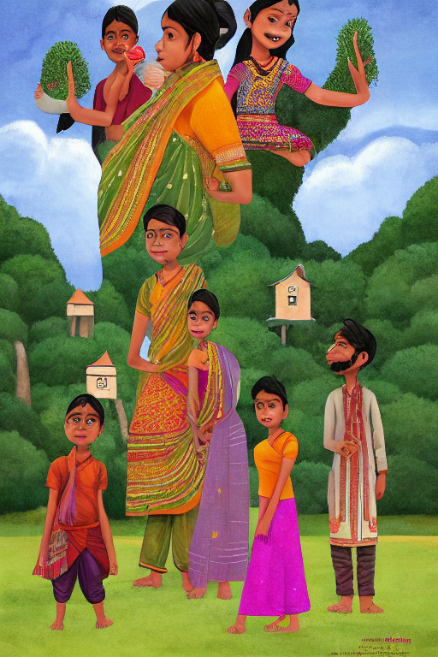
RuralHealth
Vision
Source-linked health education with optional AI-generated artwork
Naitik Shrivastava · Akshat Sharma
Indian Institute of Information Technology Bhopal
Minor project report | November 2026
https://github.com/Its-Akshat-0/Healthcare-image-Generation
Notes:
Project overview and team details are based on the project report. Cover artwork is a sample project-generated illustration in generated/dengue_prevention_illustration.png.

Slide 2
The information problem
Finding clear, trustworthy health information can take time.
Scattered sources
Technical language
Limited connectivity
A reader may not know which website to trust.
Long pages can be hard to scan and understand.
Searching across multiple sites can be slow.
Project goal
Connect a question to a short answer, a checkable source, and clear limits.
RuralHealth Vision
02 / 10
Notes:
The motivation and project goal are summarized from the Introduction in RuralHealth_Vision_Minor_Project_Report_Updated.docx.

Slide 3
What the prototype does
It can
It is not
• Search a local collection of health passages
• Return a likely answer span with source links
• Add a safety note
• Create an optional educational poster
• A diagnostic or treatment decision tool
• A replacement for clinicians or official guidance
• Clinically evaluated or professionally reviewed
• A permanent GPU-hosted service
Educational prototype only. Do not use it to make diagnosis or treatment decisions.
RuralHealth Vision
03 / 10
Notes:
Scope and limitations are stated in the project report and application documentation.

Slide 4
System workflow
User question
Local retrieval
Answer extraction
Response
Topic + health question
Rank passages in JSONL
DistilBERT proposes a span
Answer + source + safety note
Optional poster path
Image artwork is generated separately. The local app overlays source-based health text and references.
RuralHealth Vision
04 / 10
Notes:
Workflow is based on app.py, image_generation.py, colab_image_service.py, and the Architecture section of the report.

Slide 5
Health passage collection
2,967
1,017
1,022
passages
topic labels
source URLs
How retrieval works
The app filters records by topic, scores word overlap with the question, and boosts sections that match the question intent.
Data quality note
Many imported MedlinePlus records are marked NOT_HUMAN_REVIEWED. Review the source passages before using them as guidance.
RuralHealth Vision
05 / 10
Notes:
Counts and data-quality caveat are reported in the project report. The source dataset is data/medical_documents.jsonl.

Slide 6
Answering from retrieved passages
1
2
3
4
Select relevant passage
Tokenize question + passage
Predict answer span
Return excerpt + source
Extractive question answering
A local DistilBERT checkpoint selects a possible text span from the chosen evidence. It does not independently verify that the passage is clinically correct.
Evaluation status
The report does not claim a completed held-out QA benchmark or clinical evaluation.
RuralHealth Vision
06 / 10
Notes:
The extraction flow and evaluation limitations are described in the report. Model implementation is in app.py and models/ruralhealth-qa.

Slide 7
Image generation: local GPU or Colab
Local CUDA GPU
Google Colab GPU
Local poster composer
Preferred automatically when CUDA and image dependencies are available.
Used when local generation is unavailable or fails; notebook and tunnel must be active.
Adds source-based text and links to returned artwork.
Only the disease name and a fixed image topic are sent to Colab. The health passages and poster text stay local.
If neither image backend works, the app can show its SVG infographic fallback.
RuralHealth Vision
07 / 10
Notes:
Backend selection is implemented in image_generation.py. Remote requests are authenticated by colab_image_service.py. Colab image service setup is in notebooks/ruralhealthvision_colab.ipynb.

Slide 8
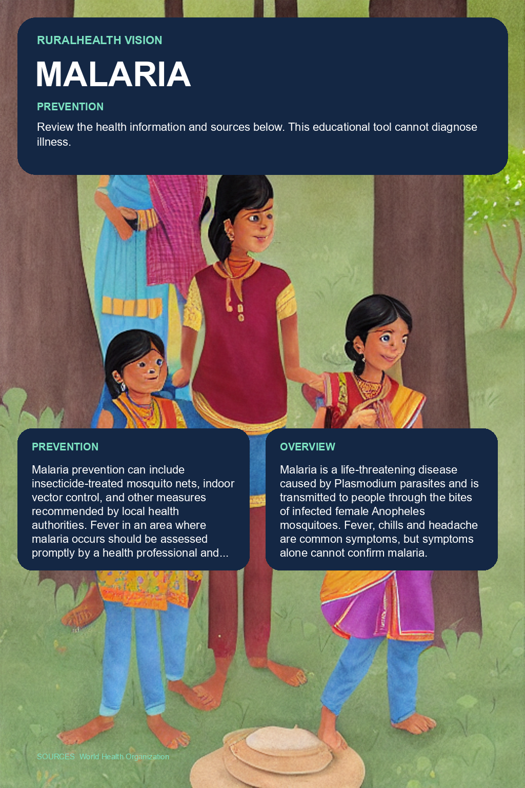
Artwork and poster composition
Generated artwork
Composed poster example
Examples are illustrative outputs, not clinically reviewed materials.
RuralHealth Vision
08 / 10
Notes:
Sample assets are from generated/dengue_prevention_illustration.png and generated/malaria_prevention_poster.png. Poster data and wording have not been clinically reviewed; the project report describes this limitation.

Slide 9
Run the project
1 Clone the repository
2 Create and activate a Python virtual environment
3 Install requirements.txt
4 Run python app.py
5 Open http://127.0.0.1:5000
Project repository
https://github.com/Its-Akshat-0/Healthcare-image-Generation
Optional image setup
Includes report, source code, dataset, notebook, and this presentation.
Local GPU: install requirements-image.txt and a compatible CUDA PyTorch build.
No local GPU: start the Colab notebook and configure the endpoint URL and token.
RuralHealth Vision
09 / 10
Notes:
Setup instructions are in README.md. Repository contents include the project report, application, dataset, scripts, and the Colab image-service notebook.

Slide 10
Current limits and next steps
Current limits
Next steps
• Imported passages need human review
• No completed QA benchmark
• No clinical evaluation
• No poster relevance study
• Colab is temporary, not always-on
• Review health content with professionals
• Build checked QA evaluation examples
• Measure retrieval and image quality
• Improve multilingual and accessibility support
• Assess usability with rural community readers
Source links, transparent limits, and human review remain central to the prototype.
https://github.com/Its-Akshat-0/Healthcare-image-Generation
RuralHealth Vision
10 / 10
Notes:
Limitations and future work are based on the project report and README.md.

