Slide 1

FLYNEST
Web-Based Application for Booking Flight Tickets
Group Members:
1.Dhananjay Ahirrao(250245920023)
2.Prachiti Sonar(250245920062)
3.Lalita Khairnar(250245920047)
4.Nirmal Gandhwani(250245920056)
5.Jaykishan Pandey(250245920059)

Slide 2

Project Overview
Flynest is a modern flight booking platform designed to simplify travel planning by offering smart search, secure booking, and 24/7 support.
It helps users discover flights and manage their journeys effortlessly.
The platform focuses on delivering competitive prices and improve user experience to enhance travel convenience.

Slide 3

Problem Statement
Booking flights online can be confusing and frustrating for many people. There are too many websites to check, and it’s hard to find the best flights quickly. Sometimes, prices are unclear, and extra charges appear at the last moment. Customers also face delays or no help from support teams when they need assistance.
Because of these problems, travelers need a better way to book flights. A platform that is easy to use, shows clear prices, and offers quick support can make the whole process smooth and stress-free. Flynest aims to provide this smart and secure solution for everyone.

Slide 4
OBJECTIVE AND DELIVERABLES
DELIVERABLES
User Registration and Login Module
Flight Search & Booking System
Secure Payment Gateway Integration
E-Ticket
Admin Login and Dashboard
Booking History and Profile Management
Mobile and Cross-browser Compatibility
OBJECTIVE
Enhance User Experience
Simplify Flight Search & Booking
Ensure Secure Transactions
Enable 24/7 Customer Support
Offer Competitive Pricing

Slide 5
REACT
Frontend Devlopment: React.js
React.js powers the interactive and dynamic user interface. It provides efficient component-based architecture for diverse user roles.
Component-Based UI | Routing | Conditional Rendering
Modular and reusable UI elements for scalability. | Seamless navigation between different portal sections. | Dynamic content display based on user roles.

Slide 6
Backend Development: .NET Web API
.NET Web API forms the robust backend. It handles all business logic. MS.NET provides a powerful framework for developing secure and scalable APIs.
RESTful APIs Enable seamless communication between frontend and database.
Authentication & Authorization Secure user access based on roles and permissions.
CRUD Operations Full support for creating, reading, updating, deleting data.
Scalability & Performance Optimized for high-volume transactions.
Tested with Postman Ensures reliable API responses and behavior.

Slide 7
Database Design: MSSQL Schema
The system uses Microsoft SQL Server (MSSQL) to manage and structure all critical application data. Below are the key tables and their roles:
Users Stores user information including name, email, password (hashed), and roles (Admin, Customer).
Flights Contains details of all flights – flight number, airline name, source, destination, departure and arrival time.
Bookings Captures user booking records with references to user ID, flight ID, booking date, and status (confirmed, cancelled, etc.).
Payments Stores payment information like transaction ID, amount, payment method, date, and status.
Cart
cement, bricks, plumbing, electrical, etc.
7.

Slide 8
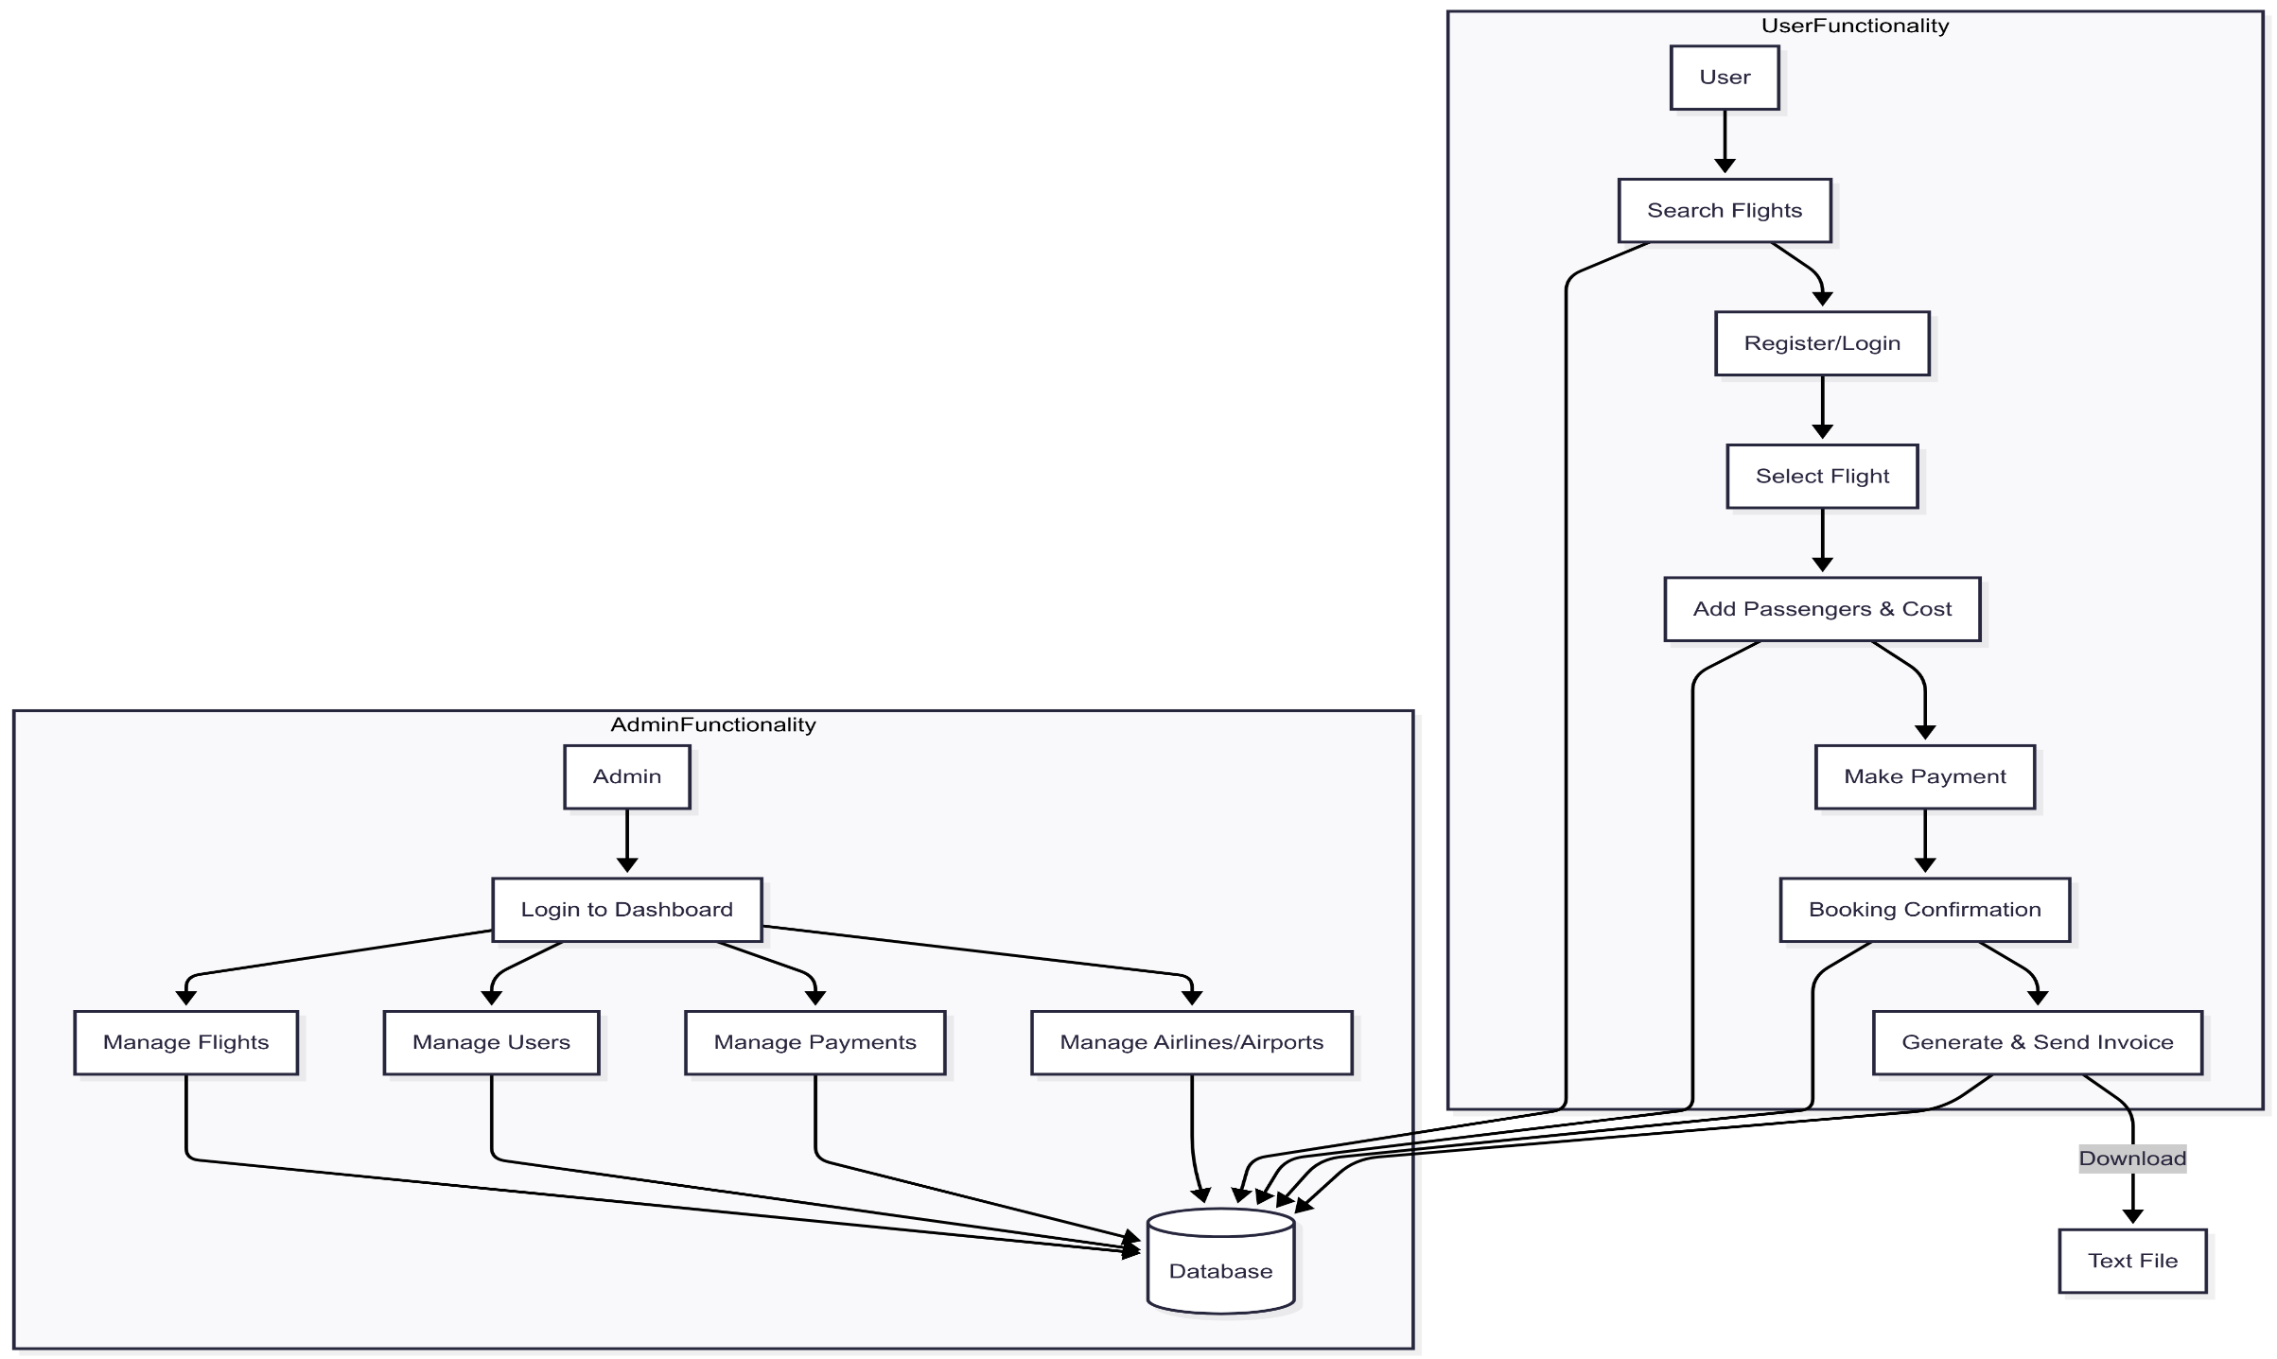
Data flow diagram

Slide 9
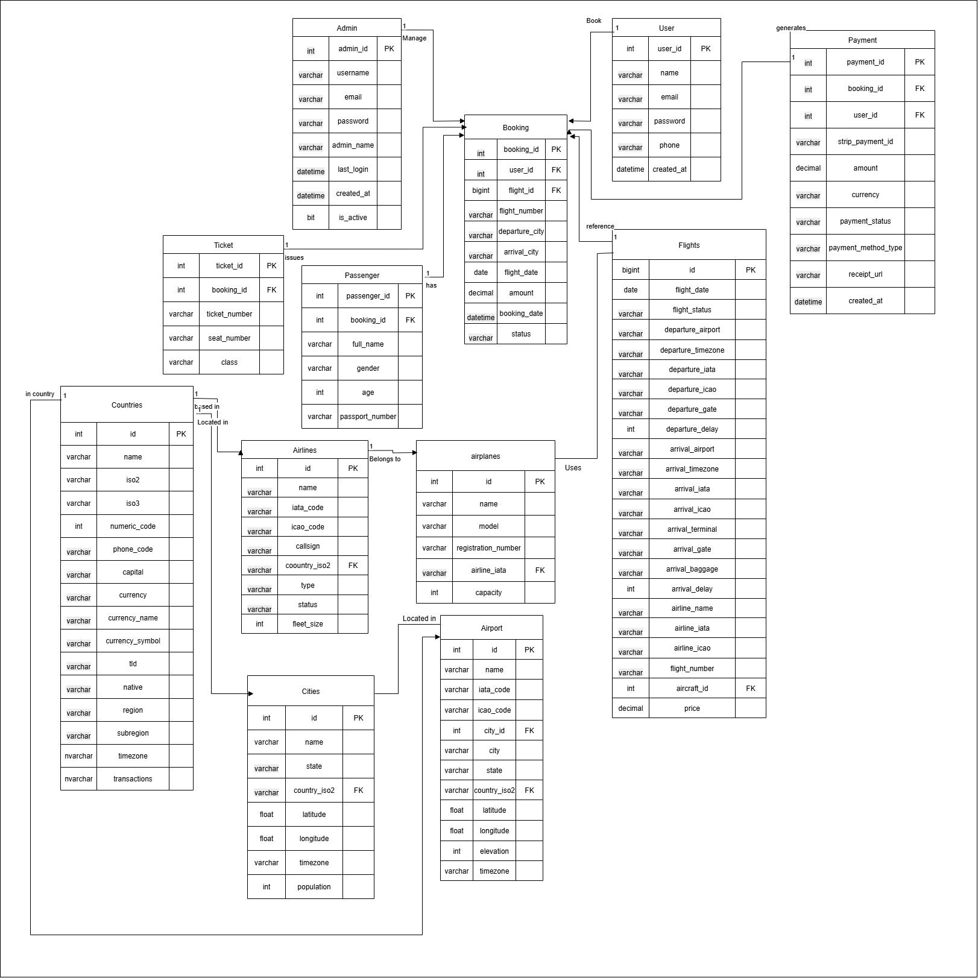
ER diagram

Slide 10
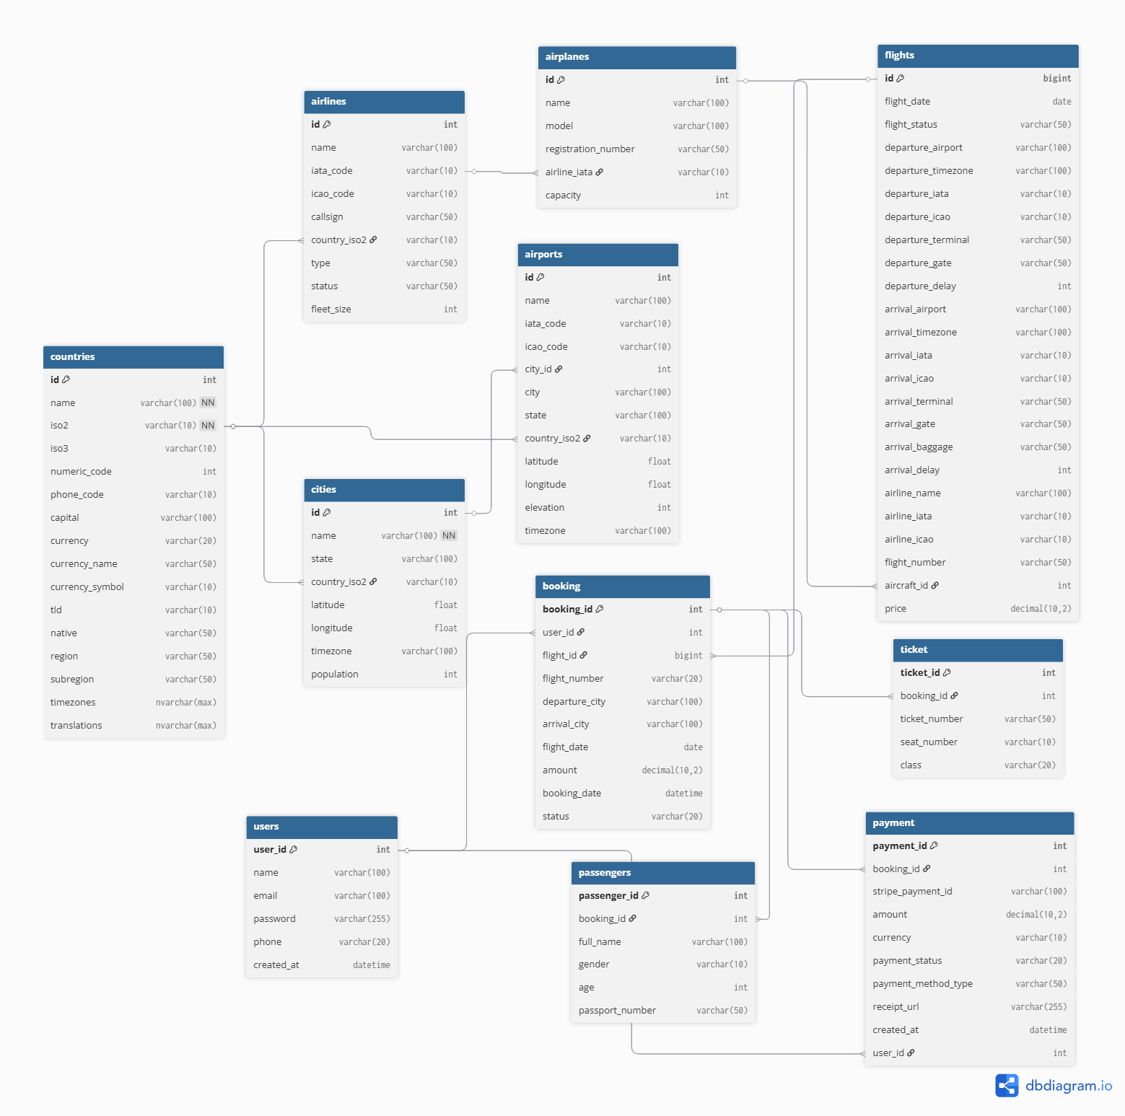
Class diagram

Slide 11
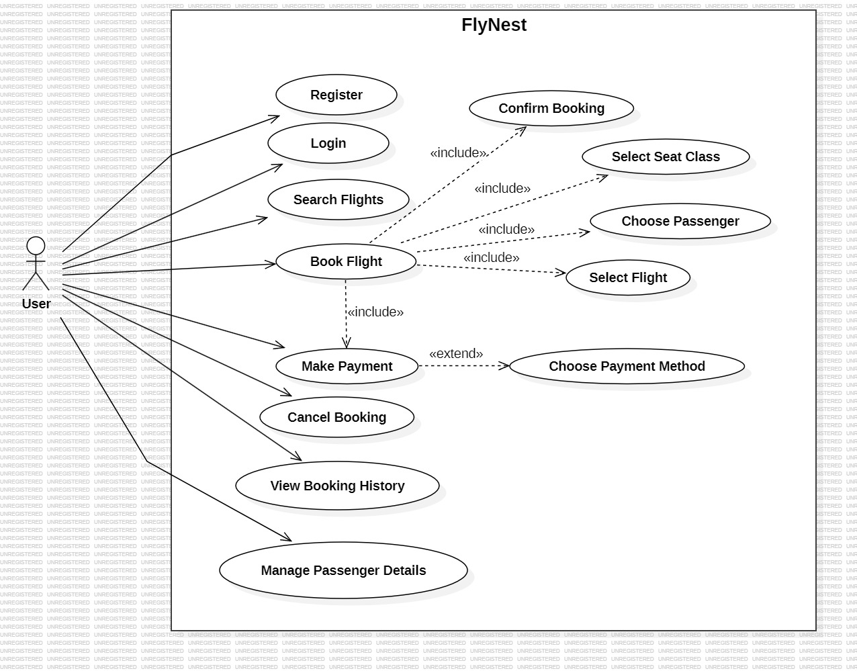
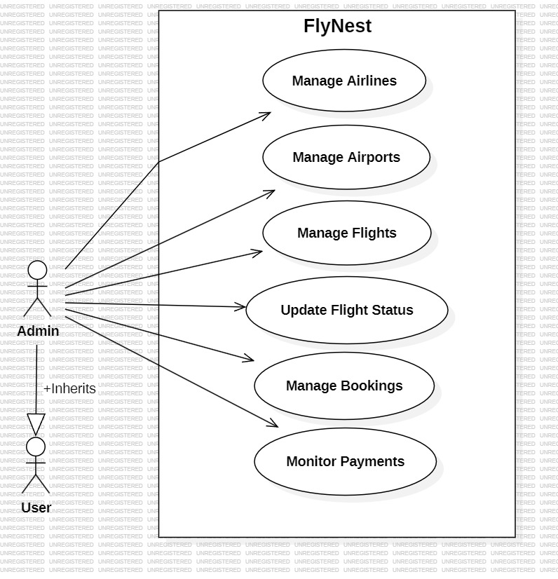
Use case diagram

Slide 12
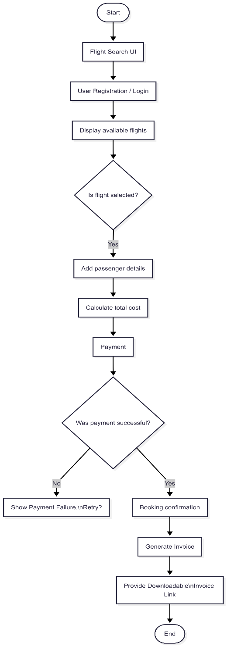
Activity diagram

Slide 13
CONCLUSION
The Flynest platform offers a modern, efficient, and user-friendly solution for flight booking, combining smart search, secure transactions, and 24/7 support to enhance the travel planning experience.
This project not only streamlines the flight booking process but also demonstrates how technology can elevate convenience, reliability, and customer satisfaction in the travel industry.

Slide 14
Thank you!
Flynest is a step toward smarter, faster, and more connected air travel. Thank you for exploring our vision.

