Slide 1
Interface in Java
Interface in Java :
An interface in java is a blueprint of a class. It has static constants and abstract methods.
The interface in Java is a mechanism to achieve abstraction. There can be only abstract methods in the Java interface, not method body. It is used to achieve abstraction and multiple inheritance in Java.
In other words, you can say that interfaces can have abstract methods and variables. It cannot have a method body.

Slide 2
Interface in Java
Why use Java interface ?
There are mainly three reasons to use interface. They are given below.
It is used to achieve abstraction.
By interface, we can support the functionality of multiple inheritance.
It can be used to achieve loose coupling.

Slide 3
Interface in Java
How to declare an interface ?
An interface is declared by using the interface keyword. It provides total abstraction; means all the methods in an interface are declared with the empty body, and all the fields are public, static and final by default. A class that implements an interface must implement all the methods declared in the interface.

Slide 4
Interface in Java
Syntax:
interface <interface_name>
{
// declare constant fields
// declare methods that abstract
// by default.
}

Slide 5
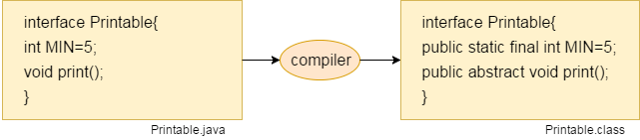
Interface in Java
Internal addition by the compiler :
The Java compiler adds public and abstract keywords before the interface method. Moreover, it adds public, static and final keywords before data members.

Slide 6
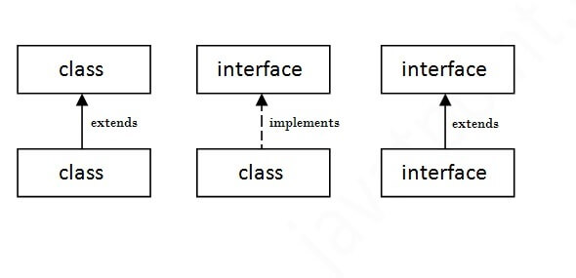
Interface in Java
The relationship between classes and interfaces
As shown in the figure given below, a class extends another class, an interface extends another interface, but a class implements an interface.

Slide 7
Interface in Java
Java Interface Example :
interface printable{
void print();
}
class A implements printable{
public void print(){System.out.println("Hello");}
public static void main(String args[]){
A obj = new A();
obj.print();
}
}

Slide 8
Interface in Java
Java Interface Example :
//Interface declaration: by first user
interface Drawable{
void draw();
}
//Implementation: by second user
class Rectangle implements Drawable{
public void draw(){System.out.println("drawing rectangle");}
}
class Circle implements Drawable{
public void draw(){System.out.println("drawing circle");}
}

Slide 9
Interface in Java
Java Interface Example :
//Using interface: by third user
class TestInterface{
public static void main(String args[]){
Drawable d=new Circle();
d.draw();
}
}

Slide 10
Interface in Java
Java Interface Example :
interface Bank
{
float rateOfInterest();
}
class SBI implements Bank
{
public float rateOfInterest()
{return 9.15f;}
}

Slide 11
Interface in Java
Java Interface Example :
class PNB implements Bank{
public float rateOfInterest(){return 9.7f;}
}
class TestInterface2{
public static void main(String[] args){
Bank b=new SBI();
System.out.println("ROI: "+b.rateOfInterest());
}}

Slide 12
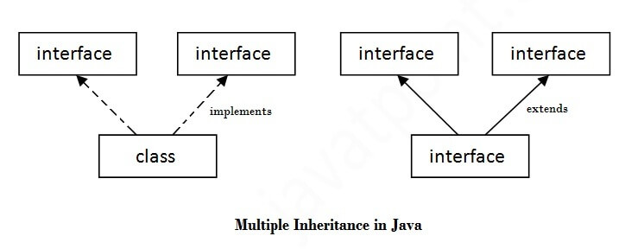
Interface in Java
Multiple inheritance in Java by interface :
If a class implements multiple interfaces, or an interface extends multiple interfaces, it is known as multiple inheritance.

Slide 13
Interface in Java
Java Multiple Interface Example :
interface Printable{
void print();
}
interface Showable{
void show();
}
class A implements Printable,Showable{
public void print(){System.out.println("Hello");}
public void show(){System.out.println("Welcome");}

Slide 14
Interface in Java
Java Multiple Interface Example :
public static void main(String args[]){
A obj = new A();
obj.print();
obj.show();
}
}

Slide 15
Interface in Java
Multiple inheritance is not supported through class in java, but it is possible by an interface, why?
Multiple inheritance is not supported in the case of class because of ambiguity. However, it is supported in case of an interface because there is no ambiguity. It is because its implementation is provided by the implementation class.

Slide 16
Interface in Java
Interface inheritance :
interface Printable{
void print();
}
interface Showable extends Printable{
void show();
}
class TestInterface implements Showable{
public void print(){System.out.println("Hello");}
public void show(){System.out.println("Welcome");}

Slide 17
Interface in Java
Interface inheritance :
public static void main(String args[]){
TestInterface obj = new TestInterface();
obj.print();
obj.show();
}
}

Slide 18
Interface in Java
Default Method in Interface
interface Drawable{
void draw();
default void msg()
{System.out.println("default method");}
}
class Rectangle implements Drawable{
public void draw()
{System.out.println("drawing rectangle");}
}

Slide 19
Interface in Java
Default Method in Interface
class TestInterfaceDefault{
public static void main(String args[]){
Drawable d=new Rectangle();
d.draw();
d.msg();
}}

Slide 20
Interface in Java
Static Method in Interface
interface Drawable
{
void draw();
static int cube(int x)
{return x*x*x;}
}
class Rectangle implements Drawable
{
public void draw()
{System.out.println("drawing rectangle");}
}

Slide 21
Interface in Java
Static Method in Interface
class TestInterfaceStatic
{
public static void main(String args[])
{
Drawable d=new Rectangle();
d.draw();
System.out.println(Drawable.cube(3));
}
}

Slide 22
Interface in Java
What is marker or tagged interface ?
An interface which has no member is known as a marker or tagged interface, for example, Serializable, Cloneable, Remote, etc. They are used to provide some essential information to the JVM so that JVM may perform some useful operation.
//How Serializable interface is written?
public interface Serializable
{
}

Slide 23
Interface in Java
Nested Interface in Java :
interface printable
{
void print();
interface MessagePrintable
{
void msg();
}
}

Slide 24
Interface in Java
Nested Interface in Java :
interface Showable
{
void show();
interface Message
{
void msg();
}
}

Slide 25
Interface in Java
Nested Interface in Java :
class TestNestedInterface implements Showable.Message
{
public void msg()
{System.out.println("Hello nested interface");}
public static void main(String args[])
{
Showable.Message message=new TestNestedInterface();
//upcasting here
message.msg();
}
}

Slide 26
Interface in Java
Difference between abstract class and interface
Abstract class | Interface
1) Abstract class can have abstract and non-abstract methods. | Interface can have only abstract methods. Since Java 8, it can have default and static methods also.
2) Abstract class doesn't support multiple inheritance. | Interface supports multiple inheritance.
3) Abstract class can have final, non-final, static and non-static variables. | Interface has only static and final variables.
4) Abstract class can provide the implementation of interface. | Interface can't provide the implementation of abstract class.
5) The abstract keyword is used to declare abstract class. | The interface keyword is used to declare interface.

Slide 27
Interface in Java
Difference between abstract class and interface
Abstract class | Interface
6) An abstract class can extend another Java class and implement multiple Java interfaces. | An interface can extend another Java interface only.
7) An abstract class can be extended using keyword “extends”. | An interface class can be implemented using keyword “implements”.
8) A Java abstract class can have class members like private, protected, etc. | Members of a Java interface are public by default.
9)Example: public abstract class Shape{ public abstract void draw(); } | Example: public interface Drawable{ void draw(); }

Slide 28
Interface in Java
Example of abstract class and interface in Java
//Creating interface that has 4 methods
interface A{
void a();//by default, public and abstract
void b();
void c();
void d();
}
//Creating abstract class that provides the implementation of one method of A interface
abstract class B implements A{
public void c(){System.out.println("I am C");}
}

Slide 29
Interface in Java
Example of abstract class and interface in Java
//Creating subclass of abstract class, now we need to provide the implementation of rest of the methods
class M extends B{
public void a(){System.out.println("I am a");}
public void b(){System.out.println("I am b");}
public void d(){System.out.println("I am d");}
}
//Creating a test class that calls the methods of A interface
class Test{
public static void main(String args[]){
A a=new M();
a.a(); a.b(); a.c(); a.d(); }}

