Slide 1
Java Package
Java Package :
A java package is a group of similar types of classes, interfaces and sub-packages.
Package in java can be categorized in two form, built-in package and user-defined package.
There are many built-in packages such as java, lang, awt, javax, swing, net, io, util, sql etc.
Here, we will have the detailed learning of creating and using user-defined packages.

Slide 2
Java Package
Advantage of Java Package :
Java package is used to categorize the classes and interfaces so that they can be easily maintained.
Java package provides access protection.
Java package removes naming collision.

Slide 3
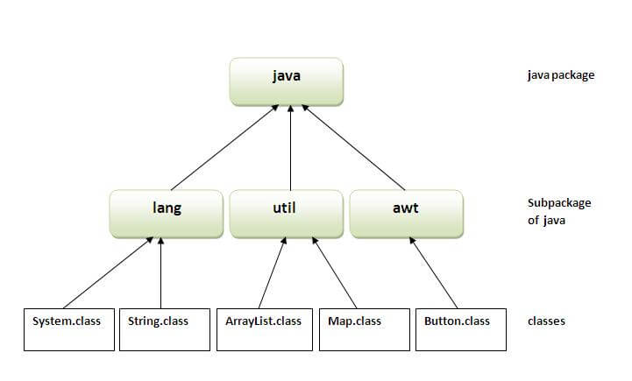
Java Package
Structure of Java Package :

Slide 4
Java Package
Simple example of java package
The package keyword is used to create a package in java.
//save as Simple.java
package mypack;
public class Simple{
public static void main(String args[]){
System.out.println("Welcome to package");
}
}

Slide 5
Java Package
How to compile java package ?
If you are not using any IDE, you need to follow the syntax given below:
javac -d directory javafilename
For example
javac -d . Simple.java
The -d switch specifies the destination where to put the generated class file. You can use any directory name like /home (in case of Linux), d:/abc (in case of windows) etc. If you want to keep the package within the same directory, you can use . (dot).

Slide 6
Java Package
How to run java package program ?
You need to use fully qualified name e.g. mypack.Simple etc to run the class.
To Compile: javac -d . Simple.java
To Run: java mypack.Simple
Output:Welcome to package

Slide 7
Java Package
How to access package from another package ?
There are three ways to access the package from outside the package.
import package.*;
import package.classname;
fully qualified name.

Slide 8
Java Package
Using packagename.* :
If you use package.* then all the classes and interfaces of this package will be accessible but not subpackages.
The import keyword is used to make the classes and interface of another package accessible to the current package.

Slide 9
Java Package
Example of package that import the packagename.*
//save by A.java
package pack;
public class A
{
public void msg()
{System.out.println("Hello");}
}

Slide 10
Java Package
Example of package that import the packagename.*
//save by B.java
package mypack;
import pack.*;
class B{
public static void main(String args[]){
A obj = new A();
obj.msg();
}
}
Output:Hello

Slide 11
Java Package
Using packagename.classname :
If you import package.classname then only declared class of this package will be accessible.
Example of package by import package.classname :
//save by A.java
package pack;
public class A{
public void msg(){System.out.println("Hello");}
}

Slide 12
Java Package
Example of package by import package.classname :
//save by B.java
package mypack;
import pack.A;
class B{
public static void main(String args[]){
A obj = new A();
obj.msg();
}
}
Output:Hello

Slide 13
Java Package
Using fully qualified name
If you use fully qualified name then only declared class of this package will be accessible. Now there is no need to import. But you need to use fully qualified name every time when you are accessing the class or interface.
It is generally used when two packages have same class name e.g. java.util and java.sql packages contain Date class.

Slide 14
Java Package
Example of package by import fully qualified name
//save by A.java
package pack;
public class A
{
public void msg()
{System.out.println("Hello");}
}

Slide 15
Java Package
Example of package by import fully qualified name
//save by B.java
package mypack;
class B{
public static void main(String args[]){
pack.A obj = new pack.A();//using fully qualified name
obj.msg();
}
}
Output:Hello

Slide 16
Java Package
Note: If you import a package, subpackages will not be imported.
If you import a package, all the classes and interface of that package will be imported excluding the classes and interfaces of the subpackages. Hence, you need to import the subpackage as well.

Slide 17
Java Package
Subpackage in java
Package inside the package is called the subpackage. It should be created to categorize the package further.
Let's take an example, Sun Microsystem has definded a package named java that contains many classes like System, String, Reader, Writer, Socket etc. These classes represent a particular group e.g. Reader and Writer classes are for Input/Output operation, Socket and ServerSocket classes are for networking etc and so on. So, Sun has subcategorized the java package into subpackages such as lang, net, io etc. and put the Input/Output related classes in io package, Server and ServerSocket classes in net packages and so on.

Slide 18
Java Package
Example of Subpackage :
package com.javatpoint.core;
class Simple{
public static void main(String args[]){
System.out.println("Hello subpackage");
}
}
To Compile: javac -d . Simple.java
To Run: java com.javatpoint.core.Simple
Output:Hello subpackage

Slide 19
Java Package
Rule: There can be only one public class in a java source file and it must be saved by the public class name.
//save as C.java otherwise Compilte Time Error
class A{}
class B{}
public class C{}

Slide 20
Java Package
How to put two public classes in a package ?
If you want to put two public classes in a package, have two java source files containing one public class, but keep the package name same. For example:
//save as A.java
package javatpoint;
public class A{}
//save as B.java
package javatpoint;
public class B{}

Slide 21
Access Modifiers in java
Access Modifiers in java :
There are two types of modifiers in java:
access modifiers and non-access modifiers.
The access modifiers in java specifies accessibility (scope) of a data member, method, constructor or class.
There are 4 types of java access modifiers:
private
default
protected
public

Slide 22
Access Modifiers in java
Access Modifiers in java :
There are many non-access modifiers such as static, abstract, synchronized, native, volatile, transient etc. Here, we will learn access modifiers.

Slide 23
Access Modifiers in java
private access modifier :
The private access modifier is accessible only within class.
class A{
private int data=40;
private void msg(){System.out.println("Hello java");}
}
public class Simple{
public static void main(String args[]){
A obj=new A();
System.out.println(obj.data);//Compile Time Error
obj.msg();//Compile Time Error
}
}

Slide 24
Access Modifiers in java
Role of Private Constructor :
If you make any class constructor private, you cannot create the instance of that class from outside the class. For example:
class A{
private A(){}//private constructor
void msg(){System.out.println("Hello java");}
}
public class Simple{
public static void main(String args[]){
A obj=new A();//Compile Time Error
}
}
Note: A class cannot be private or protected except nested class.

Slide 25
Access Modifiers in java
Default access modifier :
If you don't use any modifier, it is treated as default bydefault. The default modifier is accessible only within package.
In this example, we have created two packages pack and mypack. We are accessing the A class from outside its package, since A class is not public, so it cannot be accessed from outside the package.
//save by A.java
package pack;
class A{
void msg(){System.out.println("Hello");}
}

Slide 26
Access Modifiers in java
Default access modifier :
//save by B.java
package mypack;
import pack.*;
class B{
public static void main(String args[]){
A obj = new A();//Compile Time Error
obj.msg();//Compile Time Error
}
}

Slide 27
Access Modifiers in java
Protected access modifier
The protected access modifier is accessible within package and outside the package but through inheritance only.
The protected access modifier can be applied on the data member, method and constructor. It can't be applied on the class.
//save by A.java
package pack;
public class A{
protected void msg(){System.out.println("Hello");}
}

Slide 28
Access Modifiers in java
Protected access modifier
//save by B.java
package mypack;
import pack.*;
class B extends A{
public static void main(String args[]){
B obj = new B();
obj.msg();
}
}
Output:Hello

Slide 29
Access Modifiers in java
Public access modifier
The public access modifier is accessible everywhere. It has the widest scope among all other modifiers.
//save by A.java
package pack;
public class A{
public void msg(){System.out.println("Hello");}
}

Slide 30
Access Modifiers in java
Public access modifier
//save by B.java
package mypack;
import pack.*;
class B{
public static void main(String args[]){
A obj = new A();
obj.msg();
}
}
Output:Hello

Slide 31
Access Modifiers in java
Understanding all java access modifiers
Access Modifier | within class | within package | outside package by subclass only | outside package
Private | Y | N | N | N
Default | Y | Y | N | N
Protected | Y | Y | Y | N
Public | Y | Y | Y | Y

Slide 32
Access Modifiers in java
Java access modifiers with method overriding :
If you are overriding any method, overridden method (i.e. declared in subclass) must not be more restrictive.
class A{
protected void msg(){System.out.println("Hello java");}
}
public class Simple extends A{
void msg(){System.out.println("Hello java");}//C.T.Error
public static void main(String args[]){
Simple obj=new Simple();
obj.msg(); } }
The default modifier is more restrictive than protected. That is why there is compile time error.

