Slide 1
Applet in Java
Java Applet :
Applet is a special type of program that is embedded in the webpage to generate the dynamic content. It runs inside the browser and works at client side.
Advantage of Applet :
There are many advantages of applet. They are as follows:
It works at client side so less response time.
Secured
It can be executed by browsers running under many plateforms, including Linux, Windows, Mac Os etc.

Slide 2
Applet in Java
Drawback of Applet :
Plugin is required at client browser to execute applet.
An applet cannot load libraries or define native methods.
An applet cannot ordinarily read or write files on the execution host.
An applet cannot read certain system properties.
An applet cannot make network connections except to the host that it came from.
An applet cannot start any program on the host that’s executing it.

Slide 3
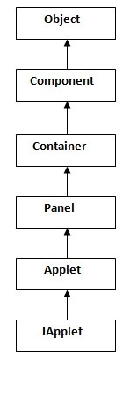
Applet in Java
Hierarchy of Applet :
As displayed in the diagram, Applet
class extends Panel. Panel class
extends Container which is the
subclass of Component.

Slide 4
Applet in Java
differences between an applet and a standalone Java application :
An applet is a Java class that extends the java.applet.Applet class.
A main() method is not invoked on an applet, and an applet class will not define main().
Applets are designed to be embedded within an HTML page.
When a user views an HTML page that contains an applet, the code for the applet is downloaded to the user's machine.

Slide 5
Applet in Java
differences between an applet and a standalone Java application :
A JVM is required to view an applet. The JVM can be either a plug-in of the Web browser or a separate runtime environment.
The JVM on the user's machine creates an instance of the applet class and invokes various methods during the applet's lifetime.

Slide 6
Applet in Java
differences between an applet and a standalone Java application :
Applets have strict security rules that are enforced by the Web browser. The security of an applet is often referred to as sandbox security, comparing the applet to a child playing in a sandbox with various rules that must be followed.
Other classes that the applet needs can be downloaded in a single Java Archive (JAR) file.

Slide 7
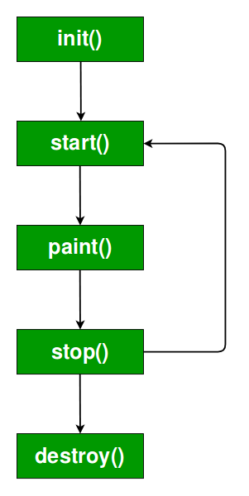
Applet in Java
Lifecycle of Java Applet :

Slide 8
Applet in Java
Lifecycle of Java Applet :
Applet is initialized.
Applet is started.
Applet is painted.
Applet is stopped.
Applet is destroyed.

Slide 9
Applet in Java
Lifecycle methods for Applet :
The java.applet.Applet class provides 4 life cycle methods and java.awt.Component class provides 1 life cycle methods for an applet.
java.applet.Applet class :
For creating any applet java.applet.Applet class must be inherited. It provides 4 life cycle methods of applet.
java.awt.Component class :
The Component class provides 1 life cycle method of applet.

Slide 10
Applet in Java
Lifecycle method for Java Applet :
init( ) : The init( ) method is the first method to be called. This is where you should initialize variables. This method is called only once during the run time of your applet.
start( ) : The start( ) method is called after init( ). It is also called to restart an applet after it has been stopped. Note that init( ) is called once i.e. when the first time an applet is loaded whereas start( ) is called each time an applet’s HTML document is displayed onscreen. So, if a user leaves a web page and comes back, the applet resumes execution at start( ).

Slide 11
Applet in Java
Lifecycle method for Java Applet :
paint( ) : The paint( ) method is called each time an AWT-based applet’s output must be redrawn. This situation can occur for several reasons. For example, the window in which the applet is running may be overwritten by another window and then uncovered. Or the applet window may be minimized and then restored.
paint( ) is also called when the applet begins execution.
Whatever the cause, whenever the applet must redraw its
output, paint( ) is called.

Slide 12
Applet in Java
Lifecycle method for Java Applet :
The paint( ) method has one parameter of type Graphics. This parameter will contain the graphics context, which describes the graphics environment in which the applet is running. This context is used whenever output to the applet is required.
stop( ) : The stop( ) method is called when a web browser leaves the HTML document containing the applet—when it goes to another page, for example. When stop( ) is called, the applet is probably running. You should use stop( ) to suspend threads that don’t need to run when the applet is not visible. You can restart them when start( ) is called if the user returns to the page.

Slide 13
Applet in Java
Lifecycle method for Java Applet :
destroy( ) : The destroy( ) method is called when the environment determines that your applet needs to be removed completely from memory. At this point, you should free up any resources the applet may be using. The stop( ) method is always called before destroy( ).

Slide 14
Applet in Java
Who is responsible to manage the life cycle of an applet ?
Java Plug-in software.
How to run an Applet ?
There are two ways to run an applet
By html file.
By appletViewer tool (for testing purpose).

Slide 15
Applet in Java
Simple example of Applet by html file:
To execute the applet by html file, create an applet and compile it. After that create an html file and place the applet code in html file. Now click the html file.
//First.java
import java.applet.Applet;
import java.awt.Graphics;
public class First extends Applet{
public void paint(Graphics g){
g.drawString("welcome",150,150);
} }
Note: class must be public because its object is created by Java Plugin software that resides on the browser.

Slide 16
Applet in Java
Simple example of Applet by html file:
myapplet.html
<html>
<body>
<applet code="First.class" width="300" height="300">
</applet>
</body>
</html>

Slide 17
Applet in Java
Simple example of Applet by appletviewer tool:
To execute the applet by appletviewer tool, create an applet that contains applet tag in comment and compile it. After that run it by: appletviewer First.java. Now Html file is not required but it is for testing purpose only.

Slide 18
Applet in Java
Simple example of Applet by appletviewer tool:
//First.java
import java.applet.Applet;
import java.awt.Graphics;
public class First extends Applet{
public void paint(Graphics g){
g.drawString("welcome to applet",150,150);
}
}
/*
<applet code="First.class" width="300" height="300">
</applet>
*/

Slide 19
Applet in Java
Simple example of Applet by appletviewer tool:
To execute the applet by appletviewer tool, write in command prompt:
c:\>javac First.java
c:\>appletviewer First.java

Slide 20
Applet in Java
Displaying Graphics in Applet :
Commonly used methods of Graphics class:
1. public abstract void drawString(String str, int x, int y): is used to draw the specified string.
2. public void drawRect(int x, int y, int width, int height): draws a rectangle with the specified width and height.
3.public abstract void fillRect(int x, int y, int width, int height): is used to fill rectangle with the default color and specified width and height.
4. public abstract void drawOval(int x, int y, int width, int height): is used to draw oval with the specified width and height.

Slide 21
Applet in Java
Displaying Graphics in Applet :
Commonly used methods of Graphics class:
5.public abstract void fillOval(int x, int y, int width, int height): is used to fill oval with the default color and specified width and height.
6. public abstract void drawLine(int x1, int y1, int x2, int y2): is used to draw line between the points(x1, y1) and (x2, y2).
7. public abstract boolean drawImage(Image img, int x, int y, ImageObserver observer): is used draw the specified image.
8. public abstract void drawArc(int x, int y, int width, int height, int startAngle, int arcAngle): is used draw a circular or elliptical arc.

Slide 22
Applet in Java
Example of Graphics in applet:
import java.applet.Applet;
import java.awt.*;
public class GraphicsDemo extends Applet{
public void paint(Graphics g){
g.setColor(Color.red);
g.drawString("Welcome",50, 50);
g.drawLine(20,30,20,300);
g.drawRect(70,100,30,30);
g.fillRect(170,100,30,30);
g.drawOval(70,200,30,30);
g.setColor(Color.pink);
g.fillOval(170,200,30,30);

Slide 23
Applet in Java
Example of Graphics in applet:
g.drawArc(90,150,30,30,30,270);
g.fillArc(270,150,30,30,0,180);
}
}
myapplet.html
<html>
<body>
<applet code="GraphicsDemo.class" width="300" height="300">
</applet>
</body>
</html>

Slide 24
Applet in Java
Displaying Image in Applet :
Applet is mostly used in games and animation. For this purpose image is required to be displayed. The java.awt.Graphics class provide a method drawImage() to display the image.
Syntax of drawImage() method:
public abstract boolean drawImage(Image img, int x, int y, ImageObserver observer)
is used draw the specified image.

Slide 25
Applet in Java
Displaying Image in Applet :
How to get the object of Image ?
The java.applet.Applet class provides getImage() method that returns the object of Image. Syntax:
public Image getImage(URL u, String image){}
Other required methods of Applet class to display image:
1. public URL getDocumentBase(): is used to return the URL of the document in which applet is embedded.
2. public URL getCodeBase(): is used to return the base URL.

Slide 26
Applet in Java
Example of displaying image in applet:
import java.awt.*;
import java.applet.*;
public class DisplayImage extends Applet {
Image picture;
public void init() {
picture = getImage(getDocumentBase(),"kiit.jpg");
}

Slide 27
Applet in Java
Example of displaying image in applet:
public void paint(Graphics g) {
g.drawImage(picture, 30,30, this);
}
}
In the above example, drawImage() method of Graphics class is used to display the image. The 4th argument of drawImage() method of is ImageObserver object. The Component class implements ImageObserver interface. So current class object would also be treated as ImageObserver because Applet class indirectly extends the Component class.

Slide 28
Applet in Java
Example of displaying image in applet:
myapplet.html
<html>
<body>
<applet code="DisplayImage.class" width="300" height="300">
</applet>
</body>
</html>

Slide 29
Animation in Applet
Example of animation in applet:
Applet is mostly used in games and animation. For this purpose image is required to be moved.
import java.awt.*;
import java.applet.*;
public class AnimationExample extends Applet {
Image picture;
public void init() {
picture =getImage(getDocumentBase(),"kiit.gif");
}

Slide 30
Animation in Applet
Example of animation in applet:
public void paint(Graphics g) {
for(int i=0;i<500;i++){
g.drawImage(picture, i,30, this);
try{Thread.sleep(100);}catch(Exception e){}
}
}
}

Slide 31
Animation in Applet
Example of animation in applet:
In the previous example, drawImage() method of Graphics class is used to display the image. The 4th argument of drawImage() method of is ImageObserver object. The Component class implements ImageObserver interface. So current class object would also be treated as ImageObserver because Applet class indirectly extends the Component class.

Slide 32
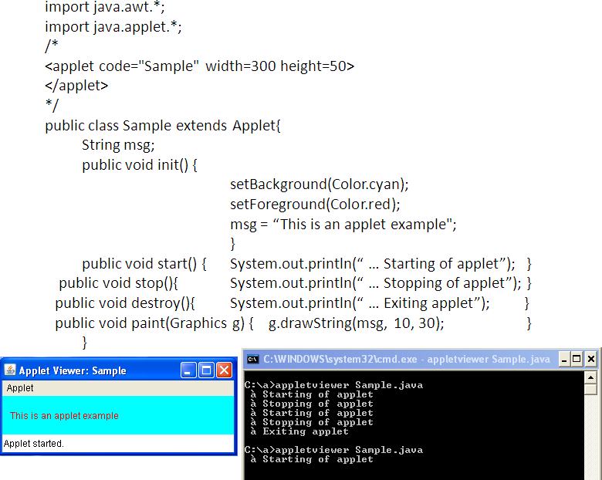
Animation in Applet

Slide 33
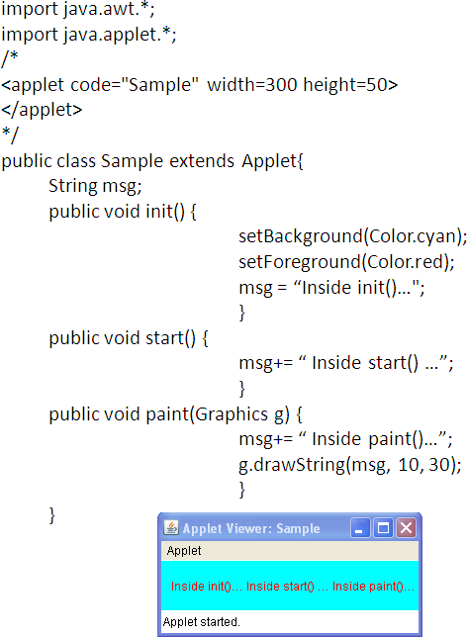
Animation in Applet

Slide 34
Animation in Applet

Slide 35
Animation in Applet
repaint() :
As a general rule, an applet writes to its window only when its update() or paint() method is called by the AWT.Whenever your applet needs to update the information displayed in its window, it simply calls repaint().
The repaint() method is defined by the AWT. It causes the AWT run-time system to execute a call to your applet’s update() method, which, in its default implementation, calls paint():

Slide 36
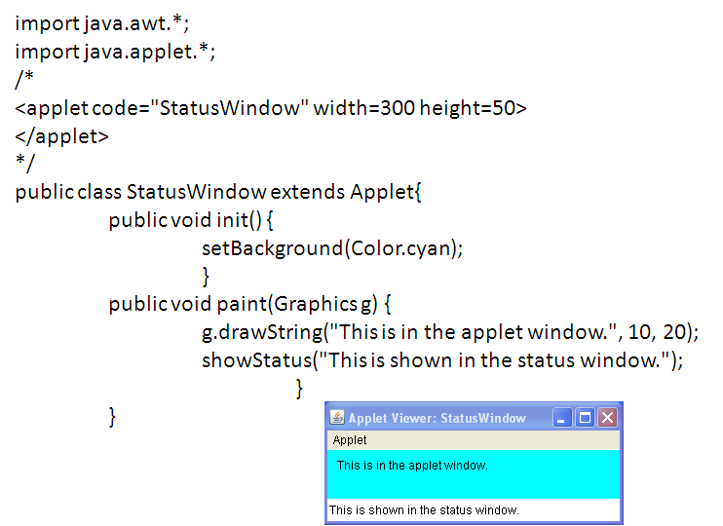
Animation in Applet
Status Window :
An applet can also output a message to the status window of the browser or applet viewer on which it is running by using showStatus() .

Slide 37
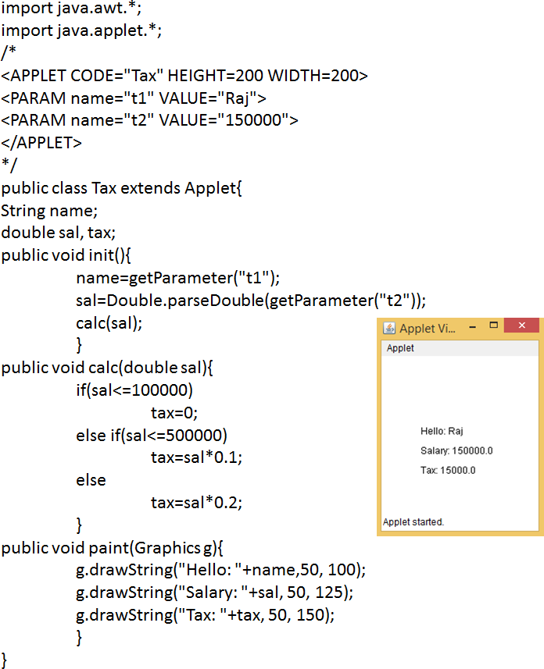
Animation in Applet
APPLET tag allows to pass parameters to the applet

Slide 38
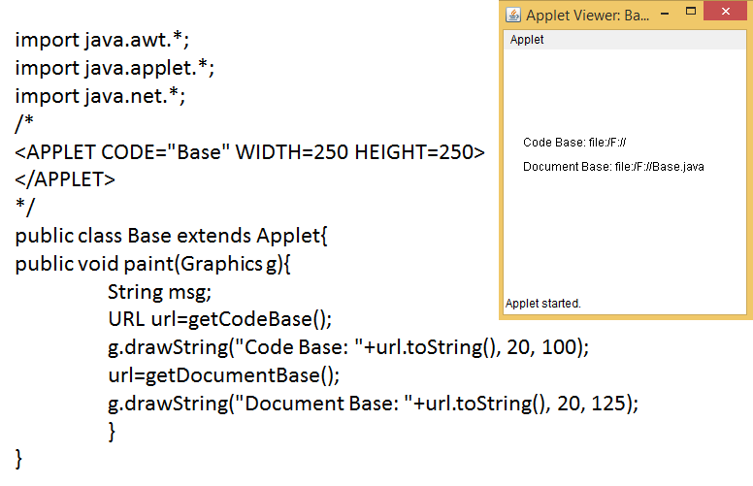
Animation in Applet
getDocumentBase() and getCodeBase()

Slide 39
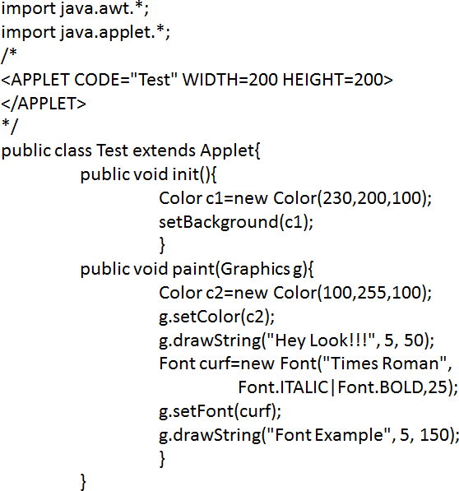
Animation in Applet
Working with Font :

