Slide 1
Collection Framework & Exploring java.lang in Java
Collection :
java.util package has an interface called Collection. It is a
framework that provides an architecture to store and manipulate the group of objects
Java Collection simply means a single unit of objects, i.e. a
group
This framework provides many interfaces(ex. Set, List, Queue, Deque, etc) and classes(ex. ArrayList, Vector, LinkedList, PriorityQueue, HashSet, LinkedHashSet, TreeSet, etc.)

Slide 2
Collection Framework & Exploring java.lang in Java
Collection :
The Collection interface (java.util.Collection) and Map interface (java.util.Map) are the two main “root” interfaces of Java collection classes.
Need for Collection Framework :
Before Collection Framework (or before JDK 1.2) was introduced, the standard methods for grouping Java objects (or collections) were Arrays or Vectors or Hashtables. All of these collections had no common interface.
Accessing elements of these Data Structures was a hassle as each had a different method (and syntax) for accessing its members.

Slide 3
Collection Framework & Exploring java.lang in Java
Java program to show why collection framework was needed :
import java.io.*;
import java.util.*;
class Test
{
public static void main (String[] args)
{
// Creating instances of array, vector and hashtable
int arr[] = new int[] {1, 2, 3, 4};
Vector<Integer> v = new Vector();
Hashtable<Integer, String> h = new Hashtable();

Slide 4
Collection Framework & Exploring java.lang in Java
Java program to show why collection framework was needed :
v.addElement(1);
v.addElement(2);
h.put(1,"geeks");
h.put(2,"4geeks");
// Array instance creation requires [], while Vector
// and hastable require ()
// Vector element insertion requires addElement(), but
// hashtable element insertion requires put()
// Accessing first element of array, vector and hashtable

Slide 5
Collection Framework & Exploring java.lang in Java
Java program to show why collection framework was needed :
System.out.println(arr[0]);
System.out.println(v.elementAt(0));
System.out.println(h.get(1));
// Array elements are accessed using [], vector elements
// using elementAt() and hashtable elements using get()
}
}

Slide 6
Collection Framework & Exploring java.lang in Java
Collection :
As we can see, none of these collections (Array, Vector or Hashtable) implement a standard member access interface. It was very difficult for programmers to write algorithms that can work for all kinds of Collections. Another drawback being that most of the ‘Vector’ methods are final, meaning we cannot extend the ’Vector’ class to implement a similar kind of Collection.
Java developers decided to come up with a common interface to deal with the above mentioned problems and introduced the Collection Framework in JDK 1.2.
Both legacy Vectors and Hashtables were modified to conform to the Collection Framework.

Slide 7
Collection Framework & Exploring java.lang in Java
Advantages of Collection Framework:
Consistent API : The API has a basic set of interfaces like Collection, Set, List, or Map. All classes (ArrayList, LinkedList, Vector, etc) that implement these interfaces have some common set of methods.
Reduces programming effort: A programmer doesn’t have to worry about the design of Collection, and he can focus on its best use in his program.
Increases program speed and quality: Increases performance by providing high-performance implementations of useful data structures and algorithms.

Slide 8
Collection Framework & Exploring java.lang in Java
Hierarchy of Collection Framework :
Collection Map
/ / \ \ |
/ / \ \ |
Set List Queue Dequeue SortedMap
/
/
SortedSet
Core Interfaces in Collections
Note that this diagram only shows core interfaces.

Slide 9
Collection Framework & Exploring java.lang in Java
Collection :
Algorithms are another important part of the collection
mechanism. Algorithms operate on collections and are defined as static methods within the Collections class.The algorithms provide a standard means of manipulating collections.
Iterator interface offers a general-purpose, standardized
way of accessing the elements within a collection, one at a time. Because each collection provides an iterator, the elements of any collection class can be accessed through the methods defined by Iterator

Slide 10
Collection Framework & Exploring java.lang in Java
Collection :
In addition to collections, the framework defines several map interfaces and classes. Maps store key/value pairs

Slide 11
Collection Framework & Exploring java.lang in Java
Collection Interface :
It is the foundation upon which the Collections Framework is built because it must be implemented by any class that
defines a collection. Collection is a generic interface as:
interface Collection <E>
E specifies the type of objects that the collection will hold
Collection extends the Iterable interface, which declares
the core methods that all collections will have
add() adds objects to a collection. addAll() adds the entire
contents of one collection to another

Slide 12
Collection Framework & Exploring java.lang in Java
Collection Interface :
remove() removes an object. removeAll() removes a group
of objects
clear() is used to empty a collection
contains() determines whether a collection contains a
specific object. containsAll() determines whether one
collection contains all members of another
isEmpty() determines when a collection is empty
size() determines the number of elements currently held in
a collection
equals() compares two collections
iterator() returns an iterator to a collection

Slide 13
Collection Framework & Exploring java.lang in Java
List Interface :
List interface extends Collection
It contains methods to insert & delete elements in index basis
A list may contain duplicate elements
interface List <E>
here, E specifies the type of objects that the list will hold

Slide 14
Collection Framework & Exploring java.lang in Java
List Interface :
List defines its own methods in addition to the methods
defined in Collection
add(int, E) and addAll(int, Collection) insert elements at
the specified index
get() returns the object stored at the specified index
set() assigns a value to an element in the list
indexOf() and lastIndexOf() find the index of an object
subList(int start, int end) obtains a sublist of a list
sort() sorts a list

Slide 15
Collection Framework & Exploring java.lang in Java
Set Interface :
Set interface defines a set. It extends Collection and specifies the behavior of a collection that doesn’t allow duplicate elements
interface Set <E>
Here, E specifies the type of objects that the set will hold
add() returns false if an attempt is made to add duplicate
elements to a set
It doesn’t specify any additional methods of its own

Slide 16
Collection Framework & Exploring java.lang in Java
Queue Interface :
Queue interface extends Collection and declares the behavior of a queue, which is a FIFO list
interface Queue <E>
Here, E specifies the type of objects that the queue will hold
Elements can only be removed from the head of the queue
There are two methods that obtain and remove elements:
poll() and remove(). poll() returns null if the queue is
empty; whereas remove throws an exception

Slide 17
Collection Framework & Exploring java.lang in Java
Queue Interface :
There are two methods that obtain but don’t remove the
element at the head of the queue: element() and peek().
element() throws an exception if the queue is empty;
whereas peek() returns null
offer() attempts to add an element to a queue

Slide 18
Collection Framework & Exploring java.lang in Java
Dequeue Interface :
Deque interface extends Queue and declares the behavior of a double-ended queue. Deques can function as standard, first-in, first-out queues or as last-in, first-out stacks
interface Deque <E>
Here, E specifies the type of objects that the deque will hold
Along with the methods of Queue, Deque adds the following:
push() and pop() methods enable a Deque to function as a
stack
descendingIterator() returns an iterator that returns
elements in reverse order

Slide 19
Collection Framework & Exploring java.lang in Java
Collection Classes :
AbstractCollection
AbstractList
AbstractQueue
LinkedList
ArrayList
ArrayDeque
AbstractSet
PriorityQueue

Slide 20
Collection Framework & Exploring java.lang in Java
ArrayList Class :
ArrayList class extends AbstractList and implements the
List interface
class ArrayList <E>
Here, E specifies the type of objects that the list will hold
ArrayList supports dynamic array
ArrayList class can contain duplicate elements
It allows random access
In ArrayList, manipulation is slow
Constructors:
ArrayList()
ArrayList(Collection <? extends E> c)
ArrayList(int capacity)
void ensureCapacity(int cap): increases the capacity
void trimToSize(): reduces the size

Slide 21
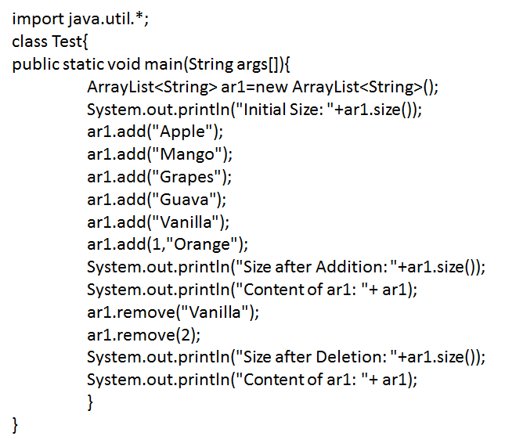
Collection Framework & Exploring java.lang in Java
ArrayList Class :

Slide 22
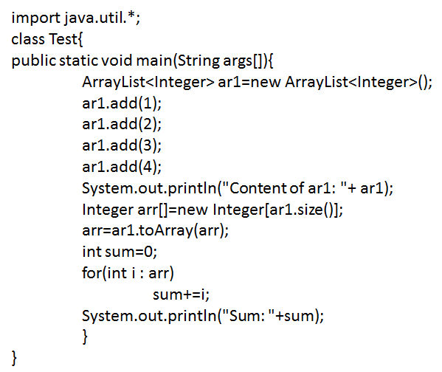
Collection Framework & Exploring java.lang in Java
Obtaining Array from ArrayList :
toArray() : obtains the actual array from ArrayList
object[] toArray(): returns an array of Object
<T>T[] toArray(T array[]): returns an array of elements
that have the same type as T

Slide 23
Collection Framework & Exploring java.lang in Java
LinkedList Class :
LinkedList class extends AbstractList class and implements List, Deque interfaces
It uses doubly linked list to store elements class LinkedList <E> Here, E specifies the type of objects that the list will hold
Constructors:
LinkedList()
LinkedList(Collection <? extends E> c)
LinkedList class can contain duplicate elements
Here, manipulation is fast
It can be used as list, stack or queue

Slide 24
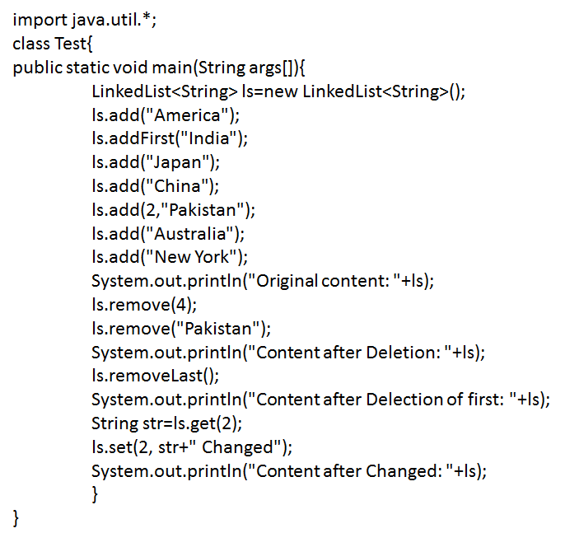
Collection Framework & Exploring java.lang in Java
LinkedList Class :

Slide 25
Collection Framework & Exploring java.lang in Java
Use of Iterator :
Each of the collection classes provides an iterator() method that returns an iterator to the start of the collection, By using the iterator object, you can access each element in the collection, one element at a time
In general, to use an iterator to cycle through the contents
of a collection, follow these steps:
i. Obtain an iterator to the start of the collection using iterator()
ii. Set up a loop that makes a call to hasNext(). Continue until hasNext() returns true
iii. Obtain each element by calling next() within the loop
For collections implementing List, you can also obtain iterator using listIterator(). It accesses the collection in either forward or backward direction and allows in modifying an element

Slide 26
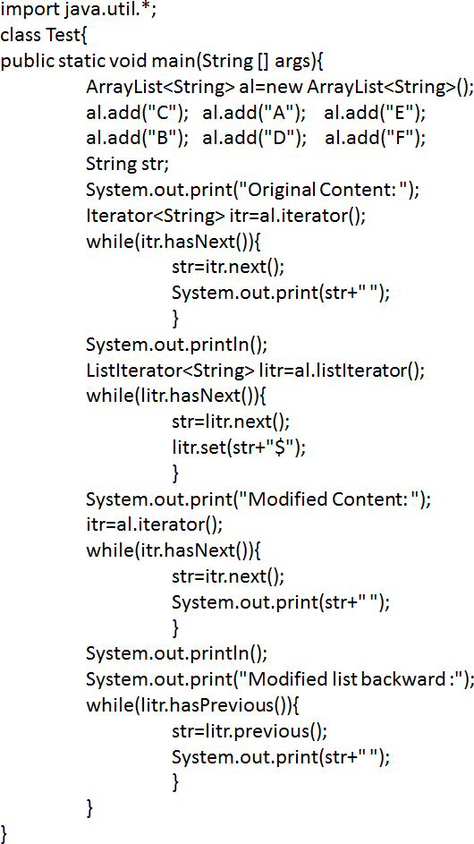
Collection Framework & Exploring java.lang in Java
Use of Iterator :

Slide 27
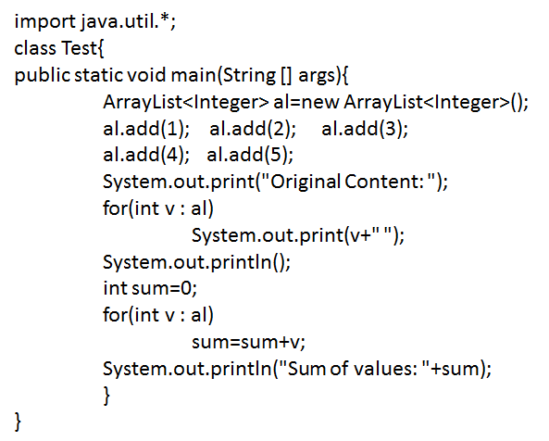
Collection Framework & Exploring java.lang in Java
For-Each alternatice to Iterator :
If you won’t be modifying the content of a collection or obtaining elements in reverse order, then for-each version of for loop is preferable over cycling through a collection than is using an iterator

Slide 28
Collection Framework & Exploring java.lang in Java
Primitive Type Wrappers :
java.lang is automatically imported into all programs
Java uses primitive types for performance reasons. These data types are not part of object hierarchy. They are passed by value to methods and can’t be directly passed by reference. Also, there is no way for two methods to refer to the same instance of an int
To address this need, java provides classes that correspond to each of the primitive types. These classes encapsulate or wrap the primitive types within a class
Double and Float are wrappers for floating point values of type double and float, respectively
Byte, Short, Integer and Long classes are wrappers for byte, short, int and long types, respectively
Character is a wrapper around a char type
Boolean is a wrapper around boolean values

Slide 29
Collection Framework & Exploring java.lang in Java
Memory Management :
Java provides automatic garbage collection. Sometimes you need to know how large the object heap and how much of it is left
To obtain these values, use totalMemory() and freeMemory()
Java garbage collector runs periodically to recycle unused
objects. gc() can be invoked using the Runtime instance to
request the garbage collection

Slide 30
Collection Framework & Exploring java.lang in Java
System :
System class holds a collection of static methods and variables
The standard input, output and error output are stored in the in, out and err variables
It provides a utility method for quickly copying a portion of
an array
It provides a means of loading files and libraries

Slide 31
Collection Framework & Exploring java.lang in Java
Object :
Object is a superclass of all other classes
It is beneficial if you want to refer any object whose type you don’t know
It provides some common behaviors to all objects

Slide 32
Collection Framework & Exploring java.lang in Java
finalize() :
finalize() is a protected and non-static method of Object class and will be available in all objects you create
It is called by the garbage collector on an object when garbage collector determines that there are no more references to the object
A subclass overrides the finalize() to keep those operations you want to perform before an object is destroyed. It is not automatically chained like constructors
You can call finalize() method explicitly on an object before it is abandoned

Slide 33
Collection Framework & Exploring java.lang in Java
toString() :
toString() method returns the string representation of the object
If you print any object, java compiler internally invokes
toString() on the object
By overriding toString() method of the Object class, we
can return values of the object
It is also widely used for logging, debugging and for passing informative error messages to Exception constructors and assertions

