Slide 1
Variable in Java
Variable
Variable is name of reserved area allocated in memory. In other words, it is a name of memory location. It is a combination of "vary + able" that means its value can be changed.

Slide 2
Java Basic
int data=10;//Here data is variable

Slide 3
Java Basic
Types of Variables:
There are three types of variables in java:
1) Local Variable
A variable declared inside the body of the method is called local variable. You can use this variable only within that method and the other methods in the class aren't even aware that the variable exists.
A local variable cannot be defined with "static" keyword.

Slide 4
Java Basic
2) Instance Variable
A variable declared inside the class but outside the body of the method, is called instance variable. It is not declared as static.
It is called instance variable because its value is instance specific and is not shared among instances.
3) Static variable
A variable which is declared as static is called static variable. It cannot be local. You can create a single copy of static variable and share among all the instances of the class. Memory allocation for static variable happens only once when the class is loaded in the memory.

Slide 5
Java example
Example to understand the types of variables in java :
public class A
{
int data=50;//instance variable
static int m=100;//static variable
void method()
{
int n=90;//local variable
}
}//end of class

Slide 6
Java example
class Simple
{
public static void main(String[] args)
{
int a=10;
int b=10;
int c=a+b;
System.out.println(c);
}
}

Slide 7
Java example
class Simple{
public static void main(String[] args)
{
int a=10;
float f=a;
int b=(int)f;
System.out.println(a);
System.out.println(f);
}
}

Slide 8
Java example
class Simple
{
public static void main(String[] args){
float f=10.5f;
//int a=f;//Compile time error
int a=(int)f;
System.out.println(f);
System.out.println(a);
}
}

Slide 9
Java example
class Simple{
public static void main(String[] args){
//Overflow
int a=133;
byte b=(byte)a;
System.out.println(a);
System.out.println(b);
}}
output :
133 -123

Slide 10
Java example
class Simple
{
public static void main(String[] args){
byte a=10;
byte b=10;
//byte c=a+b;//Compile Time Error: because a+b=20 will be int
byte c=(byte)(a+b);
System.out.println(c);
}
}

Slide 11
Data Types in Java
Data types specify the different sizes and values that can be stored in the variable. There are two types of data types in Java:
Primitive data types: The primitive data types include Integer, Character, Boolean, and Floating Point.
Non-primitive data types: The non-primitive data types include Classes, Interfaces, and Arrays.

Slide 12
Data Types in Java
Java Primitive Data Types :
In Java language, primitive data types are the building blocks of data manipulation. These are the most basic data types available in Java language.

Slide 13
Data Types in Java
There are 8 types of primitive data types:
boolean data type
byte data type
char data type
short data type
int data type
long data type
float data type
double data type

Slide 14
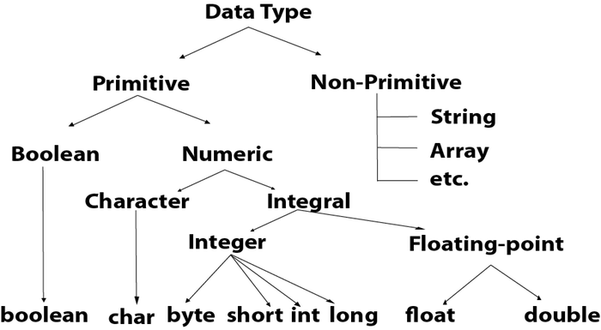
Data Types in Java

Slide 15
Data Types in Java
Data Type | Default Value | Default size
boolean | false | 1 bit
char | '\u0000' | 2 byte
byte | 0 | 1 byte
short | 0 | 2 byte
int | 0 | 4 byte
long | 0L | 8 byte
float | 0.0f | 4 byte
double | 0.0d | 8 byte

Slide 16
Unicode System
Unicode is a universal international standard character encoding that is capable of representing most of the world's written languages.
Why java uses Unicode System ?
Before Unicode, there were many language standards:
ASCII (American Standard Code for Information Interchange) for the United States.
ISO 8859-1 for Western European Language.
KOI-8 for Russian.
GB18030 and BIG-5 for chinese, and so on.

Slide 17
Unicode System
This caused two problems:
A particular code value corresponds to different letters in the various language standards.
The encodings for languages with large character sets have variable length.Some common characters are encoded as single bytes, other require two or more byte.

Slide 18
Unicode System
To solve these problems, a new language standard was developed i.e. Unicode System.
In unicode, character holds 2 byte, so java also uses 2 byte for characters.
lowest value:\u0000
highest value:\uFFFF

Slide 19
Operators in Java
Operator in java is a symbol that is used to perform operations. For example: +, -, *, / etc.
There are many types of operators in java which are given below:
Unary Operator
Arithmetic Operator
Shift Operator
Relational Operator
Bitwise Operator
Logical Operator
Ternary Operator
Assignment Operator

Slide 20
Operators in Java
Operator Type | Category | Precedence
Unary | postfix | expr++, expr--
 | prefix | ++expr ,--expr ,+expr, -expr, ~ !
Arithmetic | multiplicative | *, / ,%
 | additive | +, -
Shift | shift | <<, >>, >>>
Relational | comparison | < ,>, <=, >= ,instanceof
 | equality | == , !=

Slide 21
Operators in Java
Operator Type | Category | Precedence
Bitwise | bitwise AND | &
 | bitwise exclusive OR | ^
 | bitwise inclusive OR | |
Logical | logical AND | &&
 | logical OR | ||
Ternary | ternary | ? :
Assignment | assignment | = ,+=, -=, *= ,/= ,%= ,&=, ^=, |=, <<=, >>=, >>>=

Slide 22
Java Unary Operator Example: ++ and --
class OperatorExample{
public static void main(String args[]){
int x=10;
System.out.println(x++);
System.out.println(++x);
System.out.println(x--);
System.out.println(--x);
}}

Slide 23
Java Unary Operator Example : ++ and --
class OperatorExample
{
public static void main(String args[]){
int a=10;
int b=10;
System.out.println(a++ + ++a);
System.out.println(b++ + b++);
}
}

Slide 24
Java Unary Operator Example: ~ and !
class OperatorExample{
public static void main(String args[]){
int a=10;
int b=-10;
boolean c=true;
boolean d=false;
System.out.println(~a);
System.out.println(~b);
System.out.println(!c);
System.out.println(!d);
}}

Slide 25
Java Unary Operator Example: ~ and !
System.out.println(~a)
-11 (minus of total positive value which starts from 0)
System.out.println(~b);
9 (positive of total minus, positive starts from 0)
System.out.println(!c);
false (opposite of boolean value)
System.out.println(!d);
true

Slide 26
Java Left Shift Operator Example
class OperatorExample{
public static void main(String args[]){
System.out.println(10<<2);
System.out.println(10<<3);
System.out.println(20<<2);
System.out.println(15<<4);
}}

Slide 27
Java Right Shift Operator Example
The operator ‘>>’ uses the sign bit (left most bit) to fill the trailing positions after shift. If the number is negative, then 1 is used as a filler and if the number is positive, then 0 is used as a filler.
class OperatorExample
{
public static void main(String args[]){
System.out.println(10>>2);
System.out.println(20>>2);
System.out.println(20>>3);
}
}

Slide 28
Java Shift Operator Example: >> vs >>>
class OperatorExample{
public static void main(String args[]){
//For positive number, >> and >>> works same
System.out.println(20>>2);
System.out.println(20>>>2);
//For negative number, >>> changes parity bit (MSB) to 0
System.out.println(-20>>2);
System.out.println(-20>>>2);
}}
output :
5 5 -5 1073741819

Slide 29
Logical && and Bitwise & Example
The logical && operator doesn't check second condition if first condition is false. It checks second condition only if first one is true.
The bitwise & operator always checks both conditions whether first condition is true or false.
class OperatorExample{
public static void main(String args[]){
int a=10;
int b=5;
int c=20;
System.out.println(a<b&&a<c);//false && true = false
System.out.println(a<b&a<c);//false & true = false
}}

Slide 30
Logical && and Bitwise & Example
class OperatorExample{
public static void main(String args[]){
int a=10;
int b=5;
int c=20;
System.out.println(a<b&&a++<c);//false && true = false
System.out.println(a);
System.out.println(a<b&a++<c);//false & true = false
System.out.println(a);
}}
output :
false 10 false 11

Slide 31
Logical || and Bitwise | Example
The logical || operator doesn't check second condition if first condition is true. It checks second condition only if first one is false.
The bitwise | operator always checks both conditions whether first condition is true or false.

Slide 32
Logical || and Bitwise | Example
class OperatorExample{
public static void main(String args[]){
int a=10;
int b=5;
int c=20;
System.out.println(a>b||a<c);//true || true = true
System.out.println(a>b|a<c);//true | true = true
//|| vs |
System.out.println(a>b||a++<c);//true || true = true
System.out.println(a);
System.out.println(a>b|a++<c);//true | true = true
System.out.println(a);
}}

Slide 33
Java Ternary Operator Example
Java Ternary operator is used as one liner replacement for if-then-else statement and used a lot in java programming. it is the only conditional operator which takes three operands.
class OperatorExample{
public static void main(String args[]){
int a=2;
int b=5;
int min=(a<b)?a:b;
System.out.println(min);
}}

Slide 34
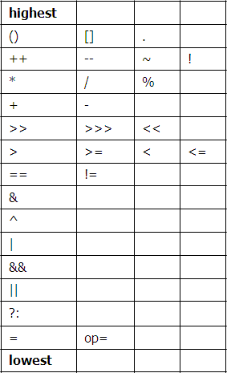
Operator Precedence
When operators have the same precedence, the earlier one binds stronger

Slide 35
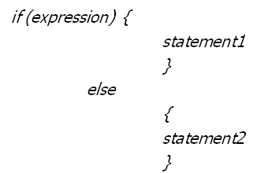
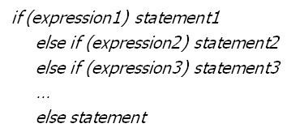
Selection Statements
if-else statement
if-else-if statement

Slide 36
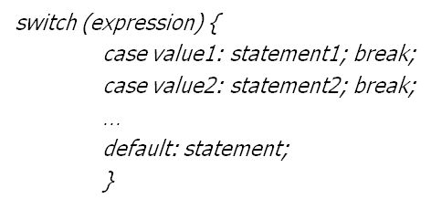
Switch Statement
switch provides a better alternative than if-else-if when the execution follows several branches depending on the value of an expression

Slide 37
Switch Statement
Expression must be of type byte, short, int or char
Each of the case values must be a literal of the compatible type
Case values must be unique
Break makes sure that only the matching statement is executed

Slide 38

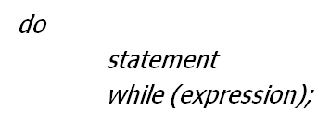
Iteration Statement
Java iteration statements enable repeated execution of part of a program until a certain termination condition becomes true
while statement
How to run an infinte while loop ?
do-while statement

Slide 39

Iteration Statement
for statement
How to run an infinte for loop ?

Slide 40
Java Labeled For Loop
public class LabeledForExample {
public static void main(String[] args) {
aa:
for(int i=1;i<=3;i++){
bb:
for(int j=1;j<=3;j++){
if(i==2&&j==2){
break aa;
}
System.out.println(i+" "+j);
}
}
}
}

Slide 41
Java Labeled For Loop
Output:
1 1
1 2
1 3
2 1

Slide 42
Java Labeled For Loop
public class LabeledForExample2 {
public static void main(String[] args) {
aa:
for(int i=1;i<=3;i++){
bb:
for(int j=1;j<=3;j++){
if(i==2&&j==2){
break bb;
}
System.out.println(i+" "+j);
}
}
}
}

Slide 43
Java Labeled For Loop
Output:
1 1
1 2
1 3
2 1
3 1
3 2
3 3

Slide 44
Jump Statement
Java jump statements enable transfer of control to other parts of program
break statement
break;
Java does not have goto statement
break label;
label: { ... }
continue statement
The break statement terminates the block of code, in particular it terminates the execution of an iterative statement

Slide 45
Jump Statement
The continue statement forces the early termination of the current iteration to begin immediately the next iteration
continue;
continue label;

Slide 46
Java Break Statement with Loop
public class BreakExample {
public static void main(String[] args) {
for(int i=1;i<=10;i++){
if(i==5){
break;
}
System.out.println(i);
}
}
}

Slide 47
Java Break Statement with Loop
Output:
1
2
3
4

Slide 48
Java Break Statement with Inner Loop
public class BreakExample2 {
public static void main(String[] args) {
for(int i=1;i<=3;i++){
for(int j=1;j<=3;j++){
if(i==2&&j==2){
break;
}
System.out.println(i+" "+j);
}
}
}
}

Slide 49
Java Break Statement with Inner Loop
Output:
1 1
1 2
1 3
2 1
3 1
3 2
3 3

Slide 50
Java Continue Statement Example
public class ContinueExample {
public static void main(String[] args) {
for(int i=1;i<=10;i++){
if(i==5){
continue;
}
System.out.println(i);
}
}
}

Slide 51
Java Continue Statement Example
Output:
1
2
3
4
6
7
8
9
10

Slide 52
Java Continue Statement with Inner Loop
public class ContinueExample2 {
public static void main(String[] args) {
for(int i=1;i<=3;i++){
for(int j=1;j<=3;j++){
if(i==2&&j==2){
continue;
}
System.out.println(i+" "+j);
}
}
}
}

Slide 53
Java Continue Statement with Inner Loop
Output:
1 1
1 2
1 3
2 1
2 3
3 1
3 2
3 3

