Slide 1
Java Swing
Java Swing :
Java Swing is a part of Java Foundation Classes (JFC) that is used to create window-based applications. It is built on the top of AWT (Abstract Windowing Toolkit) API and entirely written in java.
Unlike AWT, Java Swing provides platform-independent and lightweight components.
The javax.swing package provides classes for java swing API such as JButton, JTextField, JTextArea, JRadioButton, JCheckbox, JMenu, JColorChooser etc.

Slide 2
Java Swing
Java Swing :
Java Swing, a graphical user interface (GUI) toolkit, has been a cornerstone of Java development for decades. Since its inception, Swing has provided Java developers with a robust framework for creating interactive, platform-independent applications. In this article, we'll delve into the fundamentals of Java Swing, explore its key features, and discuss its relevance in modern application development.
Java Swing was introduced as part of the Java Foundation Classes (JFC) in the late 1990s, aiming to address the limitations of the earlier Abstract Window Toolkit (AWT). Unlike AWT, that relies on the native platform's components for rendering, Swing is entirely written in Java, offering a consistent look and feel across different operating systems.

Slide 3
Java Swing
Key Features of Java Swing :
1. Platform Independence
2. Rich Set of Components
3. Customizability
4. Event Handling
5. Layout Managers

Slide 4
Java Swing
Modern Applications of Java Swing :
While newer GUI frameworks such as JavaFX and web technologies like React and Angular have gained popularity in recent years, Java Swing remains a viable choice for certain types of applications:
1. Desktop Applications
2. Legacy Systems
3. Educational Purposes

Slide 5
Java Swing
Difference between AWT and Swing
 | Java AWT | Java Swing
1) | AWT components are platform-dependent. | Java swing components are platform-independent.
2) | AWT components are heavyweight. | Swing components are lightweight.
3) | AWT doesn't support pluggable look and feel. | Swing supports pluggable look and feel.
4) | AWT provides less components than Swing. | Swing provides more powerful components such as tables, lists, scrollpanes, colorchooser, tabbedpane etc.

Slide 6
Java Swing
Difference between AWT and Swing
 | Java AWT | Java Swing
5) | AWT doesn't follows MVC(Model View Controller) where model represents data, view represents presentation and controller acts as an interface between model and view. | Swing follows MV

Slide 7
Java Swing
What is JFC ?
The Java Foundation Classes (JFC) are a set of GUI components which simplify the development of desktop applications.
Java Swing Examples :
There are two ways to create a frame:
1. By creating the object of Frame class (association)
2. By extending Frame class (inheritance)
We can write the code of swing inside the main(), constructor or any other method.

Slide 8
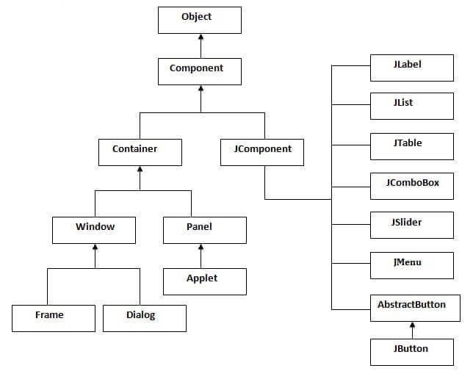
Java Swing
Hierarchy of Java Swing classes :

Slide 9
Java Swing
import javax.swing.*;
public class FirstSwingExample {
public static void main(String[] args) {
JFrame f=new JFrame();//creating instance of JFrame
JButton b=new JButton("click");//creating instance of JButton
b.setBounds(130,100,100, 40);//x axis, y axis, width, height
f.add(b);//adding button in JFrame
f.setSize(400,500);//400 width and 500 height
f.setLayout(null);//using no layout managers
f.setVisible(true);//making the frame visible
}}

