Slide 1
Multithreading in JAVA

Slide 2
Outline
Process versus Thread
Synchronization
Multithreading with Java

Slide 3
Topic
Process versus Thread.
Synchronization

Slide 4
Process Model
A process is a sequential program in execution.
A process is a unit of computation.
Process components:
The program (code) to be executed.
The data on which the program will execute.
Resources required by the program.
The status of the process execution.
A process runs in an abstract machine environment (could be OS) that manages the sharing and isolation of resources among the community of processes.
Code
Data
Process Status
Resource
Abstract Machine Environment

Slide 5
Program and Process
Program and process – distinction?
A program is a static entity made up of program statements. The latter define the run-time behavior.
A process is a dynamic entity that executes a program on a particular set of data.
Two or more processes could execute the same program, each using their own data and resources.

Slide 6
Thread Model
A thread is an alternative form (to the process) of schedulable unit of computation.
In the thread model:
Each thread is associated with a process.
A thread is an entity that executes by relying on the code and resources, holding by the associated process.
Several threads could be associated with a single process. Those threads share the code and resources of the process.
A thread allocates part of the process’s resources for its needs.
A thread has its own data and status.
Resource
Process
Thread
Data
Code
Data
Process Status
Thread Status

Slide 7
Thread Model
Control in a normal program usually follows a single thread of execution.
What differentiates threads from normal processes is the shared memory (objects), which is visible to all threads in a multi-threaded program.
A thread has much less overhead than a process so is sometimes called as light-weight process.
Multithreading allows an application to have multiple threads of execution running concurrently.

Slide 8
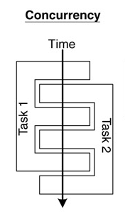
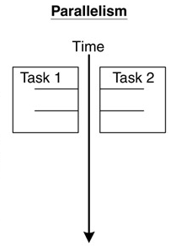
Concurrency and Parallelism
Concurrent multithreading systems give the appearance of several tasks executing at once, but these tasks are actually split up into chunks that share the processor with chunks from other tasks.
In parallel systems, two tasks are actually performed simultaneously. Parallelism requires a multi-CPU system.

Slide 9
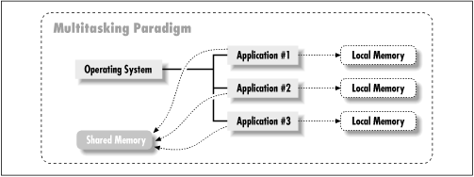
Multitasking
Multitasking operating systems run multiple programs simultaneously.
Each of these programs has at least one thread within it - single-threaded process:
The process begins execution at a well-known point. In Java, C# or C++, the process begins execution at the first statement of the function called main().
Execution of the statements follows in a completely ordered, predefined sequence for a given set of inputs.
While executing, the process has access to certain data – local, global, static etc.

Slide 10
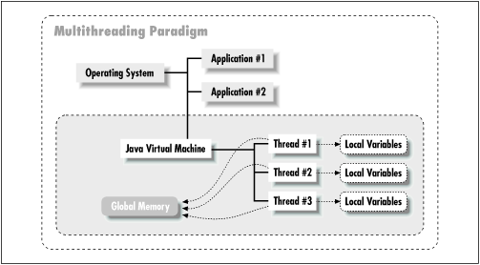
Multithreading
A program with multiple threads running within a single instance could be considered as a multitasking system within an OS.
In a multithreading program, threads have the following properties:
A thread begin execution at a predefined, well-known location. For one of the threads in the program, that location is the main() method; for the rest of the threads, it is a particular location the programmer decides on when the code is written.
A thread executes code in an ordered, predefined sequence.
A thread executes its code independently of the other threads.
The threads appear to have a certain degree of simultaneous execution.

Slide 11
Threading Models
There are typically two threading models supported by OS:
Cooperative Threading Model;
Preemptive Threading Model.
Cooperative Threading Model
In a cooperative system, a thread retains control of the processor until it decides to give it up (which might be never).
Supporting OS – Windows 3.x, Solaris, Mac OS.
The various threads have to cooperate with each other. If not, some of them will be starving (never given a chance to run).
Scheduling in most cooperative systems is done strictly by priority level - when the current thread gives up control, the highest-priority waiting thread gets control.

Slide 12
Threading Models
Preemptive Threading Model
In a preemptive system, some sort of timer is used by the operating system itself to cause a context swap.
Supporting OS – Windows 9x, XP, NT (2000), Solaris, Linux.
When the timer "ticks" the OS can abruptly take control away from the running thread and give control to another thread.
The interval between timer ticks is called a time slice.
To get to concurrency, the OS must do the thread scheduling.
Preemptive systems are less efficient than cooperative ones because the thread management must be done by the OS’ kernel, but they are easier to program (except their synchronization).

Slide 13
Synchronization
Background
Concurrent access to shared data may result in data inconsistency.
Maintaining data consistency requires mechanisms to ensure the orderly execution of cooperating processes (or threads).
When do we need synchronization?
When two or more processes (or threads) work on the same data simultaneously.

Slide 14
Synchronization
Example:
Two threads are trying to update the same shared variable simultaneously:
The result is unpredictable.
The result depends on which of the two threads was the last one to change the value.
The competition of the threads for the variable is called race condition.
The first thread is the one who wins the race to update the variable.

Slide 15
Classical Synchronization Problems
Mutual exclusion
Only one process executes a piece of code (critical section) at any time.
OS examples: access to shared resources, e.g., a printer.
Sequencing
A process waits for another process to finish executing some code.
OS examples: waiting for an event, e.g., ls (dir) command suspends until there is some data to read from the file system.

Slide 16
Classical Synchronization Problems
Bounded-buffer
(also referred to as the Producer-Consumer problem)
A pool of n buffers.
Producer processes put items into the pool.
Consumer processes take items out of the pool.
Issues: mutual exclusion, empty pool, and full pool.
OS examples: buffering for pipes, file caches, etc.

Slide 17
Classical Synchronization Problems
Readers-Writers
Multiple processes access a shared data object X.
Any number of readers can access X at the same time.
No writer can access it at the same time as a reader or another writer.
Mutual exclusion is too constraining. Why?
Variations:
reader-priority: a reader must not wait for a writer;
writer-priority: a writer must not wait for a reader,
OS examples: file locks.

Slide 18
Classical Synchronization Problems
Dining Philosophers
5 philosophers with 5 chopsticks placed between them.
To eat requires two chopsticks.
Philosophers alternate between thinking and eating.
OS examples: simultaneous use of multiple resources.
Many examples, along with Java code
http://www.doc.ic.ac.uk/~jnm/book/book_applets/concurrency.html

Slide 19
The Critical Section Problem
Definition:
A critical section is a piece of code that accesses a shared resource (data structure or device) that must not be concurrently accessed by more than one thread of execution.
Conditions:
n processes (or threads) all competing to use some shared data.
Each process has a code segment, called critical section, in which the shared data is accessed.
Problem: How to ensure that when one process is executing in its critical section, no other process is allowed to execute in its critical section?

Slide 20
The Critical Section Problem - Example
Suppose that two processes are trying to increment the same variable. They both execute the statement
x := x + 1;
To execute this statement each process reads the variable x, then adds one to the value, then write it back.
Suppose the value of x is 3.
If both processes read x at the same time then they would get the same value 3.
If they then both added 1 to it then they would both have the value 4.
They would then both write 4 back to x.
The result is that both processes incremented x, but its value is only 4, instead of 5.

Slide 21
The Critical Section Problem
Solution – three requirements:
Only one process is allowed to be in its critical section at a time. Hence, the execution of critical sections is mutually exclusive.
If there is no process in its critical section, but some processes are waiting to enter their critical sections, only the waiting processes may compete for getting in. Ultimately, there must be progress in the resolution and one process must be allowed to enter.
Processes waiting to enter their critical sections must be allowed to do so in a bounded timeframe. Hence, processes have bounded waiting.

Slide 22
The Critical Section Problem
Critical sections are General Framework for process (thread) synchronization:
ENTRY SECTION
CRITICAL SECTION CODE
EXIT SECTION
The ENTRY SECTION controls access to make sure no more than one process Pi gets to access the critical section at any given time. It acts as a guard.
The EXIT SECTION does bookkeeping to make sure that other processes that are waiting know that Pi has exited.

Slide 23
Semaphores
The Semaphores are a solution to the Critical Section Problem.
Help in making the Critical Section atomic.
A semaphores is:
a single integer variable S;
accessed via two atomic operations:
WAIT (sometimes denoted by P)
while S <= 0 do wait();
S := S-1;
SIGNAL (sometimes denoted by V)
S := S+1;
wake up a waiting process (if any);
WAITing processes cannot “lock out” a SIGNALing process.
Binary semaphores - S is restricted to take on only the values 0 and 1.
Mutual Exclusion Semaphore
//**** initially S = 1
P( S ) //**** WAIT
CRITICAL SECTION
V( S ) //**** SIGNAL

Slide 24
Topic
Multithreading with Java

Slide 25
Threads in Java
There are two ways to create a java thread:
By extending the java.lang.Thread class.
By implementing the java.lang.Runnable interface.
The run() method is where the action of a thread takes place.
The execution of a thread starts by calling its start() method.
class PrimeThread extends Thread {
long minPrime;
PrimeThread(long minPrime) {
this.minPrime = minPrime; }
public void run() {
// compute primes larger than minPrime . . .
}
}
The following code would then create a thread and start it running:
PrimeThread p = new PrimeThread(143);
p.start();

Slide 26
Implementing the Runnable Interface
In order to create a new thread we may also provide a class that implements the java.lang.Runnable interface.
Preferred way in case our class has to subclass some other class.
A Runnable object can be wrapped up into a Thread object:
Thread(Runnable target)
Thread(Runnable target, String name)
The thread’s logic is included inside the run() method of the runnable object.
class ExClass
extends ExSupClass
implements Runnable {
…
public ExClass (String name) {
}
public void run() {
…
}
}
class A {
…
main(String[] args) {
…
Thread mt1 = new Thread(new ExClass("thread1”));
Thread mt2 = new Thread(new ExClass("thread2”));
mt1.start();
mt2.start();
}
}

Slide 27
Implementing the Runnable Interface
Constructs a new thread object associated with the given Runnable object.
The new Thread object's start() method is called to begin execution of the new thread of control.
The reason we need to pass the runnable object to the thread object's constructor is that the thread must have some way to get to the run() method we want the thread to execute. Since we are no longer overriding the run() method of the Thread class, the default run() method of the Thread class is executed:
public void run() {
if (target != null) {
target.run();
}
}
Here, target is the runnable object we passed to the thread's constructor. So the thread begins execution with the run() method of the Thread class, which immediately calls the run() method of our runnable object.

Slide 28
Sleep, Yield, Notify & Wait Thread’s Functions
sleep(long millis) - causes the currently executing thread to sleep (temporarily cease execution) for the specified number of milliseconds.
yield() - causes the currently executing thread object to temporarily pause and allow other threads to execute.
wait() - causes current thread to wait for a condition to occur (another thread invokes the notify() method or the notifyAll() method for this object). This is a method of the Object class and must be called from within a synchronized method or block.
notify() - notifies a thread that is waiting for a condition that the condition has occurred. This is a method of the Object class and must be called from within a synchronized method or block.
notifyAll() – like the notify() method, but notifies all the threads that are waiting for a condition that the condition has occurred.

Slide 29
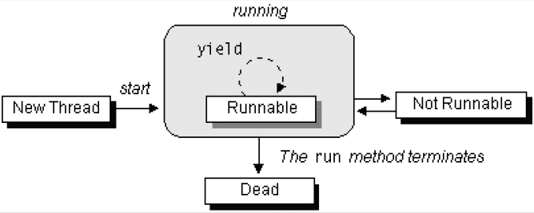
The Lifecycle of a Thread
The start() method creates the system resources necessary to run the thread, schedules the thread to run, and calls the thread's run() method.
A thread becomes Not Runnable when one of these events occurs:
Its sleep() method is invoked.
The thread calls the wait() method.
The thread is blocked on I/O operations.
A thread dies naturally when the run() method exits.

Slide 30
Thread Priority
On a single CPU, threads actually run one at a time in such a way as to provide an illusion of concurrency.
Execution of multiple threads on a single CPU, in some order, is called scheduling.
The Java runtime supports a very simple scheduling algorithm (fixed priority scheduling). This algorithm schedules threads based on their priority relative to other runnable threads.
The runtime system chooses the runnable thread with the highest priority for execution.

Slide 31
Thread Priority
If two threads of the same priority are waiting for the CPU, the scheduler chooses one of them to run in a round-robin fashion - each process is guaranteed to get its turn at the CPU at every system-specified time interval.
The chosen thread will run until:
A higher priority thread becomes runnable.
It yields (calls its yield() method), or its run() method exits.
On systems that support time-slicing, its time allotment has elapsed.
You can modify a thread's priority at any time after its creation by using the setPriority() method.

Slide 32
Synchronization of Java Threads
In many cases concurrently running threads share data and must consider the state and activities of other threads.
If two threads can both execute a method that modifies the state of an object then the method should be declared to be synchronized, those allowing only one thread to execute the method at a time.
If a class has at least one synchronized method, each instance of it has a monitor. A monitor is an object that can block threads and notify them when the method is available.
Example:
public synchronized void updateRecord() {
//**** critical code goes here …
}
Only one thread may be inside the body of this function. A second call will be blocked until the first call returns or wait() is called inside the synchronized method.

Slide 33
Synchronization of Java Threads
If you don’t need to protect an entire method, you can synchronize on an object:
public void foo() {
synchronized (this) {
//critical code goes here …
}
…
}
There are two syntactic forms based on the synchronized keyword - blocks and methods.
Block synchronization takes an argument of which object to lock. This allows any method to lock any object.
The most common argument to synchronized blocks is this.
Block synchronization is considered more fundamental than method synchronization.

Slide 34
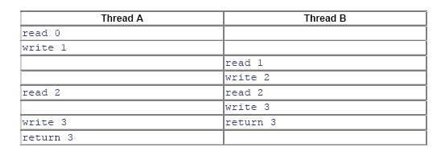
Applying Synchronization (Example)
Consider the following class:
class Even {
private int n = 0;
public int next(){
++n;
++n;
return n; //**** next is always even
}
}
Without synchronizing, the desired postcondition may fail due to a storage conflict when two or more threads execute the next method of the same Even object.
Here is one possible execution trace:
Declaring the next method as synchronized would resolve such conflicting problems.
synchronized

Slide 35
Synchronization of Java Threads
To program the synchronization behavior we use the Object class’ methods wait(), notify() and notifyAll().
With these methods we allow objects to wait until another object notifies them:
synchronized( waitForThis ) {
try { waitForThis.wait();}
catch (InterruptedException ie) {}
}
To wait on an object, you must first synchronize on it.
InterruptedException is thrown when a thread is waiting, sleeping, or otherwise paused for a long time and another thread interrupts it using the interrupt method in class Thread.

Slide 36
Synchronization of Java Threads
A thread may call wait() inside a synchronized method. A timeout may be provided. If missing or zero then the thread waits until either notify() or notifyAll() is called, otherwise until the timeout period expires.
wait() is called by the thread owning the lock associated with a particular object.
notify() or notifyAll() are only called from a synchronized method. One or all waiting threads are notified, respectively. It’s probably better (safer) to use notifyAll(). These methods don't release the lock. The threads awakened will not return from their wait() call immediately, but only when the thread that called notify() or notifyAll() finally relinquishes ownership of the lock.

Slide 37
Synchronization of Java Threads
The wait() method releases the lock prior to waiting, and reacquires the lock prior to returning from the wait() method.
It is possible a synchronized method to make a self-call to another synchronized method on the same object without freezing up.
Methods that are not synchronized may still execute at any time, even if a synchronized method is in progress. In other words, synchronized is not equivalent to atomic, but synchronization can be used to achieve atomicity.

Slide 38
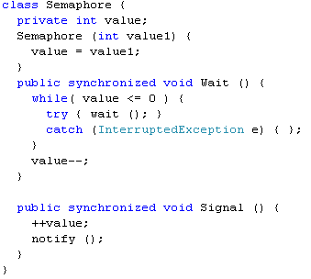
Java Semaphore - Example

Slide 39
Protecting Static Fields
Locking an object does not automatically protect access to the static fields of that object's class or any of its superclasses.
Access to static fields is instead protected via static synchronized methods and blocks.
Consider the following class:
class Even {
public static int n = 0;
public static synchronized int next(){ //**** will lock n as well and
++n;
++n;
return n; //**** next is always even
}
}
Will prevent outer access on n, until the end of the next() method.

Slide 40
Java Threading API
:: Stopping Threads
The Thread class does contain a stop() method that allows you to stop a thread immediately: no matter what the thread is doing, it will be terminated.
However, the stop() method is very dangerous. In Java 2, the stop() method is deprecated.
Why?
If a thread holds a lock at the time it is stopped, the lock will be released when the thread stops.
But if the thread that is being stopped is in the middle of updating a linked list, for example, the links in the list will be left in an inconsistent state.
Hence, if we were able to interrupt a thread in the middle of this operation, we would lose the benefit of its obtaining the lock.
The reason we needed to obtain a lock on the list in the first place was to ensure that the list would not be found by another thread in an inconsistent state.

Slide 41
Java Threading API
:: The suspend() and resume() Methods
The suspend() and resume() methods are very dangerous and they became deprecated.
The problem with using the suspend() method is that it can conceivably lead to cases of lock starvation - including cases where the starvation shuts down the entire virtual machine.
If a thread is suspended while it is holding a lock, that lock remains held by the suspended thread. As long as that thread is suspended, no other thread can obtain the lock.
There is no danger in the resume() method itself, but since the resume() method is useful only with the suspend() method, it too has been deprecated.
Java Thread primitives deprecation: http://java.sun.com/j2se/1.5.0/docs/guide/misc/threadPrimitiveDeprecation.html

Slide 42
Java Threading API
:: Thread Naming
It is possible to assign a String name to the Thread object itself:
void setName(String name) //assigns a name to the Thread instance
String getName() //gets the name of the Thread instance
The system does not use this string for any specific purpose.
We can use it for debugging. With an assigned name, the debugger and the toString() method display thread information in terms of a “logical" name instead of a number.
The naming support is also available as a constructor of the Thread class:
Thread(String name) constructs a thread object with a name that is already assigned. This constructor is used when threading by inheritance.
Thread(Runnable target, String name) constructs a thread object that is associated with the given Runnable object and is created with a name that is already assigned. This constructor is used when threading by interfaces.

Slide 43
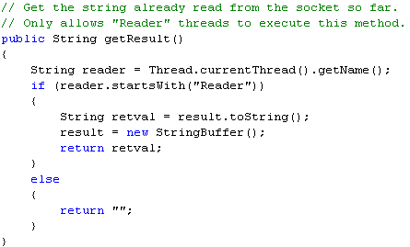
Java Threading API
:: Thread Access – The currentThread() Method
static Thread currentThread() gets the Thread object that represents the current thread of execution. The method is static and may be called through the Thread class name.
Why is this method important?
The Thread object for the current thread may not be saved anywhere, and even if it is, it may not be accessible to the called method.
In this code we are assuming that reader threads are threads whose names start with "Reader." This name could have been assigned by the setName() method earlier or when the threads were constructed.
To obtain a name, we need simply to call the getName() method. However, since we do not have the Thread object reference of the caller, we must call the currentThread() method to obtain the reference.

Slide 44
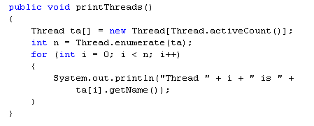
Java Threading API
:: Thread Access – Enumerating Threads in JVM
The Thread class provides methods that allow you to obtain a list of all the threads in the program:
static int enumerate(Thread threadArray[]) gets all the thread objects of the program and stores the result into the thread array. The value returned is the number of thread objects stored into the array. The method is static and may be called through the Thread class name.
static int activeCount() returns the number of threads in the program. The method is static and may be called through the Thread class name.

Slide 45
Thread Synchronization
Java | C#
synchronized | lock
Object.wait() method | Monitor.Wait( object obj ) method
Object.notify() method | Monitor.Pulse( object obj ) method
Object.notifyAll() method | Monitor.PulseAll( object obj ) method
In addition to the lock construct, C# has provided access to its internal methods to acquire and release locks:
Monitor.Enter( object obj );
Monitor.Exit( object obj ).
Using these methods can buy a programmer the same benefits as using the lock construct, but it can also provide more elaborate locking abilities, such as being able to lock variables in one method and have them released at different times or different points in the code, depending on the code path.

Slide 46
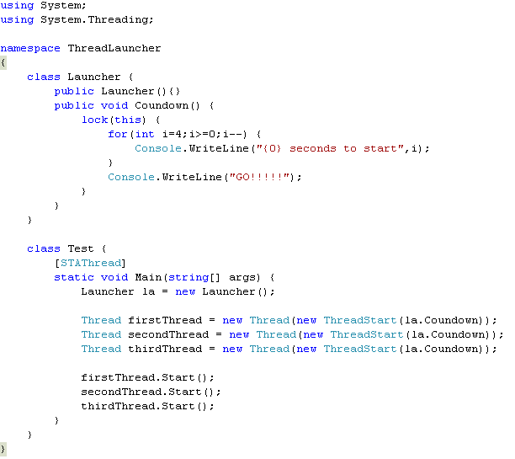
Example: Thread Synchronization

