Slide 1
Inheritance in Java
What is Inheritance ?
Inheritance in Java is a mechanism in which one object acquires all the properties and behaviors of a parent object.
Why use inheritance in java ?
For Method Overriding (so runtime polymorphism can be achieved).
For Code Reusability.

Slide 2
Inheritance in Java
Terms used in Inheritance
Class: A class is a group of objects which have common properties. It is a template or blueprint from which objects are created.
Sub Class/Child Class: Subclass is a class which inherits the other class. It is also called a derived class, extended class, or child class.
Super Class/Parent Class: Superclass is the class from where a subclass inherits the features. It is also called a base class or a parent class.
Reusability: As the name specifies, reusability is a mechanism which facilitates you to reuse the fields and methods of the existing class when you create a new class. You can use the same fields and methods already defined in the previous class.

Slide 3
Inheritance in Java
The syntax of Java Inheritance
class Subclass-name extends Superclass-name
{
//methods and fields
}
The extends keyword indicates that you are making a new class that derives from an existing class. The meaning of "extends" is to increase the functionality.

Slide 4
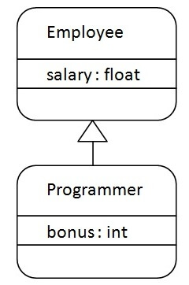
Inheritance in Java
Java Inheritance Example

Slide 5
Inheritance in Java
Java Inheritance Example
class Employee{
float salary=40000;
}
class Programmer extends Employee{
int bonus=10000;
public static void main(String args[]){
Programmer p=new Programmer();
System.out.println("Programmer salary is:"+p.salary);
System.out.println("Bonus of Programmer is:"+p.bonus);
}
}

Slide 6
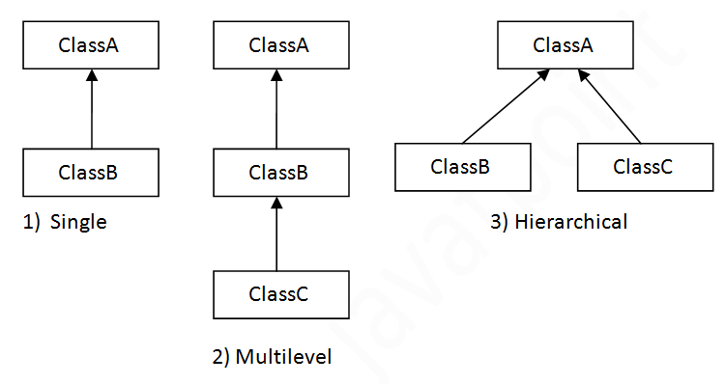
Inheritance in Java
Java Inheritance Example

Slide 7
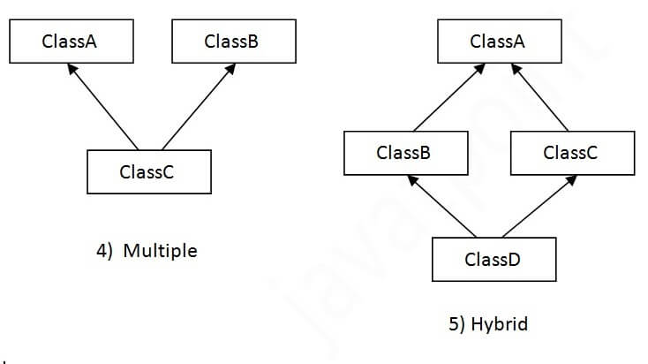
Inheritance in Java
Java Inheritance Example
Note: Multiple inheritance is not supported in Java through class.

Slide 8
Inheritance in Java
Single Inheritance Example
class Animal
{
void eat(){System.out.println("eating...");}
}
class Dog extends Animal
{
void bark(){System.out.println("barking...");}
}
class TestInheritance{
public static void main(String args[]){
Dog d=new Dog();
d.bark();
d.eat(); }}

Slide 9
Inheritance in Java
Multilevel Inheritance Example
class Animal{
void eat(){System.out.println("eating...");} }
class Dog extends Animal{
void bark(){System.out.println("barking...");} }
class BabyDog extends Dog{
void weep(){System.out.println("weeping...");}
}
class TestInheritance{
public static void main(String args[]){
BabyDog d=new BabyDog();
d.weep();
d.bark();
d.eat(); }}

Slide 10
Inheritance in Java
Hierarchical Inheritance Example
class Animal{
void eat(){System.out.println("eating...");} }
class Dog extends Animal{
void bark(){System.out.println("barking...");} }
class Cat extends Animal{
void meow(){System.out.println("meowing...");} }
class TestInheritance3{
public static void main(String args[]){
Cat c=new Cat();
c.meow();
c.eat();
//c.bark();//C.T.Error
}}

Slide 11
Inheritance in Java
Why multiple inheritance is not supported in java?
To reduce the complexity and simplify the language, multiple inheritance is not supported in java.
Consider a scenario where A, B, and C are three classes. The C class inherits A and B classes. If A and B classes have the same method and you call it from child class object, there will be ambiguity to call the method of A or B class.
Since compile-time errors are better than runtime errors, Java renders compile-time error if you inherit 2 classes. So whether you have same method or different, there will be compile time error.

Slide 12
Inheritance in Java
Why multiple inheritance is not supported in java?
class A{
void msg(){System.out.println("Hello");}
}
class B{
void msg(){System.out.println("Welcome");}
}
class C extends A,B{//suppose if it were
Public Static void main(String args[]){
C obj=new C();
obj.msg();//Now which msg() method would be invoked?
}
}

Slide 13
Aggregation in Java
Aggregation in Java :
If a class have an entity reference, it is known as Aggregation.
Consider a situation, Employee object contains many informations such as id, name, emailId etc. It contains one more object named address, which contains its own informations such as city, state, country, zipcode etc. as given below.
class Employee{
int id;
String name;
Address address;//Address is a class
}

Slide 14
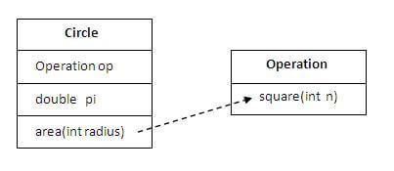
Aggregation in Java
Why use Aggregation ?
For Code Reusability.
Simple Example of Aggregation :

Slide 15
Aggregation in Java
Example of Aggregation
class Operation{
int square(int n){
return n*n; }
}
class Circle{
Operation op;//aggregation
double pi=3.14;
double area(int radius){
op=new Operation();
int rsquare=op.square(radius);//code reusability (i.e. delegates the method call).
return pi*rsquare; }

Slide 16
Aggregation in Java
Example of Aggregation
public static void main(String args[]){
Circle c=new Circle();
double result=c.area(5);
System.out.println(result);
}
}

Slide 17
Aggregation in Java
Example of Aggregation 1
public class Address {
String city,state,country;
public Address(String city, String state, String country) {
this.city = city;
this.state = state;
this.country = country;
}
}

Slide 18
Aggregation in Java
Example of Aggregation 1
public class Emp {
int id;
String name;
Address address;
public Emp(int id, String name,Address address) {
this.id = id;
this.name = name;
this.address=address;
}
void display(){
System.out.println(id+" "+name);
System.out.println(address.city+" "+address.state+" "+address.country); }

Slide 19
Aggregation in Java
Example of Aggregation 1
public static void main(String[] args) {
Address address1=new Address("gzb","UP","india");
Address address2=new Address("gno","UP","india");
Emp e=new Emp(111,"varun",address1);
Emp e2=new Emp(112,"arun",address2);
e.display();
e2.display();
}
}

Slide 20
Method overloading in Java
Can we overload java main() method?
Yes, by method overloading. You can have any number of main methods in a class by method overloading. But JVM calls main() method which receives string array as arguments only.
class TestOverloading{
public static void main(String[] args) {System.out.println("main with String[]");}
public static void main(String args) {System.out.println("main with String");}
public static void main()
{System.out.println("main without args");}
}

Slide 21
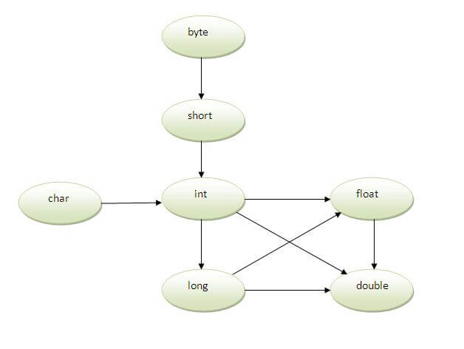
Method overloading in Java
Method Overloading and Type Promotion :
One type is promoted to another implicitly if no matching datatype is found. Let's understand the concept by the figure given below:

Slide 22
Method overloading in Java
Example of Method Overloading with TypePromotion
class OverloadingCal{
void sum(int a,long b)
{System.out.println(a+b);}
void sum(int a,int b,int c)
{System.out.println(a+b+c);}
public static void main(String args[]){
OverloadingCal obj=new OverloadingCal();
obj.sum(20,20);//now second int literal will be promoted to long
obj.sum(20,20,20);
}
}

Slide 23
Method overloading in Java
Example of Method Overloading with Type Promotion in case of ambiguity
class OverloadingCal{
void sum(int a,long b)
{System.out.println("a method invoked");}
void sum(long a,int b)
{System.out.println("b method invoked");}
public static void main(String args[]){
OverloadingCal obj=new OverloadingCal();
obj.sum(20,20);//now ambiguity
}
}

Slide 24
Method overriding in Java
Method Overriding in Java
If subclass (child class) has the same method as declared in the parent class, it is known as method overriding in java.
In other words, If subclass provides the specific implementation of the method that has been provided by one of its parent class, it is known as method overriding.
Usage of Java Method Overriding :
Method overriding is used to provide specific implementation of a method that is already provided by its super class.
Method overriding is used for runtime polymorphism

Slide 25
Method overriding in Java
Understanding the problem without method overriding
class Vehicle
{
void run(){System.out.println("Vehicle is running");}
}
class Bike extends Vehicle
{
public static void main(String args[])
{
Bike obj = new Bike();
obj.run();
}
}

Slide 26
Method overriding in Java
Example of method overriding
class Vehicle
{
void run(){System.out.println("Vehicle is running");}
}
class Bike extends Vehicle
{
void run()
{System.out.println("Bike is running safely");}
public static void main(String args[])
{
Bike obj = new Bike();
obj.run();
}

Slide 27
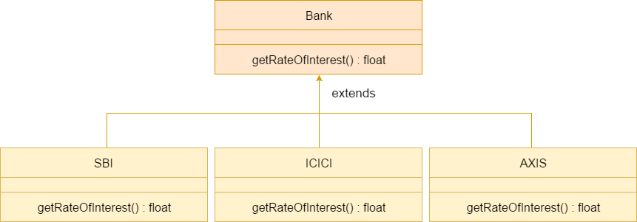
Method overriding in Java
Example of method overriding 1
Consider a scenario, Bank is a class that provides functionality to get rate of interest. But, rate of interest varies according to banks. For example, SBI, ICICI and AXIS banks could provide 8%, 7% and 9% rate of interest.

Slide 28
Method overriding in Java
Why we cannot override static method ?
Because static method is bound with class whereas instance method is bound with object. Static belongs to class area and instance belongs to heap area.
Can we override java main method ?
No, because main is a static method.

Slide 29
Method overriding in Java
Covariant Return Type
The covariant return type specifies that the return type may vary in the same direction as the subclass.
Before Java5, it was not possible to override any method by changing the return type. But now, since Java5, it is possible to override method by changing the return type if subclass overrides any method whose return type is Non-Primitive but it changes its return type to subclass type.

Slide 30
Method overriding in Java
Simple example of Covariant Return Type
class A{
A get(){return this;}
}
class B1 extends A{
B1 get(){return this;}
void message()
{System.out.println("welcome to covariant return type");}
public static void main(String args[]){
new B1().get().message();
}
}

Slide 31
Method overriding in Java
Simple example of Covariant Return Type
As you can see in the above example, the return type of the get() method of A class is A but the return type of the get() method of B1 class is B1. Both methods have different return type but it is method overriding. This is known as covariant return type.

Slide 32
Method overriding in Java
How is Covariant return types implemented ?
Java doesn't allow the return type based overloading but JVM always allows return type based overloading. JVM uses full signature of a method for lookup/resolution. Full signature means it includes return type in addition to argument types. i.e., a class can have two or more methods differing only by return type. javac uses this fact to implement covariant return types.

Slide 33
super keyword in java
super keyword in java :
The super keyword in java is a reference variable which is used to refer immediate parent class object.
Whenever you create the instance of subclass, an instance of parent class is created implicitly which is referred by super reference variable.

Slide 34
super keyword in java
Usage of java super Keyword :
super can be used to refer immediate parent class instance variable.
super can be used to invoke immediate parent class method.
super() can be used to invoke immediate parent class constructor.

Slide 35
super keyword in java
super is used to refer immediate parent class instance variable.
super can be used to refer immediate parent class instance variable.
super can be used to invoke immediate parent class method.
super() can be used to invoke immediate parent class constructor.

Slide 36
super keyword in java
super is used to refer immediate parent class instance variable
class Animal{
String color="white"; }
class Dog extends Animal{
String color="black";
void printColor(){
System.out.println(color);//prints color of Dog class
System.out.println(super.color);//prints color of Animal class
} }
class TestSuper{
public static void main(String args[]){
Dog d=new Dog();
d.printColor();
}}

Slide 37
super keyword in java
super can be used to invoke parent class method
class Animal{
void eat(){System.out.println("eating...");}
}
class Dog extends Animal{
void eat(){System.out.println("eating bread...");}
void bark(){System.out.println("barking...");}
void work(){
super.eat();
bark(); } }
class TestSuper{
public static void main(String args[]){
Dog d=new Dog();
d.work();
}}

Slide 38
super keyword in java
super is used to invoke parent class constructor
class Animal{
Animal(){System.out.println("animal is created");}
}
class Dog extends Animal{
Dog(){
super();
System.out.println("dog is created");
}
}
class TestSuper{
public static void main(String args[]){
Dog d=new Dog();
}}

Slide 39
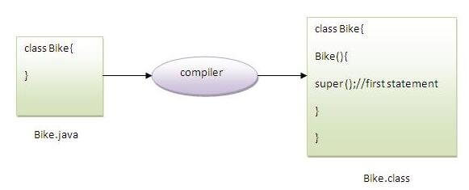
super keyword in java
Note: super() is added in each class constructor automatically by compiler if there is no super()
As we know well that default constructor is provided by compiler automatically if there is no constructor. But, it also adds super() as the first statement.

Slide 40
super keyword in java
Another example of super keyword where super() is provided by the compiler implicitly.
class Animal{
Animal(){System.out.println("animal is created");}
}
class Dog extends Animal{
Dog(){
System.out.println("dog is created");
}
}
class TestSuper{
public static void main(String args[]){
Dog d=new Dog();
}}

Slide 41
super keyword in java
Another example of super keyword
class Person{
int id;
String name;
Person(int id,String name){
this.id=id;
this.name=name;
} }
class Emp extends Person{
float salary;
Emp(int id,String name,float salary){
super(id,name);//reusing parent constructor
this.salary=salary;
}

Slide 42
super keyword in java
Another example of super keyword
void display(){System.out.println(id+" "+name+" "+salary);}
}
class TestSuper{
public static void main(String[] args){
Emp e1=new Emp(1,"ankit",45000f);
e1.display();
}}

Slide 43
Instance initializer block in java
Instance initializer block :
Instance Initializer block is used to initialize the instance data member. It run each time when object of the class is created.
The initialization of the instance variable can be done directly but there can be performed extra operations while initializing the instance variable in the instance initializer block.
Why use instance initializer block?
Suppose I have to perform some operations while assigning value to instance data member e.g. a for loop to fill a complex array or error handling etc.

Slide 44
super keyword in java
Example of instance initializer block :
class Bike{
int speed;
Bike(){System.out.println("speed is "+speed);}
{speed=100;}
public static void main(String args[]){
Bike b1=new Bike();
Bike b2=new Bike();
}
}
Output:speed is 100
speed is 100

Slide 45
super keyword in java
What is invoked first, instance initializer block or constructor ?
class Bike{
int speed;
Bike(){System.out.println("constructor is invoked");}
{System.out.println("instance initializer block invoked");}
public static void main(String args[]){
Bike b1=new Bike();
Bike b2=new Bike();
}
}

Slide 46
super keyword in java
What is invoked first, instance initializer block or constructor ?
class Bike{
int speed;
Bike(){System.out.println("constructor is invoked");}
{System.out.println("instance initializer block invoked");}
public static void main(String args[]){
Bike b1=new Bike();
Bike b2=new Bike();
}
}

Slide 47
super keyword in java
What is invoked first, instance initializer block or constructor ?
Output:
instance initializer block invoked
constructor is invoked
instance initializer block invoked
constructor is invoked
In the above example, it seems that instance initializer block is firstly invoked but NO. Instance intializer block is invoked at the time of object creation. The java compiler copies the instance initializer block in the constructor after the first statement super(). So firstly, constructor is invoked.

Slide 48
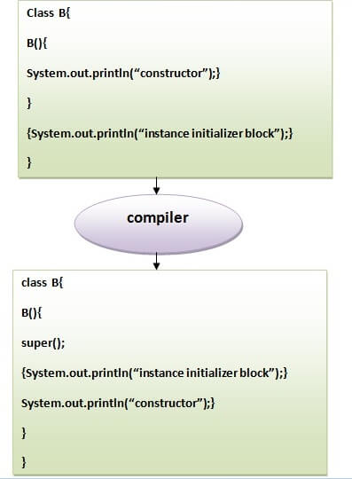
super keyword in java
Note: The java compiler copies the code of instance initializer block in every constructor.

Slide 49
super keyword in java
Rules for instance initializer block :
There are mainly three rules for the instance initializer block. They are as follows:
The instance initializer block is created when instance of the class is created.
The instance initializer block is invoked after the parent class constructor is invoked (i.e. after super() constructor call).
The instance initializer block comes in the order in which they appear.

Slide 50
super keyword in java
Program of instance initializer block that is invoked after super()
class A{
A()
{System.out.println("parent class constructor invoked");}
}
class B2 extends A{
B2(){
super();
System.out.println("child class constructor invoked"); }
{System.out.println("instance initializer block is invoked");}
public static void main(String args[]){
B2 b=new B2(); } }

Slide 51
super keyword in java
Another example of instance block
class A{
A(){
System.out.println("parent class constructor invoked");
}
}
class B3 extends A{
B3(){
super();
System.out.println("child class constructor invoked");
}

Slide 52
super keyword in java
Another example of instance block
B3(int a){
super();
System.out.println("child class constructor invoked "+a);
}
{System.out.println("instance initializer block is invoked");}
public static void main(String args[]){
B3 b1=new B3();
B3 b2=new B3(10);
}
}

Slide 53
Final Keyword In Java
Final :
The final keyword in java is used to restrict the user. The java final keyword can be used in many context. Final can be:
variable
method
class
The final keyword can be applied with the variables, a final variable that have no value it is called blank final variable or uninitialized final variable. It can be initialized in the constructor only. The blank final variable can be static also which will be initialized in the static block only.

Slide 54
Final Keyword In Java
Java final variable :
If you make any variable as final, you cannot change the value of final variable(It will be constant).
class Bike{
final int speedlimit=90;//final variable
void run(){
speedlimit=400;
}
public static void main(String args[]){
Bike obj=new Bike();
obj.run();
} }
Output:Compile Time Error

Slide 55
Final Keyword In Java
Java final method :
If you make any method as final, you cannot override it.
class Bike{
final void run(){System.out.println("running");}
}
class Honda extends Bike{
void run()
{System.out.println("running safely with 100kmph");}
public static void main(String args[]){
Honda honda= new Honda();
honda.run();
} }
Output:Compile Time Error

Slide 56
Final Keyword In Java
Java final class :
If you make any class as final, you cannot extend it.
final class Bike{}
class Honda1 extends Bike{
void run()
{System.out.println("running safely with 100kmph");}
public static void main(String args[]){
Honda1 honda= new Honda1();
honda.run();
}
}
Output:Compile Time Error

Slide 57
Final Keyword In Java
Is final method inherited ?
Yes, final method is inherited but you cannot override it.
class Bike{
final void run()
{System.out.println("running...");}
}
class Honda extends Bike{
public static void main(String args[]){
new Honda().run();
}
}
Output: running...

Slide 58
Final Keyword In Java
What is blank or uninitialized final variable ?
A final variable that is not initialized at the time of declaration is known as blank final variable.
If you want to create a variable that is initialized at the time of creating object and once initialized may not be changed, it is useful. For example PAN CARD number of an employee.
It can be initialized only in constructor.
class Student{
int id;
String name;
final String PAN_CARD_NUMBER;
... }

Slide 59
Final Keyword In Java
Can we initialize blank final variable ?
class Bike{
final int speedlimit;//blank final variable
Bike(){
speedlimit=70;
System.out.println(speedlimit);
}
public static void main(String args[]){
new Bike();
}
}

Slide 60
Final Keyword In Java
static blank final variable :
A static final variable that is not initialized at the time of declaration is known as static blank final variable. It can be initialized only in static block.
class A{
static final int data;//static blank final variable
static{ data=50;}
public static void main(String args[]){
System.out.println(A.data);
}
}

Slide 61
Final Keyword In Java
What is final parameter ?
If you declare any parameter as final, you cannot change the value of it.
class Bike{
int cube(final int n){
n=n+2;//can't be changed as n is final
n*n*n;
}
public static void main(String args[]){
Bike b=new Bike();
b.cube(5);
} }
Output: Compile Time Error

Slide 62
Final Keyword In Java
Can we declare a constructor final ?
No, because constructor is never inherited.

