Slide 1
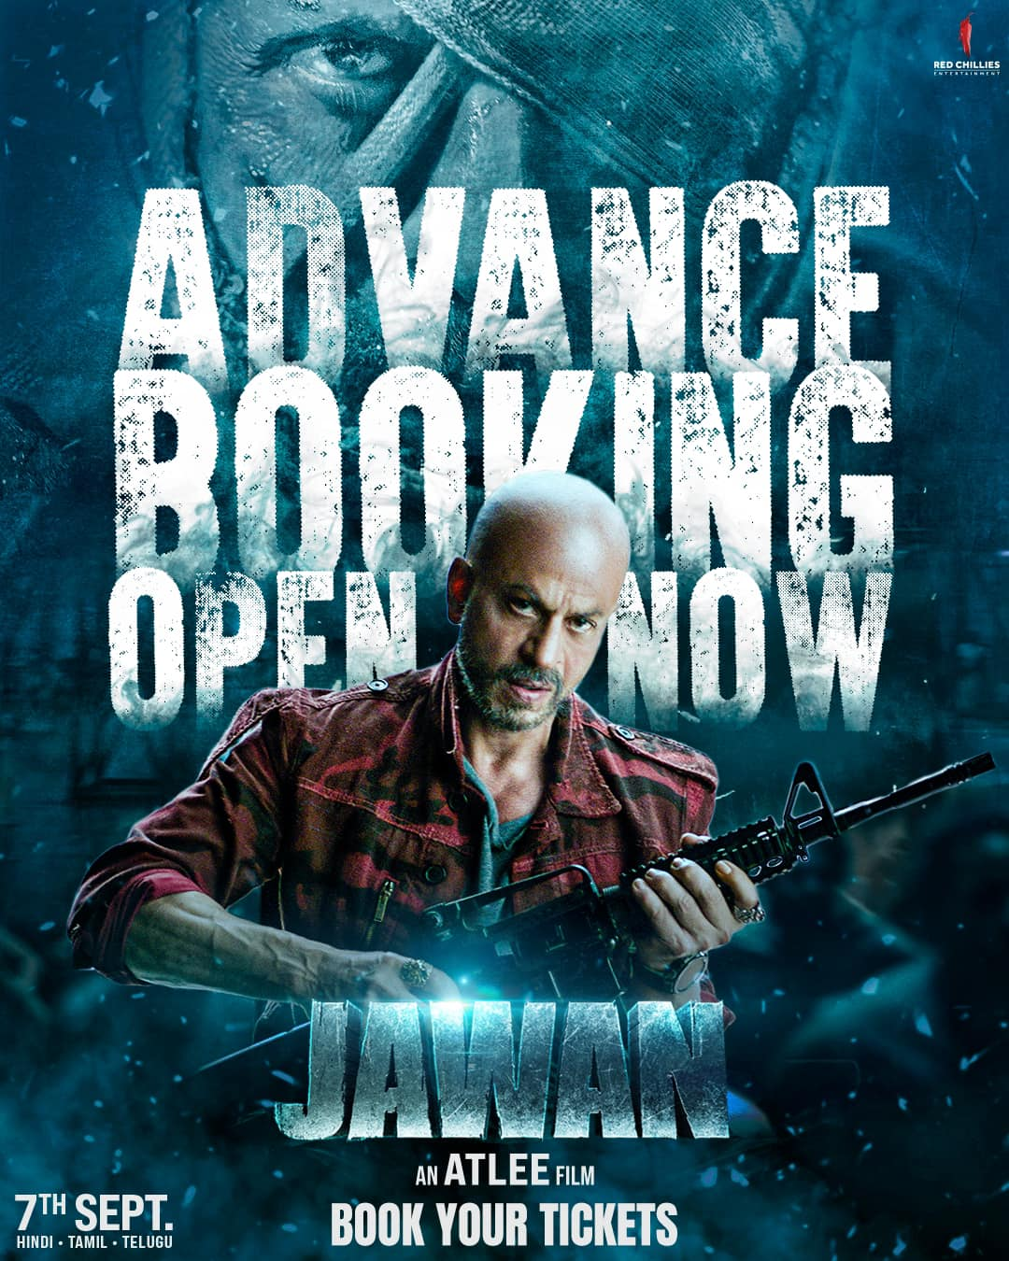

Slide 2

Introduction
Project Name: Popcorn
Tag line: “Don’t miss a single frame”

Slide 3
Project Summary
The "Movie Ticket Booking Website" project aims to create an online platform for users to conveniently browse, select, and purchase movie tickets and order food in theaters.
This website will feature a user-friendly interface, real-time movie listings, showtimes, seat selection, and secure payment options. It will provide a seamless movie booking experience, enhancing accessibility to cinema entertainment for users.

Slide 4
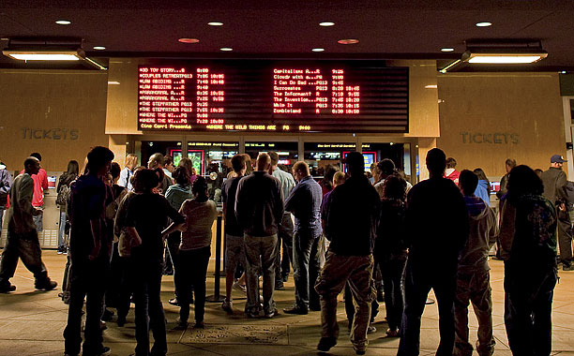
Problem Statement
There is Many problem we face when we book our movie ticket by going to hall…
Travel and Commute
Queue and Wait Times
Payment Methods
Limited Availability
More and More….

Slide 5
Solution Statement
If we have “Popcorn” we can solve all of this problem very easily…
Online Booking
Reservation System
Real-Time Availability
Flexible Timing
Digital Payment Options
Loyalty Programs

Slide 6
Market Size
Describe: In Bangladesh, Movies are really popular from past time. People went to Cinema hall and book their ticket by hand.
In todays time, we still book our ticket by going to cinema hall. But but but…
There is “NO” single screen “Online Movie Ticket Booking” website in Bangladesh. This is our opportunity to gain the market in hole Bangladesh.

Slide 7
Competitor
Direct competitor:
Star Cineplex,
blockbusterbd.com
Indirect Competitor:
Sohoz.com

Slide 8
Competitive Advantage
Our competitive platform star-Cineplex and blockbusterbd.com help us getting idea of implementation of online movie ticket system and gaining people in our platform.
By using Bangladesh Railway website for online train seat booking system people can easily use and trust this online based movie ticket booking system.

Slide 9
Technology Strategy Product architecture
Platform Selection
Scalability
Database Architecture
Mobile Responsiveness
User Authentication and Authorization
Payment Gateway Integration
Real-time Features
Search and Recommendation Engine
Content Management
Security and Privacy
Performance Optimization
Analytics and Monitoring
Continuous Integration and Deployment (CI/CD)
Feedback and Customer Support
Compliance and Regulations
Innovation and Future-proofing
User Experience (UX) Testing
Marketing and Promotion

Slide 10
Technology Strategy
Key technologies & platforms:
Front-End Technologies:
HTML, CSS, JavaScript
Tailwind or Material-UI
Back-End Technologies:
Laravel
Database Management:
Relational Database (MySQL)
Payment Gateway Integration:
Bkash, Rocket, or Nagad

Slide 11
Scalability:
Load Balancing
Auto-Scaling
Database Scaling
Database Caching
Monitoring and Alerting
Security:
Data Encryption
Authentication and Authorization
Regular Security Audits
Regular Updates and Patching
User Input Validation
Deployment plan:
Continuous Integration and Continuous Deployment (CI/CD)
Rollback Plan
Health Checks and Monitoring
Backup and Disaster Recovery
Documentation

Slide 12
Business Strategy
Product Plan:
Movie Listings and Details:
Theater Information
Booking and Seat Selection:
User Reviews and Ratings
Responsive Website and Mobile App
Partnerships:
Md Shojib Hossain
Rukhsana Khatun and
Sheikh Hasina Software Technology Park
Marketing plan:
Online Advertising
Social Media Marketing
Partnerships and Collaborations
Content Marketing
Sales plan:
Sales Team and Training
Pricing and Revenue Models
Discount and Food Combo
Notes:
Dubai Futures Foundation:
http://gulfnews.com/news/uae/government/huge-global-response-for-dubai-future-accelerators-programme-1.1880339

Slide 13
Financial Strategy
Describe:
Budget:
Cash flow projection:
Notes:
Dubai Futures Foundation:
http://gulfnews.com/news/uae/government/huge-global-response-for-dubai-future-accelerators-programme-1.1880339

Slide 14
Implementation Plan Business plan quarterly
Phase-1: Planning, Analysis
Phase-2:Design, Implementation (Coding)
Phase-3: Testing, Deployment
Phase-4: Maintenance
Notes:
Dubai Futures Foundation:
http://gulfnews.com/news/uae/government/huge-global-response-for-dubai-future-accelerators-programme-1.1880339

Slide 15
Implementation Plan Technical Plan quarterly
1st quarter:
Project Kickoff
Market Research and Analysis
Documentation
2nd quarter:
Front-End Development
Back-End Development
Database Development
3rd quarter:
Security Implementation
Deployment
Testing
4th quarter:
User Support
Marketing
Performance Evaluation
Notes:
Dubai Futures Foundation:
http://gulfnews.com/news/uae/government/huge-global-response-for-dubai-future-accelerators-programme-1.1880339

Slide 16
Strength
Booking Ticket Anytime and Anywhere
Security
Promotions and Discounts
Payment Gateway
Movie Listings
Showtime Information
Seat Selection
Mobile App
Customer Support
Feedback and Reviews
Food Combo Pack

Slide 17
Weakness
Dependency on Cinemas
Technical Issues
Dependence on Internet Connectivity
Marketing Costs

Slide 18
Conclusion:
As there is no single screen “Online Movie Ticket Booking” website in Bangladesh, so creating an online movie ticket booking website is an exciting venture with immense potential.
By embarking on this project, we're not just offering a convenient platform for movie enthusiasts; we're crafting an immersive cinematic experience. With the right technology stack, a user-centric design, and robust security measures, we're poised to make the lives of moviegoers easier and more enjoyable. Moreover, this project presents opportunities for partnerships, innovation, and growth.
As we move forward, let's keep the user experience at the forefront, continuously adapt to industry trends, and stay committed to delivering a seamless and secure platform. In doing so, we can build a thriving community of movie lovers and usher in a new era of entertainment convenience.

Slide 19
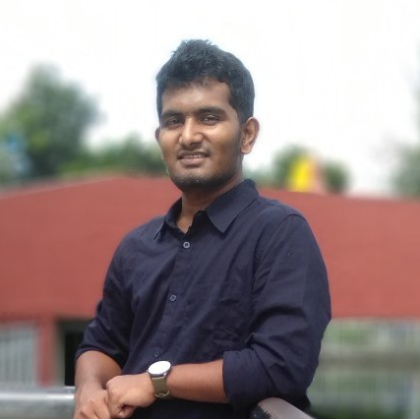
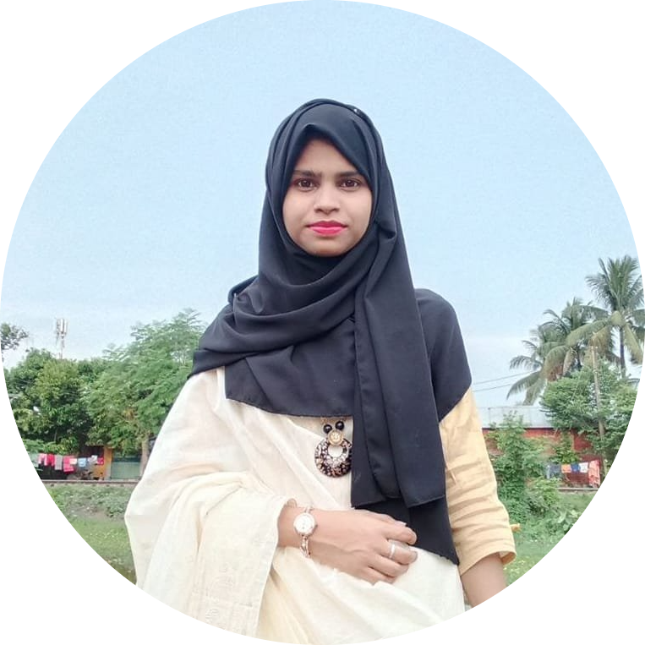
Team
Md Shojib Hossain
ID: 190103
Rukhsana Khatun
ID: 190148

