Slide 1


Green Pace
Security Policy Presentation
Developer: Coden Polk
Project Two: Security Policy Presentation

Slide 2

OVERVIEW: DEFENSE IN DEPTH
One policy baseline for a growing team
Reduce attack surface • assume any single control can fail • protect critical assets in layers
DEFENSE IN DEPTH

Slide 3
THREATS MATRIX
Risk is prioritized by severity + likelihood.
Level 5 items are release blockers; Level 4 items require rapid remediation.
LIKELY STD-007 Exceptions STD-010 Concurrency | PRIORITY STD-004 SQL Injection STD-005 Memory Protection STD-008 Initialization
LOW PRIORITY STD-001 Data Type STD-002 Data Value STD-006 Assertions STD-009 File I/O | UNLIKELY STD-003 String Correctness

Slide 4
10 PRINCIPLES
Principles 1–5
Principles 6–10
1. Validate Input Data — 001, 002, 003, 004
2. Heed Compiler Warnings — 001, 002, 005, 006, 008
3. Design for Security Policies — 007, 009, 010
4. Keep It Simple — 003, 005, 006, 007, 008, 009, 010
5. Default Deny — 004
6. Least Privilege — 004, 009
7. Sanitize Data Sent to Other Systems — 004
8. Defense in Depth — 003, 004, 005, 007, 008, 009, 010
9. Effective QA — 001–010
10. Secure Coding Standard — 001–010

Slide 5
CODING STANDARDS
LEVEL 5 — CRITICAL
LEVEL 4 — HIGH
LEVEL 2 — PLANNED
STD-004 SQL Injection
STD-005 Memory Protection
STD-008 Initialization
High impact + likely exploitation or failure.
STD-003 String Correctness
STD-007 Exceptions
STD-010 Concurrency
Serious impact, but lower likelihood or scope.
STD-001 Data Type
STD-002 Data Value
STD-006 Assertions
STD-009 File I/O
Lower immediate threat, still enforced.
Ranking uses severity, likelihood, exploitability, availability/data impact, and remediation cost.

Slide 6
ENCRYPTION POLICIES
AT REST
IN FLIGHT
IN USE
Encrypt stored databases, backups, disks, and sensitive files.
Use approved strong encryption and managed keys; never hard-code keys.
Protect data crossing processes, hosts, APIs, and networks.
Require authenticated TLS; certificate validation stays enabled.
Minimize plaintext lifetime in memory.
Restrict process access, avoid needless copies, and use protected-memory options for highly sensitive workloads.

Slide 7
TRIPLE-A POLICIES
AUTHENTICATION
AUTHORIZATION
ACCOUNTING
Verify identity before access.
Unique accounts, MFA for privileged/remote access, secure credential storage, and login monitoring.
Control what an authenticated identity may do.
Default deny, role/attribute-based controls, and least privilege for users and services.
Create traceable evidence.
Log logins, user creation, privilege changes, database changes, and sensitive file access.

Slide 8
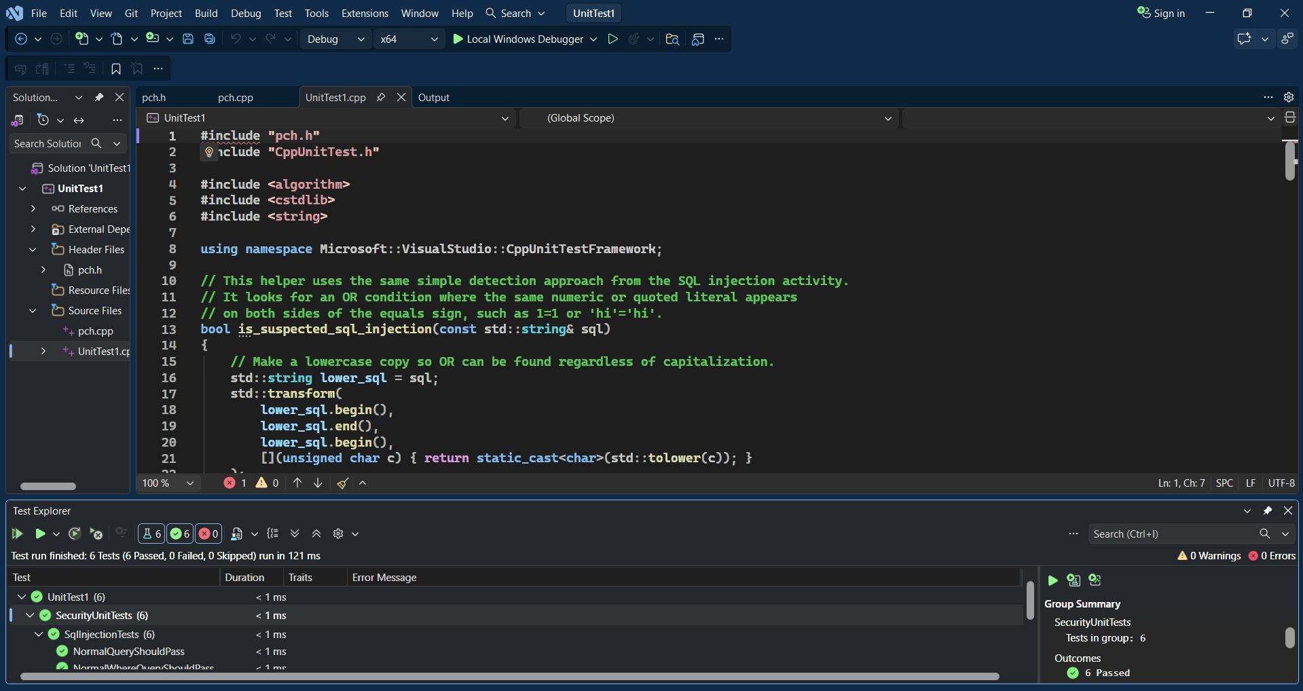
UNIT TESTING: SQL INJECTION
Framework: Microsoft Native Unit Test Framework for C++
Coverage: 2 valid queries + 4 malicious-input tests
Outcome: 6 passed, 0 failed
6 / 6 PASSED

Slide 9
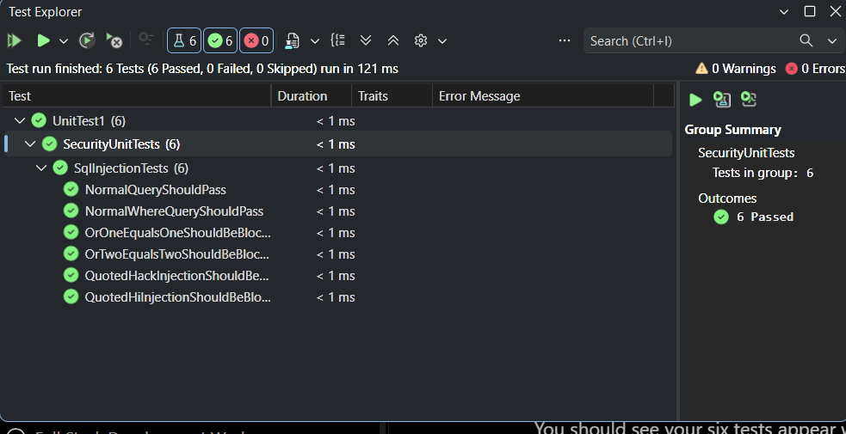
TEST 1 — NORMAL QUERY
Does a normal SELECT query pass?
PASS
Test input
SELECT * FROM USERS;
Expected: Not flagged as SQL injection.
Result: Passed — valid query allowed.
Take it further: Add more valid SELECT patterns so security checks do not create false positives.

Slide 10
TEST 2 — VALID WHERE QUERY
Does a normal WHERE query pass?
PASS
Test input
SELECT ID, NAME, PASSWORD FROM USERS WHERE NAME='Fred';
Expected: Not flagged as SQL injection.
Result: Passed — valid WHERE query allowed.
Take it further: Add parameterized-query tests using names with spaces, punctuation, and apostrophes.

Slide 11
TEST 3 — OR 1=1
Does OR 1=1 get blocked?
PASS
Test input
SELECT * FROM USERS WHERE NAME='Fred' OR 1=1;
Expected: Flagged as suspicious input.
Result: Passed — attack pattern detected.
Take it further: Test case changes, extra whitespace, comments, and encoded forms; parameterized SQL remains the primary defense.

Slide 12
TEST 4 — OR 2=2
Does OR 2=2 get blocked?
PASS
Test input
SELECT * FROM USERS WHERE NAME='Fred' OR 2=2;
Expected: Flagged as suspicious input.
Result: Passed — detection is not hard-coded to 1=1.
Take it further: Use fuzzing/property-based tests to generate many equivalent tautologies automatically.

Slide 13
TEST 5 — QUOTED STRING
Does a quoted tautology get blocked?
PASS
Test input
SELECT * FROM USERS WHERE NAME='Fred' OR 'hi'='hi';
Expected: Flagged as suspicious input.
Result: Passed — quoted-string pattern detected.
Take it further: Add tests for escaping, Unicode, and alternative encodings to reduce bypass opportunities.

Slide 14
TEST 6 — SECOND STRING CASE
Does another quoted tautology get blocked?
PASS
Test input
SELECT * FROM USERS WHERE NAME='Fred' OR 'hack'='hack';
Expected: Flagged as suspicious input.
Result: Passed — generic quoted match detected.
Take it further: Keep unit tests as a regression safety net, but prevent SQL injection at the database boundary with parameterized queries.

Slide 15

AUTOMATION SUMMARY
Create: compiler/IDE checks → Verify: unit tests + SAST/SCA → Pre-production: fuzz/DAST → Release: signing → Detect/Respond: logs + runtime controls → Adapt: feed findings back

Slide 16
TOOLS
CREATE / BUILD
VERIFY / TEST
PRE-PROD / RUN
Visual Studio compiler + code analysis
• Warnings treated as defects
• Secure coding rules in IDE
Fast feedback before commit.
Cppcheck 2.21.0
CodeQL / approved SAST
Native C++ unit tests
Dependency/SCA scanning
Automated in CI.
Fuzzing + DAST
Signed release artifacts
Centralized logs / SIEM
WAF/RASP where appropriate
Runtime feedback closes the loop.
No tool finds everything: combine automation, manual review, threat modeling, and security testing.

Slide 17
RISKS AND BENEFITS
ACT NOW — BENEFITS
WAIT — RISKS
• Fix Level 5 issues before release
• Reduce data loss, crashes, and exploit paths
• Lower remediation cost while code is fresh
• Produce audit evidence automatically
• Prevent security debt from compounding
• Larger incident impact and recovery cost
• More code depends on insecure behavior
• Emergency fixes can create new defects
• Technical debt grows
• Tool findings may become too noisy to triage
Tradeoff: automation costs time to tune, but release gates and risk-based prioritization keep it manageable.

Slide 18
RECOMMENDATIONS
CURRENT / FUTURE GAPS
GET IN FRONT OF THREATS
• Formal third-party dependency and SBOM policy
• Measurable security-test coverage and release gates
• Scheduled threat-model and attack-surface reviews
• Stronger key/secret rotation metrics
• More runtime application/database telemetry
• Ask what an attacker wants: money, data, disruption
• Threat-model before coding
• Fuzz trust boundaries and high-risk parsers
• Continuously scan dependencies and code
• Feed incidents and test failures back into policy
Real-world lesson: CISA/FBI documented active exploitation of the 2023 MOVEit SQL injection flaw (CVE-2023-34362).

Slide 19
CONCLUSIONS
KEEP
ADOPT
MEASURE
SEI CERT C++ as the coding baseline
Defense in depth
Triple-A controls
Encryption across the data lifecycle
NIST SSDF for lifecycle governance
OWASP ASVS 5.0 for web-application verification requirements
Risk-based CI/CD release gates
Time to remediate high-risk findings
Security test coverage
Dependency age / known vulnerabilities
Policy exceptions and repeat defects
Goal: security becomes a normal engineering activity—not a final checkpoint after development is finished.

Slide 20
REFERENCES
Seacord, R. C. (2013). Secure Coding in C and C++ (2nd ed.). Addison-Wesley.
Software Engineering Institute. (n.d.). SEI CERT C++ Coding Standard. Carnegie Mellon University. https://wiki.sei.cmu.edu/
National Institute of Standards and Technology. (2022). Secure Software Development Framework (SSDF) Version 1.1 (SP 800-218). https://doi.org/10.6028/NIST.SP.800-218
Microsoft. (n.d.). Use the Microsoft Unit Testing Framework for C++ in Visual Studio. https://learn.microsoft.com/visualstudio/test/how-to-use-microsoft-test-framework-for-cpp
Cppcheck. (n.d.). Cppcheck manual. https://cppcheck.sourceforge.io/manual.html
CISA & FBI. (2023, June 7). #StopRansomware: CL0P ransomware gang exploits CVE-2023-34362 MOVEit vulnerability (AA23-158A). https://www.cisa.gov/
OWASP Foundation. (2026). Application Security Verification Standard (ASVS) 5.0.0. https://owasp.org/projects/asvs

