Slide 1
Legends of the Three Kingdoms – Chromecast concept
Kevin Vinh Nguyen
Andrew Truong

Slide 2
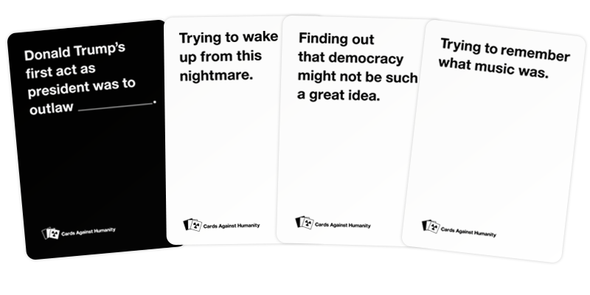
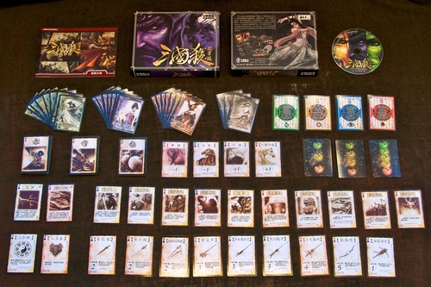
Inspiration
Legends of The Three Kingdoms – Chinese board game
Cards Against Humanity – online version
Pretend You’re Xyzzy

Slide 3
What is San Guo SHA?
BANG! Clone set in medieval china, specifically the “Romance of The Three Kingdoms” era
Popular board game that involves special characters, abilities, and weapons.
BANG! And Mafia combined and on steroids

Slide 4
USE-CASE OF THIS APPLICATION
Parties where having a full set is difficult
Remote Gaming
One-piece, self-contained service
Reducing gaming expenses

Slide 5
Demo TIme

Slide 6
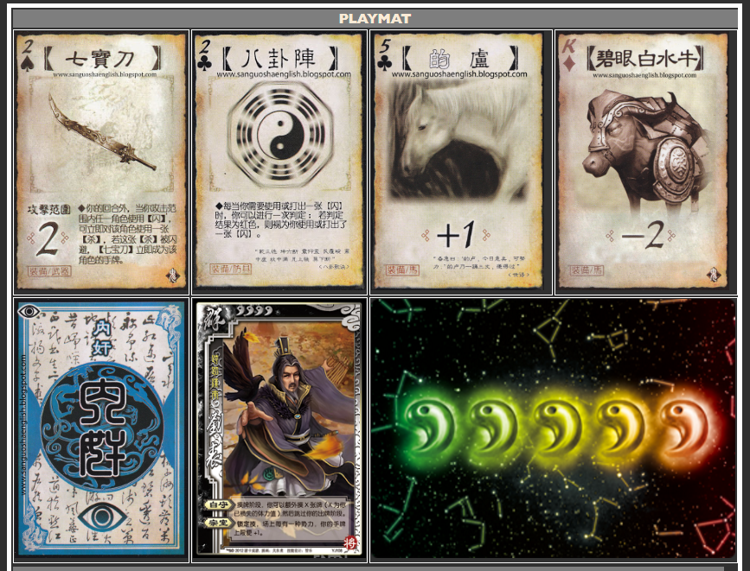
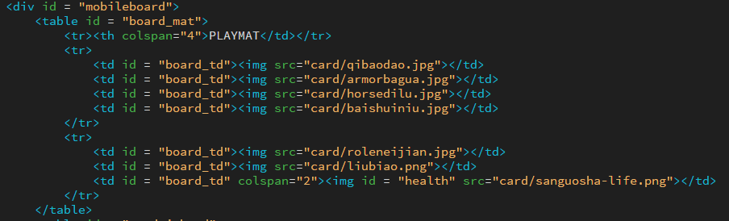
KISS IN Action
Playmat can be interpreted as a table- keeps manipulation and design simple.

Slide 7
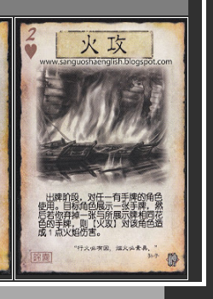
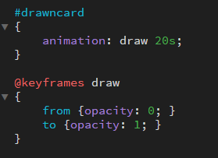
ANIMATIONS
Cards coming into view is unclear, so cards that are drawn in or consumed are faded in/out, respectively.

Slide 8
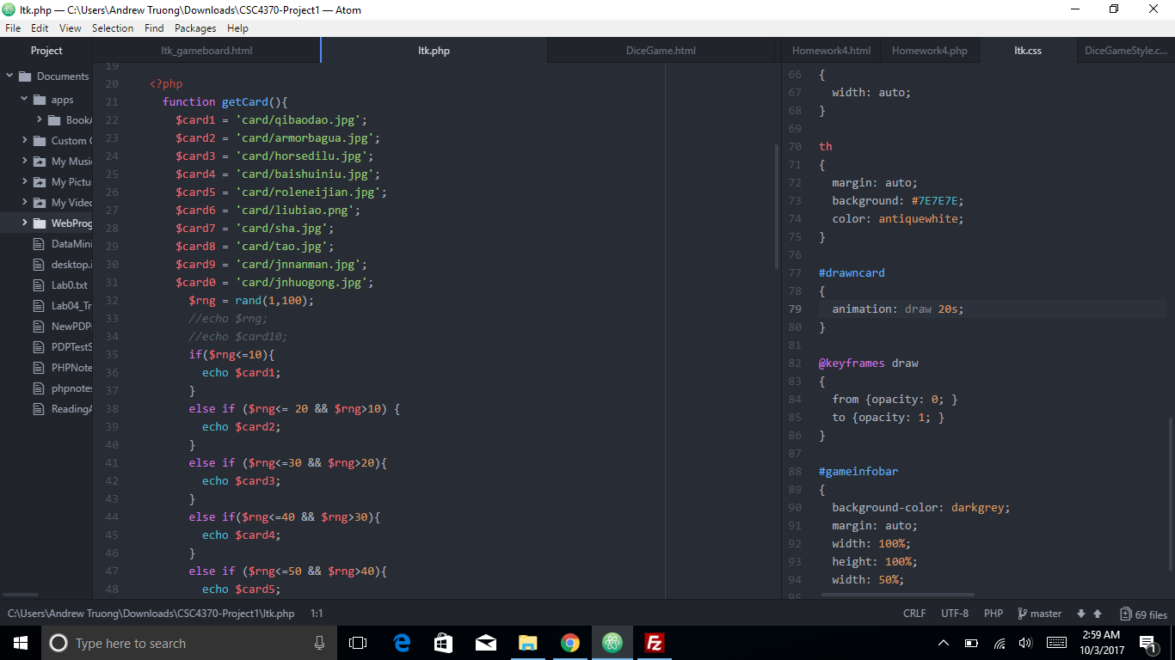
PHP example

Slide 9
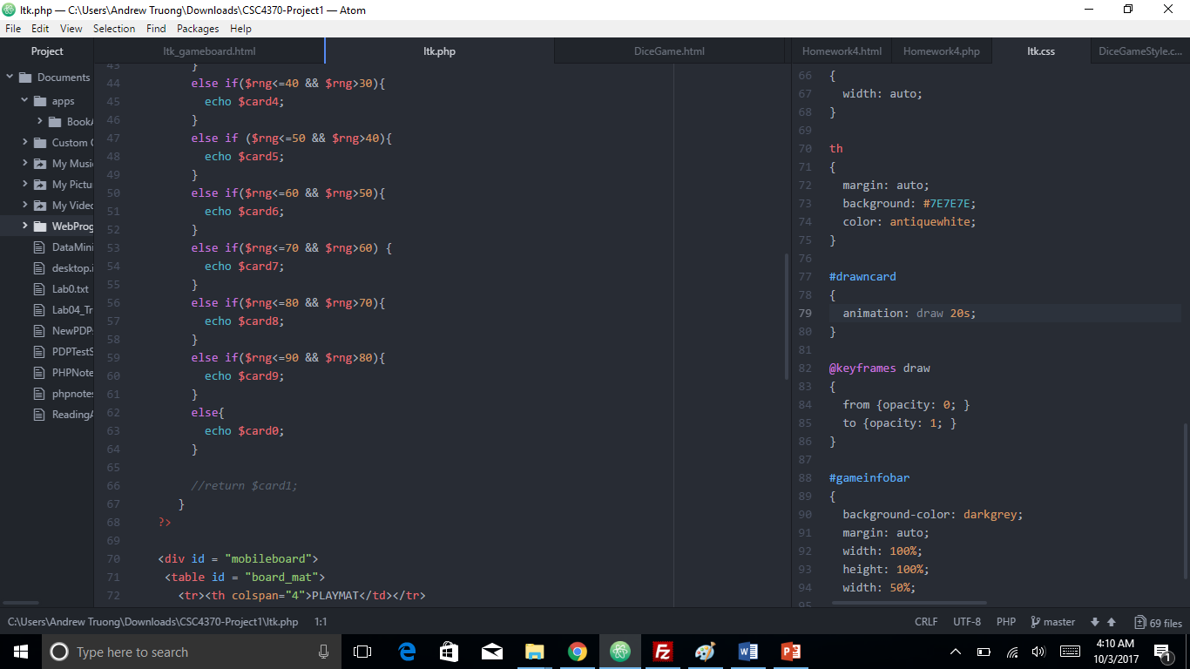
PHp example

Slide 10
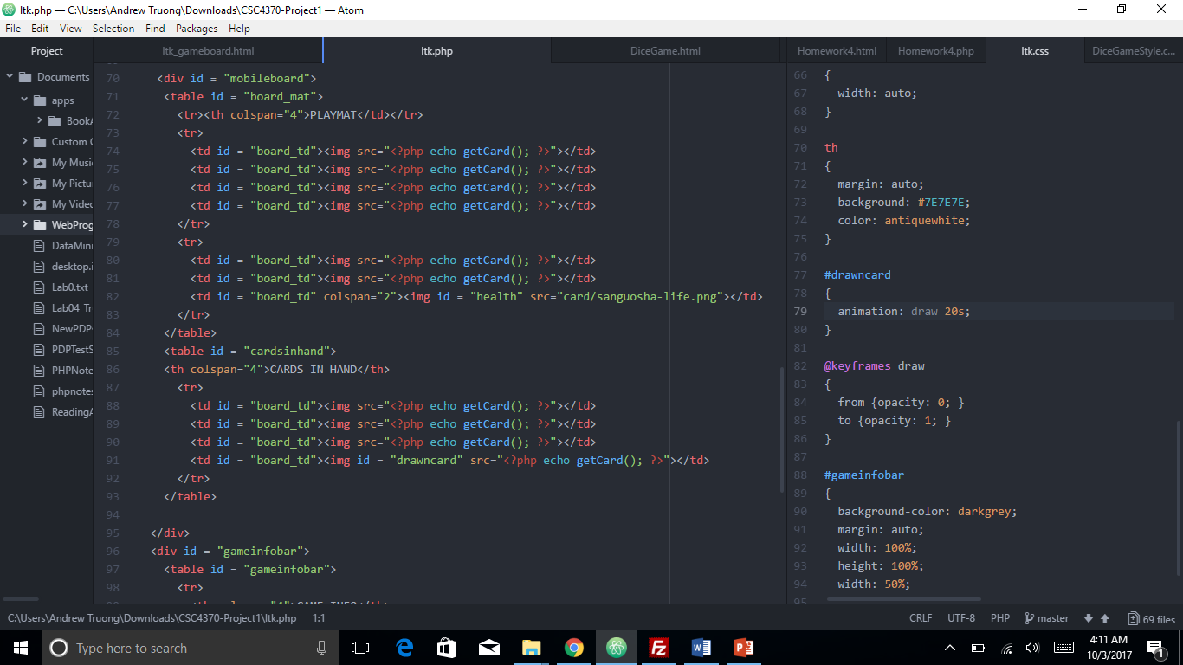
Php example

Slide 11
Q&A Session

