Slide 1
Online Cab Booking System
- A Spring Boot Application
Ankit Pandey
Java J2EE Batch-2

Slide 2
Technology Used:
Application will be developed in following
1. Spring Boot + Rest Controller + Spring Data JPA

Slide 3
PROBLEM STATEMENT
To Create an Application for Online Cab Booking
Customer should be able to view the list of available cabs.
Customer should be able to book cab for desired location from a certain location.
Admin should be able to perform below operations:
- admin can add/update/delete/view the cabs
- admin can add/update/delete/view the driver
– admin can view and cancel the bookings
- admin can delete/view the customer
Customer should be able to perform below operations:
- Customer can register
- Customer can update their profile
- Customer can view all the available cabs
- Customer can book and cancel the booking
- Customer can view the booking history.
Driver should be able to perform below operations:
- Driver can view the booking details
- Driver can view the booking history

Slide 4
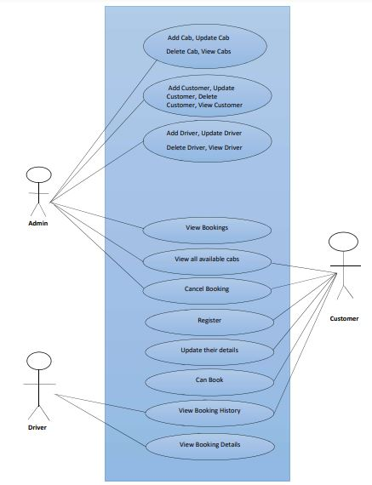
USE CASE DIAGRAM:

Slide 5
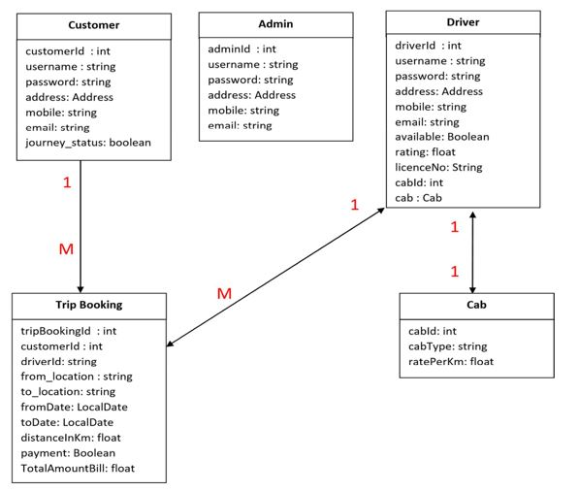
CLASS DESIGN:

Slide 6
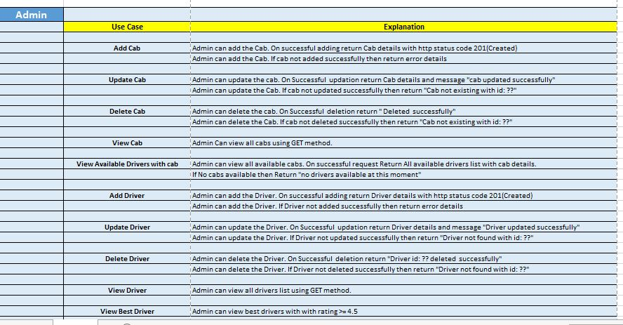
USER STORIES:

Slide 7
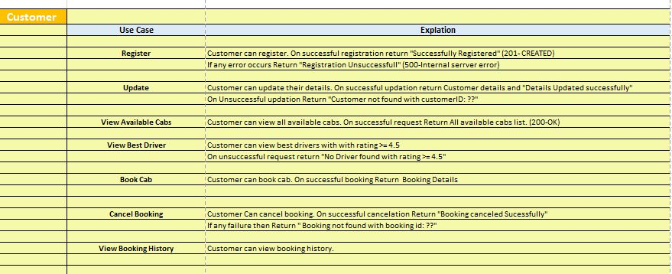
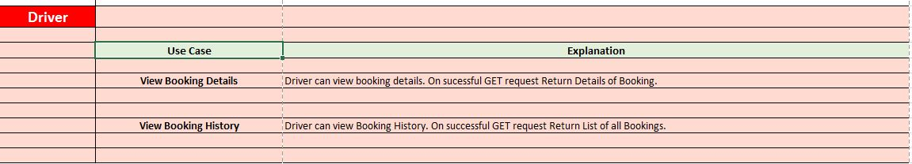

Slide 8
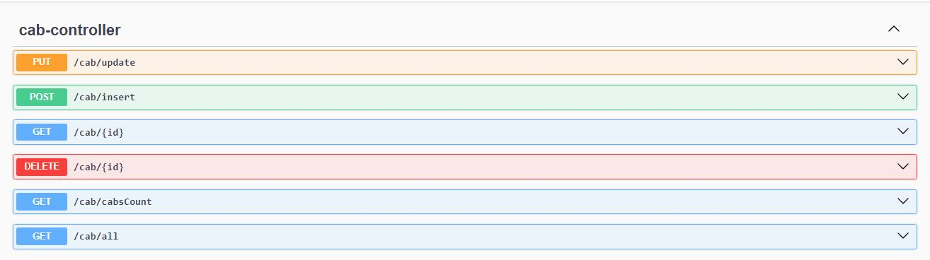
Cab Controller

Slide 9
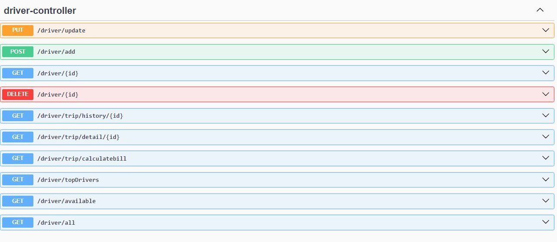
Driver Controller

Slide 10
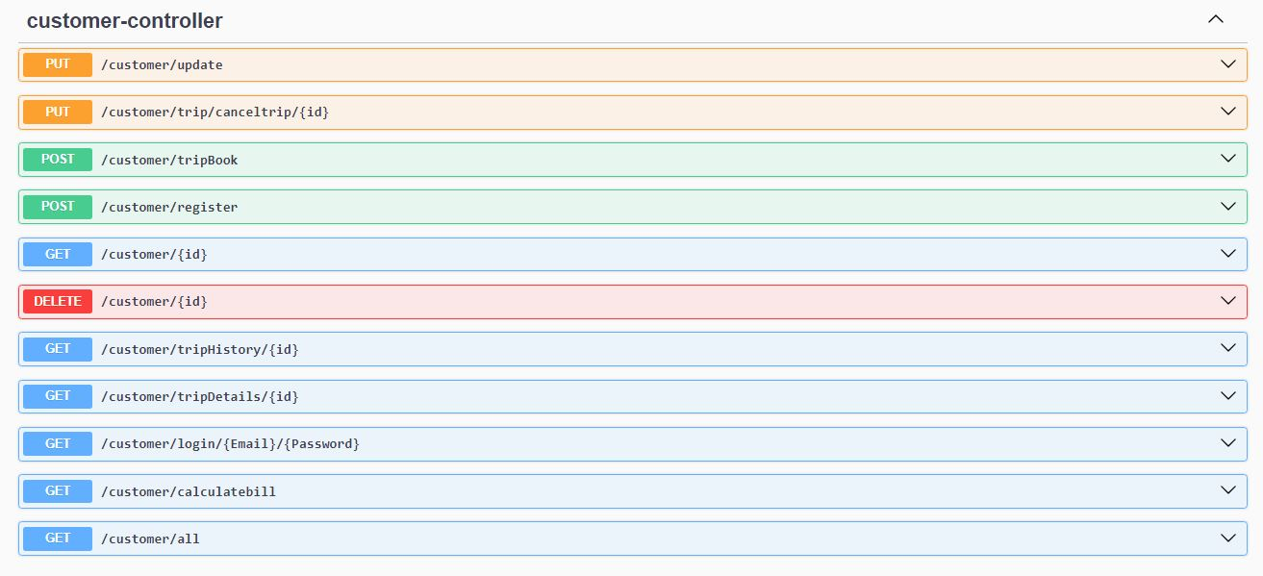
Customer Controller

Slide 11
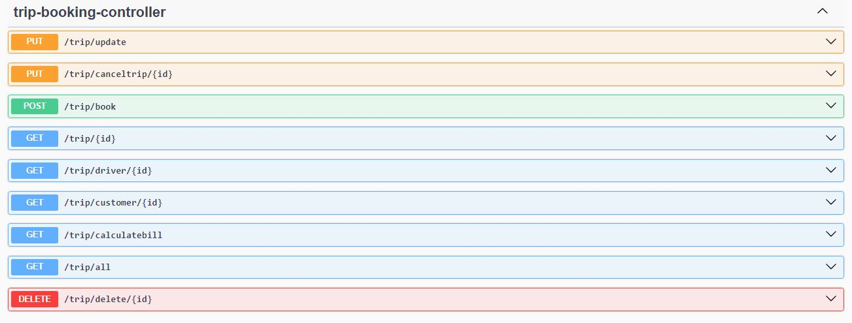
Trip Controller

Slide 12
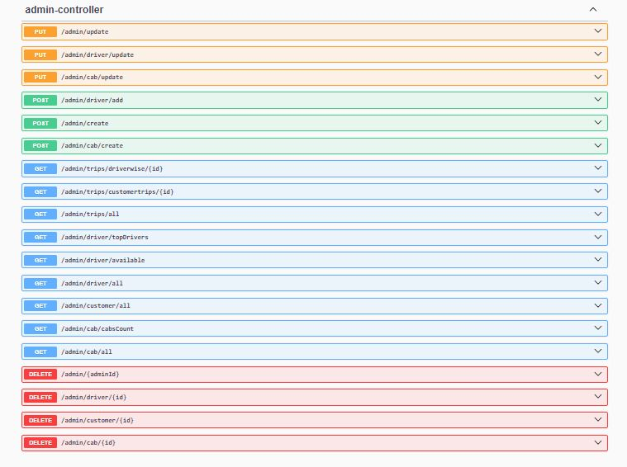

Slide 13
MICRO-SERVICES:
Cab Service
Driver Service
Customer Service
TripBooking Service
Admin Service
SERVER:
Eureka Server

Slide 14
REQUIREMENTS:
Dependency:
SpringBoot dev tools
Spring Data JPA
Spring Web
Eureka Server
Eureka Discovery Client
mYsql Driver
Lombok
Actuator
Swagger

Slide 15
THANK YOU

