Slide 1
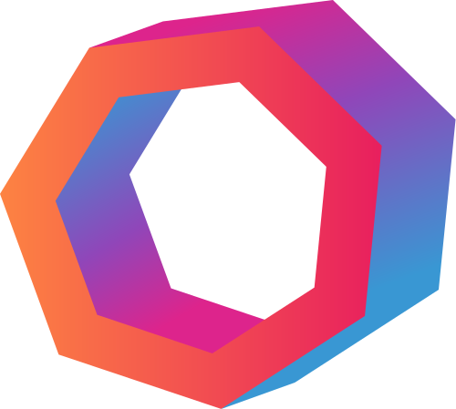

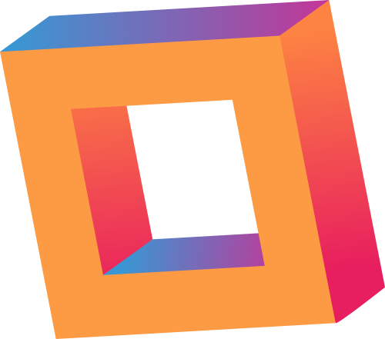
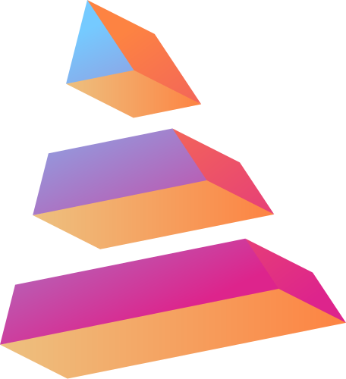

CARENEST
“SMART RECOVERY, POWERED BY CARE”

Slide 2

Problem
Statement
POST-SURGERY RECOVERY TRACKER
Post-surgery recovery requires close monitoring to ensure timely detection of complications, but many patients skip or delay follow-up visits due to travel constraints, busy schedules, or limited access to specialists. This often leads to preventable health complications and relapse.

Slide 3

Our Solution
CareNest
CareNest is a digital companion that lets patients log pain, medication, wound photos, and mobility. AI-powered analysis predicts complications, offers recovery insights, and enables in-app doctor communication, making post-surgery care proactive, continuous, and accessible anywhere at anytime.

Slide 4
Core
Features
Daily Logs
Patient Records
Mobility Progress
AI driven Wound-Healing analysis
Chat with medical experts
Predictive alerts for Potential complications

Slide 5
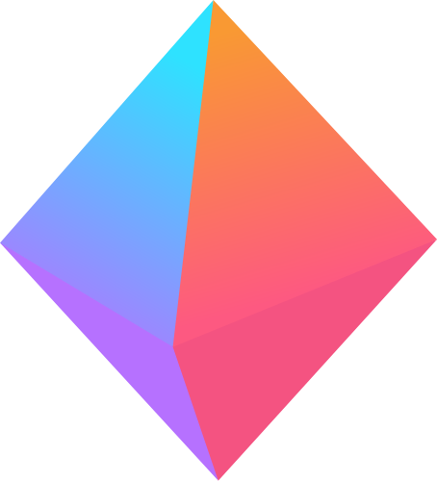
Unique Selling Point
AI POWERED CHATBOT
COMPUTER VISION BASED WOUND ANALYSIS
PERSONALIZED RECOVERY RECOMMENDATIONS
Provides instant guidance, answers recovery questions, and reminds patients about medications and exercises, acting as a 24/7 virtual assistant.
Analyzes wound photos to detect infection or slow healing and gives a healing progress score to alert doctors if needed.
Generates tailored advice on diet, exercises, and mobility based on patient data and recovery trends for a safer, faster recovery.

Slide 6

Business
Model
PREMIUM SUBSCRIPTION
Get prioritized consultations with a dedicated medical staff, customized nutrition/physio plans, and online video consultations with experts.
PARTNERSHIPS WITH HOSPITALS & CLINICS
Hospitals pay a subscription fee for using the platform for patient monitoring.
INSURANCE COLLABORATIONS
Partner with health insurance providers to offer the app as part of post-surgery recovery coverage.
ADVERTISEMENTS
In-App Ads: Health-related products, supplements, physiotherapy services, wearable devices.

Slide 7
Tech Stack
FRONTEND
BACKEND
DATA STORE
React, HTML, CSS, JavaScript, React.js
Python Flask, OpenCV + numpy (Python), Google Gemini API
MongoDB

Slide 8
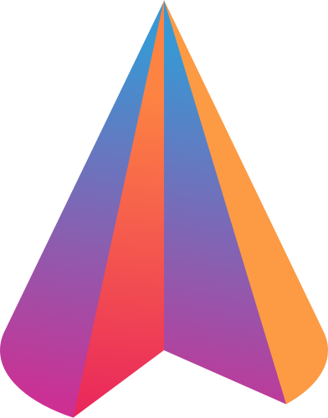


ANUSHKA JAIN (LEADER)
COGNITIVE
Agents
ANSHIKA LOHAN
ARJUN BHALLA
ARNAV RATHI
https://github.com/ItsArnavRathi/Post-Surgery-Recovery-Tracker
https://www.youtube.com/watch?v=9R5n0wW4PLs

