Slide 1
PROJECT NAME:
DESKTOP ASSISSTANT AI

Slide 2
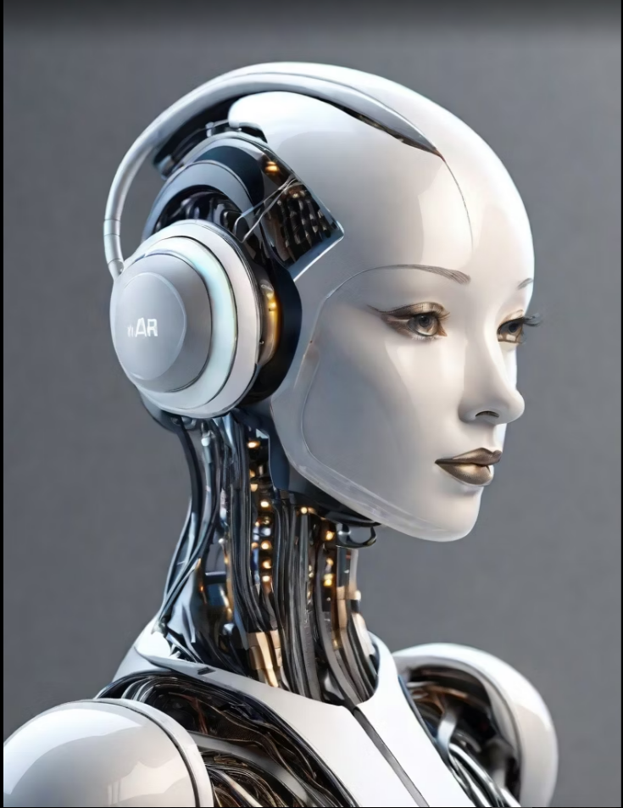
JARVIS
GROUP MEMBERS:
Hurmat - Team Leader
Responsible for coordinating the group's efforts and ensuring the smooth execution of the presentation.
Mahnoor Iqbal - Researcher
Conducted in-depth research on making Jarvis to gather relevant coding and information for the presentation.
Syeda Ayesha Hussain- Designer
Created visually appealing slides and graphics to enhance the overall presentation.

Slide 3


Introduction:
Jarvis is an AI-powered virtual assistant designed to assist users in various tasks and provide personalized recommendations. Its purpose is to streamline daily activities, enhance productivity, and simplify decision-making processes. Jarvis leverages advanced natural language processing and machine learning algorithms to understand user inputs and deliver relevant information and solutions. With a user-friendly interface and intuitive features, Jarvis is a versatile tool that can be used in both personal and professional settings.

Slide 4
Main Points:
Why Jarvis?
Jarvis is a powerful AI assistant that can automate tasks, provide valuable insights, and enhance productivity.
It streamlines workflows and frees up time for more strategic and creative work.
Real-Life Applications
Jarvis can be used in various industries, such as finance, healthcare, and customer service.
It can assist with data analysis, customer support, and decision-making processes.

Slide 5
JARVIS - CODE:
import speech_recognition as sr #To convert speech into textimport pyttsx3 #To convert text into speechimport datetime #To get the date and timeimport wikipedia #To get information from wikipediaimport webbrowser #To open websitesimport os #To open filesimport time #To calculate timeimport subprocess #To open filesfrom tkinter import * #For the graphicsimport pyjokes #For some really bad jokesfrom playsound import playsound #To playsoundimport keyboard #To get keyboardname_file = open("Assistant_name", "r")name_assistant = name_file.read()engine = pyttsx3.init('sapi5') voices = engine.getProperty('voices')
engine.setProperty('voice', voices[1].id)
def speak(text): engine.say(text) print(name_assistant + " : " + text)
…
microphone_photo = PhotoImage(file = "assistant_logo.png")
microphone_button = Button(image=microphone_photo, command = Process_audio) microphone_button.pack(pady=10)
settings_photo = PhotoImage(file = "settings.png")
settings_button = Button(image=settings_photo, command = change_name_window)
settings_button.pack(pady=10)
info_button = Button(text ="Info", command = info)
info_button.pack(pady=10)
screen.mainloop()main_screen()

Slide 7

Conclusion:
Jarvis is a powerful AI assistant that can revolutionize various industries.
It can automate repetitive tasks, provide valuable insights, and enhance decision-making.
Jarvis has real-life applications in fields such as healthcare, finance, and customer service.
By leveraging the capabilities of Jarvis, businesses can increase efficiency, productivity, and innovation.
Embracing Jarvis can lead to a competitive advantage and drive success in the digital age.

Slide 8

“OFFICE WIZARDS TO PYTHON PROGRAMMING”
CLASSES: Class is taken punctually. The teacher is well-experienced and explain each and every thing as well as she ensures that every student clear the concept, she gives. Everything is well-managed and well-organized by the system. I am really satisfied from “Banoqabil” which is providing such a meaningful platform to every student of the city.
COURSE: "Office Wizards to Python Programming" is a course that guide beginners from office tools to Python coding. It clarifies programming concepts, making it accessible to non-programmers and an ideal resource for those looking to enhance their skill set and embark on a journey into the world of Python programming. Whether you're a spreadsheet enthusiast or a data analyst, this course equips you with the tools to unlock the potential of programming in your professional toolkit.

