Slide 1
Oop Week 2

Slide 2
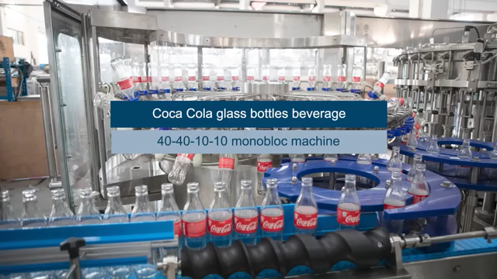

Slide 3
What is the price of the bottle?

Slide 4
Where is the bottle manufactured?

Slide 5
What is the total stock?

Slide 6
What is the expiry date?

Slide 7
Display the bottle details?

