Slide 1
VIRTUAL INTERNSHIP PROJECT · WEEK 4
Shield Insurance
Business Intelligence Dashboard
Presented by: Deepak Biswas
Data Analytics · Power BI · Business Intelligence
Powered by Codebasics Internship Program

Slide 2
Introduction
About Shield Insurance
About This Project
Customer-first insurance provider
Covers individuals across all age groups
Core values: Affordability, Flexibility & Simplicity
Reliable financial security for every life stage
Strong multi-city & multi-channel presence
Week 4 – Virtual Internship at Codebasics
Focused on business intelligence & dashboarding
Tool used: Microsoft Power BI
Covers: Overview, Sales Mode & Age Group analysis
Transforms raw data into actionable insights
Shield Insurance · BI Dashboard Project

Slide 3
Problem Statement
⚡ Scattered Data
⏱ No Real-Time Insights
Data spread across regions, channels & segments — no unified view
Lack of live data slows decision-making & responsiveness
🔍 Hidden Gaps & Trends
📊 Raw Data Problem
Difficult to identify performance gaps & growth opportunities
Unable to convert raw data into actionable business intelligence
Shield Insurance · BI Dashboard Project

Slide 4
Project Objective
Build a comprehensive, interactive Power BI dashboard that turns scattered data into clear business intelligence
01
Unified View — Single dashboard for all business performance metrics
02
Data-Driven Decisions — Empower stakeholders with real-time insights
03
Multi-Dimensional Analysis — Drill down by city, channel, age group & policy
04
Trend Identification — Surface key patterns and seasonal behaviors
05
Growth Opportunities — Highlight underperforming areas for strategic action
Shield Insurance · BI Dashboard Project

Slide 5
Approach & Methodology
1
2
3
4
Data Integration
Data Modeling
Dashboard Development
Analytics & KPIs
Merged offline, online, app & website data
Linked Customers, Policies, Transactions & Time
Built 4-page interactive Power BI dashboard
Revenue, Customer Count, DRG & DCG metrics
Created a single unified data source
Structured relational model for Power BI
Filters & slicers for easy navigation
Trend analysis & customer segmentation views
Shield Insurance · BI Dashboard Project

Slide 6

Dashboard · Home Page

Slide 7
Home Page — Analysis
Overview
Sales Mode
Displays key revenue, customer & growth metrics across cities and age groups
Analyzes revenue and customer distribution by offline vs. digital channels
Age Group
Resources
Examines age-group trends, policy preferences, settlement behavior & sales modes
Contains supporting notes, data sources, and contact information
Entry point of the dashboard · Clean navigation with 4 sections

Slide 8
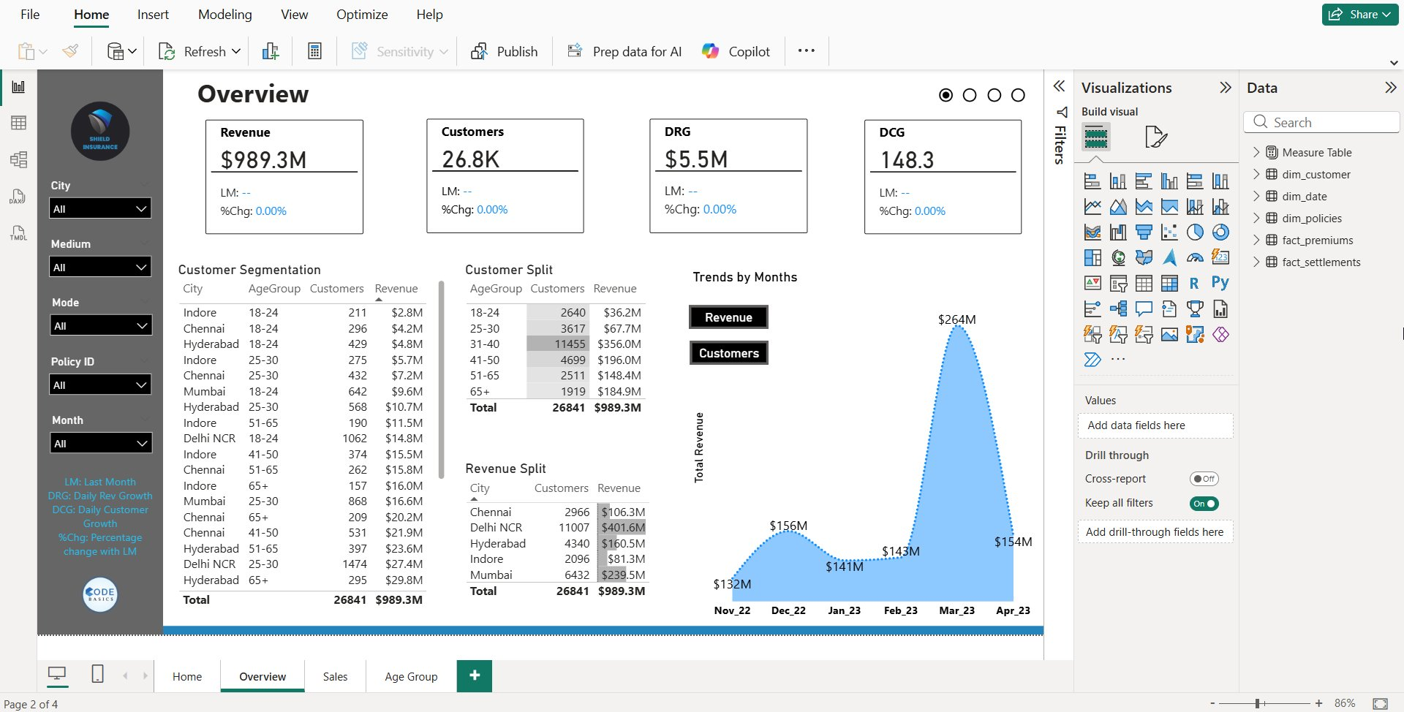
Dashboard · Overview (Business Summary)

Slide 9
Overview — Key Findings
$989.3M
26.8K
$5.5M
148.3
Total Revenue
Total Customers
Daily Rev Growth
Daily Cust Growth
Key Insights
Delhi NCR leads revenue at ~$401.6M (~40% share); Mumbai at $239.5M; Indore lowest at $81.3M
31–40 age group dominates with 11,455 customers and $356M revenue — core customer segment
March 2023 was peak month at $264M revenue; November 2022 was the lowest at $132M
Significant revenue concentration in top cities — growth opportunity in tier-2 markets
Revenue and customer trends move together — strong correlation between acquisition & revenue
Shield Insurance · BI Dashboard Project

Slide 10
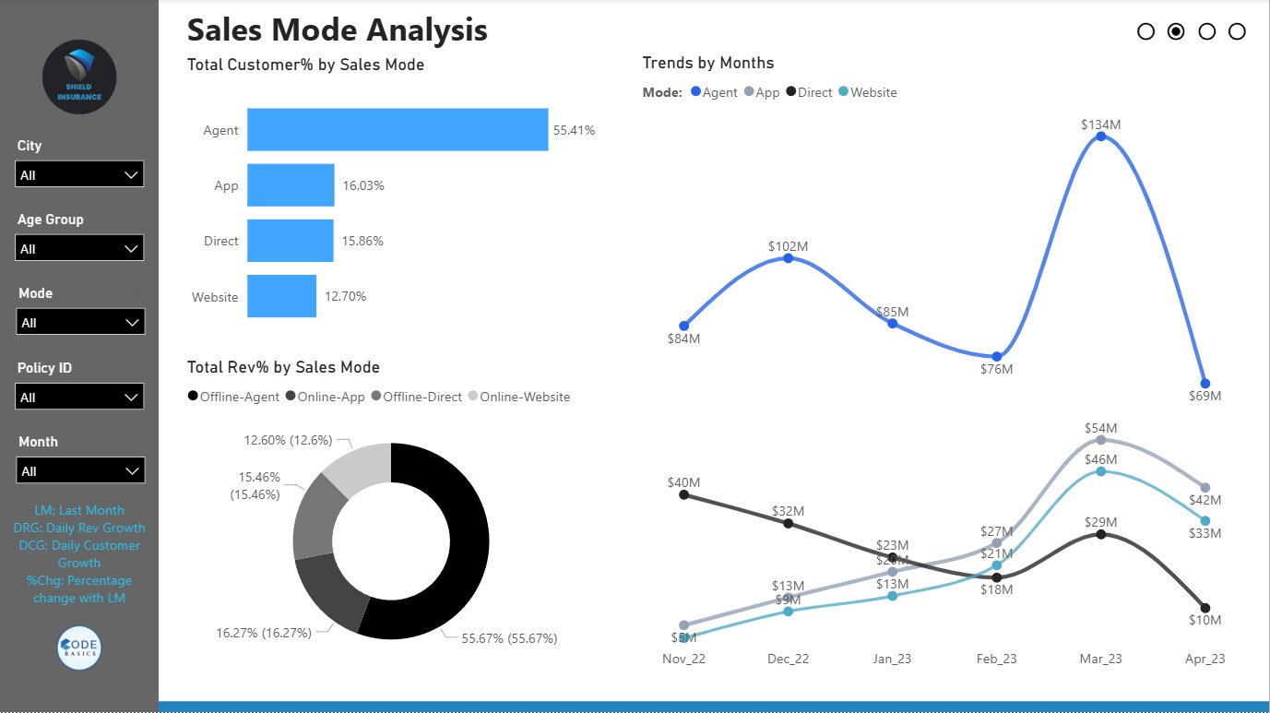
Dashboard · Sales Mode Analysis

Slide 11
Sales Mode Analysis — Key Findings
Customer Distribution by Channel
Key Findings & Trends
Agent (Offline)
Agents dominate with 55%+ customer share — business is still heavily offline-driven
Agent channel peaked at $134M revenue in March 2023 alone
App & Website channels are growing steadily — digital shift underway
Direct channel showing a declining trend — needs strategic review
Revenue distribution mirrors customer split: agents generate majority of income
Digital adoption is increasing but remains underdeveloped vs. overall potential
55.41%
55.67%
App (Online)
16.03%
Direct (Offline)
15.86%
Website (Online)
12.70%
Shield Insurance · BI Dashboard Project

Slide 12
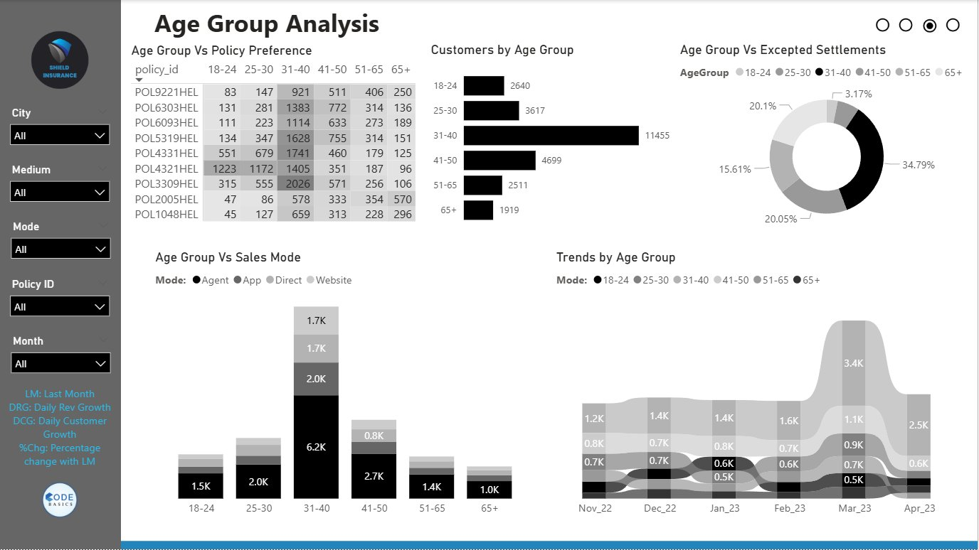
Dashboard · Age Group Analysis

Slide 13
Age Group Analysis — Key Findings
Customers by Age Group
Key Findings & Behavior
31–40
11,455
31–40 segment is most valuable: highest in customers, revenue & claims
31–40 age group accounts for 34.79% of all expected settlements
Older customers (65+) prefer agents; younger groups lean digital
Top policy POL2005HEL generates ~$324M — product concentration risk
March 2023 peak visible across all age groups — consistent seasonal pattern
65+ has lowest count (1,919) but shows strong policy diversity
41–50
4,699
25–30
3,617
18–24
2,640
51–65
2,511
65+
1,919
Shield Insurance · BI Dashboard Project

Slide 14
Key Insights
📅 Business Trends
🏙 Regional Insights
👥 Customer Insights
▸ March 2023 = peak month for revenue & customers
▸ November 2022 = lowest activity → clear seasonality
▸ Delhi NCR = ~40% revenue share
▸ Large gap between top & low-performing cities
▸ 31–40 is most valuable segment
▸ Drives highest customers, revenue & claims
📲 Channel Insights
📋 Product Insights
▸ 55%+ dependency on agents
▸ Digital growing — significant untapped potential
▸ Revenue concentrated in few policies
▸ Some products need repositioning
Shield Insurance · BI Dashboard Project

Slide 15
CONCLUSION
This project transforms scattered raw data into a structured, interactive, insight-driven dashboard.
Transforming Data
into Decisions
⚡ Faster, better decision-making with real-time KPI tracking
🎯 Identifies growth opportunities across cities and channels
By: Deepak Biswas
Codebasics Virtual Internship
Week 4 — Power BI Project
👤 Improves customer targeting with age-group segmentation
📊 Optimizes channel & product strategies with data evidence
🏆 Demonstrates power of BI in driving business performance

