Slide 1
Building Pipeline for Posts and streams leveraging Singer SDK

Slide 2
ETL-Phase
Data originates from JSONPlaceholder REST API endpoints (/users, /posts, /comments)
Singer tap makes HTTP requests to fetch raw JSON data
Each stream (Users, Posts, Comments) is processed independently
Initial parsing converts JSON responses into Python dictionaries
Basic error handling catches API connectivity and response issues
Streams implement configurable batch sizes for optimal performance

Slide 3
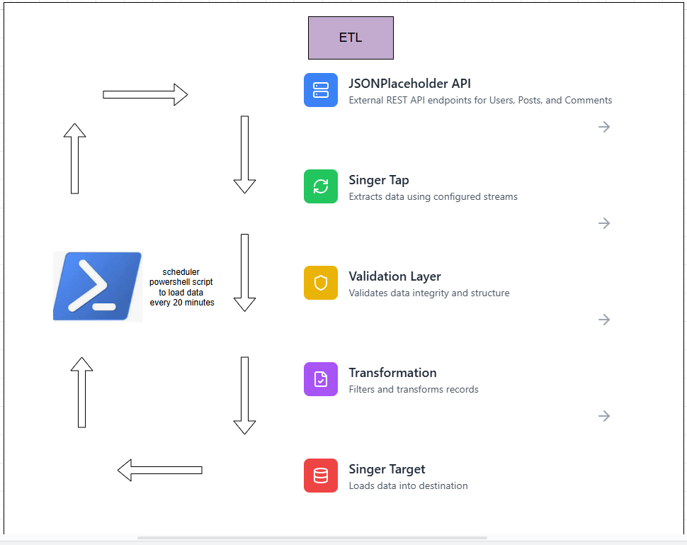
ETL- Phase Diagram

Slide 4
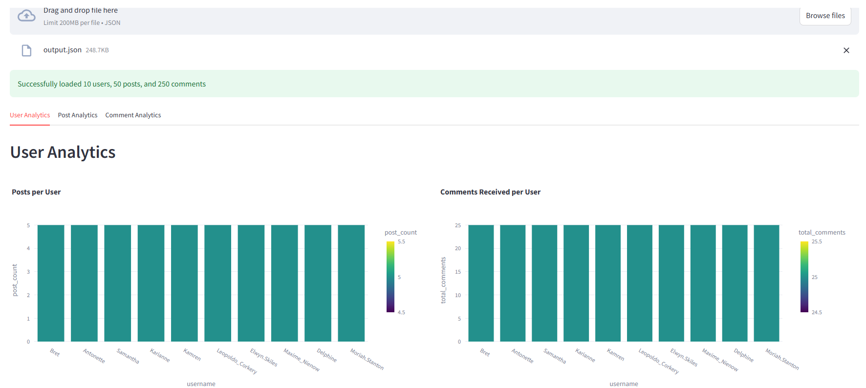
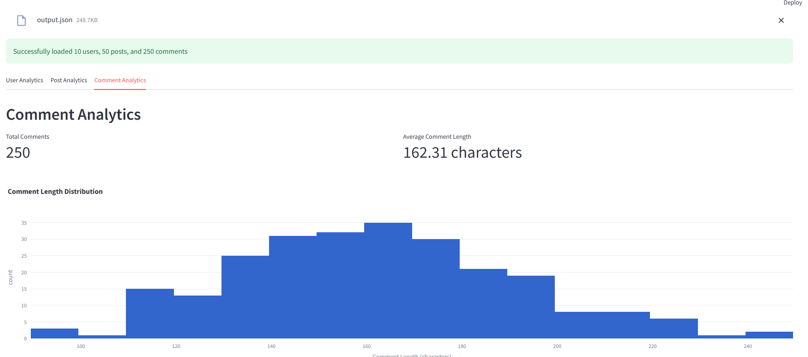
Analytics Phase
Report Generatetion in a csv format for aggregated metrics via a python module data_analyzer.py
Streamlit dashboard to visualize analyzed results streamlit run app.py

Slide 5
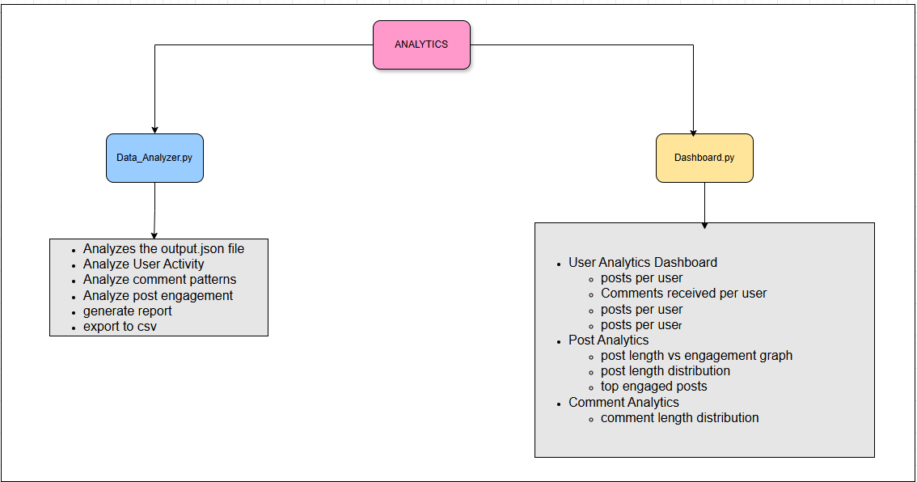
Anaytics Phase

