Slide 1
IBM University Engagement Project Submission
“Exploring the Power of Agentic AI with IBM Granite and LangFlow”

Slide 2
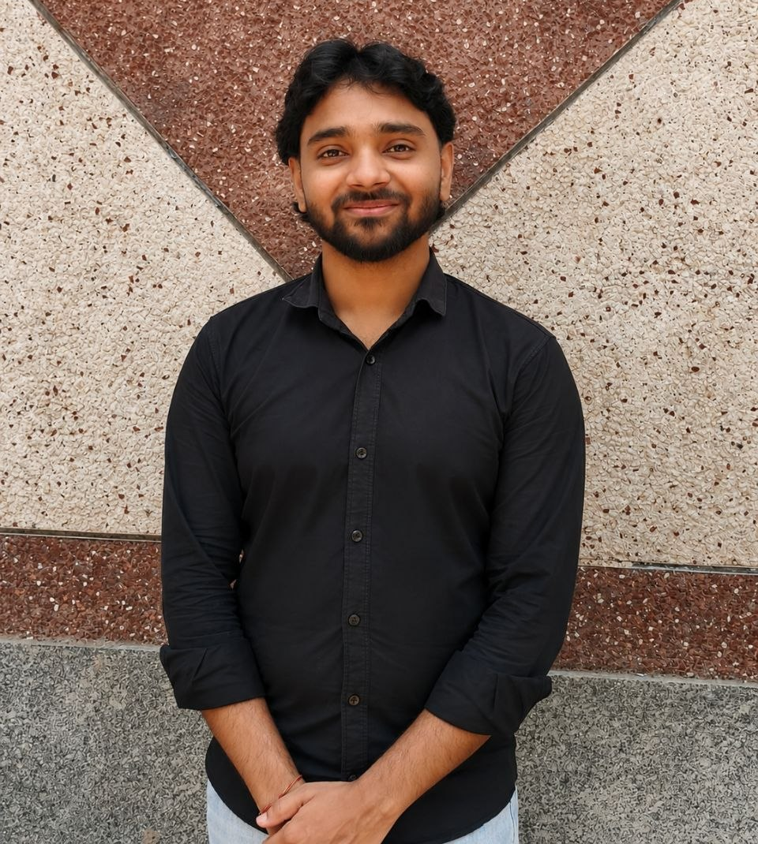
AI agent for chronic disease monitoring
Domain of Project – Health
Student Name | Recent Passport Photo | Email ID | Mobile number [WhatsApp]
CHIRAG |  | Chiragrajesh392@gmail.com | 9717498724

Slide 3
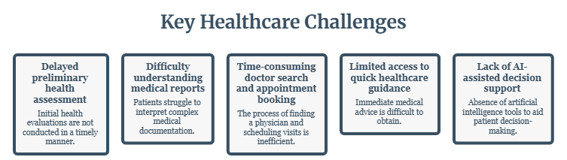
Problem Statement -
Problem Statement : Chronic disease monitoring
Healthcare systems often require multiple manual steps for disease identification, medical report interpretation, finding the right specialist, and booking appointments. This process can be time-consuming and confusing for patients, leading to delays in receiving appropriate medical guidance. There is a need for an integrated AI-powered platform that provides quick preliminary health assessments and simplifies access to healthcare services.

Slide 4
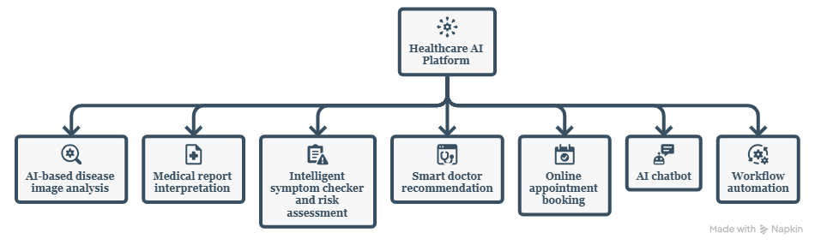
Proposed Solution -
Proposed Solution: AI agent for chronic disease monitoring
Our project proposes HealthSense AI & Smart Doctor Recommendation System that combines Artificial Intelligence and n8n workflow automation to provide quick and intelligent healthcare assistance. The system analyzes disease images, medical reports, and symptoms using AI, assesses health risks, recommends suitable specialists, enables online appointment booking, and offers chatbot support through a single, user-friendly platform.

Slide 5
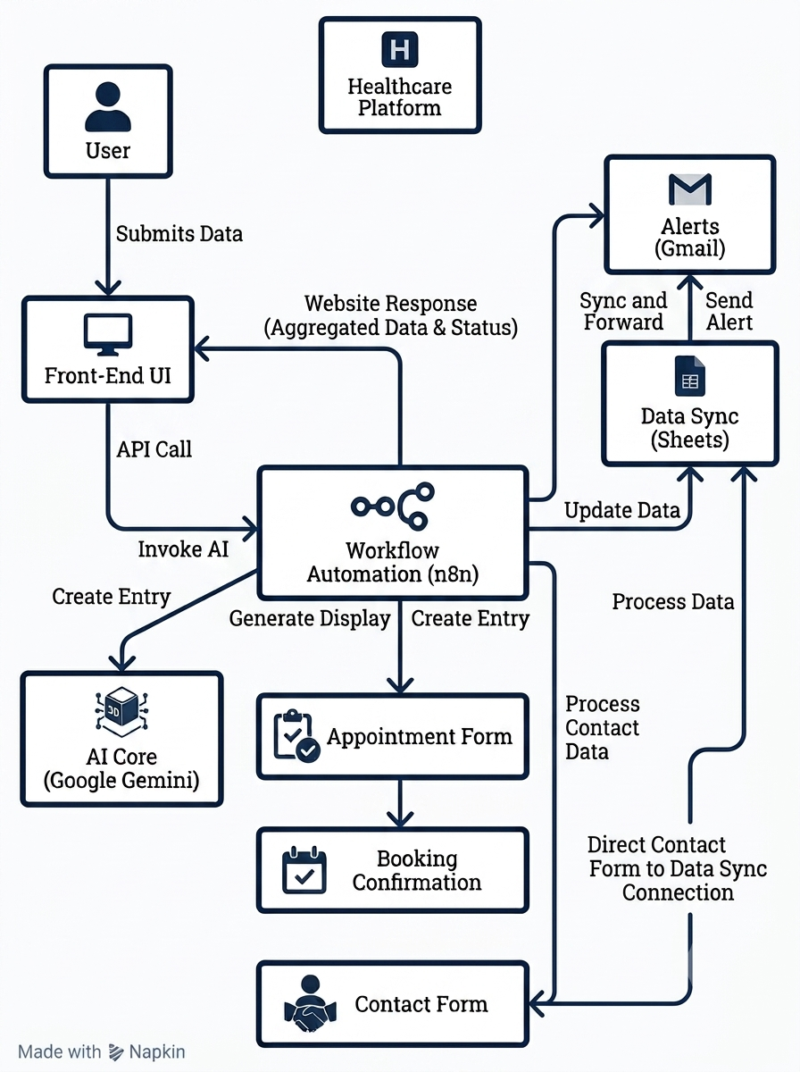
System Approach
System Flow
User submits health data through the website.
Frontend sends the request to n8n via API/Webhooks.
n8n triggers the appropriate workflow.
Google Gemini AI analyzes disease images, symptoms, or medical reports.
AI generates health insights and recommendations.
Appointment and contact details are stored in Google Sheets.
Gmail sends automated appointment confirmations and notifications.
The processed results are displayed on the website in real time.

Slide 6
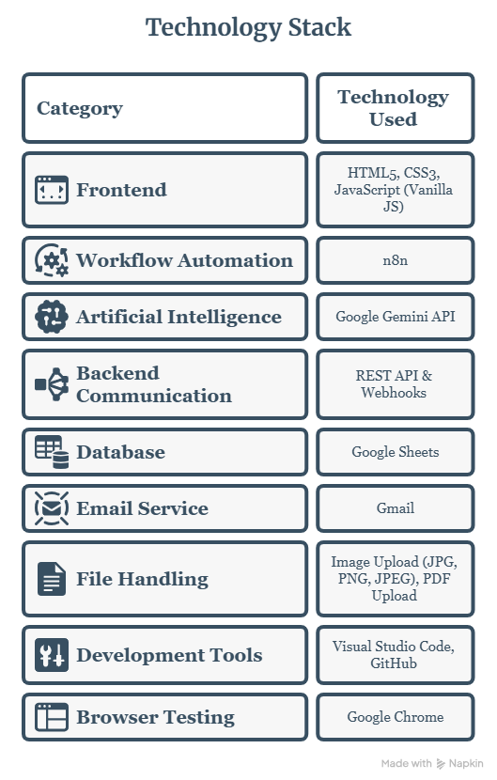
Technology Stack
Key Technologies
HTML5 – Structure of the web application.
CSS3 – Responsive UI with Glassmorphism effects and animations.
JavaScript – Handles frontend logic and API communication.
n8n – Automates workflows between the website and external services.
Google Gemini API – Performs AI-based disease image and symptom analysis.
Google Sheets – Stores appointment and contact form data.
Gmail – Sends automated appointment confirmations and notifications.
REST APIs & Webhooks – Connect the frontend with n8n workflows and AI services.

Slide 7
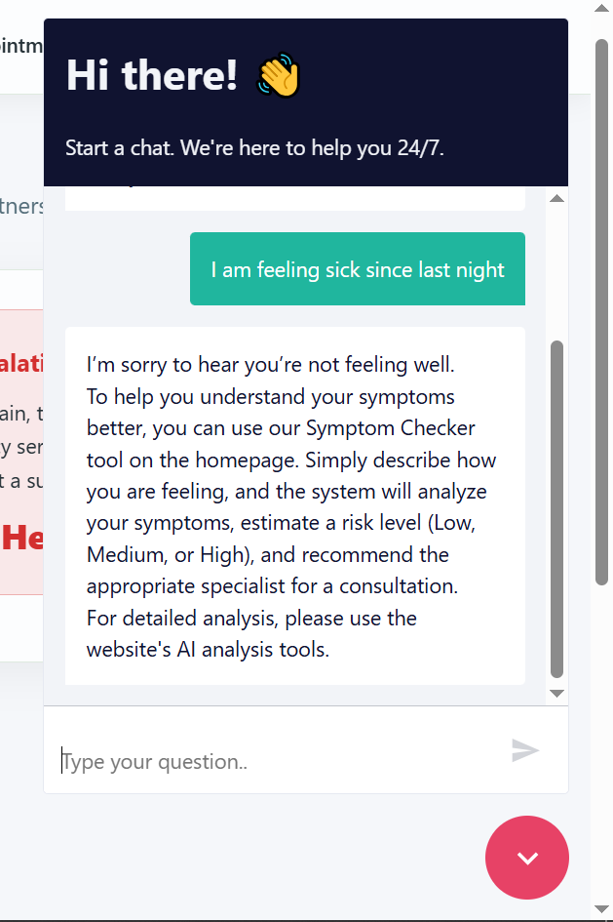
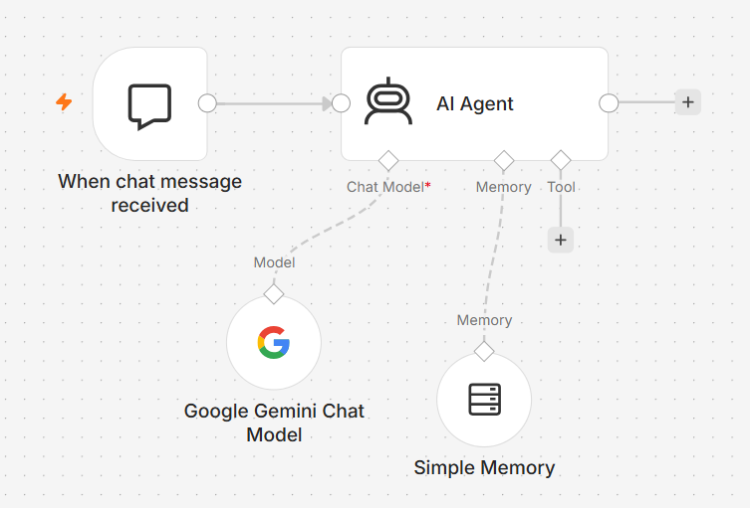
Result
1. Chatbot Automation
GitHub Link: https://github.com/ItsDeveloperChirag/HealthSense-AI

Slide 8
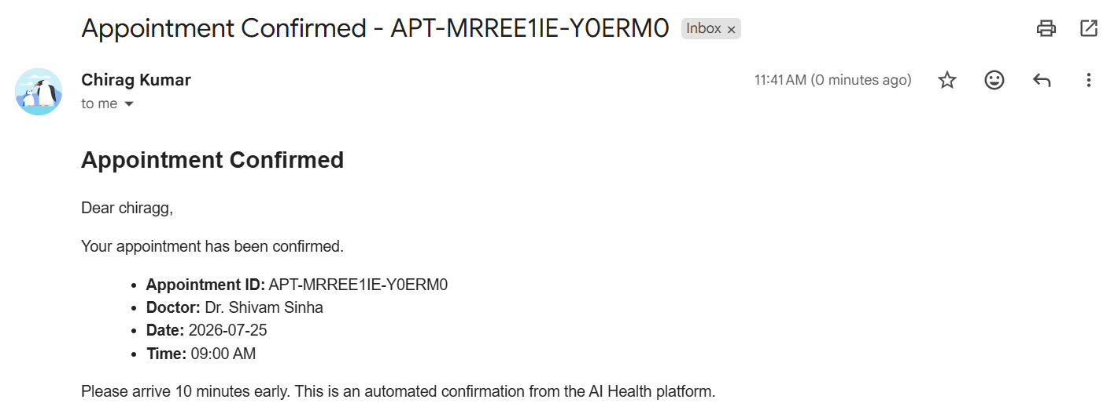
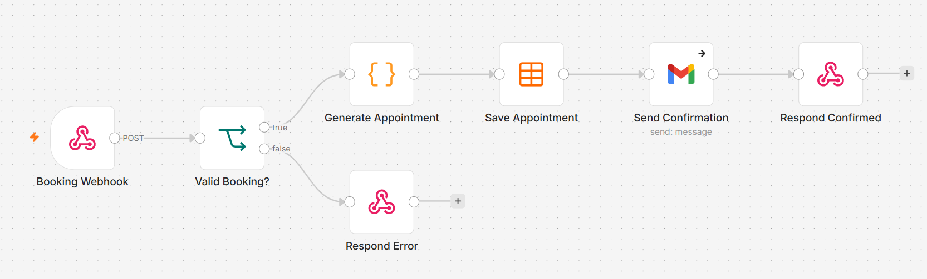
Result
2. Appointment Automation

Slide 9
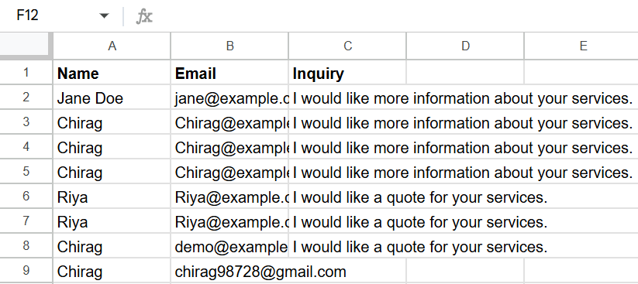
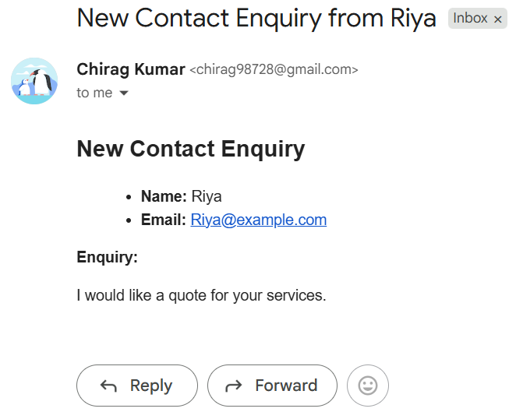
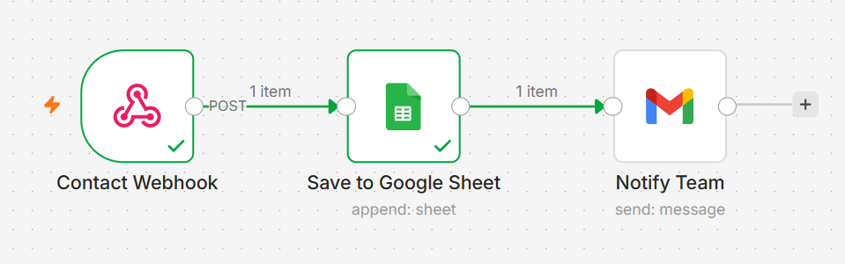
Result
3. Contact Automation

Slide 10
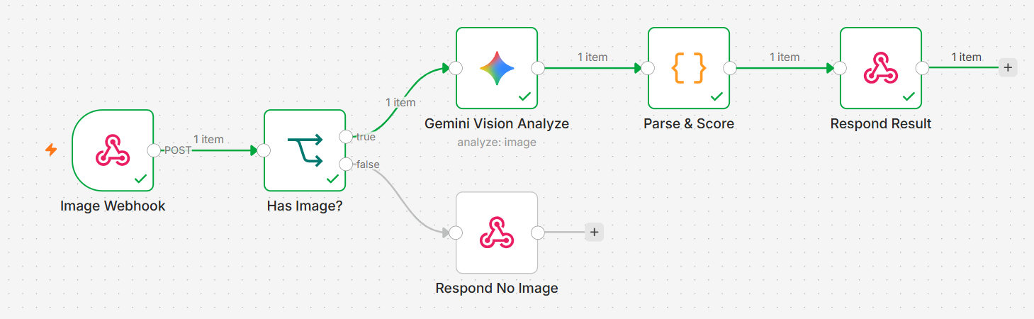
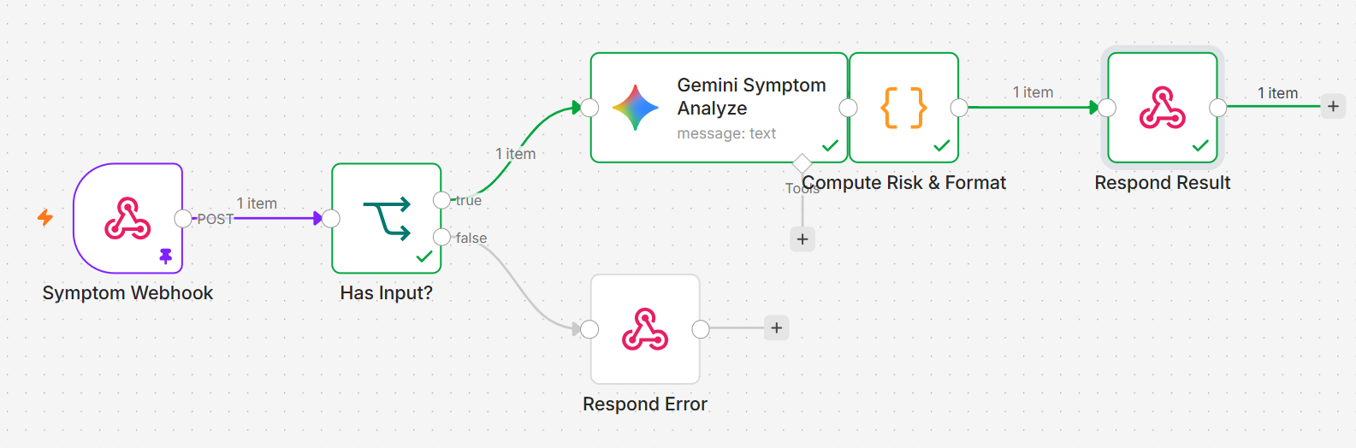
Result
4. Disease Scanner Automation
5. Symptom Checker Automation

Slide 11
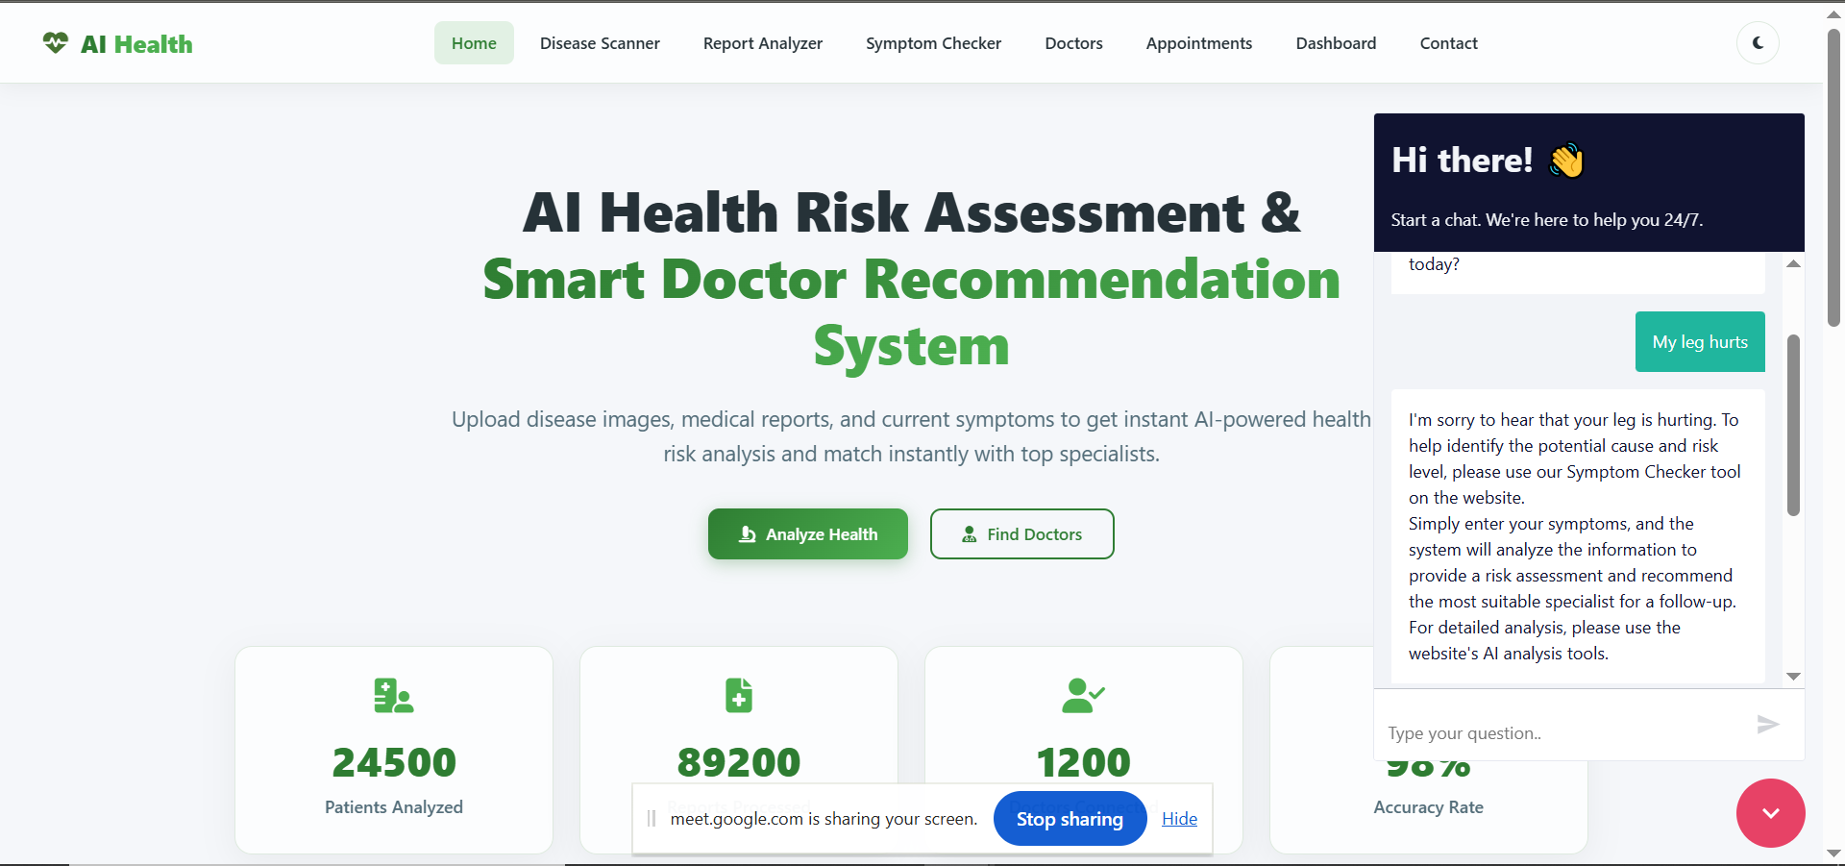
Result

Slide 12
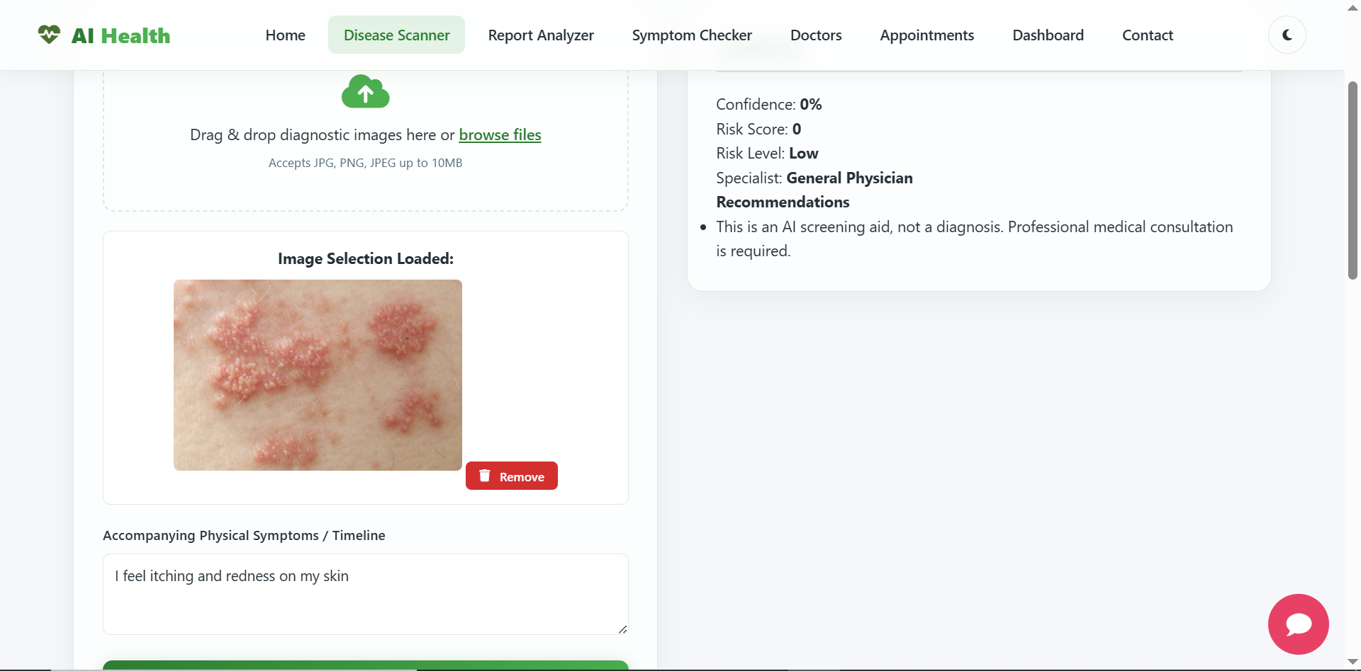
Result

Slide 13
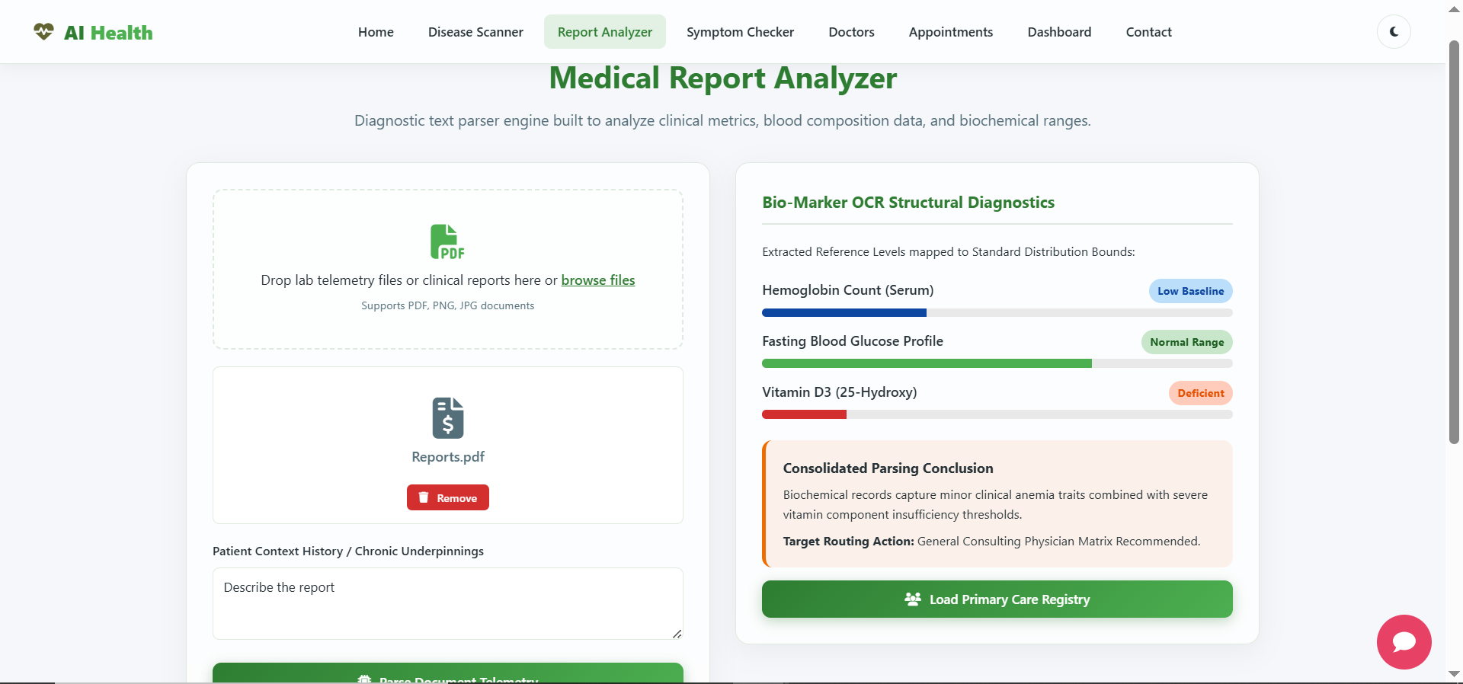
Result

Slide 14
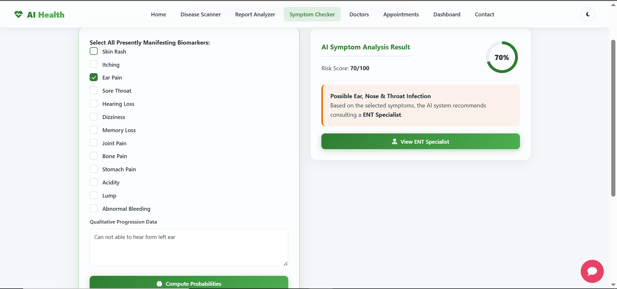
Result

Slide 15
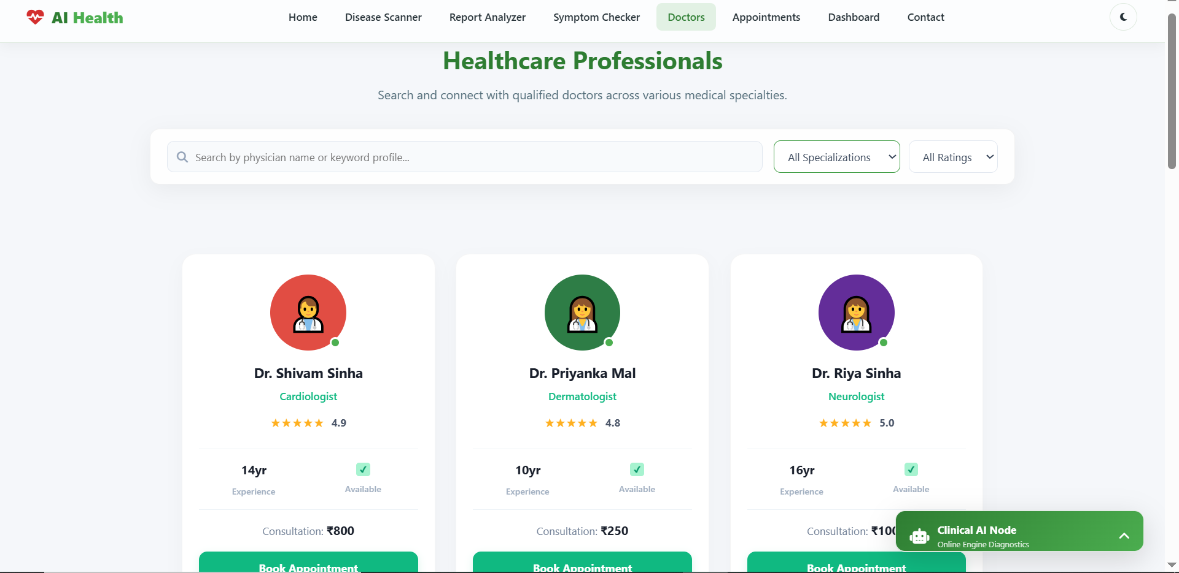
Result

Slide 16
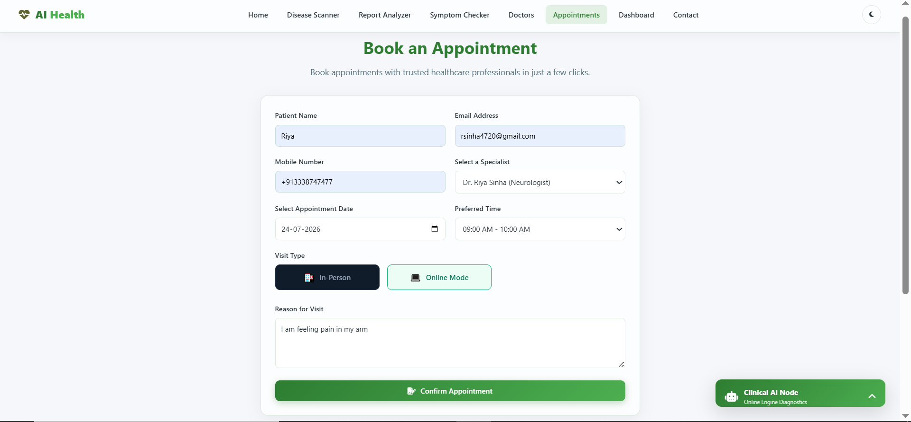
Result

Slide 17
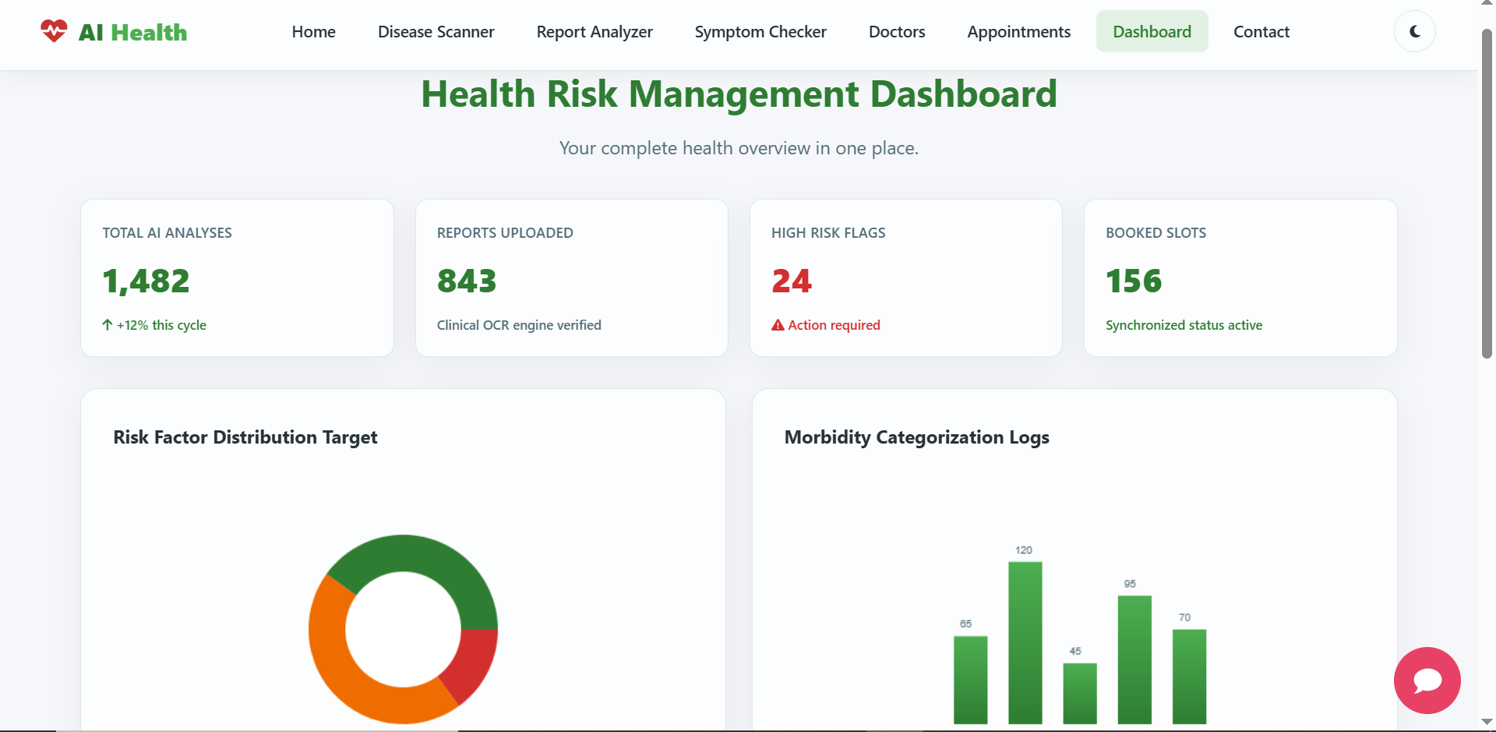
Result

Slide 18
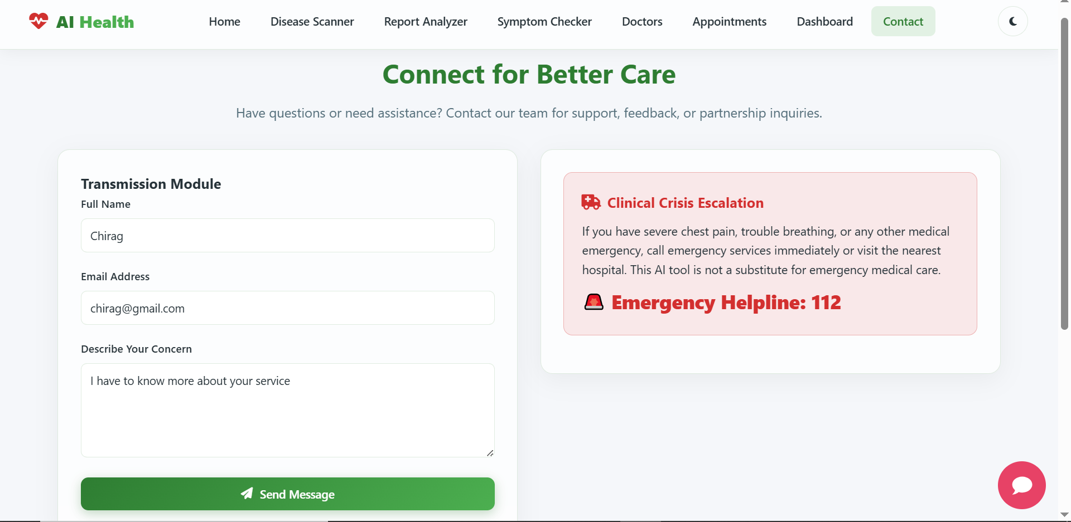
Result

Slide 19
Conclusion
The HealthSense AI & Smart Doctor Recommendation System successfully integrates Artificial Intelligence and n8n workflow automation to provide an efficient and user-friendly healthcare solution. The system enables disease image analysis, medical report interpretation, symptom assessment, smart doctor recommendations, appointment booking, and chatbot assistance through a single platform. By automating healthcare processes and providing quick preliminary health insights, the project improves accessibility, enhances user experience.
Key Achievements
AI-powered health analysis.
Automated workflows using n8n.Smart doctor recommendation.
Seamless appointment booking.
Improved healthcare accessibility and efficiency.
·
·
·

Slide 20
Future Scope
Future Enhancements
Develop Android and iOS mobile applications for better accessibility.
Integrate real-time wearable device data for continuous health monitoring.
Support video consultations and telemedicine with healthcare professionals.
Add multi-language support to serve users from different regions.
Integrate with Electronic Health Records (EHR) for comprehensive patient history.
Enhance AI models with larger medical datasets to improve prediction accuracy.
Implement secure cloud storage and advanced data privacy features.
Enable real-time hospital and pharmacy integration for appointments and medicine availability.
·
·
·

Slide 21
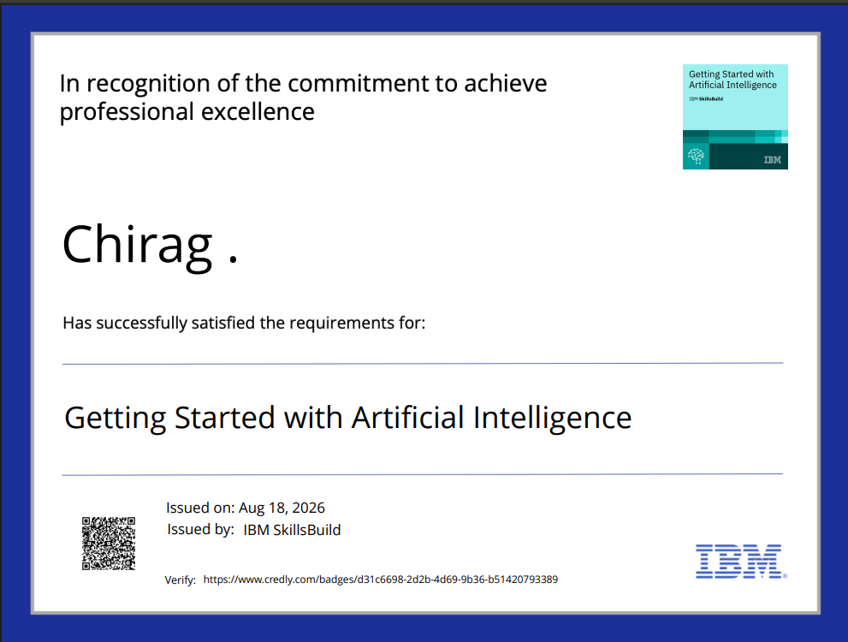
Certificates Earned:

Slide 22
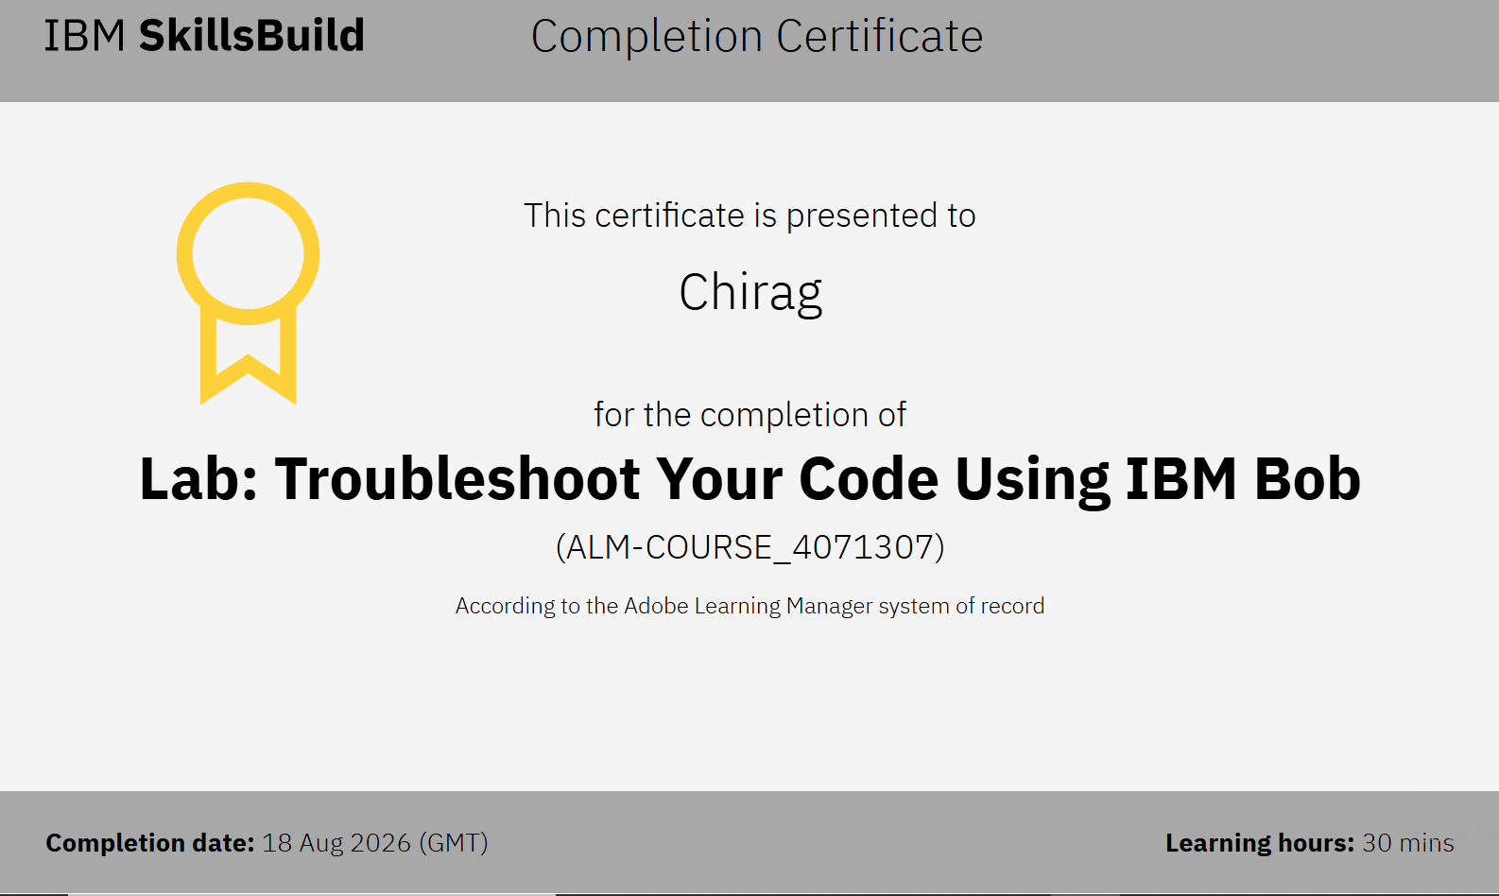
Certificates Earned:​

Slide 23


