Slide 1
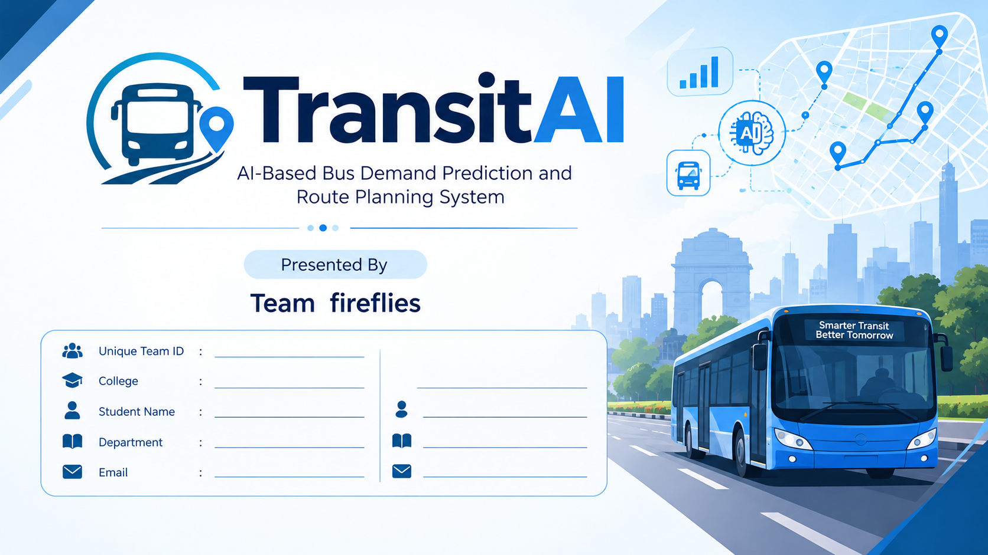
Name | : | Chirag
Internship ID | : | IBMUEML004546
Contact Number | : | 9717498724
College Name | : | Guru Tegh Bahadur 4th Centenary Engineering College

Slide 2



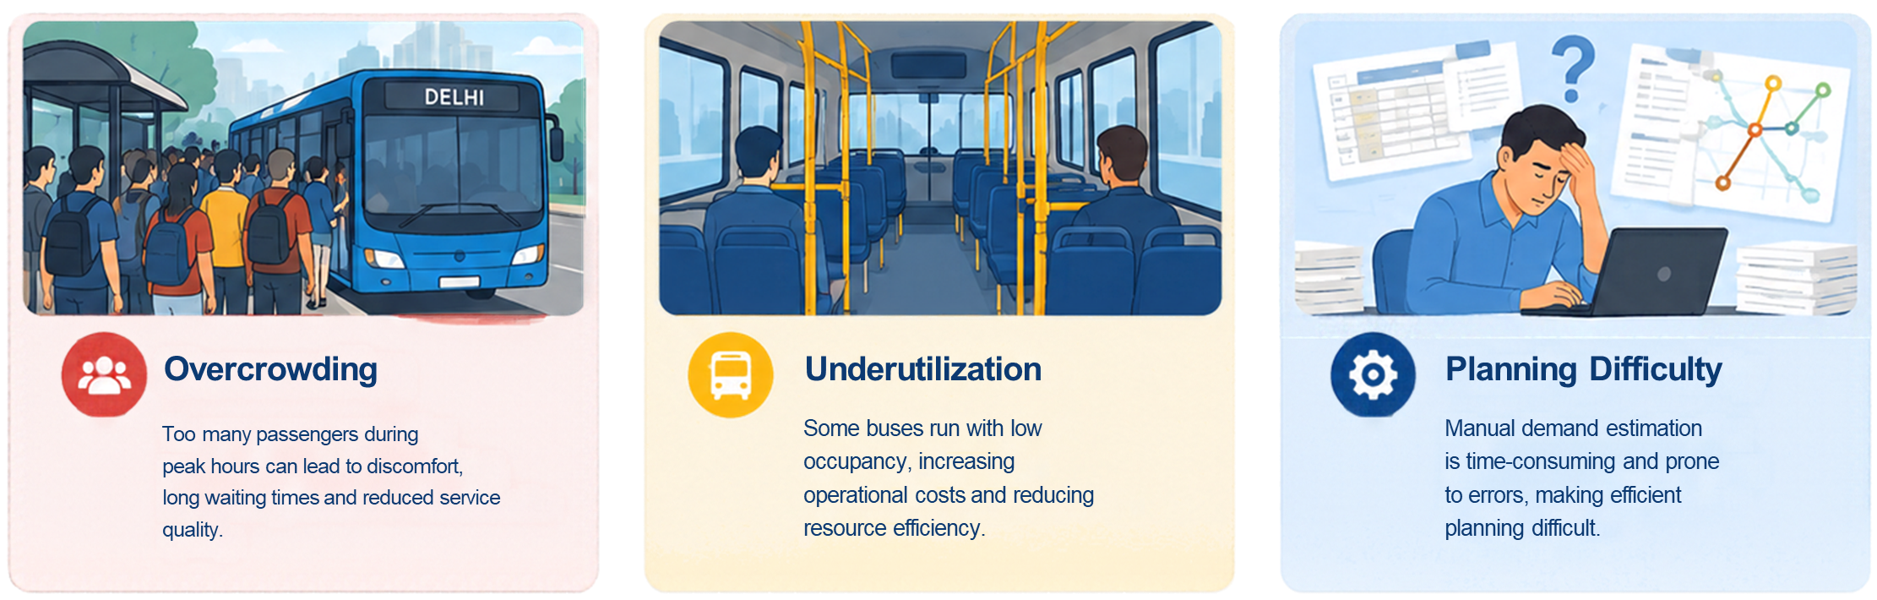
Problem Statement
Public transportation faces changing passenger demand throughout the day.
Fixed bus allocation may lead to overcrowding during peak hours.
Underutilized buses can increase operational costs.
Manual demand estimation makes efficient planning difficult.
Transport planners need a data-driven approach to estimate demand and support bus allocation.

Slide 3

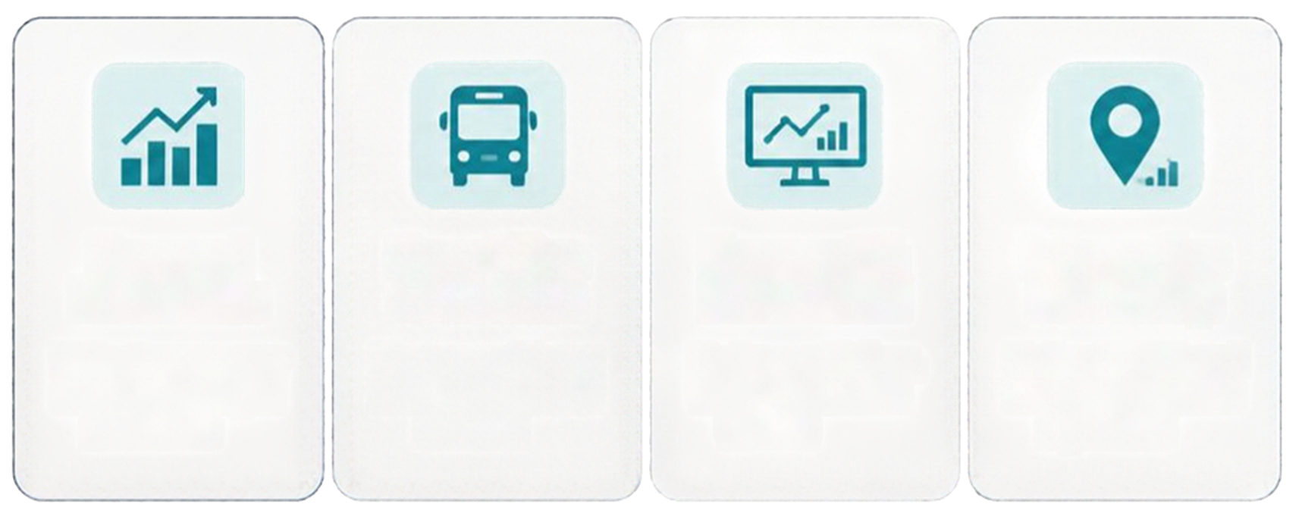

Proposed Solution
TransitAI is an AI-based bus demand prediction and route planning system that uses Machine Learning to estimate passenger demand and recommend suitable bus allocation.
Demand
Prediction
Smart Bus
Allocation
Forecast &
Dashboard
Interactive
Delhi Map
Estimate passenger
demand from input
Recommend buses
based on predicted
Review predictions,
trends, and model
Explore GTFS-based
bus stops and route
SDG 11:
Supports more efficient public transport
planning and smarter urban mobility
Sustainable Cities and Communities

Slide 4
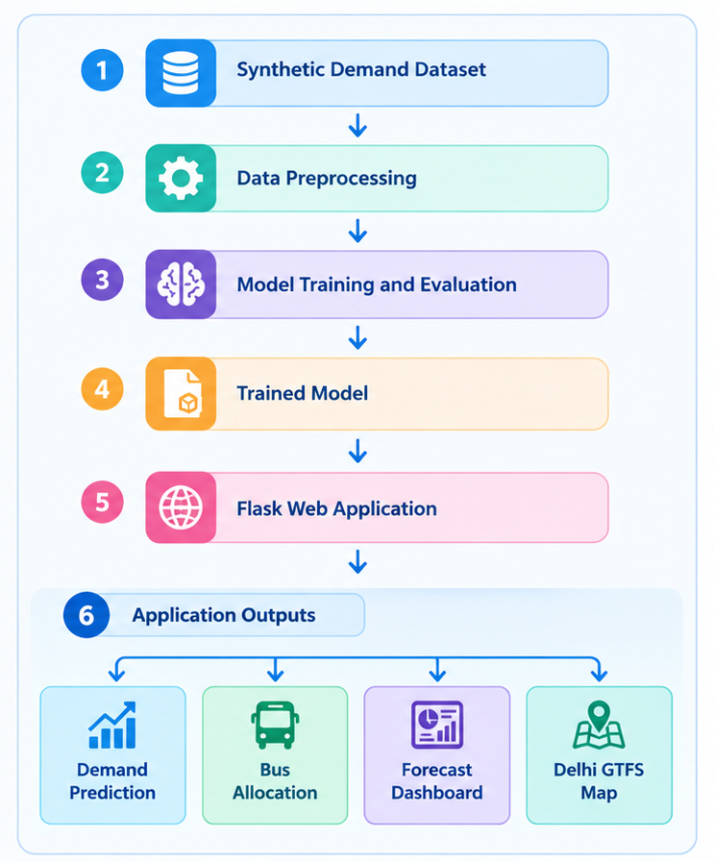

System Approach
System Flow
Collect and prepare the synthetic bus-demand dataset.
Process the input features required by the prediction model.
Train and evaluate the machine learning model.
Save the trained model for application use.
Accept user inputs through the Flask web application.
Generate predicted passenger demand.
Recommend the required number of buses.
Display predictions, forecasts, and dashboard information.
Visualize Delhi bus stops and route sequences using GTFS data.

Slide 5
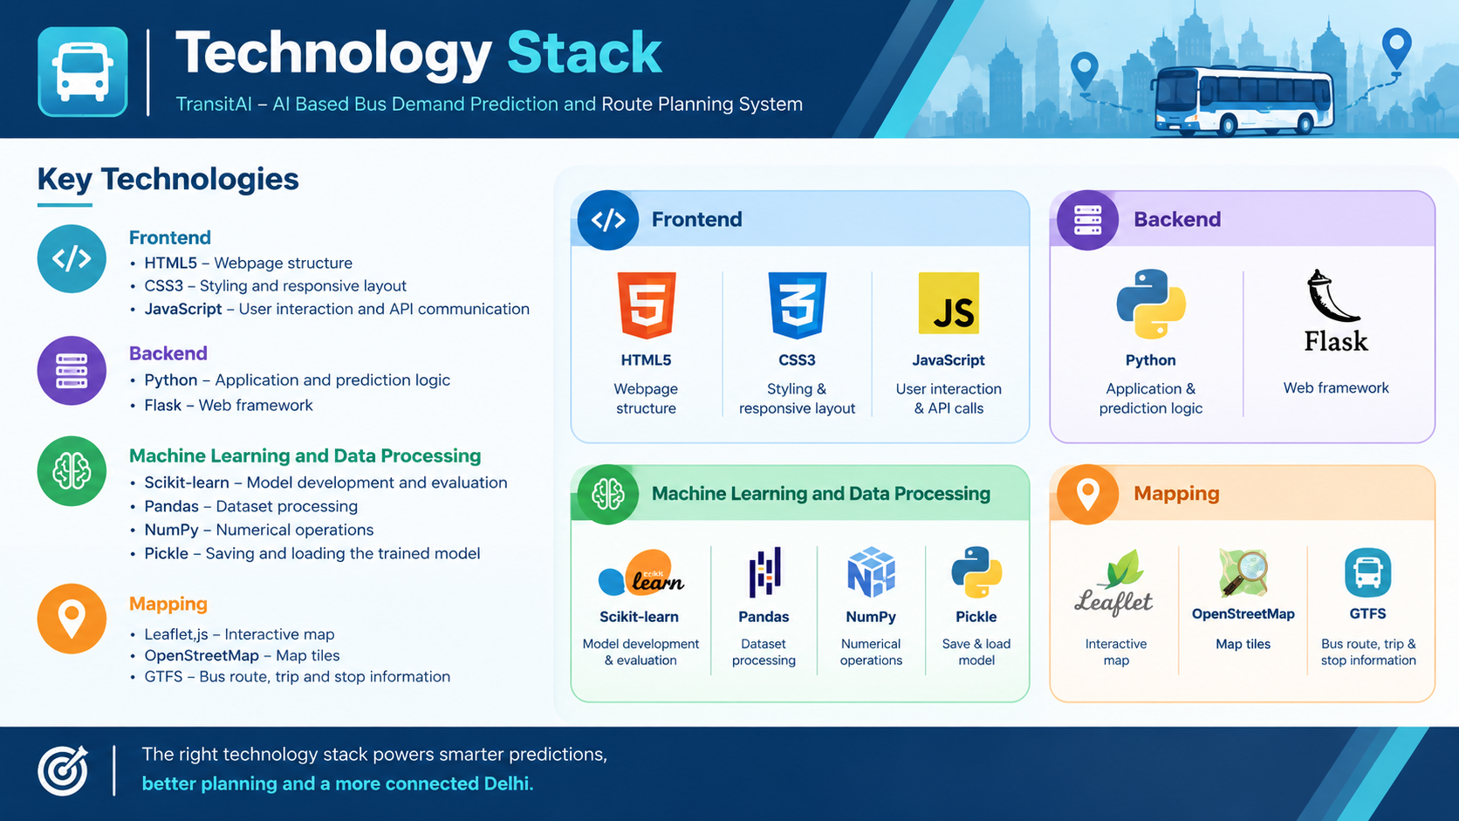

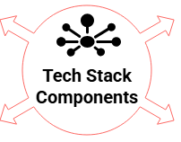
Technology Stack

Slide 6
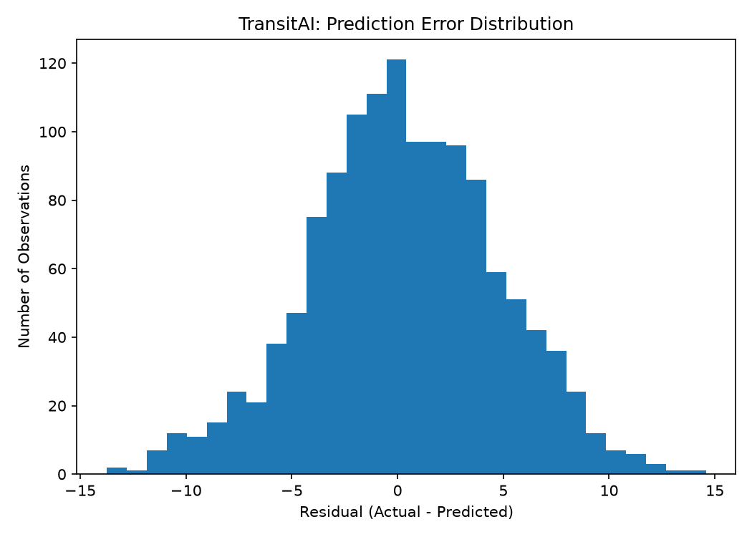
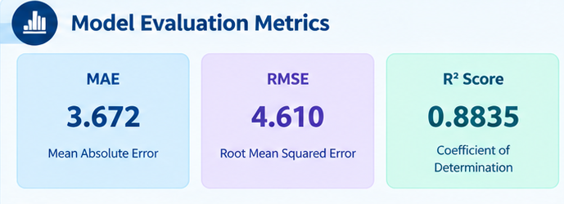
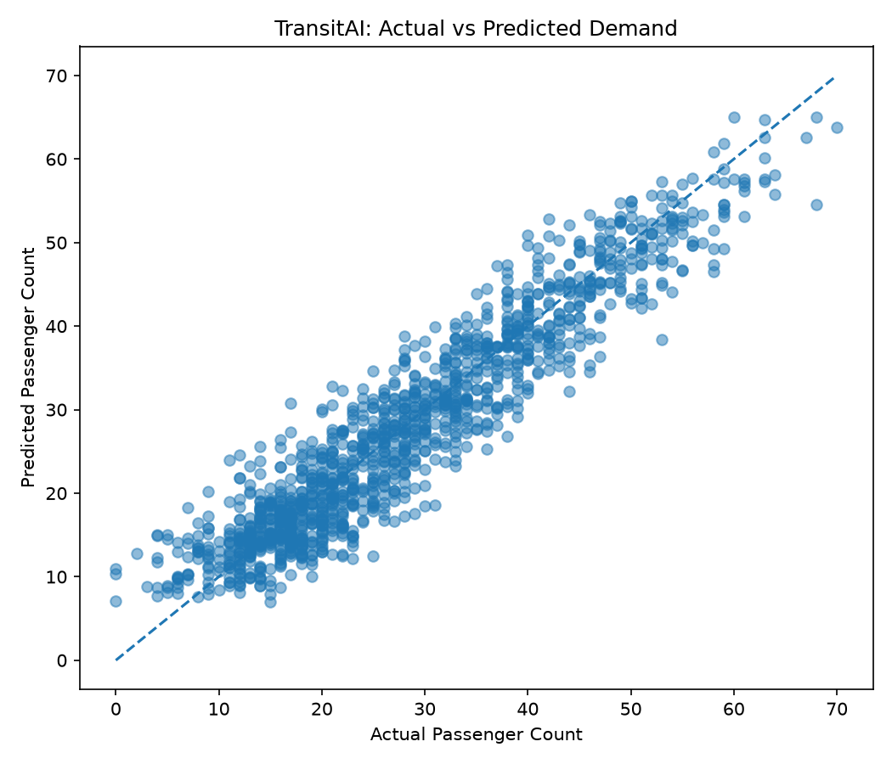
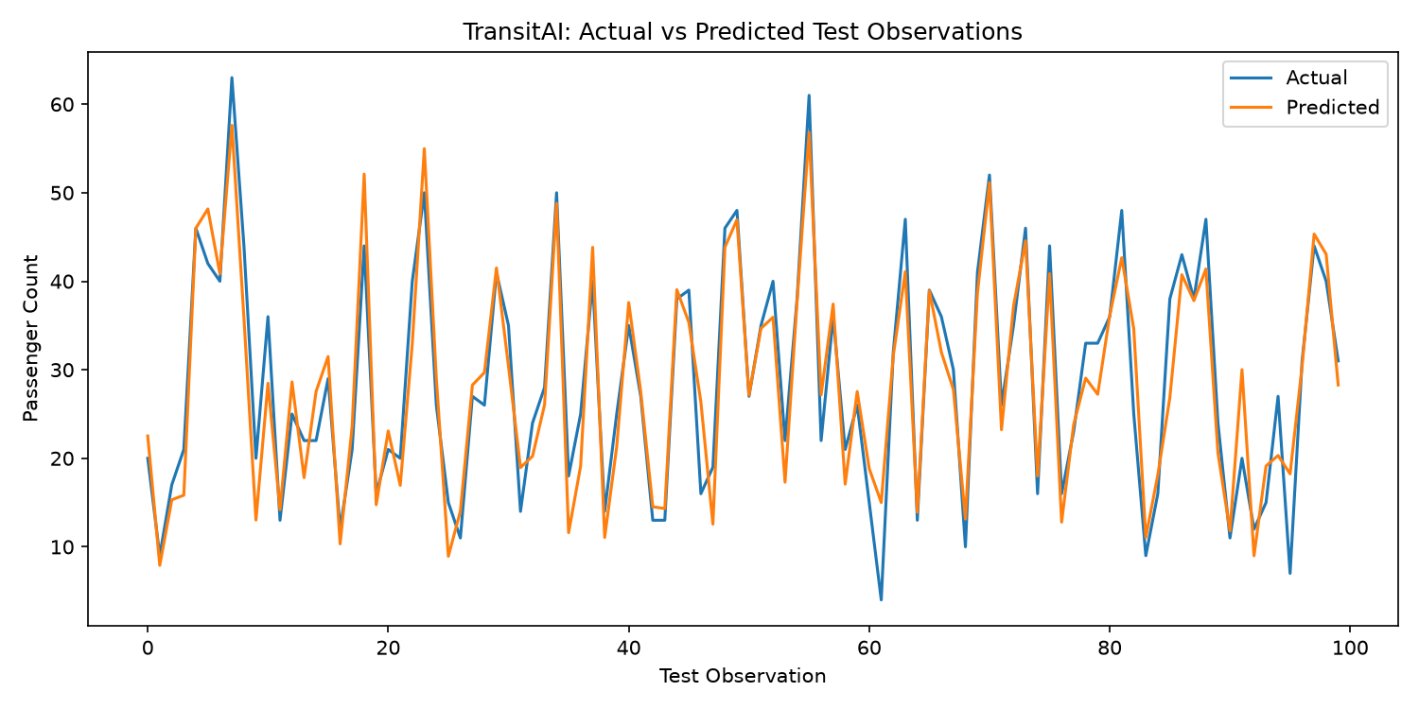
Result
1. Model Evaluation and Performance
Evaluated trained machine learning model using a temporal holdout test set.
Measured prediction error using MAE and RMSE.
Used the R² score to assess how well the model explains demand variation.

Slide 7
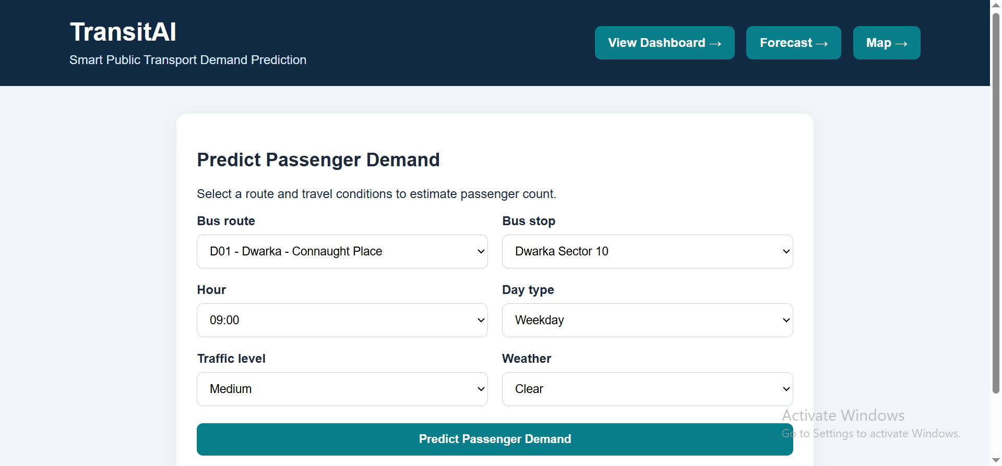
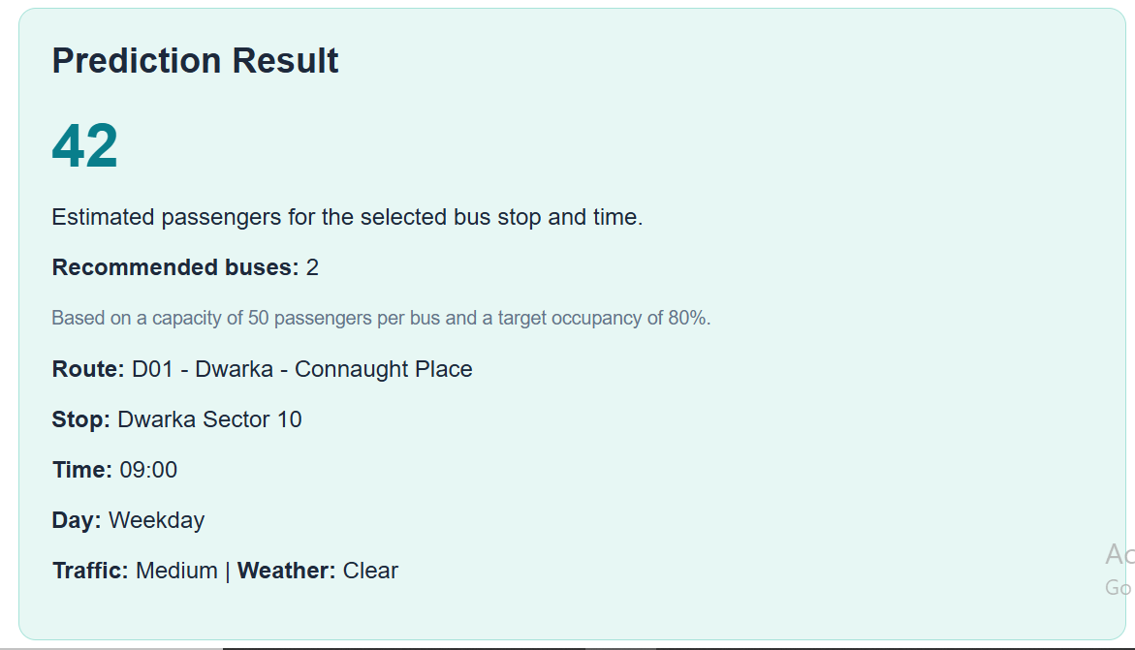
Result
2. Passenger Demand Prediction
Accepts route, day type, time period, weather, and event information as user inputs.
Uses the trained machine learning model to estimate passenger demand.
Displays the predicted passenger count through the Flask web interface.
Helps users understand expected demand for a selected scenario.
Example result: If the model predicts 42 passengers, the application displays the estimated demand as 42 passengers

Slide 8
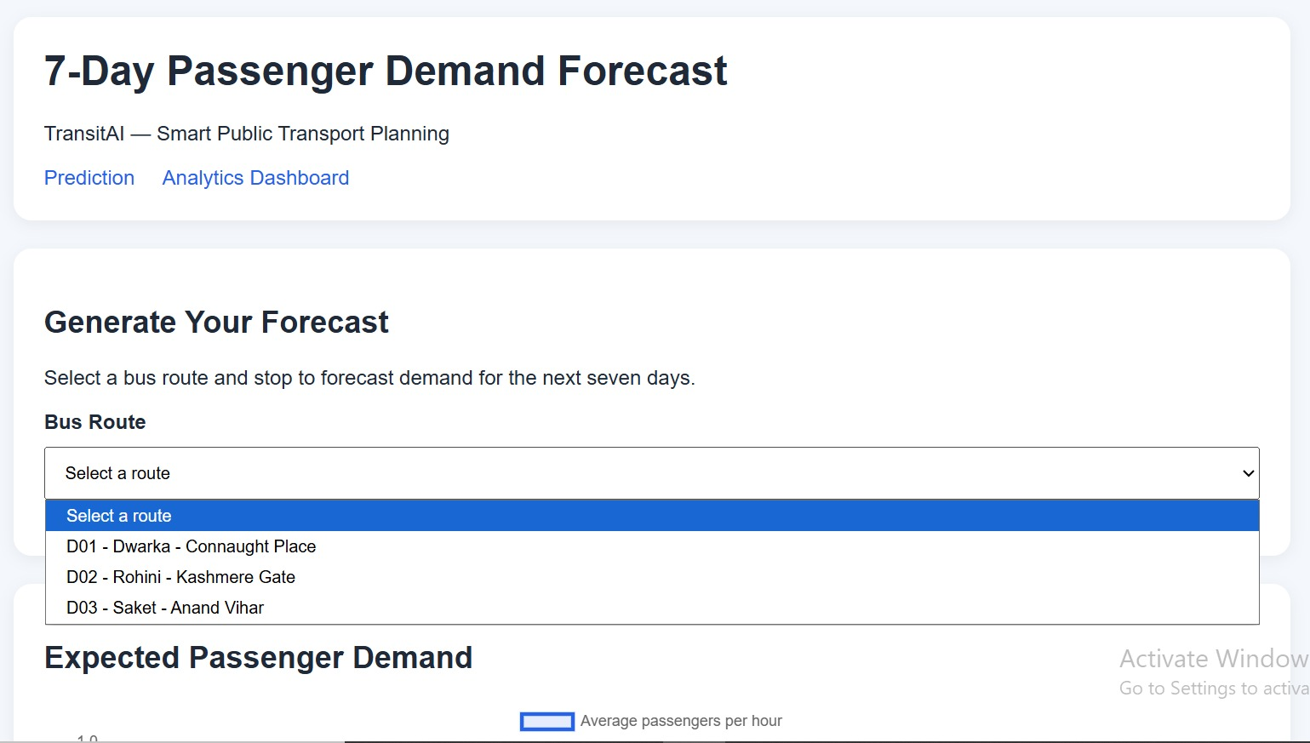
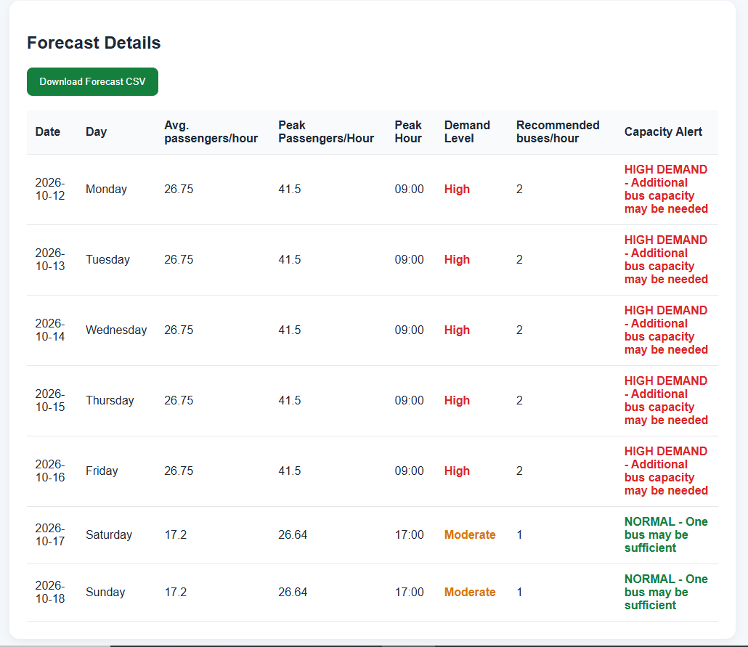
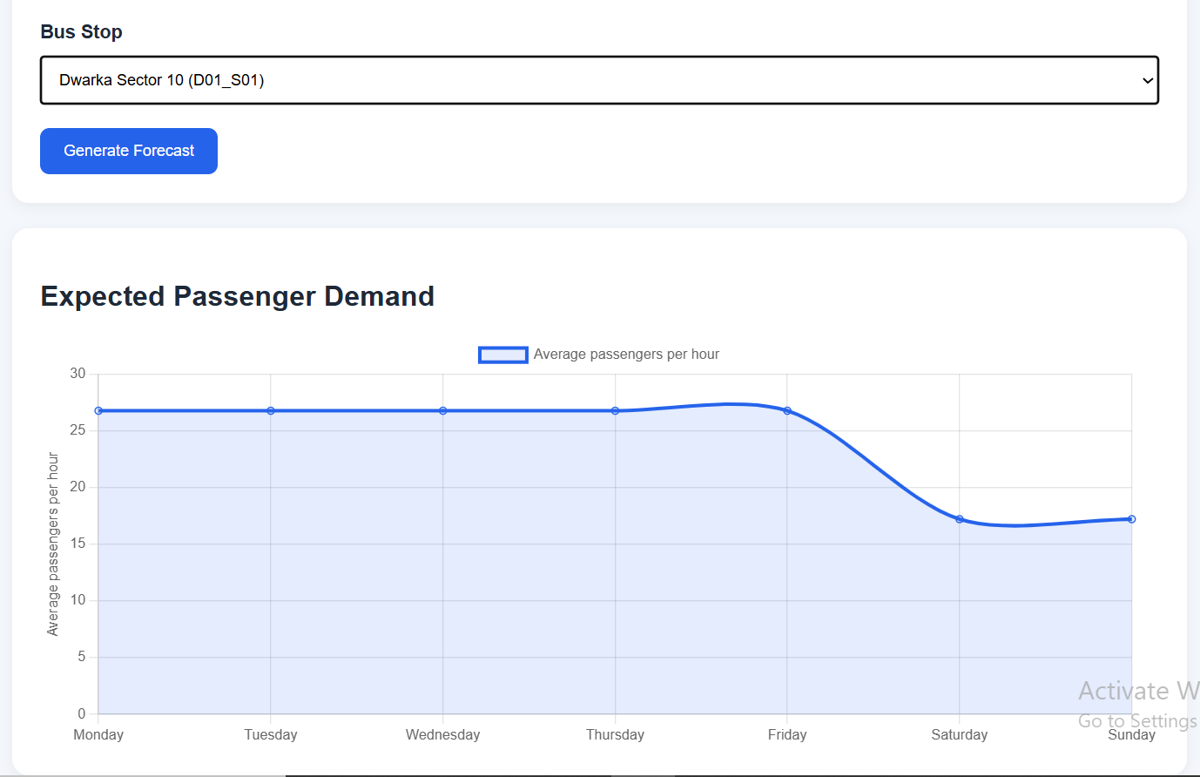
Result
3. Passenger Demand Prediction
Converts predicted passenger demand into a recommended number of buses. Uses a bus capacity of 40 passengers per bus. Applies a capacity-based calculation to avoid allocating fewer buses than required.
Supports downloading forecast results as a CSV file.

Slide 9
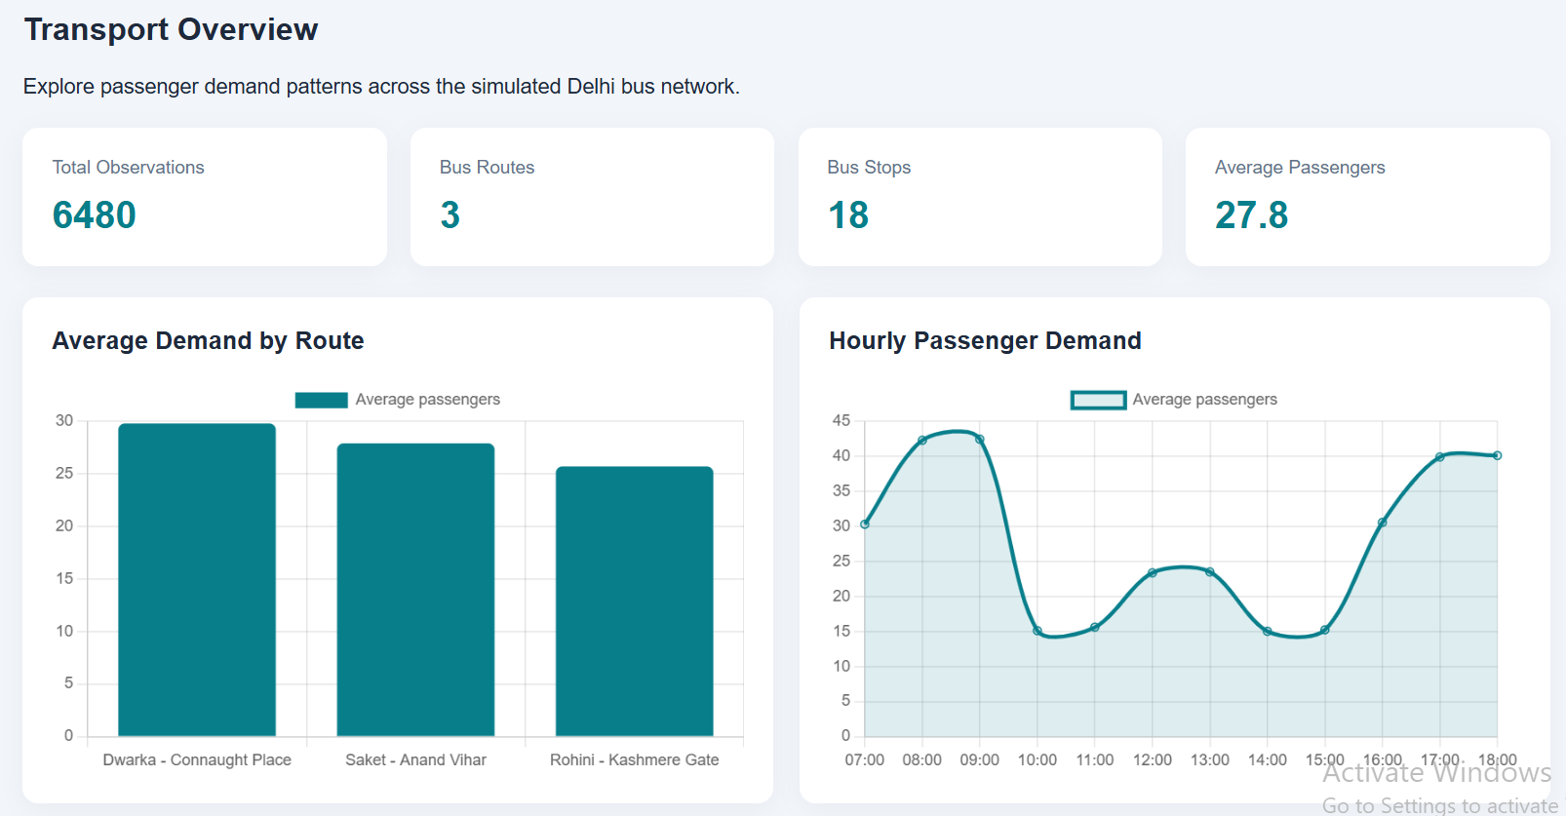
Result
4. Analytics Dashboard

Slide 10
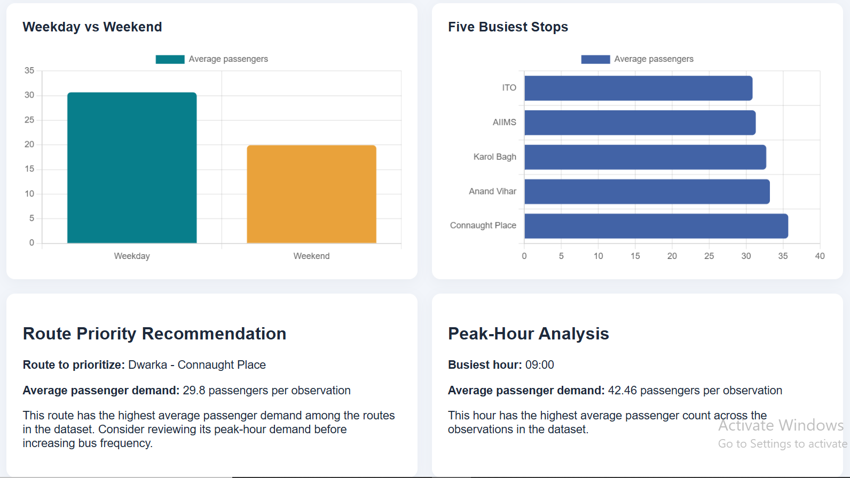
Result
4. Analytics Dashboard

Slide 11
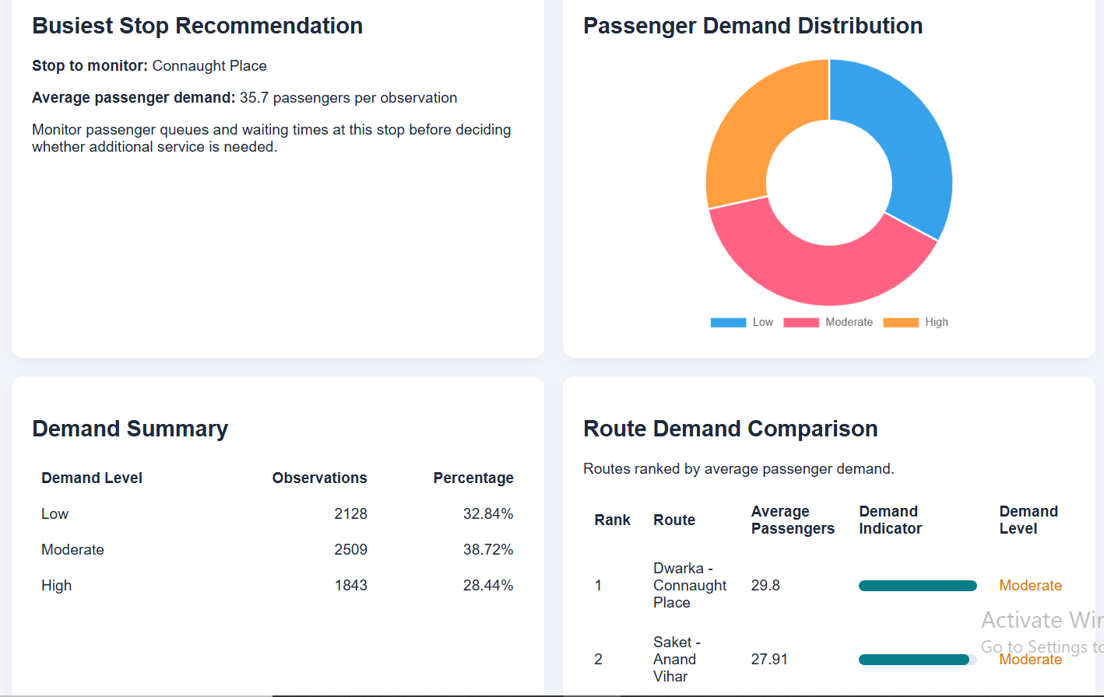
Result

Slide 12
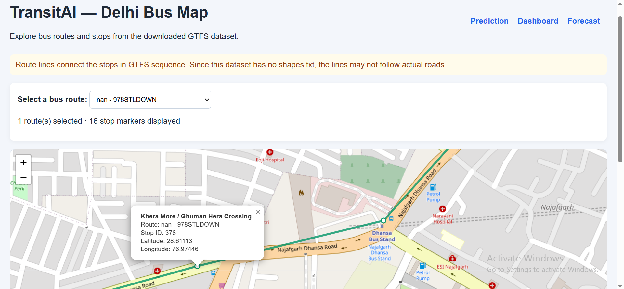
Result
Integrates Delhi transit information from GTFS files. Displays bus stops as markers on an interactive map. Helps users explore the geographical distribution of stops and routes.
5. Interactive Delhi GTFS Map

Slide 13
Conclusion
TransitAI demonstrates a machine learning-based approach to passenger demand prediction and preliminary bus allocation.
The application integrates a Flask web interface, a trained prediction model, a dashboard, forecasting functionality, CSV export, and an interactive Delhi bus map.
The project provides a foundation for data-driven public transportation planning while highlighting the need for real passenger ridership data for practical deployment.
Key Achievements
Developed a working demand-prediction web application.
Implemented model evaluation and demand forecasting.
Generated bus allocation recommendations from predicted demand.
Integrated GTFS-based stop and route visualization.
Enabled structured forecast data export.

Slide 14
Future Scope
Future Enhancements
Integrate real passenger ridership and ticketing data.
Connect GTFS route identifiers with demand-prediction records.
Incorporate traffic conditions, weather, events, and holidays.
Use official route geometry for road-accurate visualization.
Optimize bus allocation using route-specific capacity and scheduling constraints.
Add live GPS tracking and passenger occupancy data.
Deploy the application on a cloud server for wider accessibility.
Retrain and validate the model using real-world observations.

Slide 15

Thank You
GitHub Link: https://github.com/ItsDeveloperChirag/TransitAI

