Slide 1
Hotel Management System
By Ehtisham Ul Haq, Muhammad Azeem, & Hassan Abbas

Slide 2
Introduction
Brief overview of the project
Manage hotel operations like reservations, employees, guests, invoices, etc.
Focus on efficient data storage and retrieval
Tools used: SQL Server / MySQL, MS PowerPoint, etc.

Slide 3
Objectives
Design a normalized relational database to manage hotel operations efficiently
Track and manage reservations, guests, employees, invoices, and services.
Ensure data consistency and integrity using primary & foreign key constraints.
Enable user login and activity logging through a trigger-based history system.
Generate insightful reports using JOIN queries across multiple tables.
Scalable design for managing multiple hotels and locations.

Slide 4
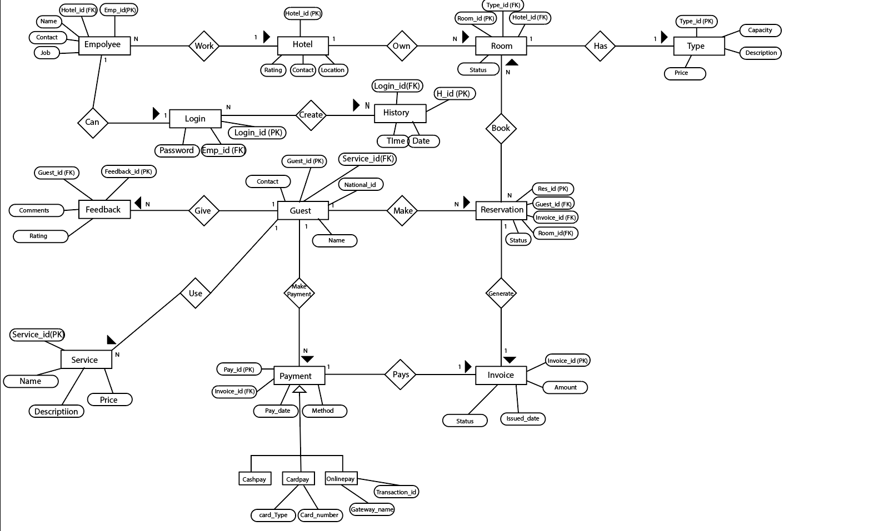
ERD

Slide 5
Tables
Employees
Login
History
Hotel
Room
Type
Reservation
Guest
Invoice
Payment
Feedback
Services

Slide 6
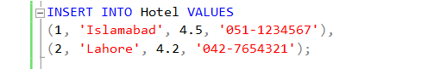
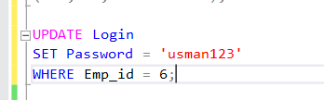
CRUD Queries
Insertion
Update

Slide 7

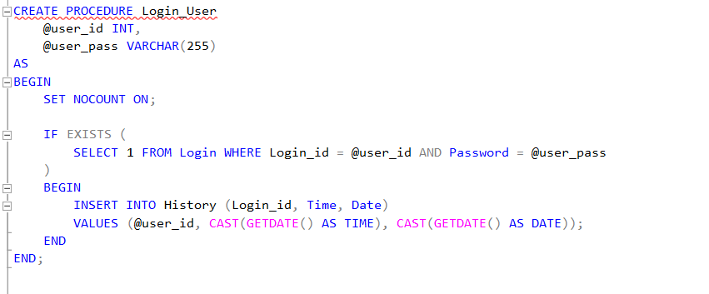
CRUD Queries
Delete
Trigger

Slide 8
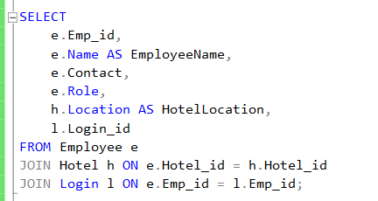
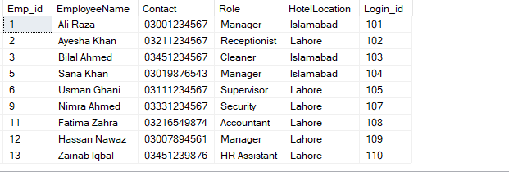
Joins

Slide 9
Conclusion
Covers all aspects of hotel database management
Ensures data integrity, user tracking, billing, and services
Scalable and secure design

Slide 10
Thank You Everyone
Any Question

