Slide 1

A mobile app to help children aged 8+ adhere to their asthma routine

Slide 2
Team
Grainne Dowdall Healthcare Professional
Eoin Connolly Developer
Enrique Moreno Developer

Slide 3
Check out our website @
ow.ly/miykh

Slide 4
What is asthma?
A chronic disease which affects the large and small airways of the lungs causing them to become inflamed and swollen, making breathing difficult
Asthma is the most common chronic disease in the world
300 million adults and children are affected globally
Medication is administered via an inhaler

Slide 5
Asthma in Ireland
Ireland has the 4th highest prevalence of asthma world wide
18.9% of 13-15 year olds have asthma
1 person a week dies from asthma in Ireland
Children miss an average of 10 school days per year
50% of patients with a chronic disease do not take their inhaler correctly

Slide 6
Cost of Asthma
Emergency Departments deliver 50,000+ emergency nebuliser treatments annually at a cost of €2.17 million. (Asthma Society)
Within Primary Care the cost of emergency nebuliser tretament in 2011 was €2.6 million. (HSE 2011)

Slide 7
How we can help
Track medication
Play games
Earn trophies

Slide 8
Benefits
Child Improved compliance leads to better quality of life
HSE Improved asthma control reduces emergency treatments and hospital stay
Industry Reduction in unfilled prescription

Slide 9
Mobile app demo

Slide 10
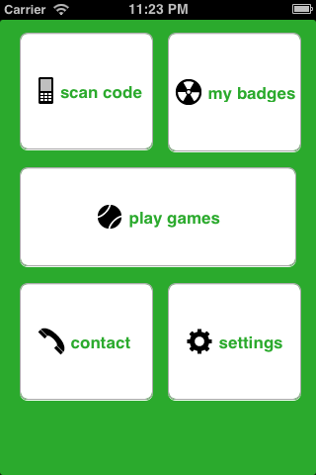
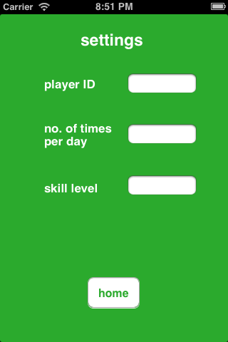
App

Slide 11
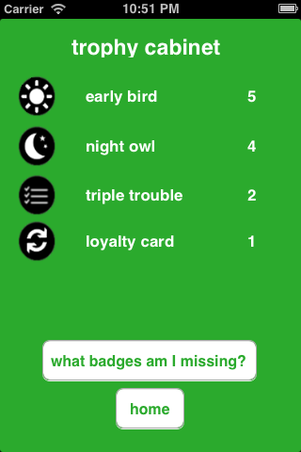

App

Slide 12
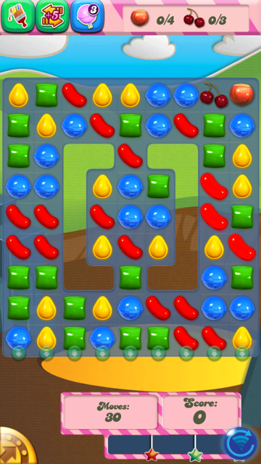

Games

Slide 13
Thank you for listening

Slide 14
References
HSE (2011) Primary Care Reimbursement Service
Statistical Analysis of Claims and Payments 2011
www.asthmasociety.ie
Asthma Society of Ireland (2011) Asthma in Ireland
Schotland, M.,Littman,K. (2012) Using a computer game to teach young children ] their brains. Games for Health Journal 1(6)

