Slide 1


MyBlockChainResume
STAND OUT FROM THE CROWD!

Slide 2
Why Resume in BlockChain?
Let your RESUME LIVE IN THE BLOCKCHAIN FOREVER
A NEW WAY TO SHOW OFF YOUR TECH SAVY!
PROVE YOUR CAREER PROGRESSION
Notes:
Why use blockchain to upload and store your resume?
Your resume is your biggest marketing asset as a job candidate. Everybody has one career but most people probably have several versions of their resumes. The versioning can change from slight updates to highlight the particular experience to a set of blatant lies just to get the job. This causes HR departments not to be able to distinguish honest candidates who has real experience and skills from those who are not trustworthy.
What if as a job candidate put your resume out there everyone can see and it stays there as unchangeable and when you upload a new version, it also goes up there creating a chain of records with time stamps . As an HR manager, what if you can trust the candidate is telling the truth by seeing several versions of candidates resume you know it got there and not changed/
Blockchain is a decentralized ledger used to store any digital record. Once a digital asset is in the blockchain it is there forever and cannot be changed. Your resume being your most valuable marketing asset but anyone can literally lie his way into a high paying job by claiming he has skills and experience on his resume, . In this context how will an honest candidate will stand out from the crowd?
We are solving this need by providing a web application that put your resumes into Etherium blockchain. Once a candidate uploads his resume to blockchain, it will become a public immutable record that can be seen by anyone in our case the hiring managers. Since it is immutable, an employee can see the history of changes by searching the candidate in the blockchain .

Slide 3
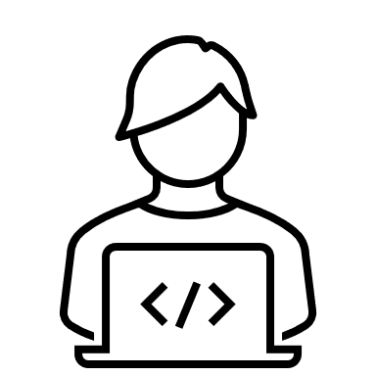
THE PROJECT
A Streamlit Web App
A Smart Contract written in Solidity
A wallet account in MetaMask
A Ganache Test-Net
StreamLit Web App
Smart Contract deployed in
Test-Net
Remix
Metamask Wallet
ARCHITECTURE
Notes:
In this project, we built a proof of concept architecture consists of 1- A streamlit web app, A wallet account in MetaMask, A testnet in Ganache which mimics Etherium main-net and a smart contract written in Solidity we wrote in the Remix.

Slide 4
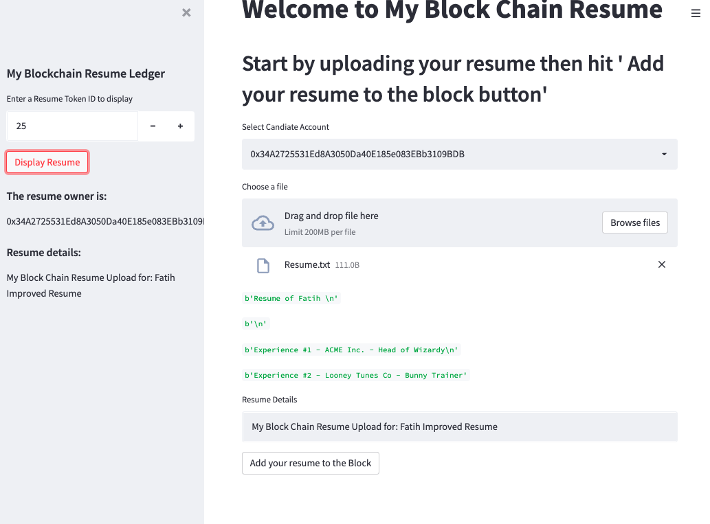
USER INTERFACE : THE WEB APP
The address of the resume owner
The Preview
Search and display resumes in blockchain

Slide 5

THE DEMO

Slide 6
THE ROADMAP
Account Login – Create a web account to manage your resumes in blockchain.
Download Feature - Download resumes from blockchain in multiple formats
Search Enhancements – Search resumes based on different criteria
UI Enhancements – Modern and responsive web interface
Office / Google Docs Plug-in for direct upload from word processing applications

Slide 7
MyBlockChainResume

