Slide 1
Primality Tests
Aidan Szilagyi, Benjamin Wolcott, Elsa Norman

Slide 2
Primality Testing
Prime number – a number which is only divisible by itself and 1
Our goal: given a number n, determine if it is prime in a way that is both fast and accurate

Slide 3
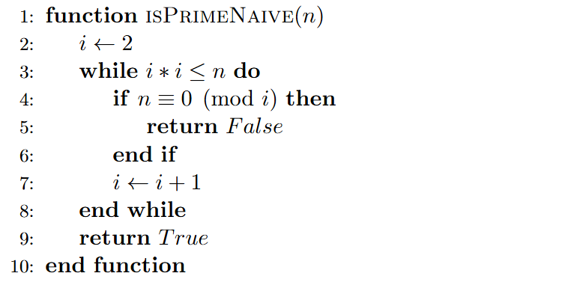

Trial Division
Naïve approach: test every possible factor and check if n evenly divides by it
Iterate from $2$ to $\sqrt{n}$
any number which divides n must be less than $\sqrt{n}$ or is multiplied by a number less than $\sqrt{n}$ to reach $n$

Slide 4

Analysis
O($\sqrt{n} log(n)$) runtime
Since we check numbers from 2 to $\sqrt{n}$
Not ideal when numbers get increasingly larger
Optimizations can be made, such as by skipping even numbers beyond 2
Slow, but accurate

Slide 5




Fermat's Little Theorem
Fermat's Little Theorem states that for all prime numbers p and integers a,
You can divide this formulation by a (when gcd(a, p) = 1) on both sides to get:
When a number fails Fermat's Little Theorem, we know it is not prime. Proving that a number is prime is more difficult
means
$$x≡a mod y$$
$$x \% y==a$$

Slide 6
Using this to test primality
If we check every possible base a, we can prove that a number is prime
If we test a non-prime p with one of its factors a, it will fail Fermat's little Theorem
However, this would be slower than our trial division algorithm
Still, if a number passes the Little Theorem with several random potential factors, then we have good reason to believe that the number is prime.

Slide 7
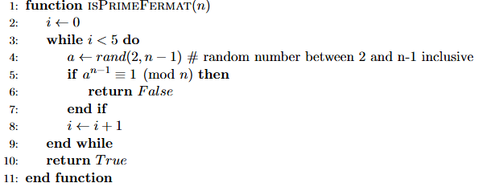
Fermat Primality Test
Idea: test a candidate number p against a few random values for a. If any value of a fails, the number is not prime. If they all pass, the number is probably prime

Slide 8


Analysis
O(k log³ n) runtime
n – number being tested
k – number of random iterations
Using binary exponentiation to compute a^{(n-1)} mod n takes O(log n) multiplications
Multiplication for large integers is O(log² n)
Carmichael Numbers
for all coprime b and n.
=> n has no repeated prime factors, and
561 = 3 × 11 × 17
1105 = 5 × 13 × 17
Notes:
Carmichael numbers are the only case where the strict inverse of Fermat's Little Theorem does not hold.
In order to find it with fermat's primality test, you have to pick a base that is not coprime with n. If you want to detect 561, you have to pick a b that has 3, 11, or 17 as a factor.
As numbers become larger, Carmichael numbers become increasingly rare. For example, there are 20138200 Carmichael numbers between 1 and 10^²¹ (approximately one in 50 trillion (5×10¹³) numbers). 1 in 48 numbers with 21 digits are actually prime, so carmichael numbers are exceedingly rare.
The other problem with this test is consistency. Outside of Carmichael numbers, there is no guarantee of the probability of a composite number passing a round of the fermat test.

Slide 9
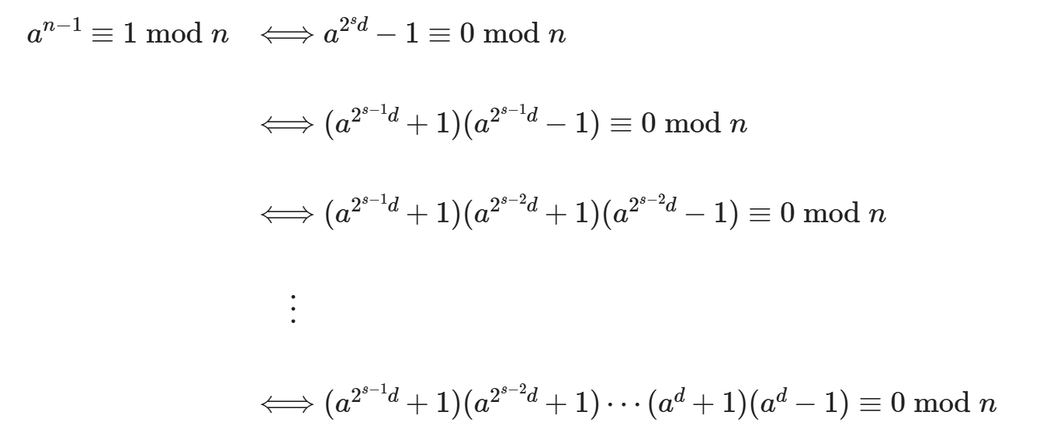
Expanding on the Fermat test
isPrimeTrialDivision(561) → False isPrimeFermat(561) → True
Faster, but not always reliable → how can we improve?
Rewrite n – 1 as 2^{s}· d where d is odd, then factorize
Notes:
For any prime number greater than 2, we can rewrite n-1 as 2^s * d, where d is odd

Slide 10
Expanding on the Fermat test
We can now test all of these factors, and if any of them are not prime we know the number is not prime.
Is this a stronger test than the basic Fermat test?

Slide 11
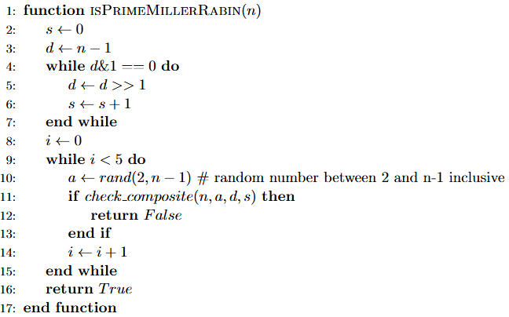
Miller-Rabin Primality Test
Use binary operations to decompose n into 2^{s} and d
Run check for each of 5 random test cases

Slide 12
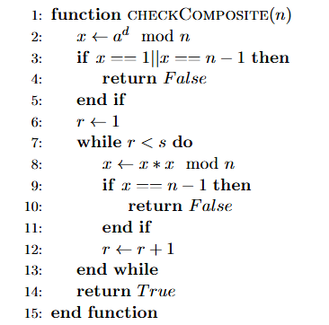
Miller-Rabin Primality Test
Check the last two factors of our factorization: (a^{d} + 1) and (a^{d} –1)
x is (a^{d} % n) at first, so multiplying it by itself produces (a^{2d} % n), then (a^{4d} % n), and with successively higher powers of 2

Slide 13

Analysis
O(k log³ n) runtime
O(log n) multiplications with binary exponentiation
O(log² n) for each multiplication
k rounds of testing
Same runtime as Fermat, but much stronger
¼ chance of failing on a composite number for any round
Overall chance of error $≤$ $\left( \frac{1}{4} \right)$^{k}
No more Carmichael issues

Slide 14
Why?
The Miller-Rabin test is more thorough than Fermat's test because residual 1 of the modulo from our Fermat's Little Theorem formulation can have different properties when our candidate p is prime or not.
Let n be prime, and x be a square root of 1 modulo n. Consider:
So n divides either (x-1) or (x+1), meaning that x is congruent to 1 or –1 mod n.

Slide 15
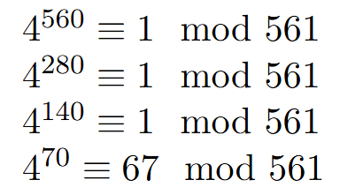
Why?
When p is prime, square roots of 1 mod p themselves are congruent to 1 or -1 mod p.
However, when p is composite, this isn't the case. Take the Carmichael number 561 and its coprime 4: with 4
Here, Miller-Rabin tested with 4 detects 561 as a composite number, since repeated square roots reveal a non-one residual

