Slide 1
Manacher’s Algorithm
By: Himani Mattoo, Ted Nyberg, Masato Takedai
Notes:
Himani 30s

Slide 2
The Problem
Longest palindromic substring
Palindrome Non-palindrome
RACECAR AAAB
ABBA ABCD
Notes:
Ted (60s)

Slide 3
Naive Approach - O(n^2)
A A A C A C A D D E
Iterate through every half-index
Expand out while the substring is palindromic
Store the longest palindrome
Notes:
Ted (90s)

Slide 4
Naive Approach - O(n^2)
A A A C A C A D D E
Longest palindrome = “A” at s.substring(0,1)

Slide 5
Naive Approach - O(n^2)
A A A C A C A D D E
Longest palindrome = “AA” at s.substring(0,2)

Slide 6
Naive Approach - O(n^2)
A A A C A C A D D E
Longest palindrome = “AA” at s.substring(0,2)

Slide 7
Naive Approach - O(n^2)
A A A C A C A D D E
Longest palindrome = “AAA” at s.substring(0,3)

Slide 8
Naive Approach - O(n^2)
A A A C A C A D D E
Longest palindrome = “AAA” at s.substring(0,3)

Slide 9
Naive Approach - O(n^2)
A A A C A C A D D E
Longest palindrome = “AAA” at s.substring(0,3)

Slide 10
Naive Approach - O(n^2)
A A A C A C A D D E
Longest palindrome = “AAA” at s.substring(0,3)

Slide 11
Naive Approach - O(n^2)
A A A C A C A D D E
Longest palindrome = “AAA” at s.substring(0,3)

Slide 12
Naive Approach - O(n^2)
A A A C A C A D D E
Longest palindrome = “AAA” at s.substring(0,3)

Slide 13
Naive Approach - O(n^2)
A A A C A C A D D E
Longest palindrome = “AAA” at s.substring(0,3)

Slide 14
Naive Approach - O(n^2)
A A A C A C A D D E
Longest palindrome = “AAA” at s.substring(0,3)

Slide 15
Naive Approach - O(n^2)
A A A C A C A D D E
Longest palindrome = “AAA” at s.substring(0,3)

Slide 16
Naive Approach - O(n^2)
A A A C A C A D D E
Longest palindrome = “ACACA” at s.substring(2,7)

Slide 17
A Faster Approach
To make it faster, we need to reuse information as we go down the string
We can take advantage of the symmetric quality of palindromes
Notes:
Masato 2min

Slide 18
Manacher’s Algorithm
0 | 0 | 1 | 0 | 3 | 0 | …
p[n]
Keep track of the longest palindrome radius centered at each index
Ex: ABCBA = radius of 2

Slide 19
Manacher’s Algorithm
0 | 1 | 2 | 3 | 4 | 5 | 6 | 7 | 8 | 9 | 10
0 | 0 | 1 | 0 | 3 | 0 | …
p[n]
L
C
R
Keep track of the right-most reaching palindrome so far

Slide 20
Manacher’s Algorithm
0 | 1 | 2 | 3 | 4 | 5 | 6 | 7 | 8 | 9 | 10
0 | 0 | 1 | 0 | 3 | 0 | ?
p[n]
L
C
R
Mirrored

Slide 21
Manacher’s Algorithm
0 | 1 | 2 | 3 | 4 | 5 | 6 | 7 | 8 | 9 | 10
0 | 0 | 1 | 0 | 3 | 0 | ?
p[n]
L
C
R
We already know index 2 has a radius of 1

Slide 22
Manacher’s Algorithm
0 | 1 | 2 | 3 | 4 | 5 | 6 | 7 | 8 | 9 | 10
0 | 0 | 1 | 0 | 3 | 0 | 1+
p[n]
L
C
R
That also means index 7 is also the same value!

Slide 23
Manacher’s Algorithm
0 | 1 | 2 | 3 | 4 | 5 | 6 | 7 | 8 | 9 | 10
0 | 0 | 1 | 0 | 3 | 0 | 2
p[n]
L
C
R
Expand further with equality checks

Slide 24
Manacher’s Algorithm
0 | 1 | 2 | 3 | 4 | 5 | 6 | 7 | 8 | 9 | 10
0 | 0 | 1 | 0 | 3 | 0 | 2 | ?
p[n]
L
C
R
Update L,C,R and move on to next index

Slide 25
Manacher’s Algorithm - Preprocessing
How can we handle both even and odd length strings the same way?
How can we avoid bounds checking every time we try to expand a palindrome?
Preprocess the string!
Notes:
Masato 60s

Slide 26
Manacher’s Algorithm - Preprocessing
Insert @ in front and $ in the end of the string
You don’t have to bounds check anymore
Insert # in between each character
All strings are now odd-length
ABABA -> @#A#B#A#B#A#$
ABBA -> @#A#B#B#A#$

Slide 27
Walkthrough
0 | 1 | 2 | 3 | 4 | 5 | 6 | 7 | 8 | 9 | 10
@ | # | a | # | b | # | b | # | a | # | $
palindrome radii array
Notes:
2.5 minute walkthrough of example
//0 1 2 3 3 2 1 0 0

Slide 28
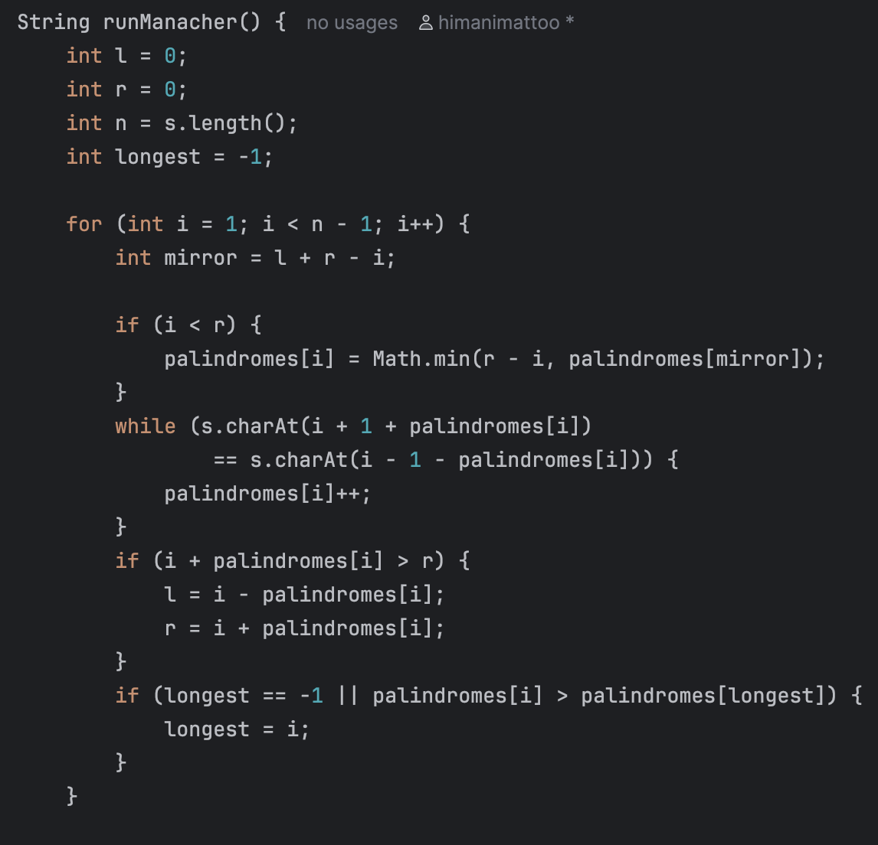
The Time Complexity
For Loop Cost - N
If Statements - O(1)
While Loop
looks like it could be N
BUT everytime this does something meaningful, it extends past the known right boundary r
Time Complexity - O(n)
Notes:
1 minute

Slide 29
Questions?
Notes:
Himani 30s

