Slide 1
Segment Tree Range Updates
Matthew, Owen, Bryan

Slide 2
Scenario
Support two operations efficiently:
Add a constant to every element in an array
Return the sum of range l…r
A plain array
O(1) to update one cell,
O(n) to sum a range.
A prefix sum array:
O(1) to sum a range,
O(n) to update one cell (every prefix after the update shifts for correctness).

Slide 3
Example
Given: [1, 2, 3]
Add 10 to range [0,1]:
[11, 12, 3]
Get sum of range [1,2]:
12 + 3 = 15

Slide 4
Optimization Progression
Unconstrained ideal:
O(1) update and O(1) query.
Impossible because a single update can change the answer to many future queries.
Core tension:
The gap between "touch every cell" and "touch a small number of summary nodes."

Slide 5
#1 Precomputing sums
Prefix sums aren’t fast enough
Summing manually is o(n)
Can we store partial sums so each query combines just a few of them?

Slide 6
#1 Precomputing sums
Build a binary tree where each node covers a contiguous slice and stores that slice's sum.
Recursively split the array in half.
Leaves cover one cell.
Internal nodes cover the union of their children.
Any query range can be covered by combining at most about
2 * log_2(len(array)) nodes.
Query becomes that many additions.
We can get a node’s sum in constant time
Node v has children 2v and 2v + 1.

Slide 7
#2 Lazy Propagation
Rewriting every leaf touched by a range-add is o(n) when computed eagerly.
But, when an update fully covers a node's range, that node's sum can be adjusted without touching its children at all.
Can the children wait to hear about the update until someone actually looks at them?
Stamp the node with a "pending addend" note.
Only push the note to children when we have to descend into them.
When descending into children, first flush the pending addend down one level

Slide 8
#2 Lazy Propagation
Any range update can be covered by combining at most about
2 * log_2(len(array)) nodes.
Query becomes that many additions.
Space increase!
O(len(array)) — two arrays of size roughly 4 × len(array), one for sums, one for pending addends.

Slide 9
Correctness
Invariant: for every tree node, tree_sums[node] equals the true sum of its array slice
When an update fully covers a node's range: we adjust that node's sum correctly and stamp a pending addend.
Descendants will see that addend when someone flushes it on the way down.
When we descend past a node we flush its pending addend to both children first.
A query returns the tree sum of a fully-covered node.
Inductively, every descent path flushes everything above it before reading, so every read is correct.

Slide 10
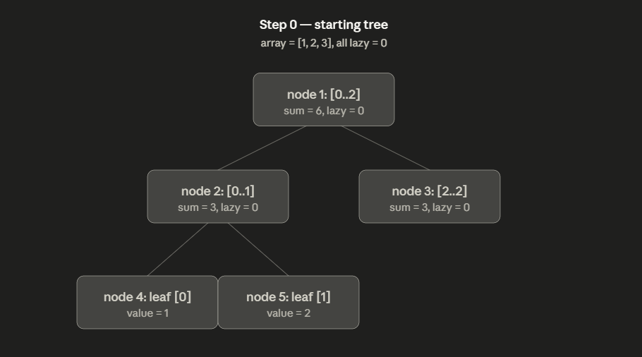
Imagine a tree…

Slide 11
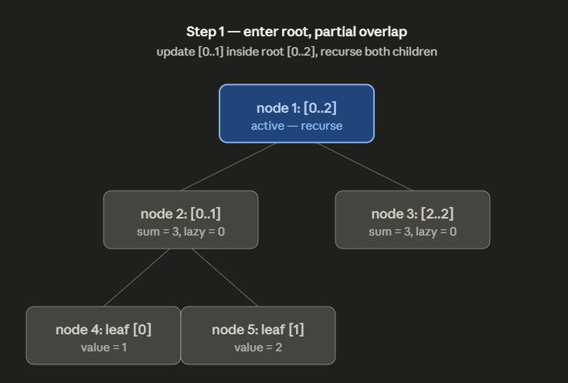
Verification - +10 to [0,1]
Start at node 1
[0..2] partially overlaps [0..1]

Slide 12
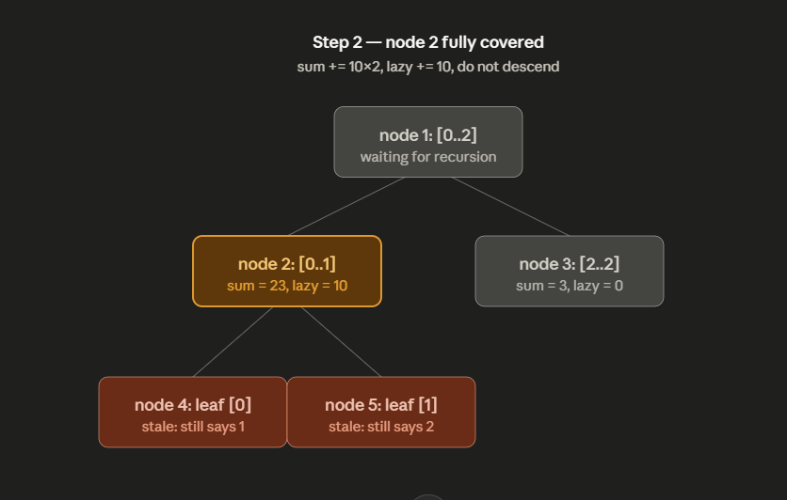
Verification - +10 to [0,1]
Recursing to node 2.
Fully covers range. Update and stop.
Tree_sums[2] = 3 + 10 * 2.

Slide 13
Verification - +10 to [0,1]
Still recursing to node 2.
Tree_sums[2] = sum + addend * covered cells = 3 + 10 * 2
Lazy_pending[2] = 10. We stop here.

Slide 14
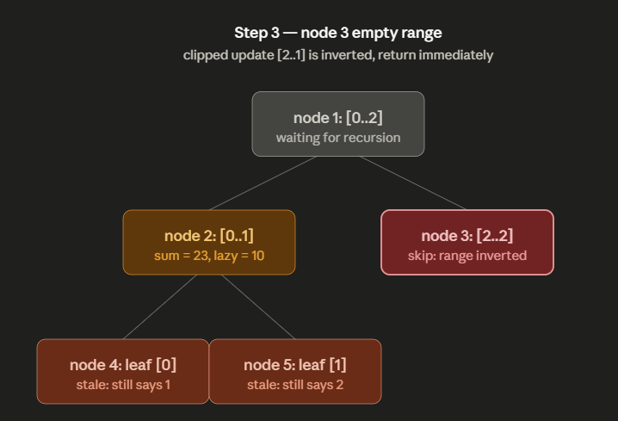
Verification - +10 to [0,1]
Let’s look at node 3.
Let’s not look at node 3 because there’s nothing to do.

Slide 15
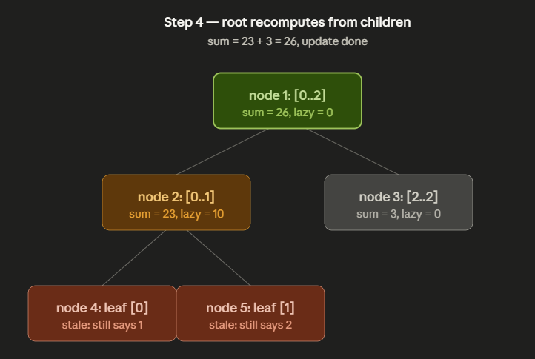
Verification - +10 to [0,1]
Bubbling back up to node 1.
Tree_sums[1] = tree_sums[2] + tree_sums[3] = 23 + 3 = 26
I.e., [11, 12, 3]

Slide 16
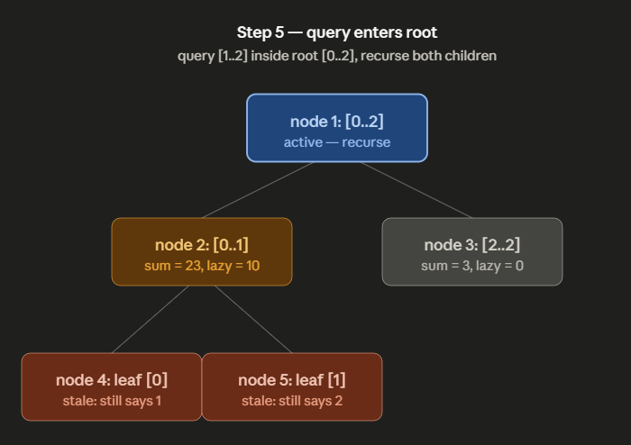
Verification - query [1,2]
Start at node 1
[0..2] partially overlaps with [0..1]
Let’s recurse.

Slide 17
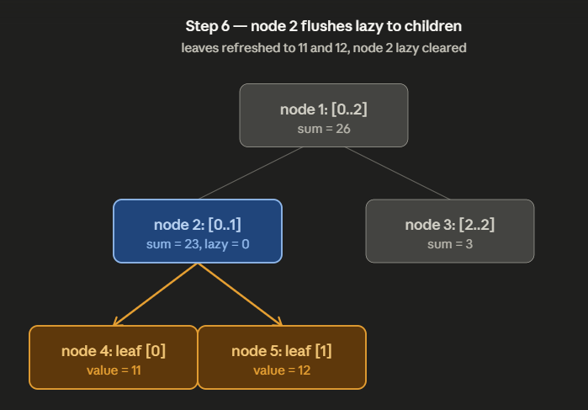
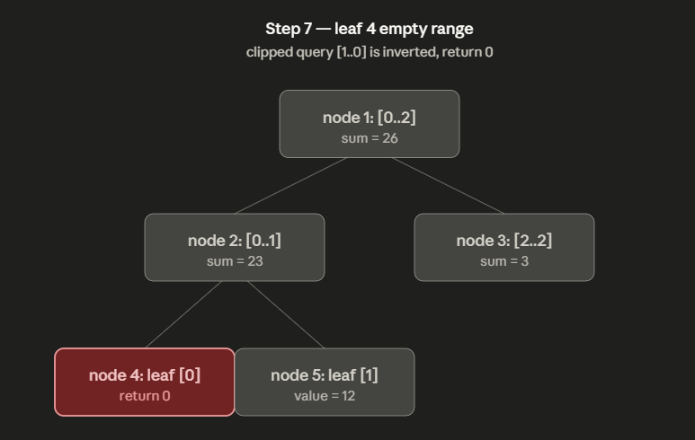
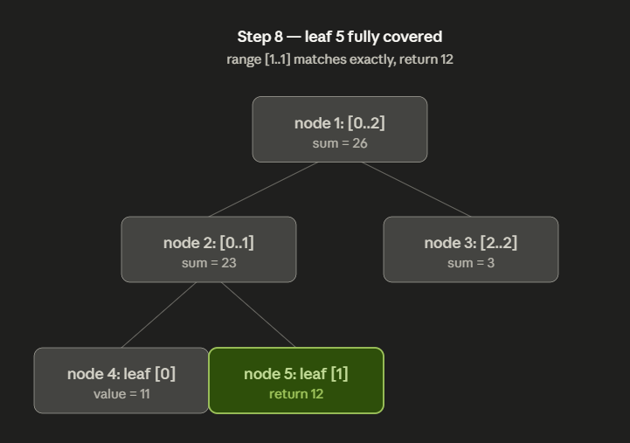
Verification - query [1,2]
Node 2 partially overlaps.
Flush lazy + 10.
Node 4 is outside the rang (inverted).
Node 5 is within our range. Gets returned up to node 2.

Slide 18
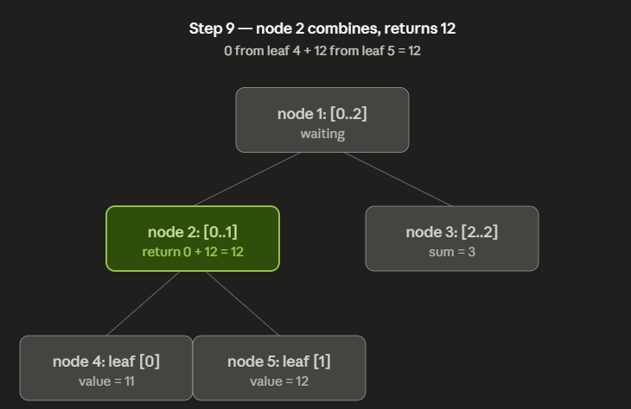
Verification - query [1,2]
Bubble up

Slide 19
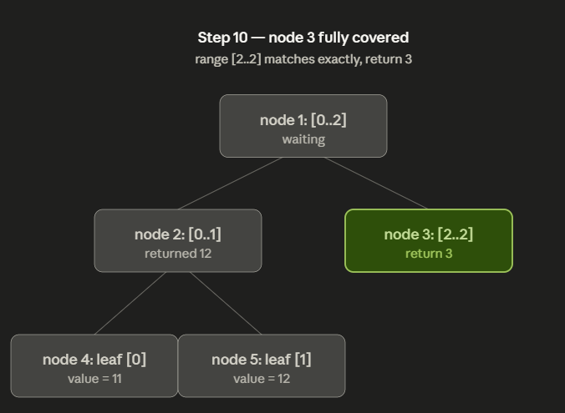
Verification - query [1,2]
Looking at node 3.
Within range; return it.

Slide 20
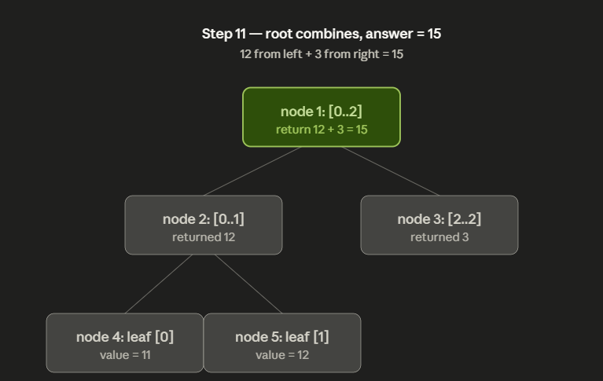
Verification - query [1,2]
At root, node 1.
Combine left and right. 12 + 3 = 15.

Slide 21
Wrap-Up
Notes:
Time per operation:
O(log(len(array))) =
× O(log(len(array))) — descent depth, up to 2 paths
× O(1) — sum merge and lazy stamp per node
Dominant cost: the descent. Lazy flush is constant per level.
Space:
O(len(array)) =
× O(4 · len(array)) — sums array
× O(4 · len(array)) — pending addends array
The 4× factor covers unbalanced tree shapes when array size isn't a power of two.

Slide 22
Possible Challenge
Every leaf node has a max capacity, but you need to add certain amounts to a range
You are an immoral employer who employs a bunch of people working on a bunch of projects
Each project that gets finished, everyone that worked on it gets a bonus
You don’t want to pay anybody more than a certain amount, if their bonus goes over their current pay, too bad it’s gone (cap to capacity)

