Slide 1
Treaps
Rui Zhang, Yushen Liu, Emily Zhou
Adv Algos

Slide 2
Motivation
Problem
Solution
BST is fast ONLY if balanced
Worst case: O(n)
Real world applications:
Network Routing Tables
Database Indexing
Existing solutions:
AVL / Red-Black has complicated rotations & rules
What if we used randomness instead of strict rules?
Notes:
Quick question: how many of you have implemented a BST before? (the answer should be everyone)
Everyone should be somewhat familiar that a BST is fast ONLY if it’s balanced. If it isn’t, then the worst case run time is O(n)
Now sure, we can avoid the O(n) case with AVL trees or Red-Black trees… but let’s be honest, they’re tedious to implement. There’s rotations, colors, balance factors…
Treaps take a totally different approach:
what if instead of enforcing balance… we just let randomness handle it? we just flip coins and somehow get O(log n) anyway.
And treaps aren't just a textbook concept as they actually show up in real systems, like IP routing tables where fast lookups and updates matter and strict rebalancing would be too costly.
And they're a go-to in competitive programming too, because you can split and merge sequences in O(log n), which makes them way easier to work with than something like a red-black tree.

Slide 3
Treap = Tree + Heap
key=5, p=90
Stores pairs: (X, Y) = (key, priority)
Properties:
BST on X (keys)
Left subtree: X ≤X₀
Right subtree: X₀≤X
Heap on Y (priorities)
Parent has higher priority than children
2, 80
8, 70
Notes:
So a treap is literally a mashup of two structures: a binary search tree and a heap.
A treap stores pairs of values in each node, written as (X, Y).
X is your key
Y is your priority
And it enforces two rules at the same time:
First: the BST property on X:
everything in the left subtree has a smaller key
everything in the right subtree has a larger key
Second: the heap property on Y:
every node has a higher priority than its children

Slide 4
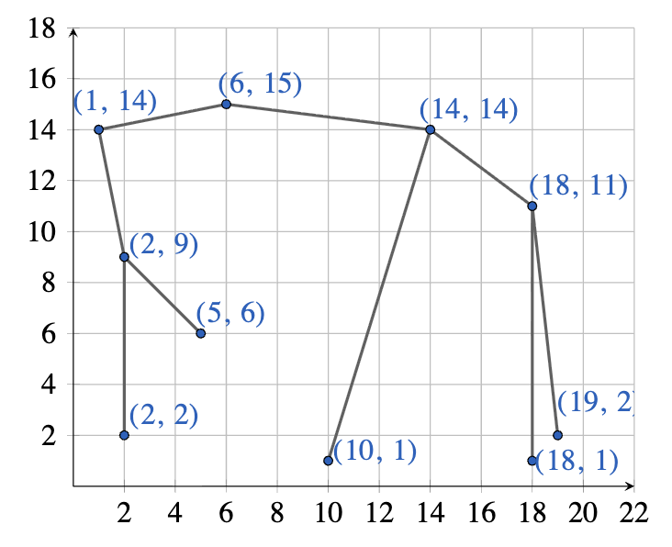
Properties
Equivalent view:
A Cartesian Tree
Can be visualized as points (X, Y)
Notes:
Another way to think about this, is that a treap is actually a Cartesian tree.
You can view every node as a point on a graph:
X-axis = key
Y-axis = priority
The treap is basically the unique tree you get if you:
keep keys in sorted order (like a BST)
and always pull the highest priority node upward (like a heap)

Slide 5
Operations
A treap provides the following operations:
Search
Insert
Delete
Split / Merge

Slide 6
Search
Operation 1:
50, 90
30, 80
70, 60
Search uses only the BST property on keys
Compare target key with current node
Move left if smaller, right if larger
Stop when found or reach null
20, 40
40, 50
65, 40
90, 30
recall:
(X, Y) = (key, priority)
Ex:
Search for key = 40
Notes:
Even though a treap also has priorities, search is exactly the same as in a binary search tree. We ignore priority and only follow the key ordering
at each node, we compare our target key with the current node’s key. If the target is smaller, we go left. If it’s larger, we go right
and we just keep doing that until we either find the key or reach a null pointer.

Slide 7
Search
Operation 1:
50, 90
30, 80
70, 60
Search uses only the BST property on keys
Compare target key with current node
Move left if smaller, right if larger
Stop when found or reach null
20, 40
40, 50
65, 40
90, 30
recall:
(X, Y) = (key, priority)
Ex:
Search for key = 40

Slide 8
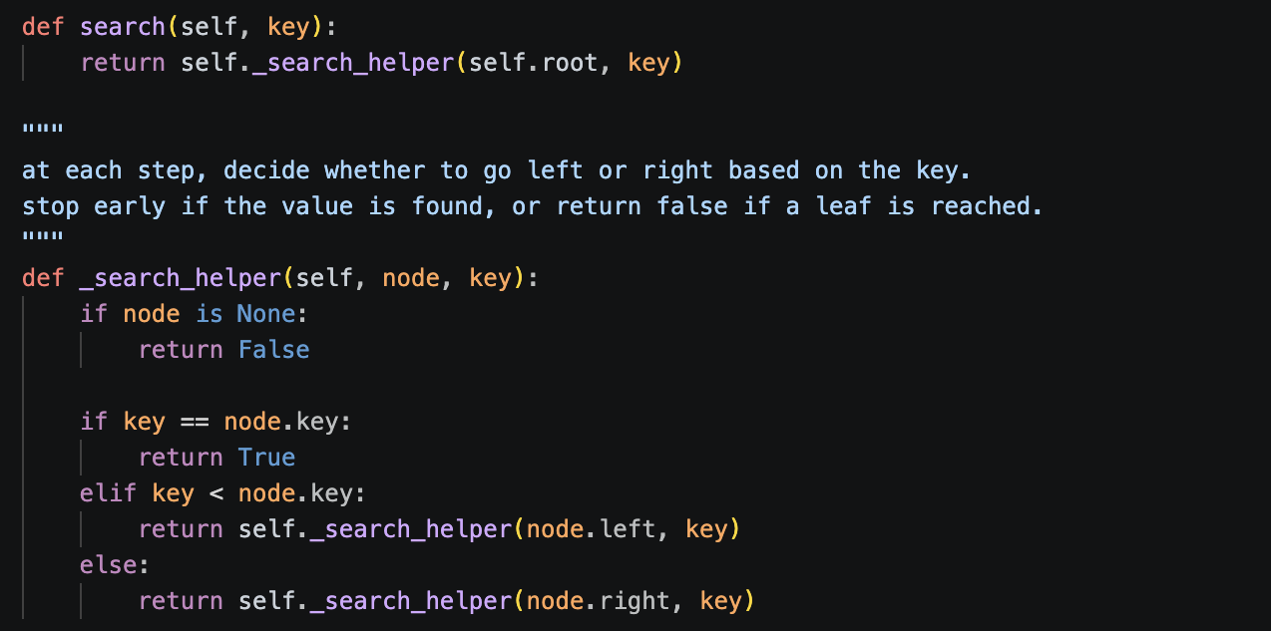
Search

Slide 9
Insert
Operation 2:
50, 90
30, 80
70, 60
Insert by BST key order
Assign a random priority
Restore heap property by rotations
Final tree satisfies both BST and heap rules
Ex:
Insert new node: (40, 95)

Slide 10
Insert
Operation 2:
50, 90
30, 80
70, 60
Insert by BST key order
Assign a random priority
Restore heap property by rotations
Final tree satisfies both BST and heap rules
40, 95
Ex:
Insert new node: (40, 95)

Slide 11
Insert
Operation 2:
50, 90
30, 80
70, 60
Insert by BST key order
Assign a random priority
Restore heap property by rotations
Final tree satisfies both BST and heap rules
40, 95
violates max-heap property:
larger priority should be higher
Ex:
Insert new node: (40, 95)

Slide 12
Insert
Operation 2:
50, 90
30, 80
70, 60
Insert by BST key order
Assign a random priority
Restore heap property by rotations
Final tree satisfies both BST and heap rules
40, 95
Rotation is all we need:
50, 90
40, 95
70, 60
Ex:
Insert new node: (40, 95)
30, 80
Notes:
Insertion has two goals: put the key in the right place, then repair the priority order. So treap insertion is basically BST insertion followed by heap fixing

Slide 13
Insert
Operation 2:
50, 90
50, 90
30, 80
70, 60
40, 95
70, 60
40, 95
30, 80
Insert by BST key order
Assign a random priority
Restore heap property by rotations
Final tree satisfies both BST and heap rules
Another rotation:
40, 95
30, 80
50, 90
Ex:
Insert new node: (40, 95)
70, 60
Notes:
Insertion has two goals: put the key in the right place, then repair the priority order. So treap insertion is basically BST insertion followed by heap fixing

Slide 14
Delete
Operation 3:
40, 95
First find the node by key
Remove it while preserving both properties
Common idea:
rotate it downward, then delete
or merge its two subtrees
30, 80
50, 90
70, 60
Ex:
Delete node: (50, 90)
Notes:
Deletion is the reverse of insertion. Instead of bubbling a node up, we push it down until it can be removed safely.

Slide 15
Delete
Operation 3:
First find the node by key
Remove it while preserving both properties
Common idea:
rotate it downward, then delete
or merge its two subtrees
40, 95
30, 80
70, 60
Ex:
Delete node: (50, 90)

Slide 16
Split & Merge
Operation 4:
50, 90
30, 80
70, 60
split(T, x) is straightforward
20, 40
40, 50
Left half:
Right half:
30, 80
50, 90
Ex:
Given a treap and key x = 40, split into:
left treap: keys <= 40
right treap: keys > 40
20, 40
40, 50
70, 60

Slide 17
Split & Merge
Left half:
Right half:
Operation 4:
30, 80
50, 90
20, 40
40, 50
45, 70
70, 60
merge(L, R) combines two valid treaps
all keys in left are smaller than all keys in right
compare root priorities
higher priority root becomes new root
recursively merge remaining subtree
Ex:
Given two treaps L and R, merge(L, R)

Slide 18
Split & Merge
Operation 4:
Left half:
Right half:
30, 80
50, 90
merge(L, R) combines two valid treaps
all keys in left are smaller than all keys in right
compare root priorities
higher priority root becomes new root
recursively merge remaining subtree
20, 40
40, 50
45, 70
70, 60
Merge ((30, 80), (50, 90))
80 < 90
Ex:
Given two treaps L and R, merge(L, R)

Slide 19
Split & Merge
Operation 4:
Left half:
Right half:
30, 80
50, 90
merge(L, R) combines two valid treaps
all keys in left are smaller than all keys in right
compare root priorities
higher priority root becomes new root
recursively merge remaining subtree
20, 40
40, 50
45, 70
70, 60
Merge ((30, 80), (50, 90))
80 < 90
50, 90
Ex:
Given two treaps L and R, merge(L, R)
70, 60

Slide 20
Split & Merge
Operation 4:
Left half:
Right half:
30, 80
50, 90
merge(L, R) combines two valid treaps
all keys in left are smaller than all keys in right
compare root priorities
higher priority root becomes new root
recursively merge remaining subtree
20, 40
40, 50
45, 70
70, 60
Merge ((30, 80), (45, 70))
80 > 70
30, 80
20, 40
45, 70
Ex:
Given two treaps L and R, merge(L, R)
40, 50

Slide 21
Split & Merge
Operation 4:
Left half:
Right half:
30, 80
50, 90
20, 40
40, 50
45, 70
70, 60
merge(L, R) combines two valid treaps
all keys in left are smaller than all keys in right
compare root priorities
higher priority root becomes new root
recursively merge remaining subtree
Plug it into the original tree
50, 90
30, 80
70, 60
20, 40
45, 70
Ex:
Given two treaps L and R, merge(L, R)
40, 50

Slide 22
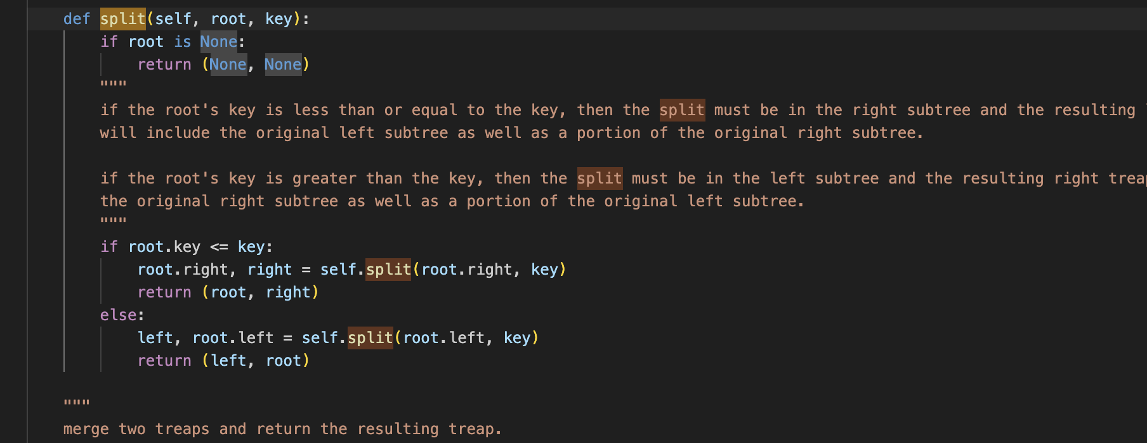
Split

Slide 23
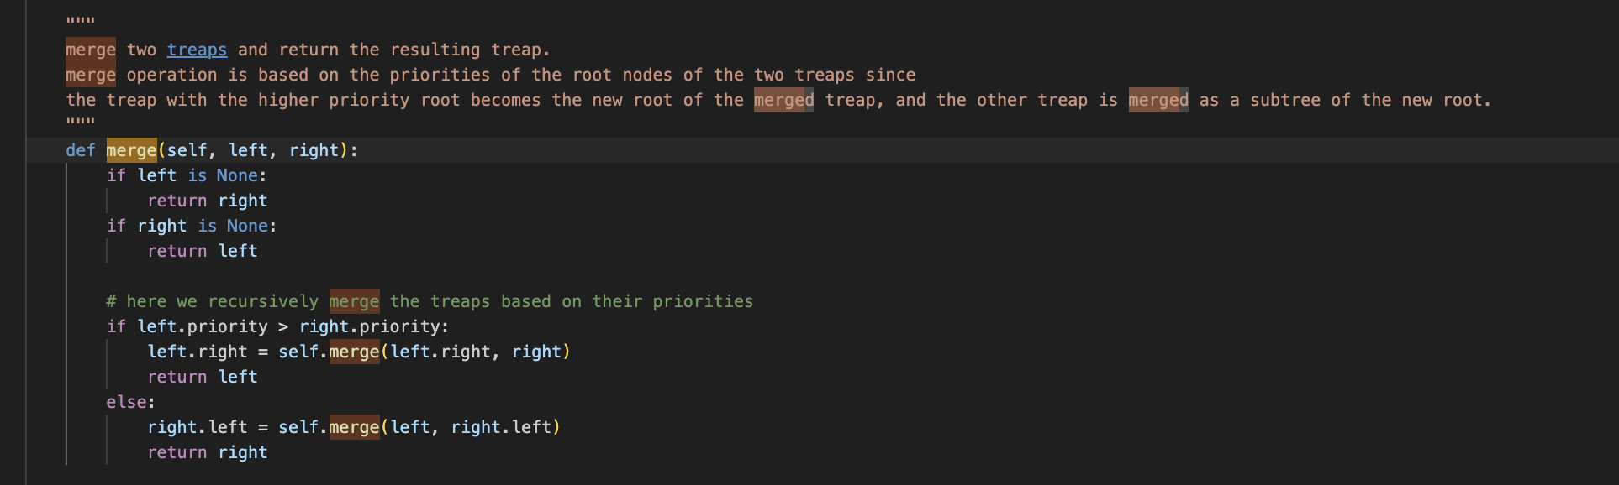
Merge

Slide 24
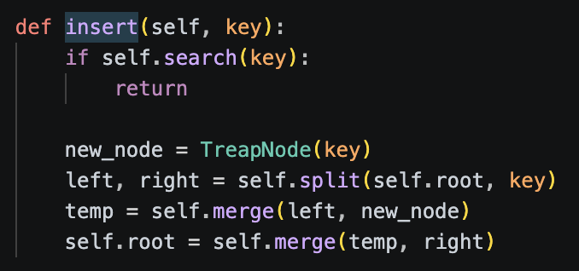
Insert

Slide 25
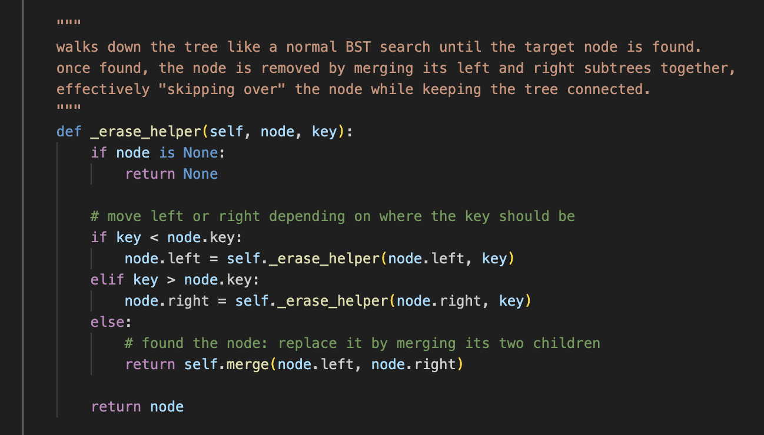
Delete

Slide 26
Comparison
Structure | Balance Type | Complexity | Difficulty
BST | none | O(n) worst | easy
AVL | strict | O(log n) | hard
Red-Black Tree | relaxed | O(log n) | medium
Treap | randomized | O(log n)* | easy
Notes:
So the tradeoff is:
AVL / Red-Black → guaranteed balance, more complex
Treap → probabilistic balance, much simpler

Slide 27
Optimizations
Implicit
BST is now ordered by position (idx in array) instead of by key
position = size(left subtree)
Used for:
dynamic arrays
sequence manipulation
Supports:
insert/delete at position
reverse subarrays
range queries
2. FHQ
Avoids rotations entirely
Uses:
split() and merge() only
Cleaner implementation
Popular in competitive programming
3. Augmented Treaps
Store extra info in nodes:
subtree size
sum / min / max
Etc. !
Enables:
range queries in O(log n)
Notes:
Treaps as is are not commonly
1. Implicit Treaps
One really cool variant is called an implicit treap.
Instead of storing keys explicitly, the ‘key’ is just the position of the node in the structure.
This is super useful for things like sequence manipulation, where you don’t really care about sorting values but moreso manipulating sequences
Now arrays that used to be O(n) are O(logn)
2. FHQ Treap
For this optimization, you don’t even use rotations anymore, which u used to use for insert/delete.
Everything is done using just two operations:
split
merge
And because of that, the code becomes way simpler and cleaner.
This version is actually very common in competitive programming.
3. Augmented Treaps
You can also augment treaps by storing extra information in each node.
subtree size
sum of values
min or max
And this lets you answer range queries in O(log n), similar to segment trees, but more flexible.

Slide 28
Takeaways
Treaps = BST + Heap
Use randomness instead of strict balancing
Simple + efficient in practice
Great for:
Competitive programming
Fast prototyping
Notes:
So to wrap up, treaps give you:
near-optimal performance
And a way simpler implementation
And if you ever find yourself thinking ‘wow I don’t wanna implement a red-black tree’... just remember: treaps exist.

Slide 29
Thank you for listening!
Any questions?

