Slide 1
BLOOM FILTER
ADVANCED ALGORITHMS MARK FLORYAN
Ethan Coon, David Hu, Aidan Liu

Slide 2
THE PROBLEM
Given a very large, unsorted dataset, it can be costly to determine whether something exists in the dataset.
Generalized solutions all have their own faults.
Array
Binary search
Hashmap
Goal: Find a fast and space-efficient way to both insert and check membership in O(1)-ish time and constant space

Slide 3
CORE IDEA
A Bloom filter uses a bit array to track set membership
Through hashing, a given element is mapped to a combination of bits in the array to add to the set or denote set membership
Bloom filter supports 2 operations
Insert
Query
(Notice: no delete!)
Tradeoff: sacrifice accuracy for less memory

Slide 4
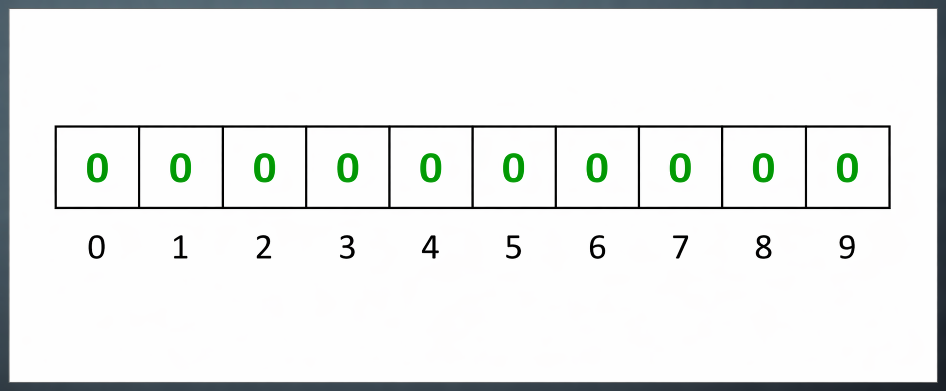
BIT ARRAY
An empty bloom filter is a bit array of m bits. All set to zero.

Slide 5
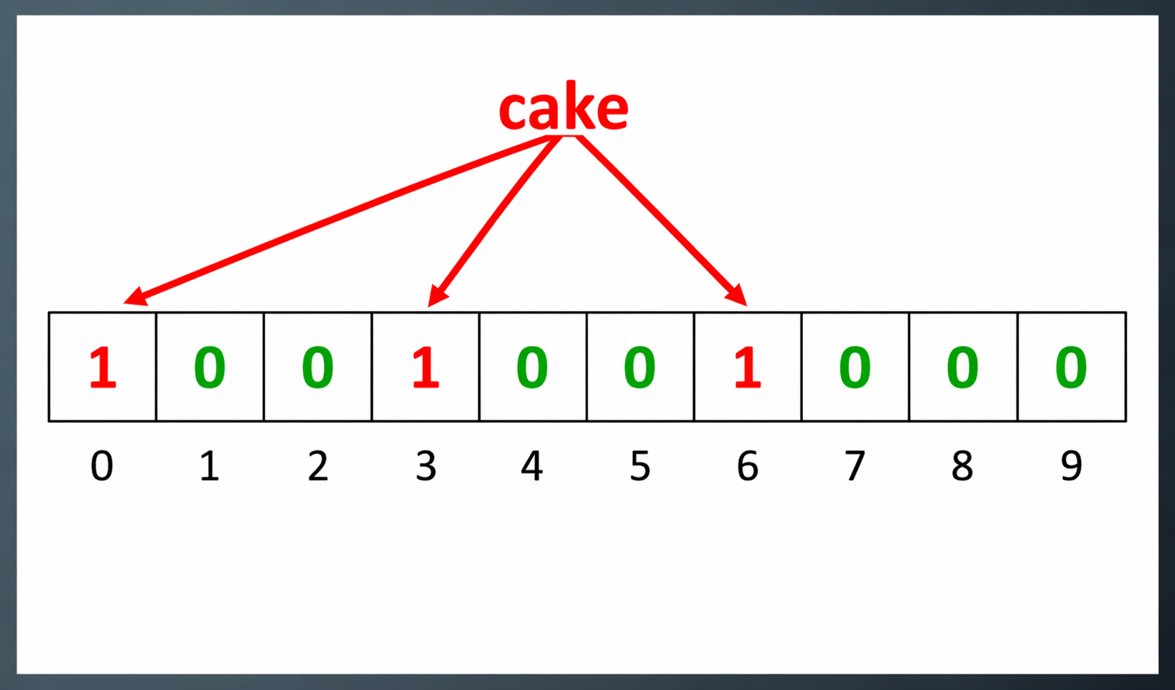
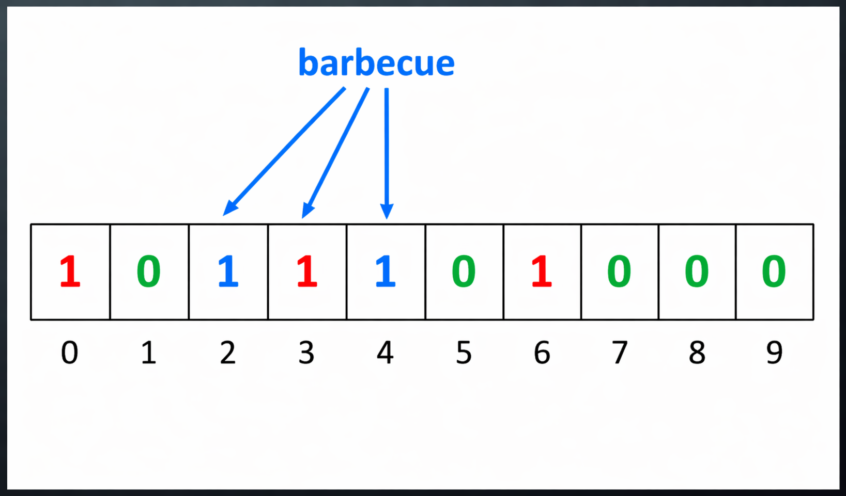
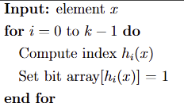
INSERT
Hash the item k times
Find the indices in the bit array corresponding to hashes
Set bit indices to 1

Slide 6
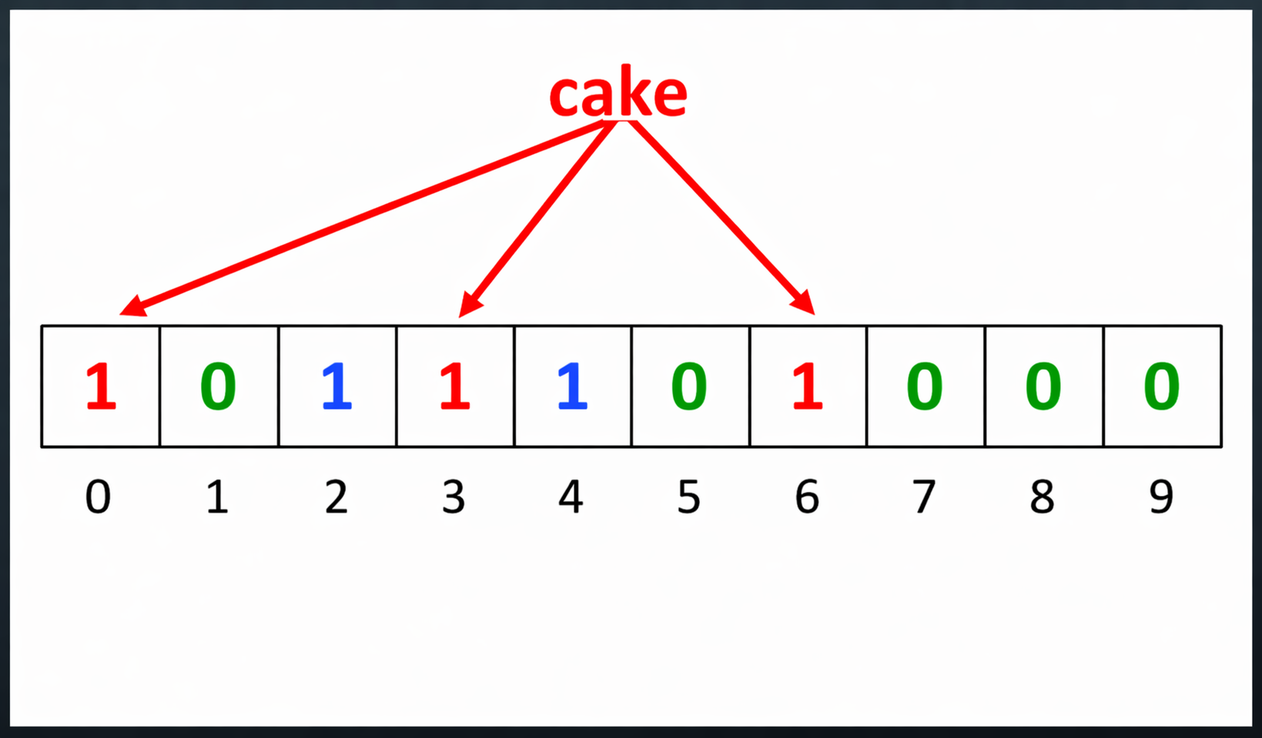
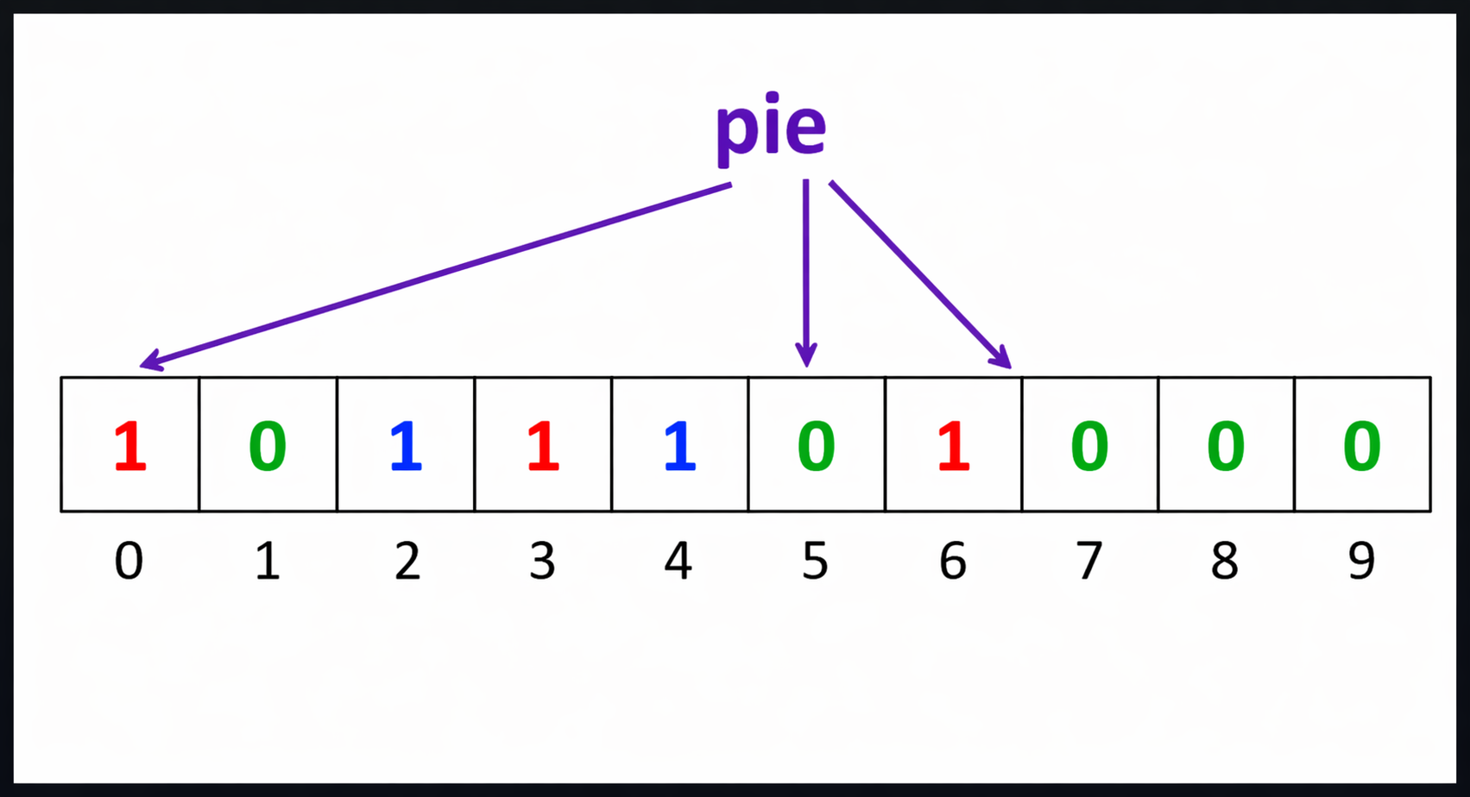
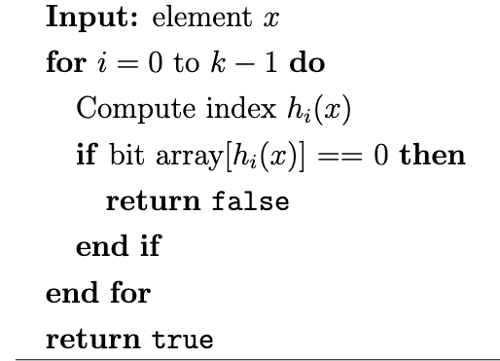
QUERY
Hash the queried element
Check bit array at hashed indices
If ALL bit indices 1 → Return True (Probably present)
Else (≥1 zero) → Return False
(Definitely not present)

Slide 7
ALGORITHM WALKTHROUGH
We hash it k times. Each hash gives us an index
Hash 1: 7 mod m → 7
Insert: “apple”
m = 10
k = 3
0 | 0 | 0 | 0 | 0 | 0 | 0 | 1 | 0 | 0
0 | 1 | 2 | 3 | 4 | 5 | 6 | 7 | 8 | 9

Slide 8
ALGORITHM WALKTHROUGH
We hash it k times. Each hash gives us an index
Hash 1: 7 mod m → 7
Hash 2: 20 mod m → 0
Insert: “apple”
m = 10
k = 3
1 | 0 | 0 | 0 | 0 | 0 | 0 | 1 | 0 | 0
0 | 1 | 2 | 3 | 4 | 5 | 6 | 7 | 8 | 9

Slide 9
ALGORITHM WALKTHROUGH
We hash it k times. Each hash gives us an index
Hash 1: 7 mod m → 7
Hash 2: 20 mod m → 0
Hash 3: 93 mod m → 3
Insertion complete
Insert: “apple”
m = 10
k = 3
1 | 0 | 0 | 1 | 0 | 0 | 0 | 1 | 0 | 0
0 | 1 | 2 | 3 | 4 | 5 | 6 | 7 | 8 | 9

Slide 10
ALGORITHM WALKTHROUGH
Hash 1: 34 mod m → 4
Can stop checking here
Query: “grape”
m = 10
k = 3
1 | 0 | 0 | 1 | 0 | 0 | 0 | 1 | 0 | 0
0 | 1 | 2 | 3 | 4 | 5 | 6 | 7 | 8 | 9

Slide 11
ALGORITHM WALKTHROUGH
Hash 1: 13 mod m → 3
Hash 2: 60 mod m → 0
Hash 3: 37 mod m → 7
False positive
Query: “Advanced Algorithms and Implementations”
m = 10
k = 3
1 | 0 | 0 | 1 | 0 | 0 | 0 | 1 | 0 | 0
0 | 1 | 2 | 3 | 4 | 5 | 6 | 7 | 8 | 9

Slide 12

HASHING
But it would be impractical to have k entirely separate hashing functions
Instead, we can generate them efficiently from just 2 hashes:
Avoids expensive hashing
Still distributes well
Important: For good distribution, h_{b} should not share factors with m, otherwise the sequence may only hit a subsection of the indices
h_{a}("apple") = 17
h_{b}("apple") = 23
h₀ = (17 + 0 * 23) mod m = 17 mod m = 7
h₁ = (17 + 1·23) mod m = 40 mod m = 0
h₂ = (17 + 2·23) mod m = 63 mod m = 3

Slide 13
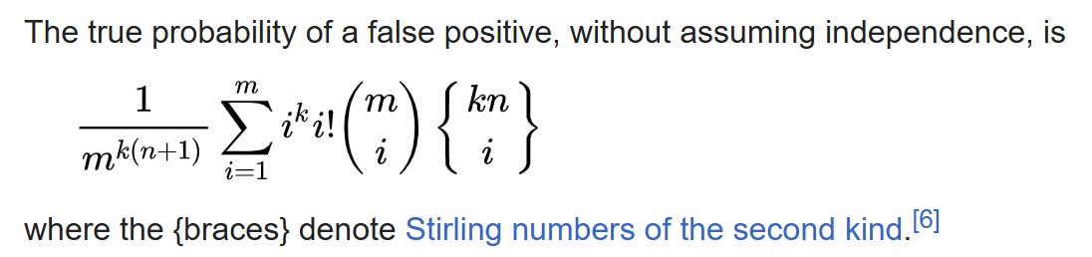
COMPLEXITY AND ACCURACY
Space: O(m) (bit array size) Insert/query: O(k) (# of hash functions)
Operations are essentially constant time and only depend on initial parameters
There is an equation for the probability of false positives… it’s pretty complex
m = bits n = elements k = # of hash functions

Slide 14
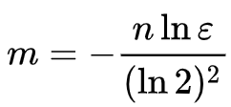
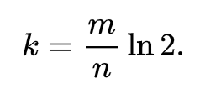
TUNING PARAMETERS
Let there be a target false positive rate ε And an expected amount of inserts that will be performed on this filter n
We can then calculate an optimal bit length of the filter m and optimal number of hash functions to use k.

Slide 15

APPLICATIONS OF BLOOM FILTERS
What do you call a group of Bloom Filters?
Databases
False negatives aren’t possible, so use Bloom Filters to speed up queries that might look for nonexistent data
Web caching
If some web resource is only going to be used once (for a very long time) why bother caching it?
Use bloom filter to detect a second request, only then should we cache
Preliminary security defenses
Chrome used to use a Bloom Filter as a first check for malicious URLs
Packet filtering

