Slide 1
Aho–Corasick
Taught by Lysander, Michael, and Daniel

Slide 2
Why use Aho-Corasick?
Like Rabin–Karp, it searches for targets inside a large corpus.
It also handles many patterns of different lengths at once.
It avoids hash-collision issues because it uses an automaton rather than hashing.
Which is why grep -F uses this approach.

Slide 3
Aho-Corasick is a combination of two constituent algorithms.
We will break this algorithm into two parts and put them together.
Knuth-Morris-Pratt is for finding a substring within a corpus using a DFA.
A trie is a DFA tree that stores many candidate strings and checks a corpus against all of them simultaneously.
We will show how Aho-Corasick is a combination of these two approaches.

Slide 4
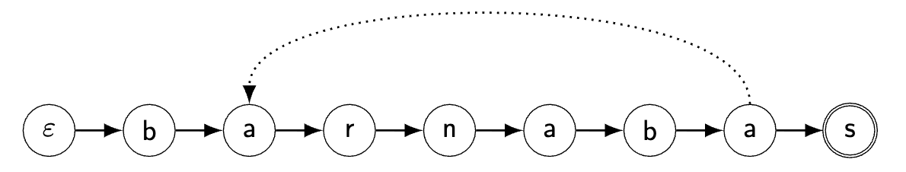
Knuth-Morris-Pratt Implementation
Key idea:
On a mismatch, do not restart the text scan.
Jump to the longest proper prefix that is also a suffix of what was matched.
Ex: barnabas has a meaningful failure link from the third a to the first one.

Slide 5
Characteristics of KMP...
Preprocessing the pattern to generate the DFA is linear in m.
Scanning through the corpus is linear in n.
Total runtime is Θ(m + n)
An aside: When you use the indexOf function, another algorithm is usually used called Boyer-Moore, which has different methods that don't scale to Aho-Corasick.

Slide 6
Motivation of a trie (optimized tree set for strings)
You want to determine if an element is a member of a set.
For trivially comparable types like numbers, you might use a tree set.
A trie works similarly, but each node in the tree is a character in the dictionary, and the children of each node are the subsequent characters in strings in the set.
When we get to the end of our test string, if we are at a terminal node, that the string is in the set.

Slide 7
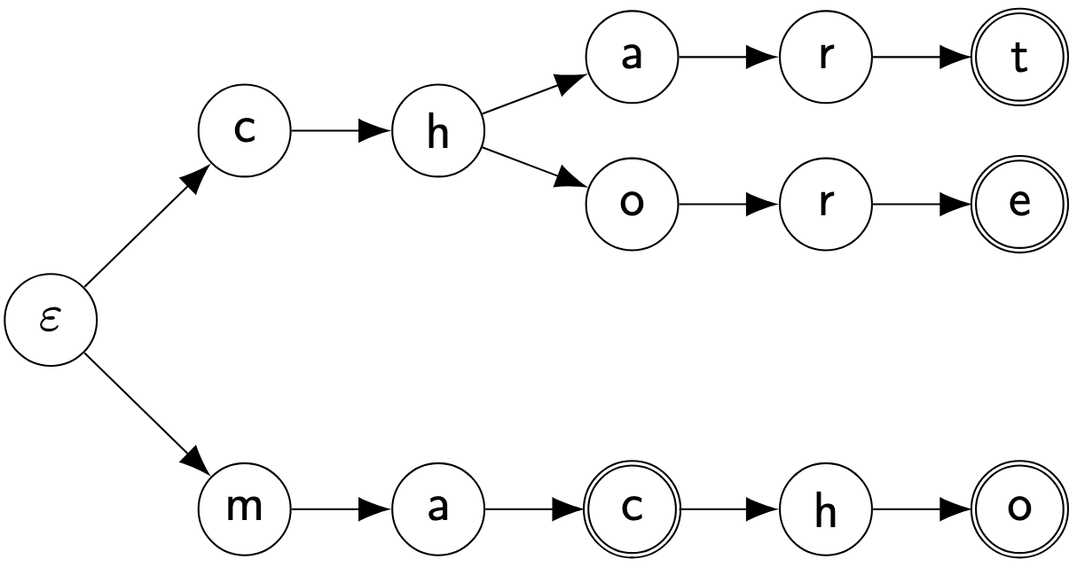
How to build a trie
It is a DFA where the root represents the empty prefix.
Every edge represents one additional character.
Terminal nodes in the DFA represent the ends of strings in the dictionary. In this example, we have the dictionary members: chart, chore, and macho, and mac.

Slide 8
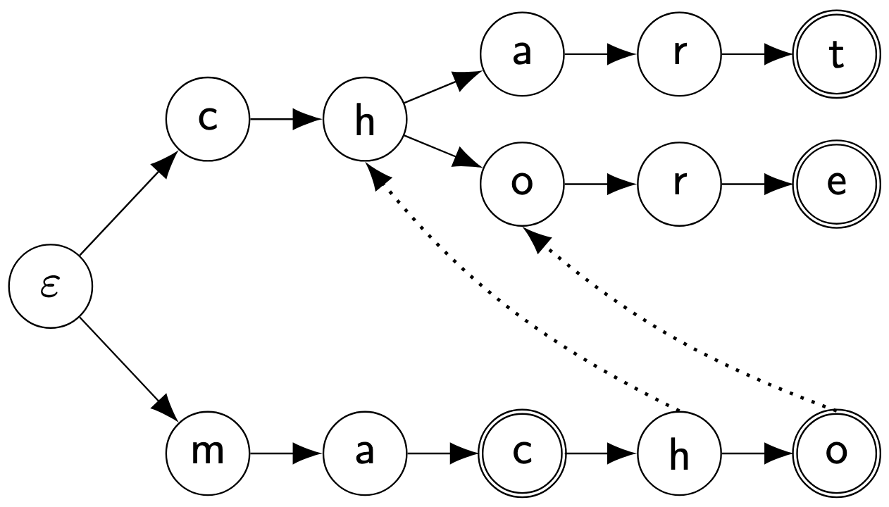
Upgrading the trie
We use the same philosophy for failure links from KMP.

Slide 9
Summary of Aho-Corasick
KMP contributes the idea of failure links: on a mismatch, we go to another position in the DFA that encodes all relevant state.
A trie contributes the ability to check against many strings simultaneously, using common prefixes in DFA.
Aho–Corasick combines them into one automaton for multi-pattern exact substring search.
Preprocessing is linear in the total dictionary size m.
Searching is linear in the corpus length n + number of matches p.
Θ(m + n + p)

