Slide 1
Knuth-Morris Pratt Algorithm
Advanced Algorithms
Paul Romer, Kevin Shi, Alex Talreja

Slide 2
Motivation
Goal: Given a text and a pattern, find all occurrences of the full pattern within the text and return those indices

Slide 3
Naïve Approach
Given a text and pattern, at every index in the text see if using that as the start there is a full pattern match
A | C | F
A | C | D | A | C | F

Slide 4
Naïve Approach
Given a text and pattern, at every index in the text see if using that as the start there is a full pattern match
A | C | F
A | C | D | A | C | F

Slide 5
Naïve Approach
Given a text and pattern, at every index in the text see if using that as the start there is a full pattern match
A | C | F
A | C | D | A | C | F

Slide 6
Naïve Approach
Given a text and pattern, at every index in the text see if using that as the start there is a full pattern match
A | C | F
A | C | D | A | C | F

Slide 7
Naïve Approach
Given a text and pattern, at every index in the text see if using that as the start there is a full pattern match
A | C | F
A | C | D | A | C | F

Slide 8
Naïve Approach
Given a text and pattern, at every index in the text see if using that as the start there is a full pattern match
A | C | F
A | C | D | A | C | F

Slide 9
Naïve Approach
Given a text and pattern, at every index in the text see if using that as the start there is a full pattern match
A | C | F
A | C | D | A | C | F

Slide 10
Naïve Approach
Given a text and pattern, at every index in the text see if using that as the start there is a full pattern match
A | C | F
A | C | D | A | C | F

Slide 11
Naïve Approach
Given a text and pattern, at every index in the text see if using that as the start there is a full pattern match
A | C | F
A | C | D | A | C | F
Print/Store 3

Slide 12
Naïve Approach Runtime
O(mn) for the naïve approach
M: length of the pattern
N: length of the text
A | C | F
B | C | A | C | D | A | C | F

Slide 13
PREFIX TABLE (idea/concept)
What if instead of losing all our progress at a mismatch, we had some way to know what the longest part of our current match could still be valid as a new starting point?
Preventing us from fully restarting at a mismatch
We do this with a prefix table
The prefix table tells us how many characters of the pattern we have already matched/seen

Slide 14
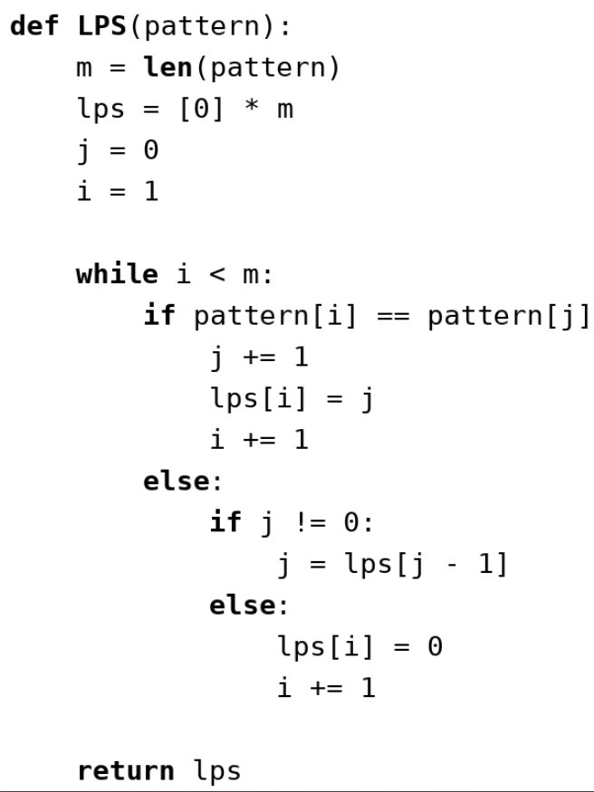
Building the lps table
A | B | A | B | C
Pattern
0
LPS
J
i

Slide 15
Building the lps table
A | B | A | B | C
Pattern
0 | 0
LPS
J
i

Slide 16
Building the lps table
A | B | A | B | C
Pattern
0 | 0 | 1
LPS
J
i

Slide 17
Building the lps table
A | B | A | B | C
Pattern
0 | 0 | 1 | 2
LPS
J
i

Slide 18
Building the lps table
A | B | A | B | C
Pattern
0 | 0 | 1 | 2
LPS
J
i

Slide 19
Building the lps table
A | B | A | B | C
Pattern
0 | 0 | 1 | 2
LPS
J
i

Slide 20
Building the lps table
A | B | A | B | C
Pattern
0 | 0 | 1 | 2 | 0
LPS
J
i

Slide 21
Core idea: Stop moving backwards
Naïve Search:
Pointer jumps back to the start of the string after every mismatch. Time wasted.
KMP Search:
Text pointer never moves backwards. Use a Longest Prefix-Suffix (LPS) Table to reuse matches.

Slide 22
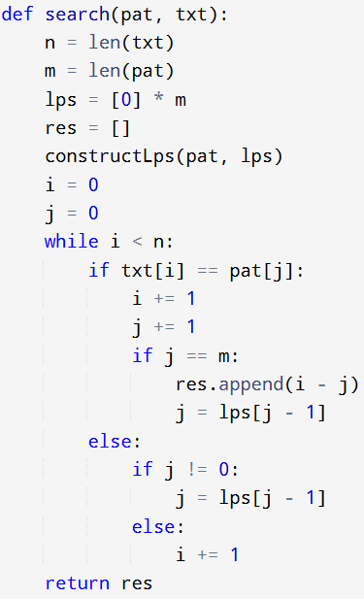
FIRST REAL WALKTHROUGH
T =
0 | 0 | 1 | 2 | 0
D | A | B | A | B | A | B | C
Text
A | B | A | B | C
Pattern

Slide 23
FIRST REAL WALKTHROUGH
T =
0 | 0 | 1 | 2 | 0
D | A | B | A | B | A | B | C
Text
A | B | A | B | C
Pattern

Slide 24
FIRST REAL WALKTHROUGH
T =
0 | 0 | 1 | 2 | 0
D | A | B | A | B | A | B | C
Text
A | B | A | B | C
Pattern

Slide 25
FIRST REAL WALKTHROUGH
T =
0 | 0 | 1 | 2 | 0
D | A | B | A | B | A | B | C
Text
A | B | A | B | C
Pattern

Slide 26
FIRST REAL WALKTHROUGH
T =
0 | 0 | 1 | 2 | 0
D | A | B | A | B | A | B | C
Text
A | B | A | B | C
Pattern

Slide 27
FIRST REAL WALKTHROUGH
T =
0 | 0 | 1 | 2 | 0
D | A | B | A | B | A | B | C
Text
A | B | A | B | C
Pattern

Slide 28
FIRST REAL WALKTHROUGH
T =
0 | 0 | 1 | 2 | 0
D | A | B | A | B | A | B | C
Text
A | B | A | B | C
Pattern

Slide 29
FIRST REAL WALKTHROUGH
T =
0 | 0 | 1 | 2 | 0
D | A | B | A | B | A | B | C
Text
A | B | A | B | C
Pattern

Slide 30
FIRST REAL WALKTHROUGH
T =
0 | 0 | 1 | 2 | 0
D | A | B | A | B | A | B | C
Text
A | B | A | B | C
Pattern

Slide 31
FIRST REAL WALKTHROUGH
T =
0 | 0 | 1 | 2 | 0
D | A | B | A | B | A | B | C
Text
A | B | A | B | C
Pattern

Slide 32
FIRST REAL WALKTHROUGH
T =
0 | 0 | 1 | 2 | 0
D | A | B | A | B | A | B | C
Text
A | B | A | B | C
Pattern

Slide 33
FIRST REAL WALKTHROUGH
T =
0 | 0 | 1 | 2 | 0
D | A | B | A | B | A | B | C
Text
A | B | A | B | C
Pattern

Slide 34
FIRST REAL WALKTHROUGH
T =
0 | 0 | 1 | 2 | 0
D | A | B | A | B | A | B | C
Text
A | B | A | B | C
Pattern

Slide 35
FIRST REAL WALKTHROUGH
T =
0 | 0 | 1 | 2 | 0
D | A | B | A | B | A | B | C
Text
A | B | A | B | C
Pattern

Slide 36
FIRST REAL WALKTHROUGH
T =
0 | 0 | 1 | 2 | 0
D | A | B | A | B | A | B | C
Text
A | B | A | B | C
Pattern

Slide 37
FIRST REAL WALKTHROUGH
T =
0 | 0 | 1 | 2 | 0
D | A | B | A | B | A | B | C
Text
A | B | A | B | C
Pattern

Slide 38
FIRST REAL WALKTHROUGH
T =
0 | 0 | 1 | 2 | 0
D | A | B | A | B | A | B | C
Text
A | B | A | B | C
Pattern

Slide 39
FIRST REAL WALKTHROUGH
T =
0 | 0 | 1 | 2 | 0
D | A | B | A | B | A | B | C
Text
A | B | A | B | C
Pattern

Slide 40
Intuition
m = length of pattern
n = length of text
Steps:
Prefix Table Construction: O(m)
KMP Search: O(n)
Overall: O(n + m) = O(n)

Slide 41
TIME COMPLEXITY
m = length of pattern
n = length of text
Steps:
Prefix Table Construction: O(m)
KMP Search: O(n)
Overall: O(n + m) = O(n)

Slide 42
Fallback Table
Key Optimization: skip fallback prefixes that are doomed
If a character match fails on 'A' at position 4, no part of the pattern can be used
Pattern
A | A | A | A | A
0 | 1 | 2 | 3 | 4
LPS Table
(standard)

Slide 43
Fallback Table
A | A | A | A | A
0 | 1 | 2 | 3 | 4
T[i]: if chars don't match, how many chars can I keep (assumed matched)?
Pattern
LPS Table
(standard)
T[i]: if chars don't match, where do I fallback to?
-1 | -1 | -1 | -1 | -1 | 4
Fallback Table

Slide 44
Why do we need this optimization?
Consider the following text and pattern below:
B | A | A | A | A | B | C | A
Text
A | A | A | A | A
Pattern

Slide 45
Walkthrough
0 | 1 | 2 | 3 | 4
T =
B | A | A | A | A | B | C | A
Text
A | A | A | A | A
Pattern

Slide 46
Walkthrough
0 | 1 | 2 | 3 | 4
T =
B | A | A | A | A | B | C | A
Text
A | A | A | A | A
Pattern

Slide 47
Walkthrough
0 | 1 | 2 | 3 | 4
T =
B | A | A | A | A | B | C | A
Text
A | A | A | A | A
Pattern

Slide 48
Walkthrough
0 | 1 | 2 | 3 | 4
T =
B | A | A | A | A | B | C | A
Text
A | A | A | A | A
Pattern

Slide 49
Walkthrough
0 | 1 | 2 | 3 | 4
T =
B | A | A | A | A | B | C | A
Text
A | A | A | A | A
Pattern

Slide 50
Walkthrough
0 | 1 | 2 | 3 | 4
T =
B | A | A | A | A | B | C | A
Text
A | A | A | A | A
Pattern

Slide 51
Walkthrough
0 | 1 | 2 | 3 | 4
T =
B | A | A | A | A | B | C | A
Text
A | A | A | A | A
Pattern

Slide 52
Walkthrough
0 | 1 | 2 | 3 | 4
T =
B | A | A | A | A | B | C | A
Text
A | A | A | A | A
Pattern

Slide 53
Walkthrough
0 | 1 | 2 | 3 | 4
T =
B | A | A | A | A | B | C | A
Text
A | A | A | A | A
Pattern
Not a match at index = 4

Slide 54
Walkthrough
0 | 1 | 2 | 3 | 4
T =
B | A | A | A | A | B | C | A
LPS is 4, go to pattern index = (4-1) = 3
Text
A | A | A | A | A
Pattern
Not a match at index = 4

Slide 55
Walkthrough
0 | 1 | 2 | 3 | 4
T =
B | A | A | A | A | B | C | A
Text
A | A | A | A | A
Pattern

Slide 56
Walkthrough
0 | 1 | 2 | 3 | 4
T =
B | A | A | A | A | B | C | A
Text
A | A | A | A | A
Pattern

Slide 57
Walkthrough
0 | 1 | 2 | 3 | 4
T =
B | A | A | A | A | B | C | A
Text
A | A | A | A | A
Pattern

Slide 58
Walkthrough
0 | 1 | 2 | 3 | 4
T =
B | A | A | A | A | B | C | A
Text
A | A | A | A | A
Pattern

Slide 59
Walkthrough
0 | 1 | 2 | 3 | 4
T =
B | A | A | A | A | B | C | A
Text
A | A | A | A | A
Pattern

Slide 60
Walkthrough
0 | 1 | 2 | 3 | 4
T =
B | A | A | A | A | B | C | A
Text
A | A | A | A | A
Pattern

Slide 61
Walkthrough
0 | 1 | 2 | 3 | 4
T =
B | A | A | A | A | B | C | A
Text
A | A | A | A | A
Pattern

Slide 62
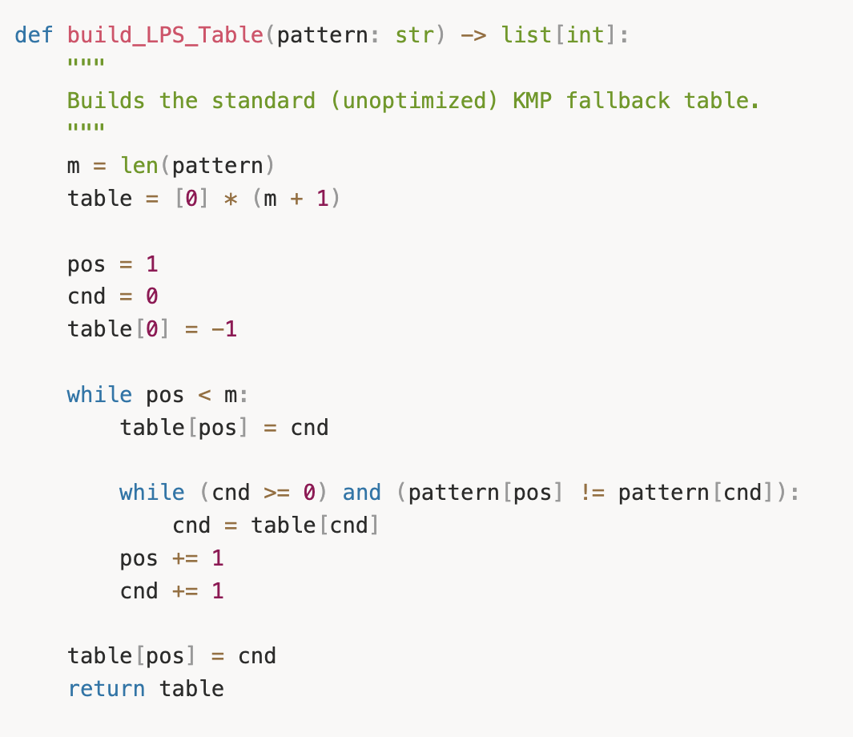
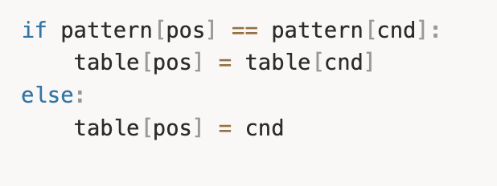
Implementation Differences
Modify construction of prefix table
Store a compressed fallback if characters are the same (would require falling back further anyways)

Slide 63
Walkthrough
-1 | -1 | -1 | -1 | -1 | 4
T =
B | A | A | A | A | B | C | A
Text
A | A | A | A | A
Pattern
Not a match at index = 4

Slide 64
Walkthrough
-1 | -1 | -1 | -1 | -1 | 4
T =
B | A | A | A | A | B | C | A
Need to shift entire pattern to -1 (beginning)
Text
A | A | A | A | A
Pattern
Not a match at index = 4

Slide 65
Walkthrough
-1 | -1 | -1 | -1 | -1 | 4
T =
B | A | A | A | A | B | C | A
Text
A | A | A | A | A
Pattern

Slide 66
Q & A
Advanced Algorithms
Paul Romer, Kevin Shi, Alex Talreja

Slide 67
Fallback Table
A | B | A | B | C | A | B | A | B
0 | 0 | 1 | 2 | 0 | 1 | 2 | 3 | 4
Pattern
LPS Table
(standard)
Fallback Table (optimized)
-1 | 0 | -1 | 0 | 2 | -1 | 0 | -1 | 0 | 4

Slide 68
building fallback table
A | A | A | A | A | B
-1
Pattern
Fallback Table

Slide 69
building fallback table
A | A | A | A | A | B
-1 | -1
Pattern
Fallback Table

Slide 70
building fallback table
A | A | A | A | A | B
-1 | -1 | -1
Pattern
Fallback Table

Slide 71
building fallback table
A | A | A | A | A | B
-1 | -1 | -1 | -1
Pattern
Fallback Table

Slide 72
building fallback table
A | A | A | A | A | B
-1 | -1 | -1 | -1 | -1
Pattern
Fallback Table

Slide 73
building fallback table
A | A | A | A | A | B
-1 | -1 | -1 | -1 | -1 | 4
Pattern
Fallback Table

Slide 74
building fallback table
A | A | A | A | A | B
-1 | -1 | -1 | -1 | -1 | 4 | 0
Pattern
Fallback Table

