Slide 1
Hopcroft's Algorithm (DFA Minimization)
Yu Cao (David), Brian Tran, Yog Tadhani

Slide 2
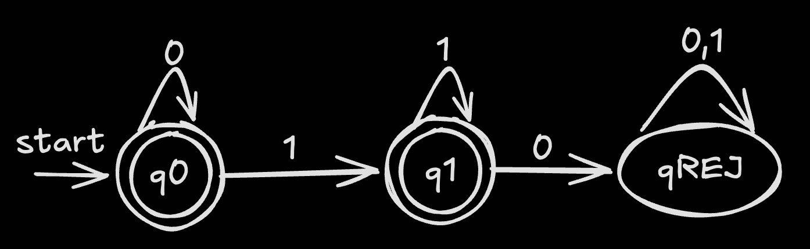
What is Deterministic Finite Automaton (DFA)?
DFA Accepts:
“” (empty)
0
1
001111
0*1*
Rejects:
101 or 01000
A DFA reads input symbols one at a time and changes states based on fixed transition rules.
For each state and input symbol, there is exactly one possible next state, making it deterministic.
Consists of:
Set of states
Input Alphabet (Σ)
Transition function (δ)
Start state (q₀)
Accept states (F)

Slide 3
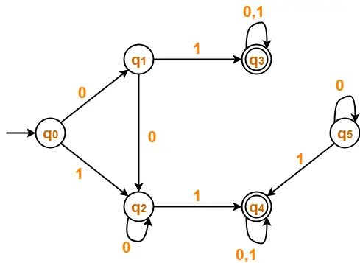
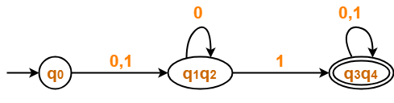
The Problem & Goal
DFA Minimization Problem
Goal: Reduce the number of states in a DFA
Must preserve the same language (same behavior)
Some states are redundant or equivalent
Equivalent states behave the same for all inputs
We can merge these states to simplify the DFA
Challenge
Need to do this efficiently
Naive methods compare every pair of states
Leads to slow runtime: O(n²)
Minimal DFA

Slide 4
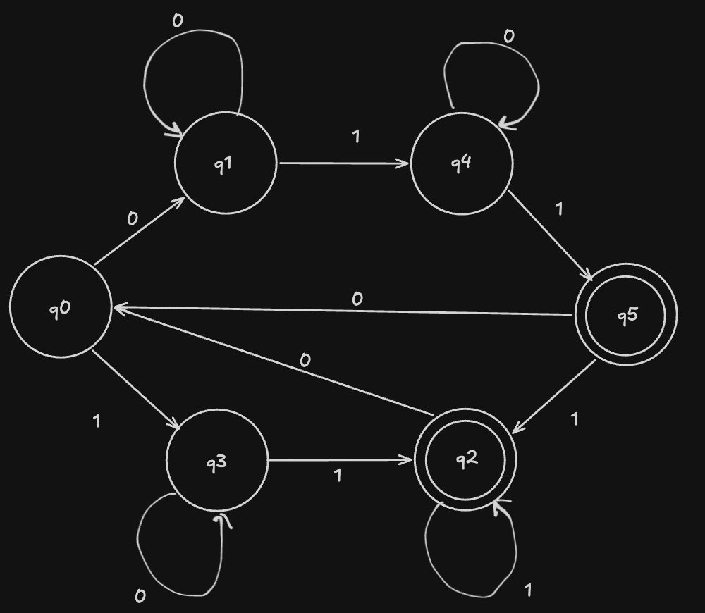
Example
M = ({q0, q1, q2, q3, q4, q5}, {0,1}, 𝛿, q0, {q2,q5})
𝛿 | 0 | 1
q0 | q1 | q3
q1 | q1 | q4
q2 | q0 | q2
q3 | q3 | q2
q4 | q4 | q5
q5 | q0 | q2

Slide 5
Example
Partition into accept and non-accept states
Initial Partition Sets
S1 = {q0, q1, q3, q4}
S2 = {q2, q5}
Pick the smallest partition to form a worklist.
Worklist = {S2}

Slide 6
Example
Partitions
S1 = {q0, q1, q3, q4}
S2 = {q2, q5}
Worklist = {} Current splitter: {S2}
Predecessors:
On symbol 0:
No state goes to q2 or q5
On symbol 1:
X = {q2, q3, q4, q5} go to q2 or q5
𝛿 | 0 | 1
q0 | q1 | q3
q1 | q1 | q4
q2 | q0 | q2
q3 | q3 | q2
q4 | q4 | q5
q5 | q0 | q2
Resulting sets
X = {q2, q3, q4, q5},
S1 = {q0, q1, q3, q4}
S2 = {q2, q5}

Slide 7
Example
X = {q2, q3, q4, q5},
S1 = {q0, q1, q3, q4}
S2 = {q2, q5}
Compare predecessors to our original partitions.
Our goal is to find states that behave differently for the specific splitter.
S2 is fully included in X so no split.
For S1, only q3 and q4 are in X, so we split S1.
𝛿 | 0 | 1
q0 | q1 | q3
q1 | q1 | q4
q2 | q0 | q2
q3 | q3 | q2
q4 | q4 | q5
q5 | q0 | q2
New Partitions
S1 = {q3, q4}
S2 = {q2, q5}
S3 = {q0, q1}
We pick the smallest partition (size of S1 = S3 arbitrary)
Worklist = {S1}

Slide 8
Example
Partitions
S1 = {q3, q4}
S2 = {q2, q5}
S3 = {q0, q1}
Worklist: {}
Current splitter: {S1}
On symbol 0:
X = {q3, q4} go to q3 or q4
S2 and S3 no intersection with X
S1 is fully included in X, no split
𝛿 | 0 | 1
q0 | q1 | q3
q1 | q1 | q4
q2 | q0 | q2
q3 | q3 | q2
q4 | q4 | q5
q5 | q0 | q2
Resulting partitions
S1 = {q3, q4}
S2 = {q2, q5}
S3 = {q0, q1}

Slide 9
Example
Partitions
S1 = {q3, q4}
S2 = {q2, q5}
S3 = {q0, q1}
Worklist: {}
Current splitter: {S1}
On symbol 1:
X = {q0, q1} go to q3 or q4
S2 and S3 no intersection with X
S3 is fully included in X, no split
𝛿 | 0 | 1
q0 | q1 | q3
q1 | q1 | q4
q2 | q0 | q2
q3 | q3 | q2
q4 | q4 | q5
q5 | q0 | q2
Resulting partitions
S1 = {q3, q4}
S2 = {q2, q5}
S3 = {q0, q1}
No conflicts so nothing added to worklist
Worklist = {}
Worklist empty, we’re done

Slide 10
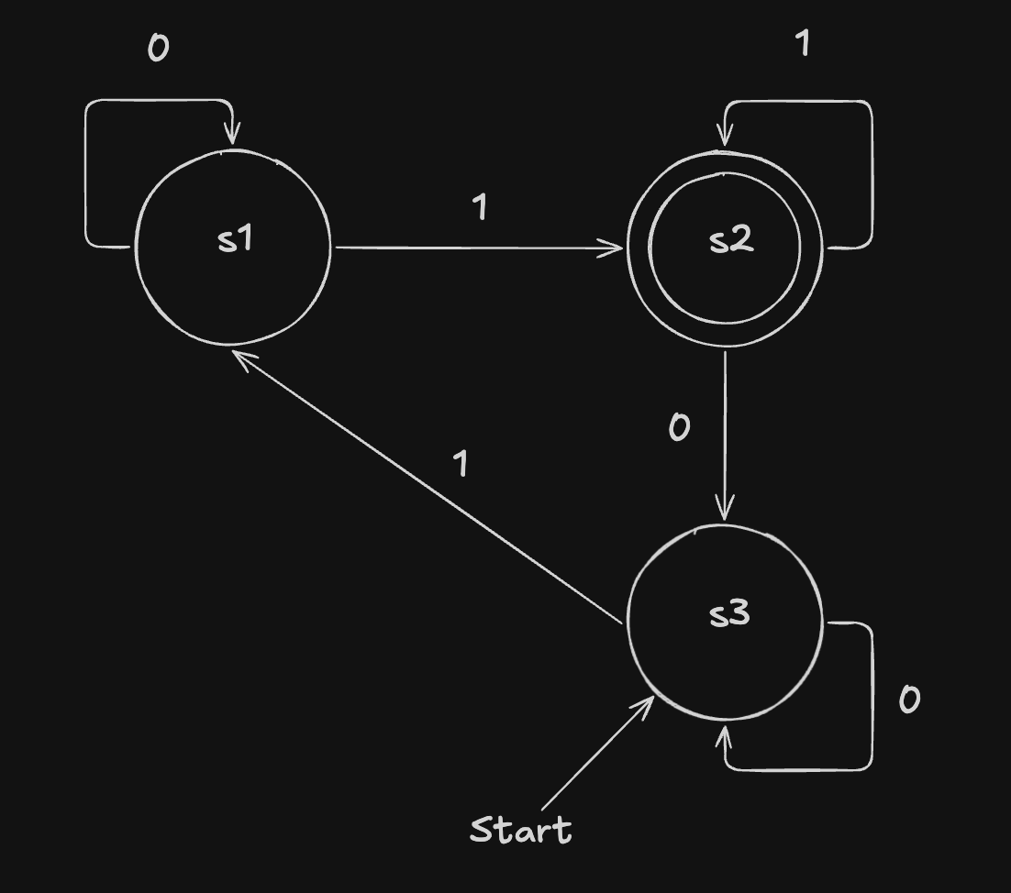
Example
𝛿 | 0 | 1
s1 | s1 | s2
s2 | s3 | s2
s3 | s3 | s1
Final Partitions
S1 = {q3, q4}
S2 = {q2, q5}
S3 = {q0, q1}
States are grouped that behave the same in relation to other partitions
Each partition can be represented by a single state.

Slide 11
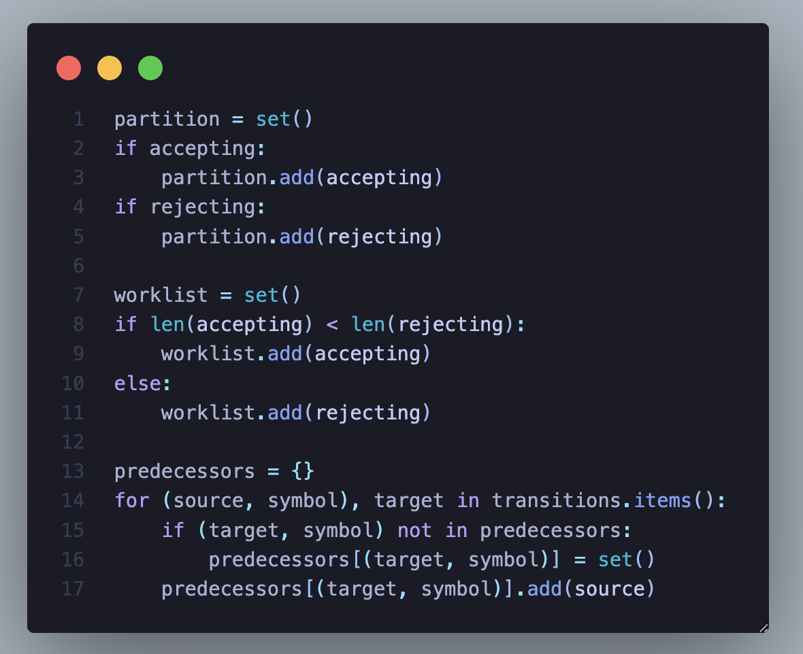
Implementation: Initial Partitioning
Add accepting and non-accepting set of states to Partition set
Add the smaller of the two sets to Worklist
Precompute Predecessor List for faster lookup
Ex:
Instead of:
q0 --1--> q2
We Store:
(q2, 1) → {q0}
Notes:
yog

Slide 12
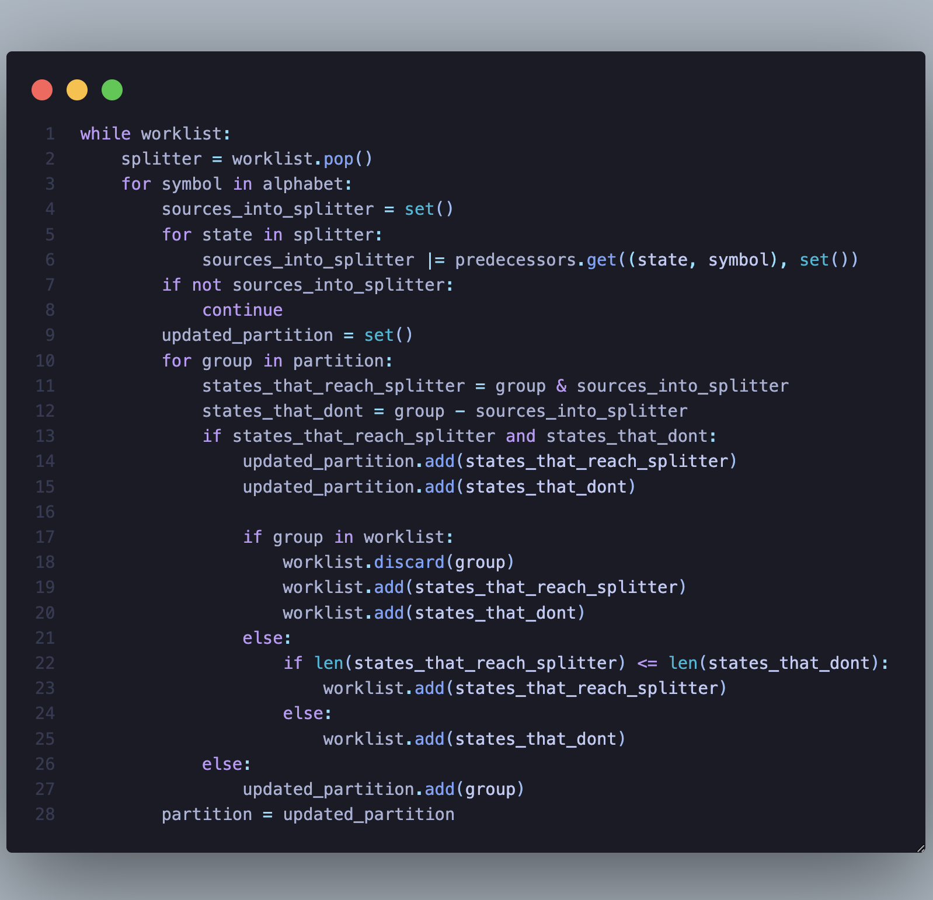
Implementation: Splitting
Find X = states that go INTO splitter on this symbol
Divide group into:
States that go into splitter (&)
States that don’t (-)
If both states behave differently:
Split
Add to updated partition
Notes:
We repeatedly split groups until all states in a group behave identically for every input and the worklist gets empty.
difference
yog

Slide 13
Implementation: List Update W/ Split
Worklist Update:
Case 1: Group already in worklist
Replace it with both splits
Case 2: Not in worklist
Add only the smaller list
If no split:
Keep the group as is
Update partition
Notes:
yog

Slide 14
Analysis - 1
Time complexity: Worse case: O(nslogn) Usually run way faster in practice
Reason: we are adding the smaller set each step, thus reducing the number of state processed by half each time
n - the number of states s - the size of alphabet

Slide 15
Analysis - 2
Space complexity:
O(ns)
Due to the predecessors map/dictionary
n - the number of states
s - the size of alphabet

Slide 16
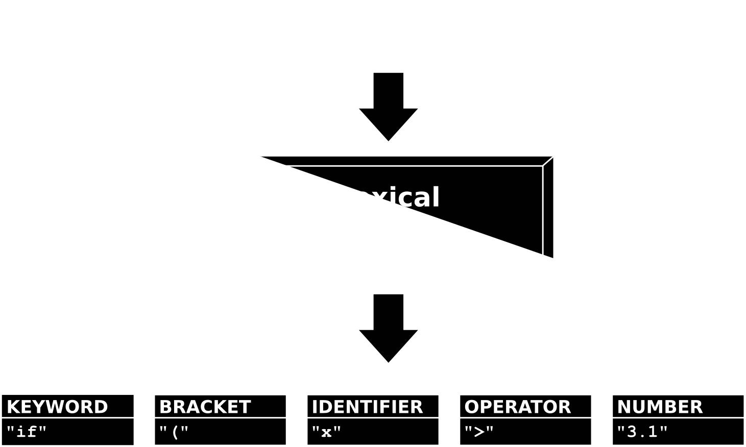
Conclusion & Application
Why Do We Care?
Smaller DFAs =
Less memory usage
Faster execution
Used in real-world systems like compilers
Scan every character in a program
Faster DFA → faster processing
Large DFAs can slow things down
Efficient algorithms (like Hopcroft’s) help solve this
Notes:
https://steemit.com/programming/@drifter1/writing-a-simple-compiler-on-my-own-lexical-analysis-using-flex
yog

