Slide 1
Toom-Cook
Sri, Sasha, Anthony, & Ryan
Notes:
Sri

Slide 2
Motivation + Overview
Divide and conquer algorithm used to multiply two very large integers
Turns O(n²) into O(n^{e}) where e = log(2k - 1) / log(k)
Toom-3 is a single instance of the algorithm where k = 3
Go-to choice for integers that are too large for Karatsuba but not yet large enough to justify complexity of Fast Fourier Transforms
Usage:
Cryptography (RSA)
Large integer libraries
Notes:
Sri

Slide 3
Polynomials: example using 123,456 ⨉ 654,321
123,456 ⨉ 654,321
12 | 34 | 56 ⨉ 65 | 43 | 21
x₂ = 12, x₁ = 34, x₀ = 56 ⨉ y₂ = 65, y₁ = 43, y₀ = 21
Now create the polynomials using base 100…
12(100)² + 34(100)¹ + 56(100)⁰ ⨉ 65(100)² + 43(100)¹ + 21(100)⁰
12(100)² + 34(100)¹ + 56(100)⁰ ⨉ 65(100)² + 43(100)¹ + 21(100)⁰
We get…
X(t) = 12t² + 34t + 56 ⨉ Y(t) = 65t² + 43t + 21
Notes:
Anthony

Slide 4

Why is this better? Pointwise Multiplication and Recursion
Classic multiplication with 9 multiplications:
What if X(1) and Y(1) were n digits long?
1 | 2 | 3
n/3
4 | 5 | 6
n/9
Toom-Cook with 5 multiplications:
X:
56 | 102 | 34 | 36 | 12
Basically this and chunking by 3 (hence Toom-3):
Y:
21 | 129 | 43 | 195 | 65
W:
1176 | 13158 | 1462 | 7020 | 780
Notes:
Anthony
In regular multiplication, every piece of the top number has to multiply with every single piece of the bottom number. Because we evaluated both numbers at the exact same x-coordinates, we can just multiply straight down. But what if our starting numbers were a million digits long? That means these 5 'smaller' multiplications are still too big, so we keep breaking them down into chunks of 3, hence Toom-3.

Slide 5
Evaluation with Magic Points (0, 1, -1, -2, ∞)
Point (t) | X(t) = 12t² + 34t + 56 | Y(t) = 65t² + 43t + 21 | W(t) = X ⨉ Y
t = 0 | 56 | 21 | 1176
t = 1 | 12 + 34 + 56 = 102 | 65 + 43 + 21 = 129 | 13158
t = -1 | 12 - 34 + 56 = 34 | 65 - 43 + 21 = 43 | 1462
t = -2 | 12(4) - 34(2) + 56 = 36 | 65(4) - 43(2) + 21 = 195 | 7020
t = ∞ | 12 | 65 | 780
X(t) ⨉ Y(t) = W(t) = c₀ + c₁t + c₂t² + c₃t³ + c₄t⁴
W(0) = c₀ + c₁(0) + c₂(0)² + c₃(0)³ + c₄(0)⁴ = c₀
W(1) = c₀ + c₁ + c₂ + c₃ + c₄
W(-1) = c₀ - c₁ + c₂ - c₃ + c₄
W(-2) = c₀ - 2c₁ + 4c₂ - 8c₃ + 16c₄
W(∞) = c₀ + c₁() + c₂()² + c₃()³ + c₄ = c₄
This step (x*y for each t) would be evaluated recursively in the algorithm implementation, until small enough to be done naïvely
Notes:
Sri : we evaluate at 5 points, why 5, b/c we are trying to find 5 coefficients, why magic numbers, because some dude pulled them outta a hat
[RYAN]: No it’s because some geek named Marco Bodrato came up with these magic points to simplify our evaluation later. Small integers like 0, 1, and -1, allows for multiplications to be replaced by simple additions and subtractions and 0 and ∞ get the lowest and highest degree coefficients respectively.
To evaluate a polynomial P at infinity actually means to take the limit as x goes to infinity. So P(inf.) is always the value of the highest degree coefficient (c4) (wikipedia).
Sri, also this is where recursion is

Slide 6
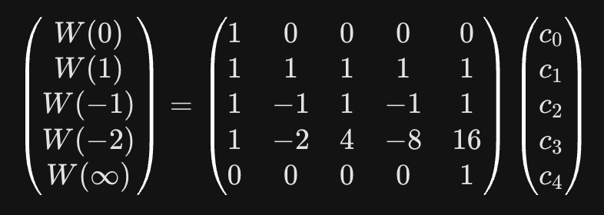
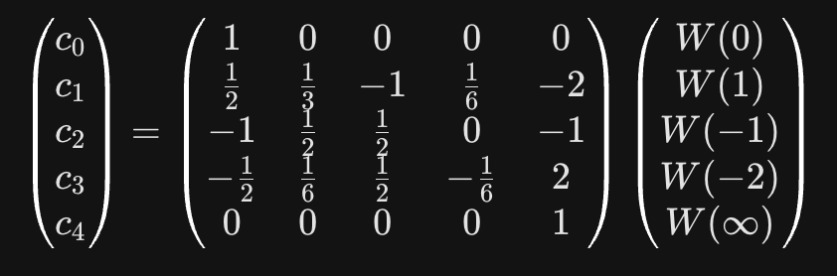
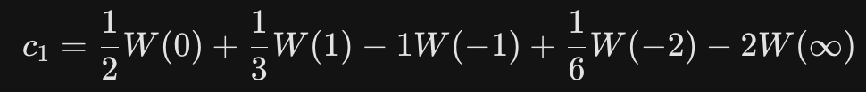
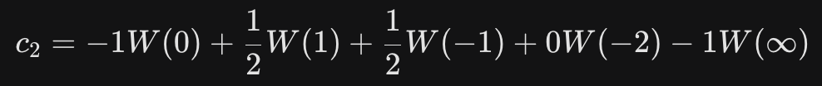
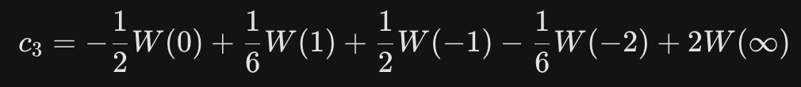
Interpolation
Recall that:
W(0) = c₀ = 1176
W(1) = c₀ + c₁ + c₂ + c₃ + c₄ = 13158
W(-1) = c₀ - c₁ + c₂ - c₃ + c₄ = 1462
W(-2) = c₀ - 2c₁ + 4c₂ - 8c₃ + 16c₄ = 7020
W(∞) = c₀ + c₁() + c₂()² + c₃()³ + c₄ = c₄ = 780
But we still need c₁, c₂, and c₃ !
Invert like so:
Extract our equations for c’s₁₋₃:
Notes:
Sasha
When you have a system of equations with multiple variables, typically you separate the coefficients (the 1s, -1s, 2s, 4s, etc.) into a Matrix [CLICK]. To solve for the unknown ‘c’ variables, we have to calculate the inverse of that matrix [CLICK] and multiply it by our answers (1176, 13158, etc.). From there we can extract the equations we need to solve for c1, c2, and c3.

Slide 7
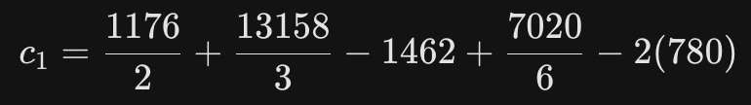
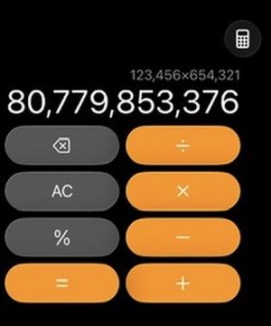
Recomposition
Solving for c₁, c₂, and c₃ by plugging in the W(t) from earlier like this:
Now we need to put our base (B = 100) back into W(t):
W(B) = c₀ + c₁(B) + c₂(B)² + c₃(B)³ + c₄(B)⁴
W(B) = 1176 + 3122(100) + 5354(100)² + 2726(100)³ + 780(100)⁴
we get:
c₁= 3122, c₂= 5354, and c₃= 2726
Recall that these are base-10 coefficients that are part of our polynomial:
W(t) = c₀ + c₁t + c₂t² + c₃t³ + c₄t⁴
Remembering that c₀ = 1176 & c₄ = 780, we have:
W(t) = 780t⁴ + 2726t³ + 5354t² + 3122t + 1176
Then just add it all up:
1,176
312,200
53,540,000
2,726,000,000
+ 78,000,000,000
-----------------------
80,779,853,376
Try it on your calculators!
Notes:
[RYAN] We originally separated our massive number into 3 chunks based on powers of 100 (our Base, ‘B’). To get them back together into our final answer, we plug the base back into the final polynomial equation.

Slide 8
The End
💕
Notes:
Sri

