Slide 1
Minkowski Sum of Convex Polygons
Isaac Assink, Brendan Malaugh, Eric Zeng

Slide 2

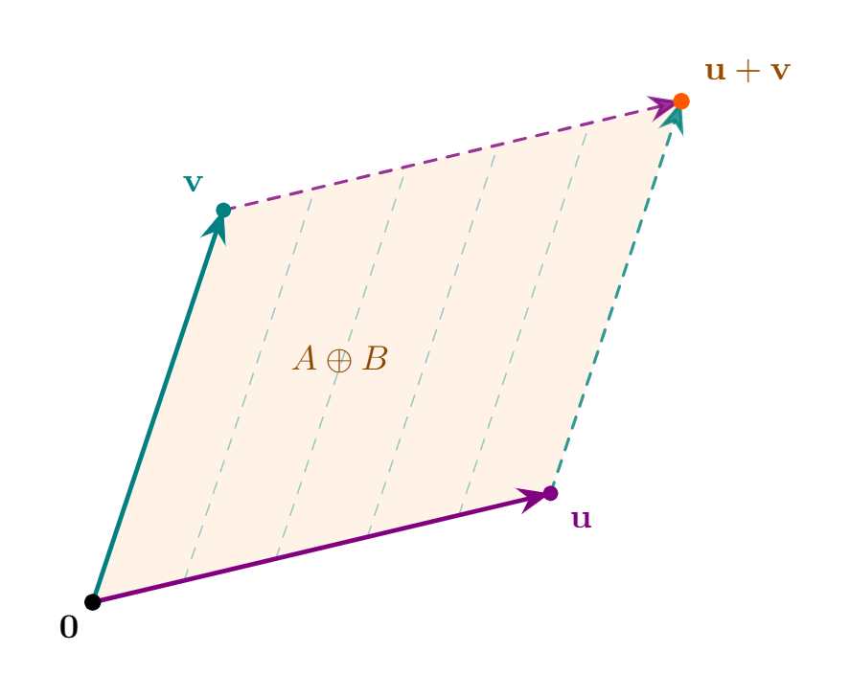
What is Minkowski Addition?
Adding sets A and B gives the set of all possible sums of some element of A and some element of B.
A and B are usually subsets of the euclidean plane
The parallelgram spanned by vectors u and v is their Minkowski sum!

Slide 3
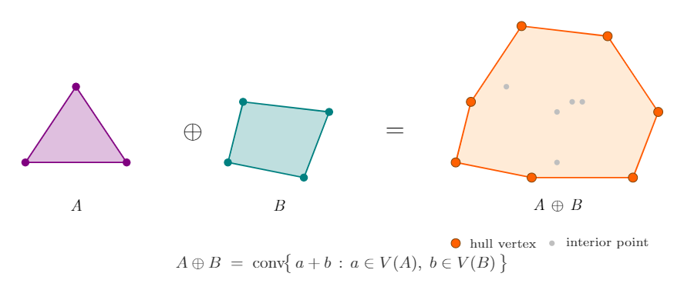
“Naive” Algorithm
Take the Minkowski sum of the set of vertices, then compute their convex hull.
Takes O( |A|*|B| * log(|A|*|B|) )

Slide 4
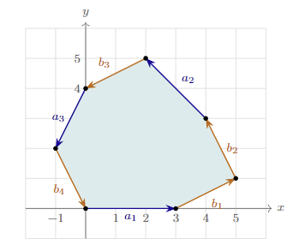
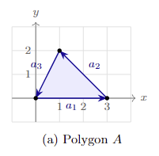
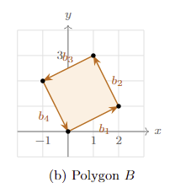
Minkowski Sum of Convex Polygons
Always produces a convex polygon
The shape is determined completely be the set of edges of the two summed polygons

Slide 5
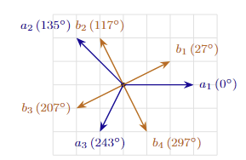
Algorithm
Represent each polygon as a chain of counter-clockwise oriented directed edges
Disassemble and sort the collection of directed edges by polar angle
Compute the bottom-most point of the resultant polygon by summing the bottom most points of A and B (ties broken by taking leftmost)
Recombine the vectors in order by stacking them tip-to-tail, rooted at the bottom-most point

Slide 6
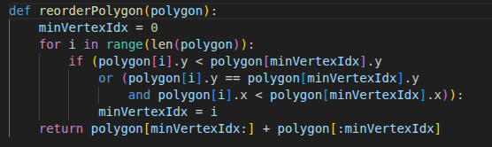

Implementation
Reorder both polygons to put point with lowest y coordinate first. If two points have the same y coordinate, choose the one with lower x coordinate.

Slide 7
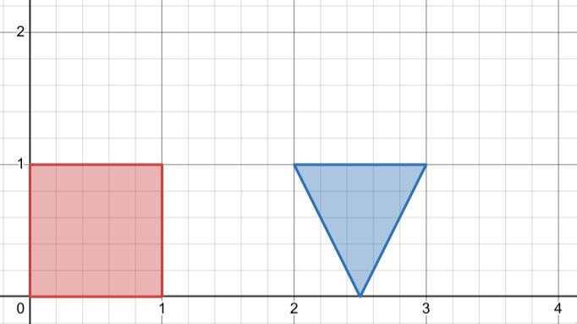
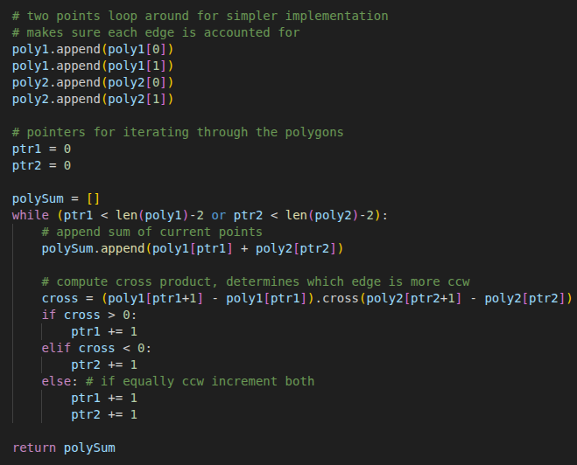
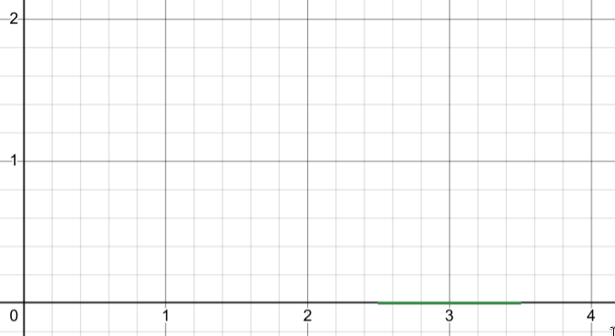
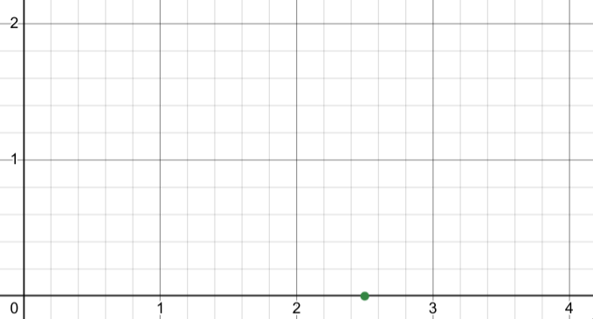
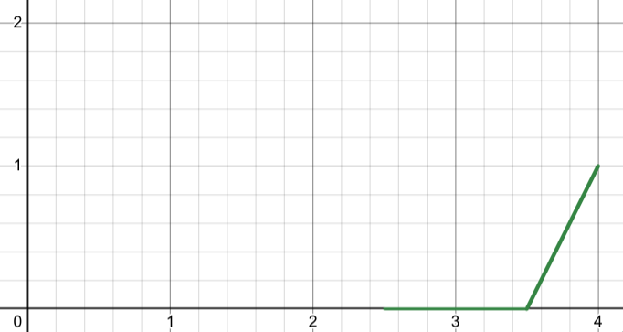
Implementation
ptr1
ptr2

Slide 8
Implementation
ptr1
ptr2

Slide 9
Implementation
ptr2
ptr1

Slide 10
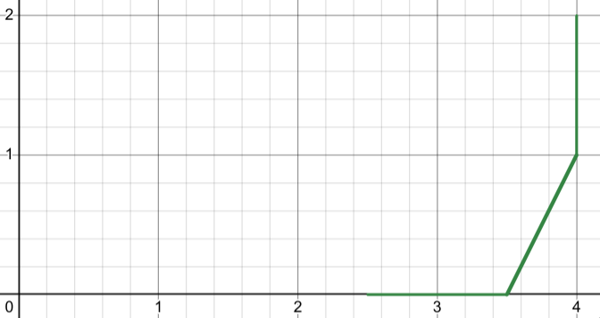
Implementation
ptr1
ptr2

Slide 11
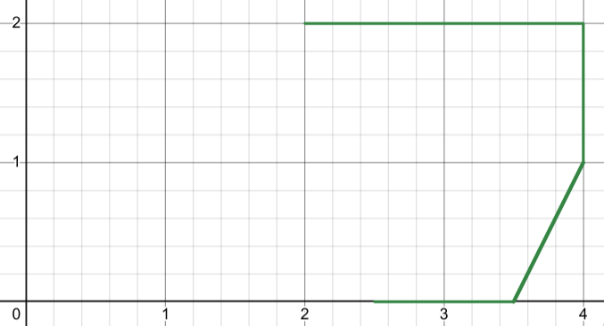
Implementation
ptr1
ptr2

Slide 12
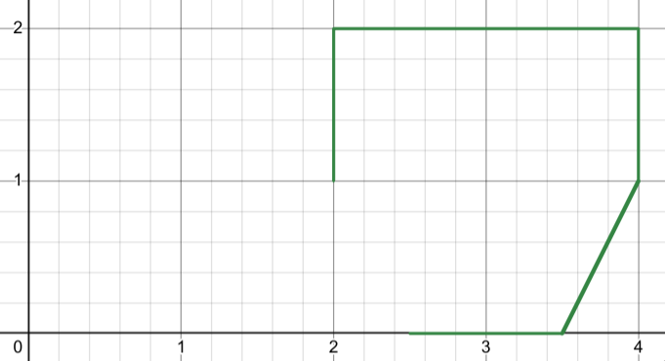
Implementation
ptr2
ptr1

Slide 13
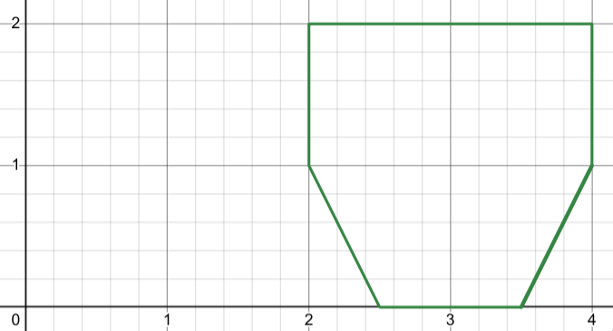
Implementation
ptr1
ptr2

Slide 14
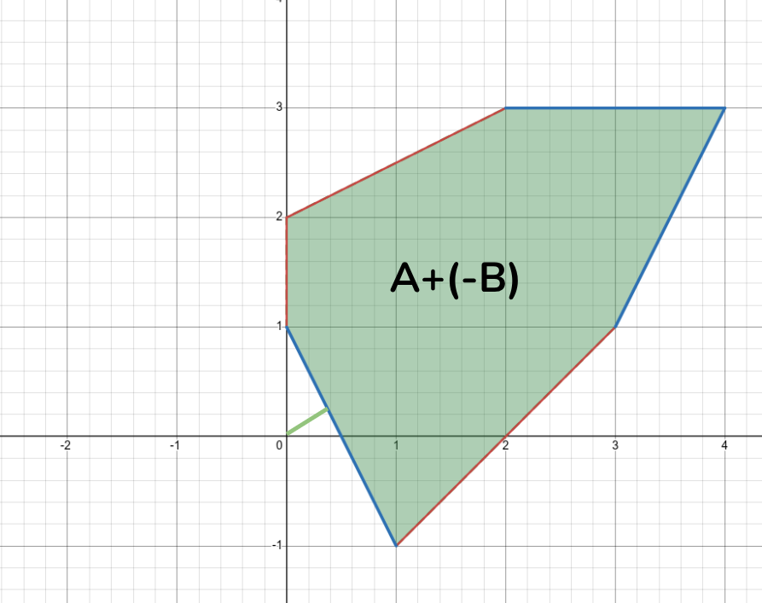
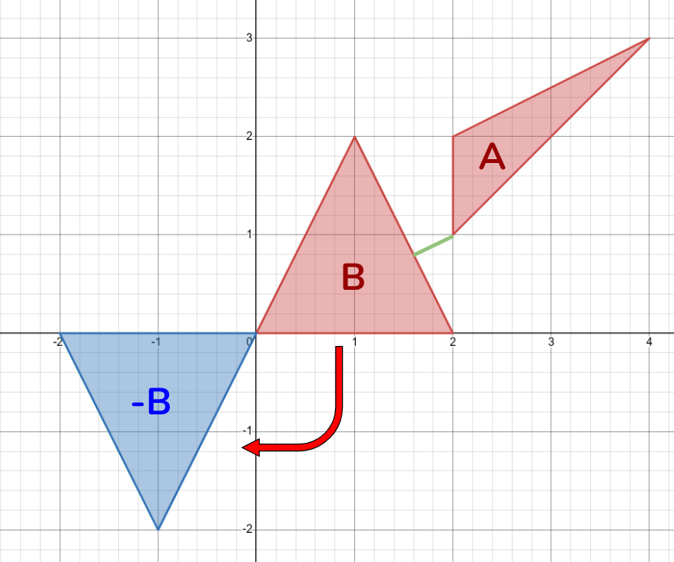

Minimum Distance Between Polygons
Recall
What is minimum distance?
Problem becomes, what is the closest point in A+(-B) to the origin?
Reduced to linear time!
Notes:
One of the most common applications of Minkowski sum is finding the minimum distance between two convex polygons.
Recall that a Minkowski sum is the set of all points that can be obtained by adding a point in A to a point in B.
The minimum distance between polygons is always between a vertex and an edge or a vertex and another vertex, so naively the solution would be the size of A times the size of B.
Let’s define the minimum distance as the minimum distance or magnitude between any pair of points.
Already, it looks like we can use Minkowski sum! If we add negative B to A, then we get the set of all little a - little b.
You can invert B by flipping B around the origin.
This is our new polygon, representing A - B.
Then, we want to find the minimum, which is simply the distance to the origin of this new sum. Now, we’re only checking a linear amount of vertices and edges!
If the polygons intersect, then our minimum distance will just be 0. This happens when the origin is inside A-B.

Slide 15
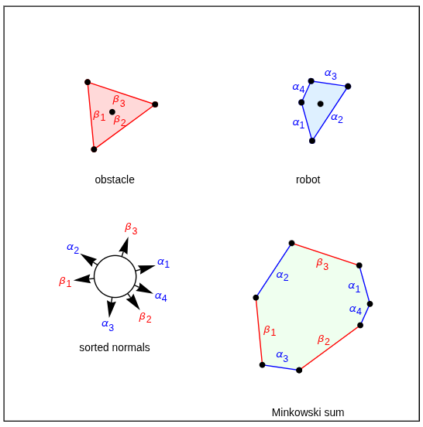
Collision Detection
Given a certain orientation of a robot, we can quickly reduce collision detection to point-polygon
If you calculate a Minkowski difference, you get a new polygon accounting for the origin of the robot
Notes:
Another common application of Minkowski Sum is collision detection, common in robotics and motion planning.
Given a certain orientation of a robot, we can quickly reduce collision detection to point-polygon. If we invert the robot

Slide 16
Questions?

