Slide 1
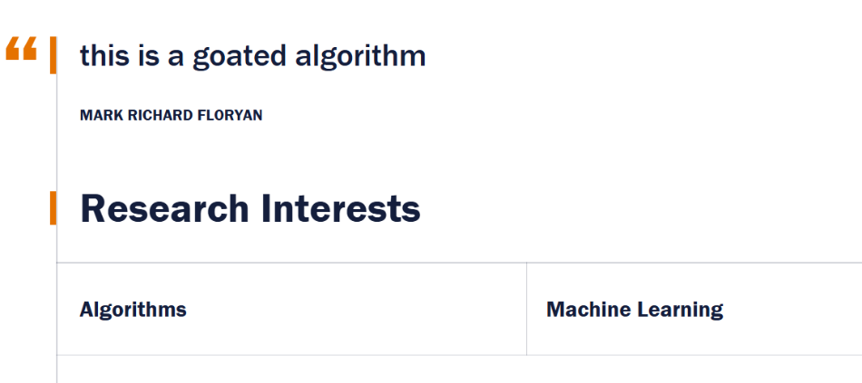
GRAPH ALGORITHMS
Eppstein's Algorithm
k shortest source to sink paths
1
3
t
2
4
2
s
4
2
5
3
Authors: Jacob Ezieme, Vrishak Vemuri, Rishik Balerao, Utkarsh Goyal,

Slide 2
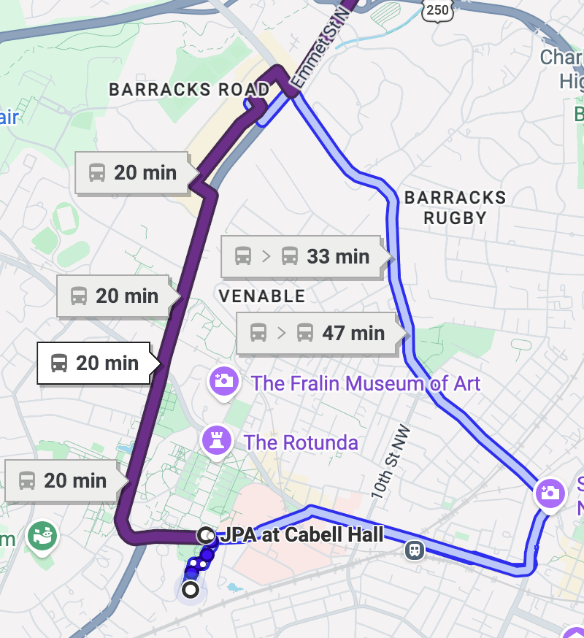
MOTIVATION
Eppstein's Algorithm
An example problem!
Is the extra time worth the tradeoffs?

Slide 3
PROBLEM
Eppstein's Algorithm
Formal statement
Input: directed graph G=(V,E), source s, target t, nonnegative edge weights.
Output: the shortest k source(s)-to-sink(t) paths, in order (just a detail)
Target runtime: O(mlogm + klogk)
Notation: n=|V|, m=|E|. Repeated vertices and edges are allowed, so a “path” here is closer to a walk.

Slide 4
RUNNING EXAMPLE
Eppstein's Algorithm
A small weighted graph
1
Some s-to-t path lengths:
4
s → 2 → t; has cost 5
s → 1 → 2 → t; has cost 5
s → 3 → 4 → t; has cost 7
s → 1 → t; has cost 6
2
1
s
3
2
2
t
4
2
3
1
4

Slide 5
FIRST ATTEMPT
Eppstein's Algorithm
Modified Dijkstra: pop each vertex up to k times
Algorithm 1
q = empty min heap
count = 0-filled array
push (0, s) on q
while count[t] < k:
(l, u) = pop q
if count[u] == k: continue
count[u] += 1
if u == t: output l
for each edge (u, v, w):
push (l + w, v)
Good motivation, but lacks the global bounds of Djikstra's, leading to slow runtimes
The same vertex can be expanded up to k times.
Each expansion may scan outgoing edges again.
Using a binary(normal) heap gives O(km log(km)).
Main issue: most heap pops are not complete answers, so we need to do a lot of pops just to get one answer

Slide 6
SIDETRACKS
Eppstein's Algorithm
The penalty of one deviation
w
3
sidetrack(u,v,w) =
(w(u,v) + d(v))− d(u)
a
d=3
3
2
d=3
1
b
2
t
Here d(x) is the shortest distance from x to t. We can assume that d(x) exists since we can manually remove any nodes that can't reach the sink before hand
u
d=2
d=0
Example 1:
Edge u→v has:
sidetrack = 5 + 1 − 5 = 1
Example 2:
Edge a→w has
sidetrack = 3 + 3 − 3 = 3
d=5
1
5
v
d=1
Because d(u) ≤ w(u,v) + d(v), every sidetrack penalty is nonnegative.

Slide 7
KEY PROOF IDEA
Eppstein's Algorithm
Paths <-> sidetrack sequences
Original path:
Given only these sidetracks, fill every gap by following shortest path edges.
So we enumerate sidetrack lists instead of full paths.
s
u
v
a
w
b
t
tree
sidetrack
tree
sidetrack
tree
Sidetracks:
(u → v)
then
(a → w)
length(path in G) = d(s) + sum of sidetrack penalties

Slide 8
CONSTRUCTION
Eppstein's Algorithm
Build the sidetrack graph G'
Default path toward t
u
p(u)
p(p(u))
t
In G’each sidetrack edge is weighted by its sidetrack(u,v,w) penalty.
nxt edges = non-sidetrack edges
We do not keep the nxt edges because they are the default move.
But from u, you must be able to choose a sidetrack now or after following nxt a few times.
Thus adj(u) inherits sidetrack edges from later vertices on its shortest path.
adj(u) = sidetracks(u) ∪ sidetracks(p(u)) ∪ …

Slide 9
ENUMERATION
Eppstein's Algorithm
k-pop on G'
Algorithm 2
q = empty min heap
push (d[s], s) on q
repeat k times:
(l, u) = pop q
output length l //or output the path
for each edge (u, v, w) in G':
push (l + w, v) //or push the new path and //some distance associated //with it
What improved?
Every pop is already a complete s-to-t path.
However, vertices in G' can still have O(m) outgoing inherited sidetracks, since they get all the sidetracks of the nodes on their shortest path
So total pushes is again k*m
Verdict: Too slow!
Each pop can scan too many outgoing edges, giving O(km log(km)) again.

Slide 10
SECOND SPEEDUP
Eppstein's Algorithm
Store adj(u) as a min-heap
Raw adjacency list
Heap adjacency list
a
{7,b}
The root is considered first. The children become candidates later, specifically, after {7,b} is popped.
8
x
b
7
{8,a}
{9,c}
9
This avoids eagerly inserting sidetracks that don’t need to be considered yet.
c
Naively, popping x pushes all three edges.

Slide 11
BOUNDING DEGREES
Eppstein's Algorithm
Heap nodes are states of the Djikstra!
Left child
Each state represents one sidetrack edge.
At most two heap-child transition (binary heap).
One transition to the heap belonging to the endpoint v (root of adj(v)).
Therefore outdegree ≤ 3!
e=(u,v)
heap(v)
Right child
Now we do at most 3*k total relaxations and O(k log k) priority-queue work!

Slide 12
EXAMPLE
Eppstein's Algorithm
Worked example
source: a
4
sink: d
Default shortest path: a → b → c → d (cost 5)
2
2
1
a
b
c
d
Distances to d: d(a)=5, d(b)=3, d(c)=1, d(d)=0
Sidetrack penalties:
6
sidetrack(b,d) = 4 + 0 − 3 = 1
11
sidetrack(a,c) = 6 + 1 − 5 = 2
shortest-path edge
sidetrack edge
sidetrack(a,d) = 11 + 0 − 5 = 6
adj(d) = ∅
Adj(u) structure in this case
adj(c) = ∅
(b→d, +1)
adj(b) = {(b→d, +1)}
adj(a) = merge(adj(b), {(a→c, +2), (a→d, +6)})
(a→c, +2)
(a→d, +6)
21

Slide 13
LEFTIST HEAPS
Eppstein's Algorithm
Leftist Heap
Why use leftist heaps?
Pseudocode
Merge(A, B)
if A = NULL return B
if B = NULL return A
if key(B) < key(A)
swap A, B
right(A) ← Merge(right(A), B)
…
To ensure future merges are efficient, we need a “self-balancing” heap
Leftist heaps are exactly the same as regular binary heaps, with the additional condition that the rightmost path is kept as short as possible
Accomplishes this by swapping the left and right children of a node when the right path becomes too “long”
17

Slide 14
EFFICIENT MERGES
Eppstein's Algorithm
Example Merge
2
5
4
2
9
7
6
5
4
9
7
6
12
12
15
14
15
14
19
17
16
18
19
17
16
18
15

Slide 15
EFFICIENT MERGES
Eppstein's Algorithm
Staying balanced
"Self-balancing" version of binary heap that keeps the rightmost path as short as possible to make future merges fast
2
u
2
5
4
5
4
9
7
12
6
6
9
7
6
12
15
14
15
14
19
17
16
18
19
17
16
18
15

Slide 16
PUTTING IT TOGETHER
Eppstein's Algorithm
Eppstein’s Algorithm: Final
Initial Djikstra
Sidetrack penalties
1
2
Find d(u) and choose the shortest path edge for all u by reversing the edges and searching starting at the sink.
Runtime: O(mlogm)
Convert each non-default edge to sidetrack a sidetrack edge.
Runtime: O(m)
Building leftist heaps for adj(u)
k-pop on heap states
3
4
Build adj(u) by merging own sidetracks with adj(p(u)).
Runtime: O(mlogm)
Each state branches to at most two heap children and heap(v).
Runtime: O(klogk)
19

Slide 17

Thx for listening!

