Slide 1
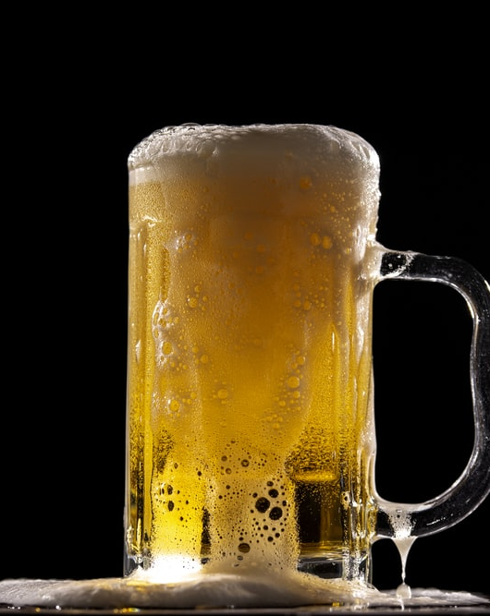
Craft Beer Brewery Development
Research Analysis
Dawn Washington
David Owens
Grey Hardy –Project Manager
Notes:
To change the image on this slide, select the picture and delete it. Then click the Pictures icon in the placeholder to insert your own image.

Slide 2
Agenda
Business Case Introduction - Grey
Analysis – Dawn
Conclusion – David

Slide 3
Business Case
Business Development: In 2017, an entrepreneur wanted to open a new brewery in the United States. She needed to determine the best location.
An analysis of 2,410 US craft beers and 510 US breweries was conducted to determine a competitive location.
Hypothesis: It was determined the style of beer with the highest alcohol by volume (ABV) is the most profitable. As a result, identifying the states with the lowest number of beers with high alcohol by volume as the best locations for the new brewery would be essential.

Slide 4
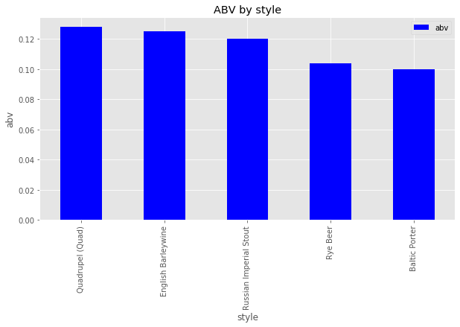
Highest ABV Among Beer Styles

Slide 5
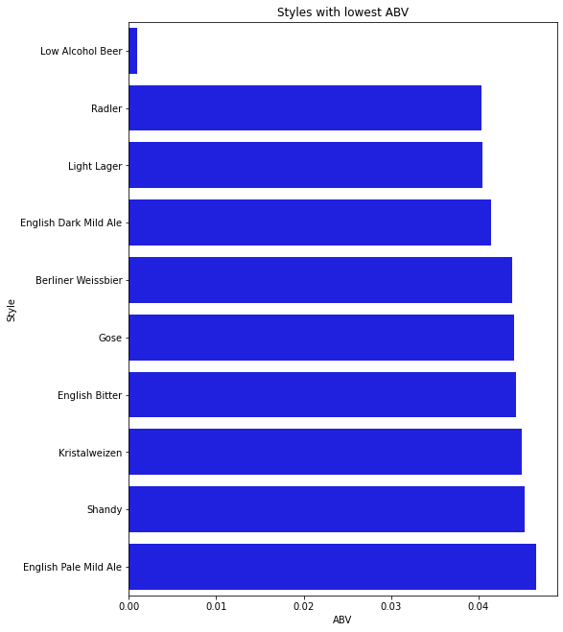
The Styles Of Beer With The Lowest ABV

Slide 6
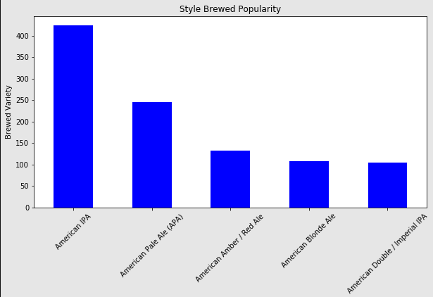
Most Brewed Style of Beer

Slide 7
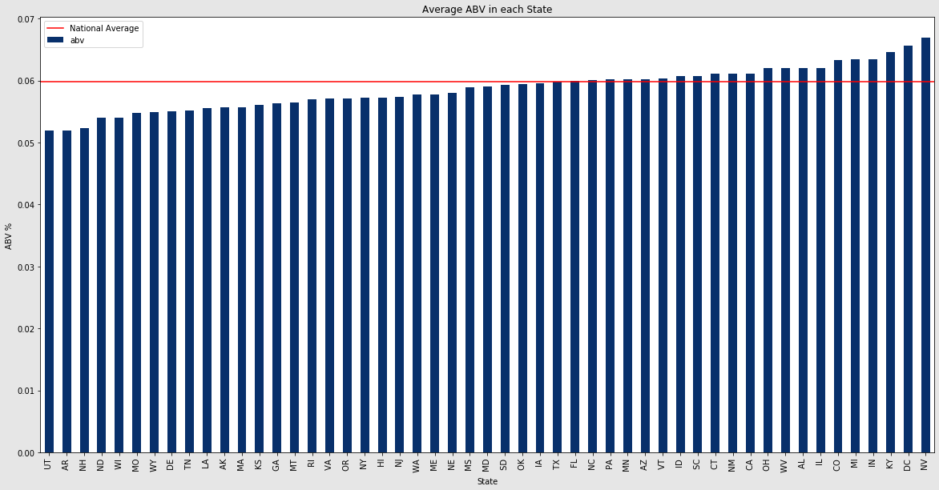
The States with the Most Beer Styles with Lowest ABV

Slide 8
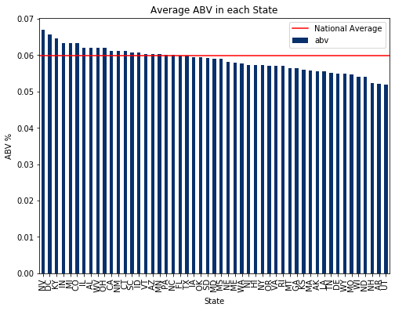
The States with the Most Beer Styles with Highest ABV

Slide 9
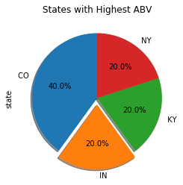
The States with the Most Beer styles with Highest ABV

Slide 10
Statistical Analysis Of Beer Styles With The Lowest ABV
Style | Count | Mean | Std | Min | 25% | 50% | 75% | Max
Quad | 4 | 24 | 19.33907961 | 10 | 10 | 17.5 | 31.5 | 51
English Barleywine | 3 | 17 | 13.85640646 | 1 | 13 | 25 | 25 | 25
Russian Imperial Stout | 11 | 221.6363636 | 202.9405197 | 6 | 21 | 166 | 390.5 | 503
Rye Beer | 18 | 158.3888889 | 154.5453061 | 10 | 47.25 | 79.5 | 278 | 471
Baltic Porter | 6 | 215.5 | 191.5638275 | 46 | 66.25 | 155.5 | 322 | 522
F_onewayResult(statistic=16.974056971673452, pvalue=8.914483349494272e-07)

Slide 11
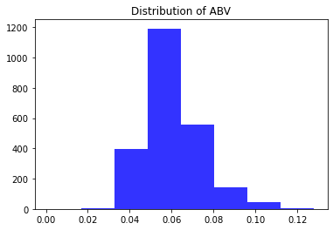
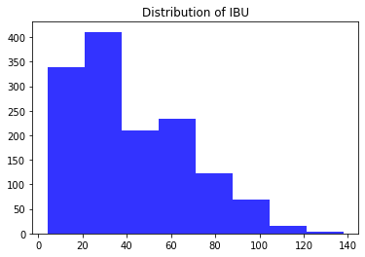
Distribution of ABV vs. IBU

Slide 12
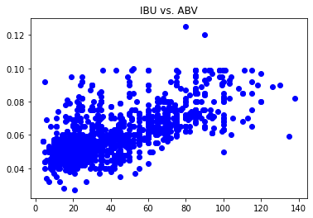
ABV vs IBU(International Bitterness Units)

Slide 13
Outline of Process Development
Identify Data
Establish Questions/Hypothesis

Slide 14
Conclusions
There are a total of 2,410 individual beers in the dataset
The 5 beer styles with the highest abv are Quad, Engish Barleywine, Russian Imperial Stout, Rye Beer and Baltic Porter
The 5 states with the lowest number of High ABV beers are Utah, Arkansas, New Hampshire, North Dakota and Wisconsin
The most competitive combination of beer style to manufacture would be a Quad and the most competitive state would be Utah
The ABV of beer is evenly distributed

