Slide 1
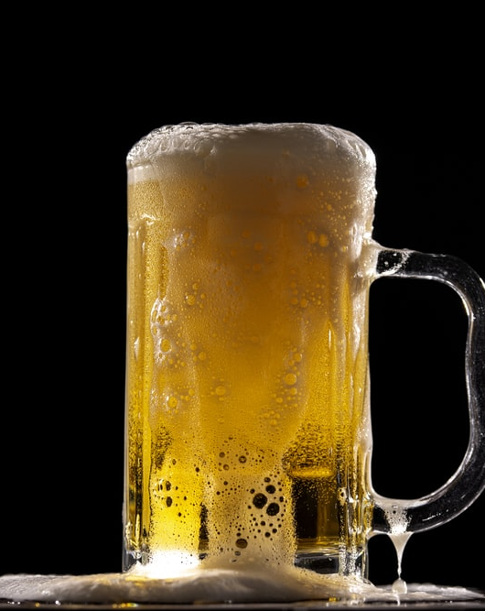
Craft Beer Brewery Development
Research Analysis
Dawn Washington
David Owens
Grey Hardy –Project Manager
Notes:
To change the image on this slide, select the picture and delete it. Then click the Pictures icon in the placeholder to insert your own image.

Slide 2
Agenda
Business Case Introduction - Grey
Analysis – Dawn
Conclusion – David

Slide 3
Business Case
Business Development: In 2017, an entrepreneur wanted to open a new brewery in the United States. She needed to determine the best location.
An analysis of 2,410 US craft beers and 510 US breweries was conducted to determine a competitive location.
Hypothesis: It was determined the style of beer with the highest alcohol by volume (ABV) is the most profitable. As a result, identifying the states with the lowest number of beers with high alcohol by volume as the best locations for the new brewery would be essential.

Slide 4
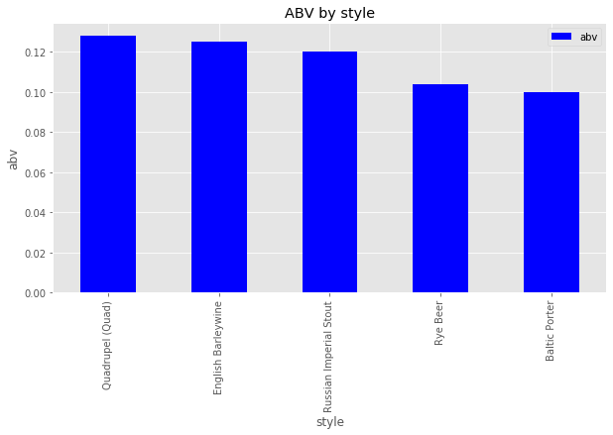
Highest ABV Among Beer Styles

Slide 5
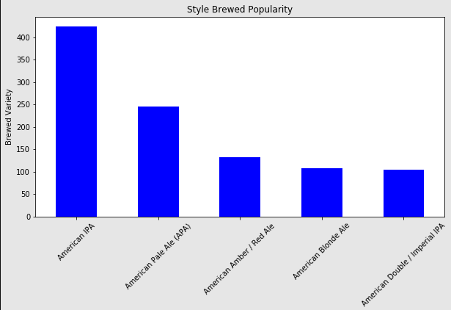
Most Brewed Style of Beer

Slide 6
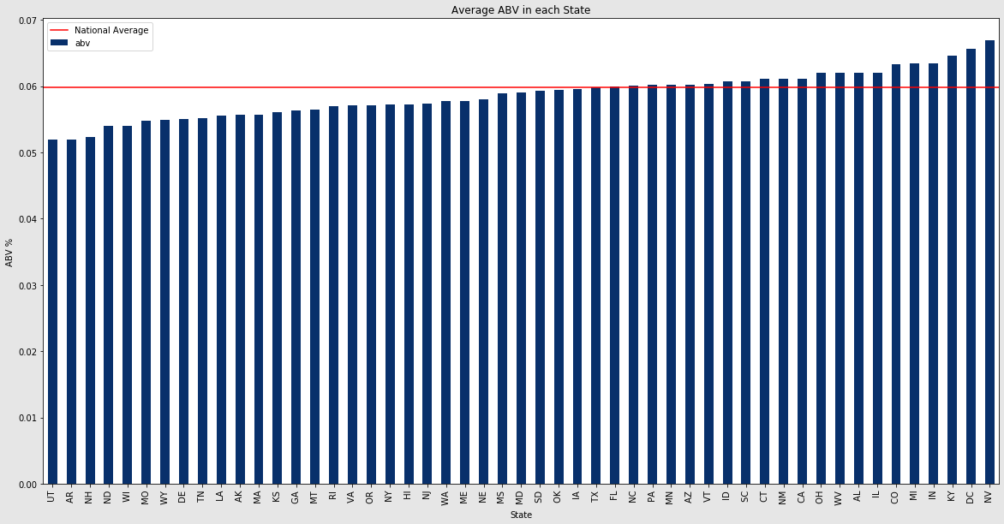
The States with the Most Beer Styles with Lowest ABV

Slide 7
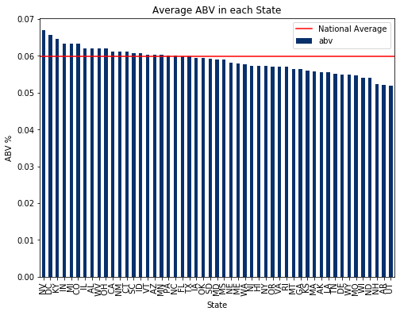
The States with the Most Beer Styles with Highest ABV

Slide 8
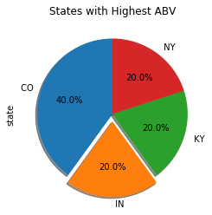
The States with the Most Beer styles with Highest ABV

Slide 10
Title and Content Layout with Chart

Slide 11
Title and Content Layout with Chart

Slide 12
Title and Content Layout with SmartArt
Step 1 Title
Step 2 Title
Step 3 Title
Step 4 Title

Slide 13
Add a Slide Title - 1

Slide 14
Add a Slide Title - 2

Slide 15
Add a Slide Title - 3

