Slide 1
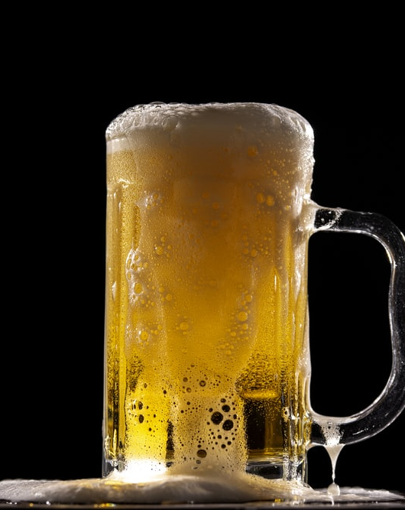
Craft Beer Brewery Development
Research Analysis
Dawn Washington
David Owens
Grey Hardy –Project Manager
Notes:
To change the image on this slide, select the picture and delete it. Then click the Pictures icon in the placeholder to insert your own image.

Slide 2
Agenda
Business Case Introduction - Grey
Analysis – Dawn
Conclusion – David

Slide 3
Outline of Process Development
Develop Business Case Identify Data for Analysis
Establish Questions & Hypothesis
Perform Exploratory Data Analysis
Produce Research Analysis

Slide 4
Business Case
Business Development: In 2017, an entrepreneur wanted to open a new brewery in the United States. She needed to determine the best location.
An analysis of 2,410 US craft beers and 510 US breweries was conducted to determine a competitive location.
Hypothesis: It was determined the style of beer with the highest alcohol by volume (ABV) is the most profitable. The best locations for the brewery would be states with the lowest number of beers produced, containing high ABV.

Slide 5
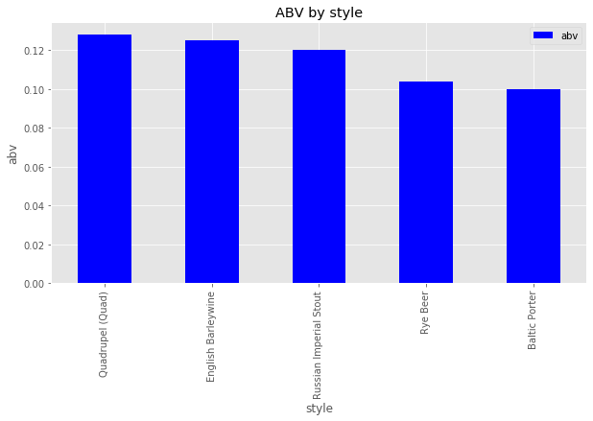
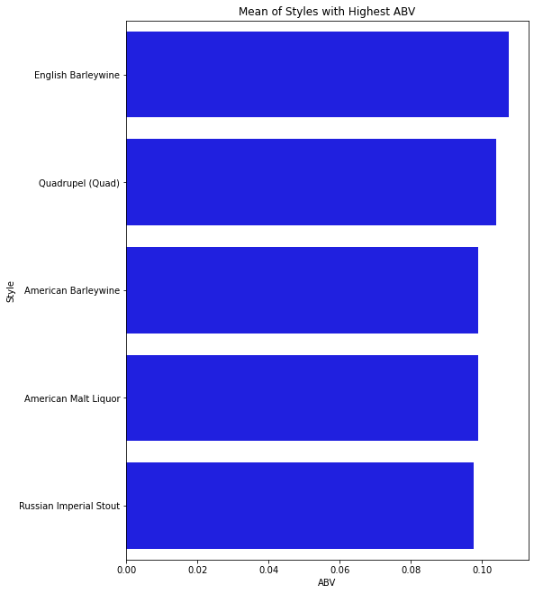
Highest ABV Among Beer Styles

Slide 6
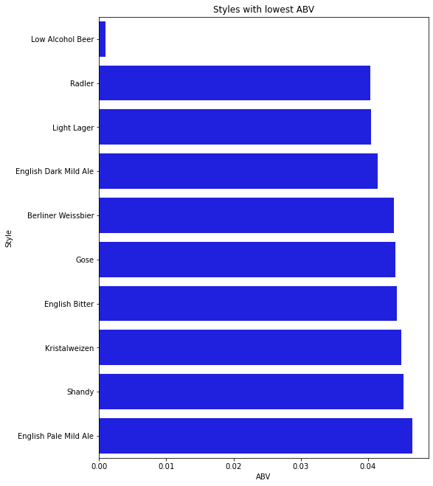
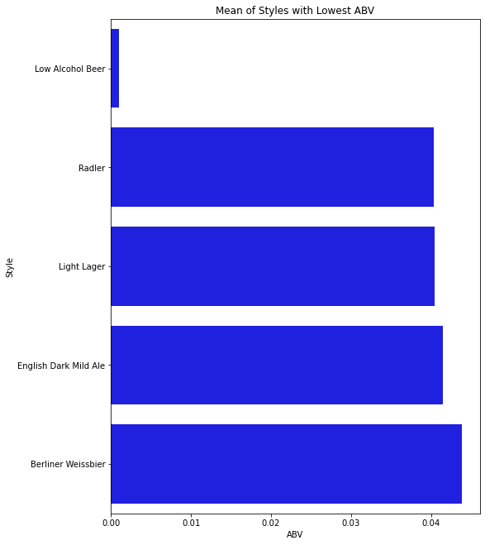
The Styles Of Beer With The Lowest ABV

Slide 7
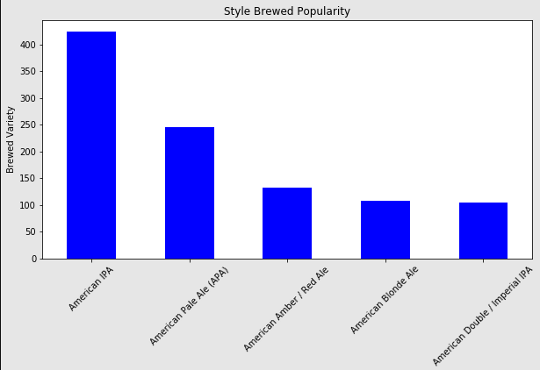
Most Brewed Style of Beer

Slide 8
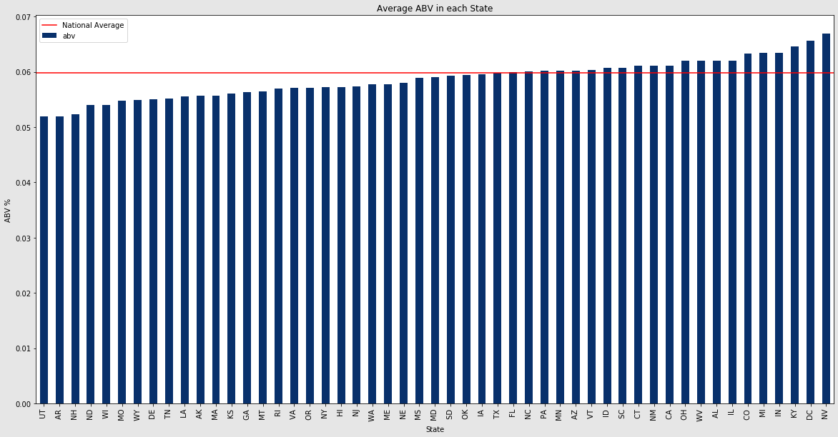
The States with the Most Beer Styles with Lowest ABV

Slide 9
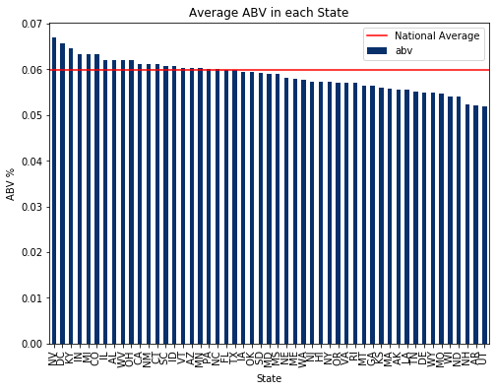
The States with the Most Beer Styles with Highest ABV

Slide 10
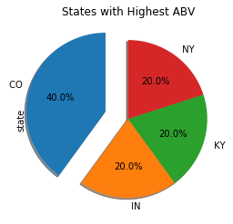
The States with the Most Beer styles with Highest ABV

Slide 11
Statistical Analysis Of Beer Styles With The Highest ABV
Style | Count | Mean | Std | Min | 25% | 50% | 75% | Max
Quad | 4 | 24 | 19.33907961 | 10 | 10 | 17.5 | 31.5 | 51
English Barleywine | 3 | 17 | 13.85640646 | 1 | 13 | 25 | 25 | 25
Russian Imperial Stout | 11 | 221.6363636 | 202.9405197 | 6 | 21 | 166 | 390.5 | 503
Rye Beer | 18 | 158.3888889 | 154.5453061 | 10 | 47.25 | 79.5 | 278 | 471
Baltic Porter | 6 | 215.5 | 191.5638275 | 46 | 66.25 | 155.5 | 322 | 522
F_onewayResult(statistic=16.974056971673452, pvalue=8.914483349494272e-07)

Slide 12
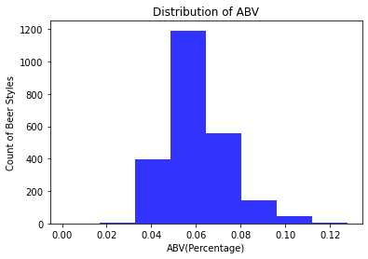
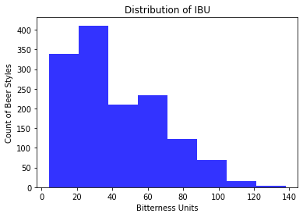
Distribution of ABV vs. IBU

Slide 13
Conclusions
The 5 beer styles with the highest ABV are Quadruple(Quad), English Barleywine, Russian Imperial Stout, Rye Beer and Baltic Porter
The 5 states with the lowest number of High ABV beers are Utah, Arkansas, New Hampshire, North Dakota and Wisconsin
The most competitive combination of beer style to manufacture would be a Quad and the most competitive state would be Utah
Next steps would be a deeper dive into the commercial real estate and labor environment in each state, as well as the marketing advantages of each style of beer

