Slide 1
Investigating Robust Overfitting in Adversarial Training
Researcher: Kaiwen Du
Principal Investigator: Dr. Nicholas Q. Tran
Department of Mathematics and Computer Science
Notes:
Hello everyone! My name is Kaiwen Du, I’m a junior Computer Science student, and today I’ll be presenting my research project: Investigating Robust Overfitting in Adversarial Training.
Modern neural networks are remarkably powerful, where they can now process image to text OCR, identify sophisticated objects, and automate daily tasks. However, they also happen to be surprisingly vulnerable to security threats, specifically adversarial attacks. What do I mean by that?

Slide 2
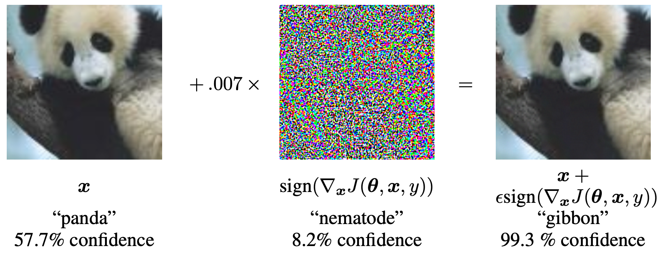
Adversarial Example: Panda to Gibbon (Goodfellow et al., 3)
We see a panda, the model sees a panda as well.
We add noises to the image, invisible to human eyes.
We still see a panda, but the model sees something else: a gibbon.
Notes:
Here is what an adversarial attack actually looks like in practice. On the left is a clean photo of a panda, and the model classifies it correctly as a panda with 57.7 percent confidence. By the way this model architecture is GoogLeNet developed by Google back in 2014. In the middle is the noise pattern the model's gradient points to, shown here at its raw, unscaled form, which is why it looks like vivid colorful static. Epsilon, 0.007, is what gets multiplied by this pattern before it is added to the image, and that scaling is what makes the actual perturbation completely invisible to human eyes. When you add that noise to the original image, you get the photo on the right, which still looks identical to a panda to any person in this room. But the model no longer sees a panda. It now classifies the image as a gibbon with 99.3 percent confidence.
The image did not change in any meaningful visual way yet the model's output got tricked completely. And this is the problem: a small, deliberate, unnoticeable change to the input is enough to make a well-performing model confidently wrong. In machine learning terminology, this is called an adversarial attack. And this panda to gibbon is an adversarial example.
Questions Covered:
"What does 0.007 mean?" → Epsilon: cap on how large the pixel change is allowed to be. It's small relative to the 0-255 Red-Green-Blue (RGB) pixel value range,which is why it stays invisible. And bigger epsilon means more visible but easier to trick the model, and smaller epsilon means less visible but harder to trick the model.
"What's the nematode image in the middle?" → That’s just what the model recognized from this noise pattern, the actual pixel changes being added before scaling by epsilon. It doesn’t look like anything to human eyes, and not to model either since it’s only with 8.2% confidence.

Slide 3
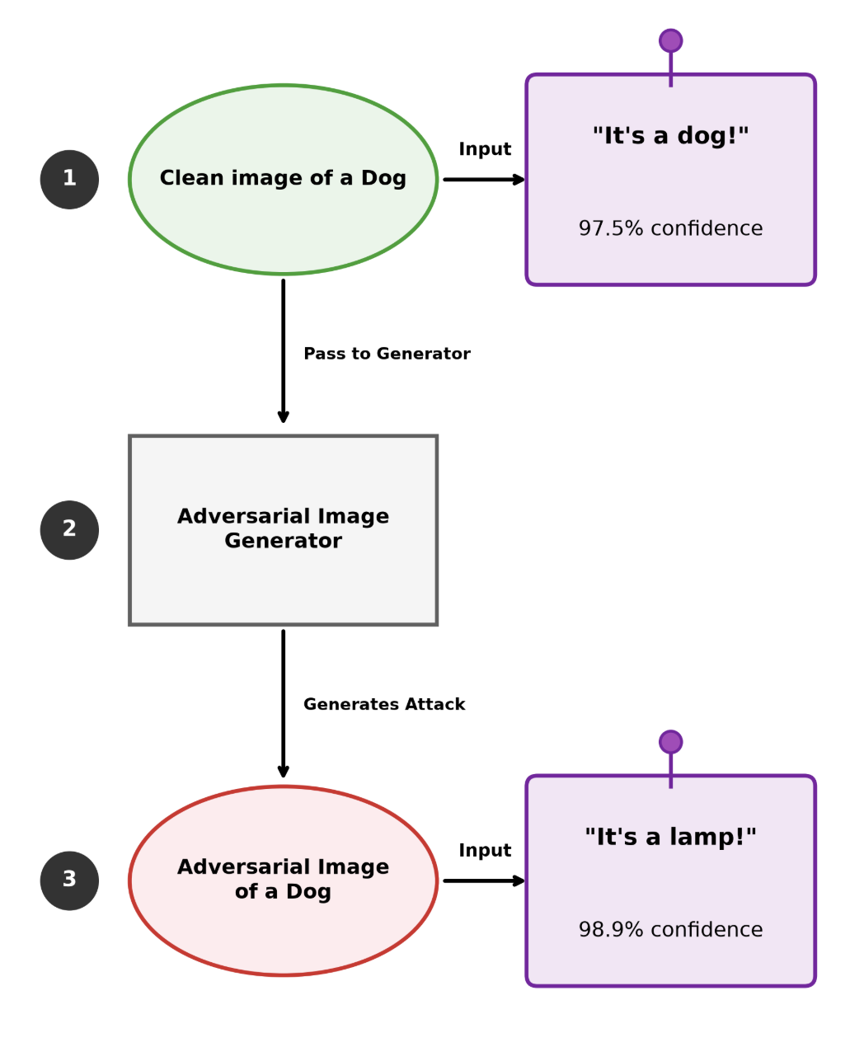


Definition (Goodfellow et al., 1)
Adversarial Attack: An imperceptible input perturbation that tricks neural networks into high-confidence misclassifications.
Adversarial Image Generator: A method that computes the smallest input change needed to fool the model (more details on next slide).
Adversarial Image: Normal-looking picture that has been intentionally changed to trick a model into misclassifying what it sees confidently.
67.8% confidence
97.9% confidence
Notes:
So now that we have seen an adversarial attack in action, let us define it more formally. An adversarial attack is an imperceptible input perturbation that tricks a neural network into a high-confidence misclassification.
We perform adversarial attacks through a machine called adversarial image generator, where it takes a clean image as input, then calculates the smallest pixel change needed to fool the model, and outputs the adversarial image. This adversarial image will still look normal to human eyes, but it has been intentionally modified to trick a machine learning model into misclassifying what it sees confidently.
On the right side there is an example: first we have a clean image of a dog, if we just feed this dog image into a normally trained machine learning model, it is going to see a dog as expected. But if we feed this image into an adversarial image generator and let it output an adversarial image of a dog, then feed it into the same machine learning model, it's going to see a completely different thing, which is a lamp, with high confidence. Note that this is just an example demonstration, it can be anything depending on how the pixel changes are calculated.

Slide 4
Generate Adversarial Images with FGSM
where x: clean image input,
ε: size of allowed change,
η: the perturbation,
x̃: adversarial image output.
How It Works:
Compute the gradient of model’s loss with respect to input image
Take the sign of that gradient, just +1 or -1 per pixel, direction only
3. Scale by ε to keep the change small and invisible
4. Add the result to the original image to get the adversarial image x̃, our output
Notes:
There is a simple and fast method to generate from clean image to adversarial image in a single step, and it is called FGSM, or Fast Gradient Sign Method. The equation is split into two parts: the first computes eta, the perturbation, by taking the sign of the gradient of the model's loss with respect to the input, then scaling it by epsilon. The second part simply adds that perturbation to the original image to get x-tilde, the adversarial output.
How it works: first, the model computes how its loss would change if you nudged each pixel, which is the gradient. Second, you take only the sign of that gradient, so each pixel gets either a plus one or a minus one, direction only, no magnitude. Third, you multiply by epsilon, which is what keeps the total change small enough to stay invisible. Finally, you add that result to the original image, and you have an adversarial example. As we saw with the panda two slides ago, epsilon was 0.007, the gradient sign gave the noise pattern in the middle, and adding it produced an image that looked identical to a panda but made the model say gibbon with 99.3 percent confidence.
Questions Covered:
x: original input y: correct label; J(θ, x, y): cost function used to train model (a measure of how wrong model's prediction is) ∇ₓ J: gradient of cost function with respect to input (direction that increases error fastest sign(·): a function that outputs +1, -1, or 0, indicating direction only, not magnitude

Slide 5
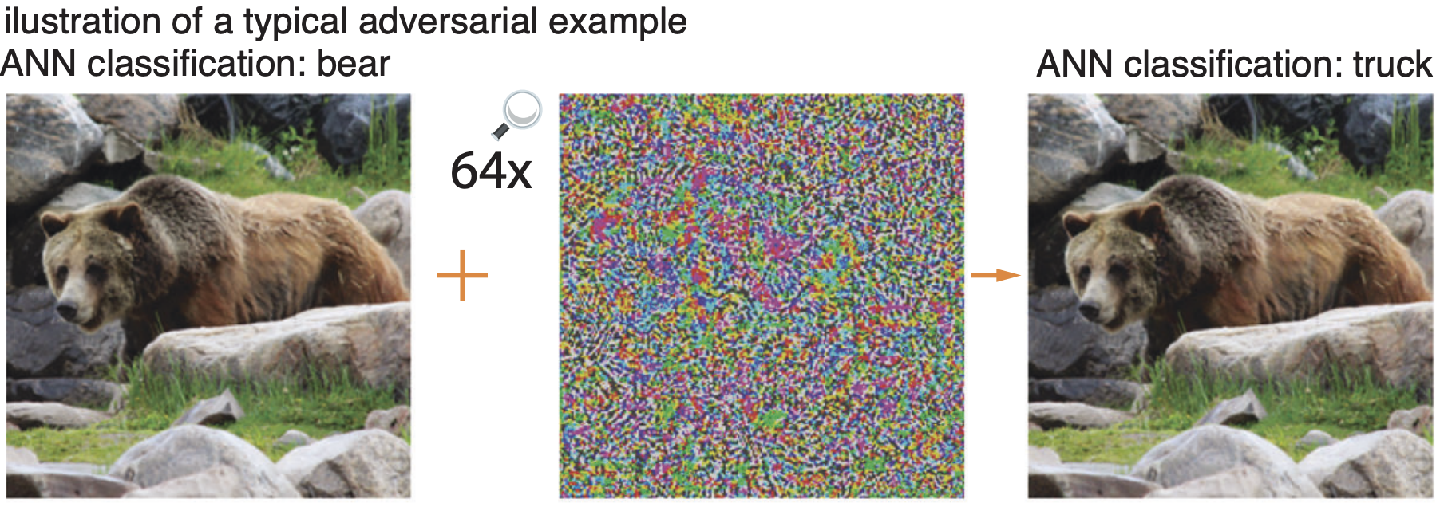
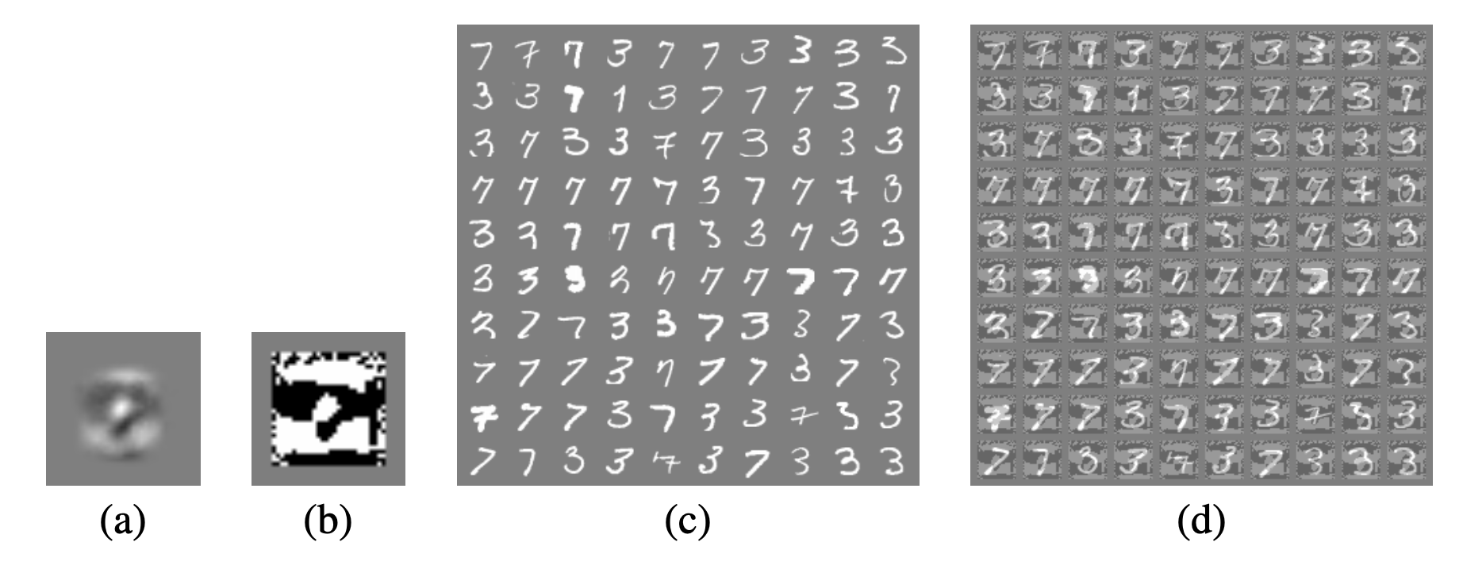
Other Adversarial Examples
Example 2:
Bear to Truck
(Veerabadran et al., 2)
Example 3:
MNIST Logistic Regression
(Goodfellow et al., 4)
Notes:
Here are two more examples.
First is the bear. At first, this image is correctly classified as bear. Then added colored noise, shown here 64 times larger so you can actually see it, since the real perturbation is nearly invisible. Once we add the true, small version, the model calls it a truck instead. This shows that Veerabadran and their team, who used their image in their paper to showcase the results, are able to demonstrate the same effect Goodfellow and their team did.
Last example, MNIST logistic regression, which are a dataset of handwritten digits. This time it's not even a deep neural network at all, just logistic regression, about the simplest model there is, trained to tell for example, 3s from 7s. On clean images, it's only wrong about 1.6 percent of the time. After the same kind of small adversarial perturbations, epsilon of 0.25 this time, so slightly more obvious to human eyes but you can still clearly see the digits, the error percentage jumped to 99%.
So what do all of these examples tell us? Small, carefully chosen changes can completely flip a model's output, and those changes are completely invisible to human eyes. And this isn't just a deep-network problem, even the simplest linear model is vulnerable. On top of that, the same adversarial input often tricks more than one model, not just the one it was built for (Goodfellow et al., 2).

Slide 6


Why Does This Happen? (Goodfellow et al., 1)
Goodfellow et al.'s linearity explanation:
A linear model changes its score by wᵀη.
FGSM chooses η = ε · sign(w), so the small terms add instead of canceling.
Therefore:
With thousands of pixels, tiny per-pixel changes can produce a large score shift.
How FGSM creates aligned changes:
Start with the clean image x.
Compute the loss gradient ∇ₓ J.
Use only the direction of each pixel's gradient.
Add the resulting perturbation η to obtain x + η.
Notes:
So why does this happen? Goodfellow et al. argued that linearity itself is enough to explain it.
For a linear model, adding a perturbation changes the model's score by w Transform * Eta. The important point is that FGSM chooses the sign of each pixel change so that every contribution pushes in the same harmful direction, instead of canceling out.
On the right, each small gray rectangle represents one tiny contribution. Each one is small because epsilon is small. But the model adds all of them together. Since an image has thousands of pixels, those tiny contributions can become one large change in the model's score.
That large score shift can cross the decision boundary, causing the model to change its prediction. This is Goodfellow et al.'s point: in high-dimensional spaces, being too linear makes small aligned perturbations powerful.
So how does the attacker make all of those tiny changes line up? It uses the gradient.
The gradient tells us how changing each pixel would affect the model's loss. FGSM keeps only the direction for each pixel, then applies the same small size epsilon to every change.
That gives us the perturbation eta. Adding eta to the clean image creates the adversarial image, x + eta.
The key is that this is not random noise. The gradient makes the small changes work together to increase the model's loss. That is why the tiny changes from the previous slide can add into a large effect.

Slide 7
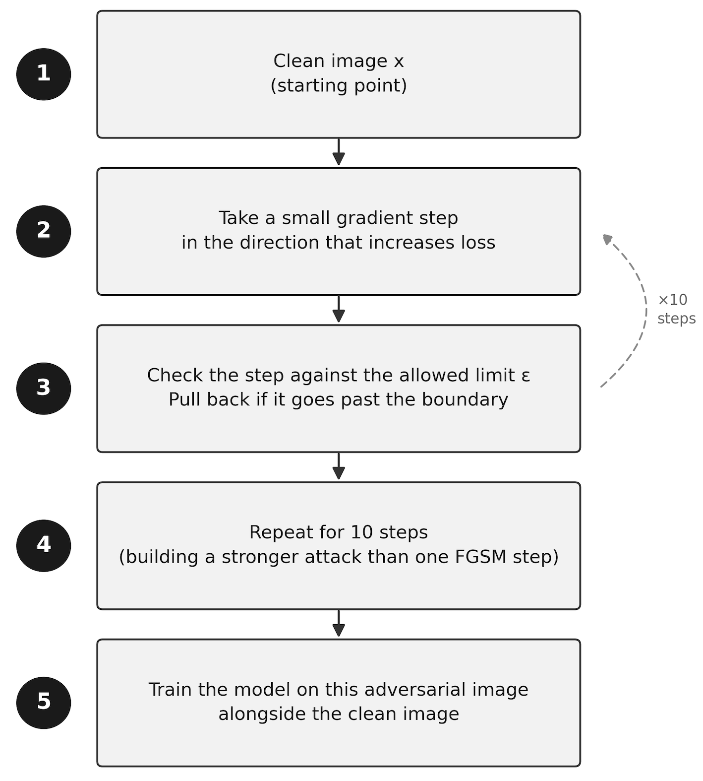
How to Defend? (Rice et al., 3-4)
Adversarial Training: Train on both clean and adversarial images.
PGD (Projected Gradient Descent) vs. FGSM (Fast Gradient Sign Method): FGSM takes one step. PGD takes several small steps, checking the boundary each time. Rice et al. use PGD rather than FGSM.
Step-by-step on how PGD adversarial training works is shown on right side.
Notes:
Now that we've learned how attacks work, how do we defend against them? Before we get into the actual defense, we first need to understand the tool used to generate strong adversarial examples in the first place, since the defense depends on it. There are two common methods worth knowing here, and we already covered one of them. FGSM, the method from slide 3, takes a single step in the direction that increases the model's error, which is fast but produces a relatively weak attack. PGD, short for Projected Gradient Descent, instead takes several small steps, checking after each change whether it has gone past the allowed perturbation limit and pulling it back if it has, which is slower but produces a much stronger attack. Rice et al. use PGD, and it's also the method our own research reproduces, so this is the version we'll be working with going forward.
Now onto the step-by-step on how PGD works, shown in the step map on the right. First, we start from the clean image and take a small step in the direction that increases the model's loss, meaning the direction that makes the model's prediction worse. Next, we check that step against the allowed limit, called epsilon, and if it's gone past that boundary, we pull it back to the edge of the limit so the change stays small enough to be a valid attack. We repeat this small step and check process multiple times, Rice et al. use 10 steps, which is what allows PGD to build a stronger, more damaging perturbation than a single FGSM step could produce.
Now that we have this PGD-generated adversarial image, what do we actually do with it? That's where adversarial training comes in, and we'll walk through that next.

Slide 8
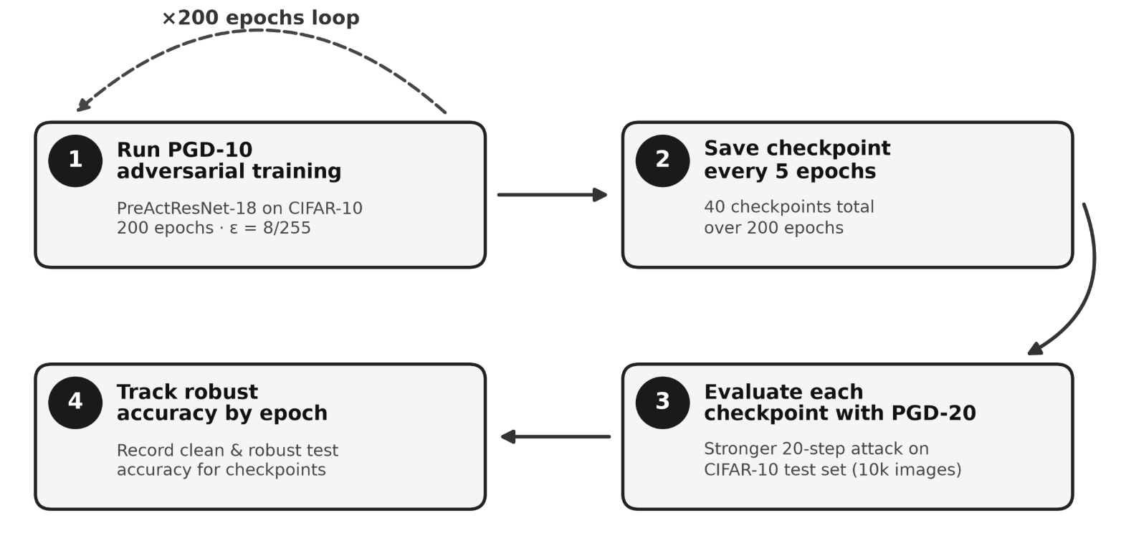
Adversarial Training (Rice et al., 4)
Neural Network Architecture: PreActResNet-18
Dataset: CIFAR-10 · 50,000 images for training · 10,000 for testing
x200 epoch loop
Notes:
The main defense against adversarial attacks is called adversarial training, where a model is trained on a mix of clean images and PGD-generated adversarial images, not clean data alone, so it learns to get the right answer even when the input has been attacked.
Here's the setup Rice et al. use. They train a PreActResNet-18 on CIFAR-10, which has 50,000 training images and 10,000 test images. Training runs for 200 epochs with PGD-10, the 10-step version we just walked through, and an epsilon of 8 over 255, which sets how large the perturbation is allowed to be.
Throughout that 200-epoch loop, they save a checkpoint of the model every 5 epochs, giving 40 checkpoints total. Then, separately from training, checkpoints are evaluated against a stronger attack than the one used in training, commonly a 20-step PGD adversary in this line of work, on the full 10,000-image test set. Evaluating with a stronger attack than the one used for training gives a more rigorous stress test of how robust each checkpoint really is, a model that only looks robust against the exact attack it trained on isn't a very convincing result.
Finally, they record both clean and robust test accuracy for every checkpoint, which is what lets them track robust accuracy epoch by epoch and pinpoint exactly where the overfitting gap emerges.
Problem solved, right? Well, not exactly. There's a new problem coming up.

Slide 9
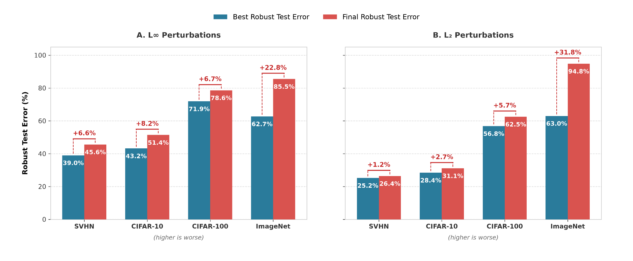
Training Too Long Can Hurt Robustness (Rice et al., 4-5)
Robust overfitting:
Robustness peaks early
Continued training erodes those gains
Robust test error: % of attacked test images misclassified.
Training longer does not mean more robust.
Notes:
We cannot just train a model forever and make it resistant to any kind of adversarial attack, because we run into a new problem during adversarial training known as robust overfitting. Robust overfitting is when a model's robust test error hits its lowest point relatively early, around the time of the first learning rate decay, and then gets worse the longer training continues, even though the model keeps improving on the training data itself. This is different from standard training, where test error on clean data usually keeps improving or levels off the longer you train. In adversarial training, robust test error rises again after that early point, so training longer actively hurts robustness instead of helping it.
Before we look at the chart, let's define robust test error itself. It is the percentage of attacked, perturbed test images the model gets wrong. So 0 percent would mean the model is never fooled by an attack, which is the ideal we are chasing but never actually reach. As a rough sense of scale, a model with no defense at all, no adversarial training, can be fooled on the vast majority of attacked images, often above 90 percent. So a well-defended model landing somewhere in the 30 to 50 percent range on CIFAR-10 is considered a strong, meaningful result in this field. That context matters for reading this chart.
Quickly, these four datasets scale up in difficulty. SVHN is street view house numbers, a relatively easy digit recognition task. CIFAR-10 and CIFAR-100 are small natural images sorted into 10 and 100 categories. ImageNet is the largest and hardest, over a thousand categories of real-world photos. So as we move left to right on each chart, we're also moving from easier to harder classification problems.
Take a look at the bar chart below. Each pair of bars compares two robust test error numbers for a given dataset: blue is the lowest robust test error the model achieved at any checkpoint during training, and red is the robust test error at the very end of training, after the model has fully converged. The left panel covers L-infinity perturbations and the right panel covers L2 perturbations, which are just two different mathematical rules for how large an attack is allowed to be. Look at CIFAR-10 on the left panel as an example. The blue bar shows 43.2 percent, which is already a reasonably strong result for this dataset. But if you just let training run to completion, the red bar climbs to 51.4 percent, an 8.2 point jump in the wrong direction, purely from training longer with no other change. ImageNet under L-infinity shows the same story at a much larger scale: 62.7 percent at best, climbing to 85.5 percent by the end, meaning the fully trained model is fooled on the overwhelming majority of attacked images, almost as if it had barely been defended at all. So the pattern across every dataset and both perturbation types is the same: whatever gains adversarial training achieves early on, continuing to train quietly erodes them, and that erosion is what we call robust overfitting.
Definitions:
L∞: Measures the maximum absolute change across all dimensions. It's sensitive to the largest perturbation in any single feature.
L₁: Measures the sum of absolute changes across all dimensions. It's sensitive to the total cumulative perturbation.

Slide 10
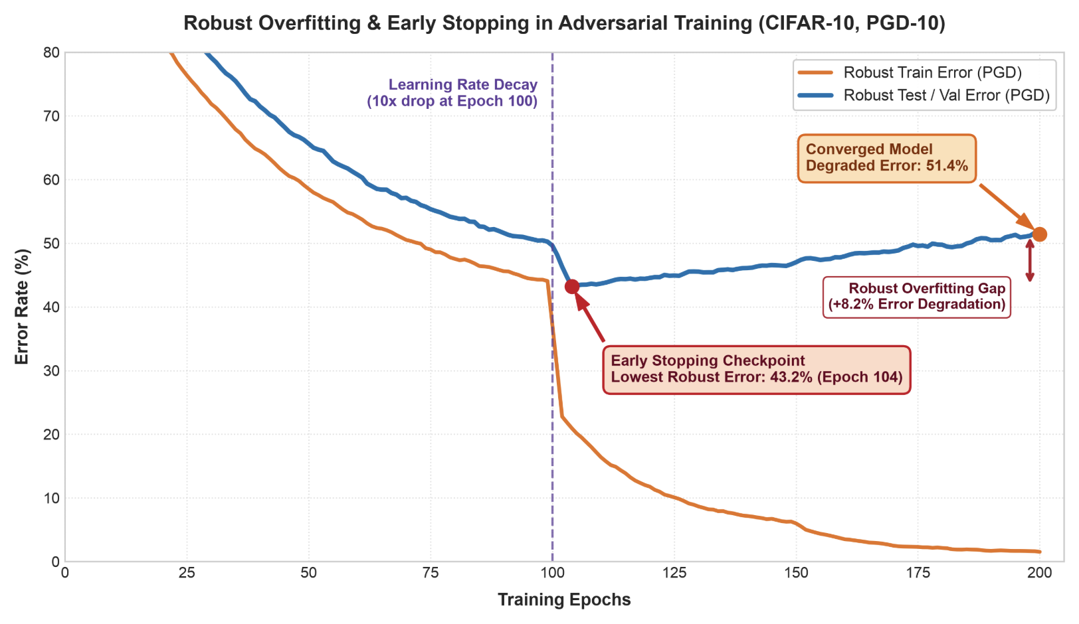
Solution: Early Stopping (Rice et al., 1, 6)
Core Mechanism: Save the best checkpoint evaluated on a held-out adversarial validation set rather than training until convergence.
Preventing Degradation: Halt training shortly after initial learning rate decay to avoid severe robust test set overfitting.
Proven Effectiveness: Simple early stopping matches or outperforms complex explicit regularization techniques across architectures.
Notes:
So are there solutions to robust overfitting? Yes, yes there is. This is going to be a happy ending, so don't worry. And one method that's proven to be very effective, and also not complicated to implement, is called early stopping.
As you probably noticed earlier, when we talked about best robust test error versus final robust test error on that bar chart, that "best" number wasn't just a random observation, it's actually the whole idea behind this solution. Instead of saving the final model at the end of training, we set aside a held-out validation set, evaluate its robust error under adversarial attack after each epoch, and save whichever checkpoint performs best along the way, rather than whichever one happens to finish last.
Now look at this chart on the right. Right after the initial learning rate drop at epoch 100, robust training error keeps falling toward zero, while robust test error briefly dips to its lowest point of 43.2 percent at epoch 104, then steadily climbs back up to 51.4 percent by the end of training. Early stopping just means catching that checkpoint at epoch 104, right at the bottom of the dip, instead of letting training run all the way to convergence. Doing that preserves an 8.2 percent point improvement in adversarial robustness, no complex regularization required, just knowing when to stop.

Slide 11
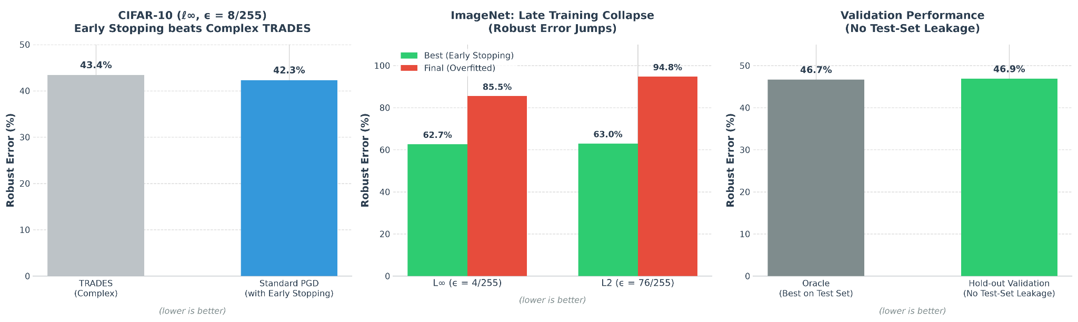
Effectiveness of Early Stopping (Rice et al., 4)
Notes:
Here are the benchmarks of early stopping. These are three bar charts. The first one on the left is CIFAR-10, comparing against TRADES, a more complex and heavily cited adversarial training algorithm that was viewed as a major improvement over plain PGD training. What this chart shows is that if you take standard PGD-based adversarial training, the simpler baseline method, and combine it with early stopping, meaning you pick the checkpoint with the best robust performance instead of training all the way to the end, it reaches 42.3 percent robust error. That is actually slightly better than TRADES's reported 43.4 percent, even though TRADES uses a more complicated loss function specifically designed to improve robustness. So the takeaway here is that a large chunk of what looked like an algorithmic improvement in TRADES can actually be explained by early stopping alone.
The second chart in the middle, ImageNet late training collapse, applies this same idea to publicly released, pretrained ImageNet models, meaning real models people actually download and use. The green bars show robust error at the best checkpoint during training, and the red bars show robust error after continuing to train those same models to convergence. Under L-infinity perturbations, robust error jumps from 62.7 percent to 85.5 percent. Under L2 perturbations, it jumps from 63.0 percent to 94.8 percent, meaning the fully converged model is wrong on almost every single attacked image it sees. This confirms robust overfitting is not just a small-scale lab artifact, it happens on large, real-world models too, and the damage from training too long does not shrink as the problem scales up, it gets worse.
The third chart on the right addresses a fair objection to all of this. If you choose your early stopping point by watching test set performance during training, isn't that leaking information from the test set, meaning you are effectively picking the checkpoint that happens to do best on the exact data you are being graded on. To check this, the researchers held out a separate validation set, completely apart from the test set, and used only that to decide when to stop training. The hold-out validation approach reaches 46.9 percent robust error, compared to 46.7 percent from the oracle method that picks the best checkpoint by looking directly at the test set. Those two numbers are almost identical.
So this confirms early stopping is not an illusion caused by test set leakage. Using a legitimate, unseen validation set to decide when to stop gets you essentially the same benefit as cheating and looking at the test set directly.

Slide 12
Our Research: Motivation and Scope
Question: During PGD adversarial training of PreActResNet-18 on CIFAR-10, how does randomly alternating pixel-space PGD and low-frequency DCT-masked PGD once per epoch affect the timing and severity of robust overfitting, relative to pixel-only and low-frequency-only training?
Hypothesis: With architecture, dataset, optimization schedule, perturbation budget, and checkpoint-evaluation schedule held fixed, mixed-domain training will produce robust-accuracy curves that differ from those of the single-domain conditions. In particular, the peak epoch, peak shape, or post-peak decline may change under pixel-space and/or low-frequency evaluation.
What we found: Pixel-only training reproduced robust overfitting. Low-frequency-only training maintained high matched-domain accuracy but failed against pixel PGD. Epoch-wise mixing produced domain-specialized states, with robustness strongly associated with the most recent training attack.
Why does this matter: Understanding how the training attack affects robust overfitting can help guide the design of training methods that preserve robustness over time. Comparing single-domain training with mixed-domain training tests whether alternating attacks is a promising direction for maintaining robustness against both.
Notes:
So our question: why does robust overfitting happen? Rice et al. documented that it happens, but they didn't explain what the model is doing internally when it does. That's the open question we're working on.
Our hypothesis is that the model memorizes specific perturbation patterns from the training set instead of learning a decision boundary that generalizes to new attacks. The perturbations generated during adversarial training depend on the model's current weights, so they act as a moving target. The model can gradually overfit to that moving target rather than learning something stable.
This summer, our goal is to reproduce Rice et al.'s robust overfitting results on CIFAR-10, using PreActResNet-18 neural network architecture under PGD-based adversarial training. We track training and test robust accuracy across every epoch, so we can locate exactly when and how the overfitting gap emerges. This is a multi-year research direction, and testing the memorization hypothesis directly is future work. What we're building this summer is the empirical foundation that hypothesis will eventually be tested against. We'll walk through our progress on that reproduction in the upcoming slides.
Why does this matter? If we can pinpoint when memorization takes over from genuine robustness learning, that gives us a diagnostic foundation. Right now the field relies on early stopping as a fix, applied after the fact, without a clear picture of the underlying cause. And more broadly, understanding the actual cause tells us how much we can really trust a model's robustness in the first place, not just whether it passes a benchmark.

Slide 13
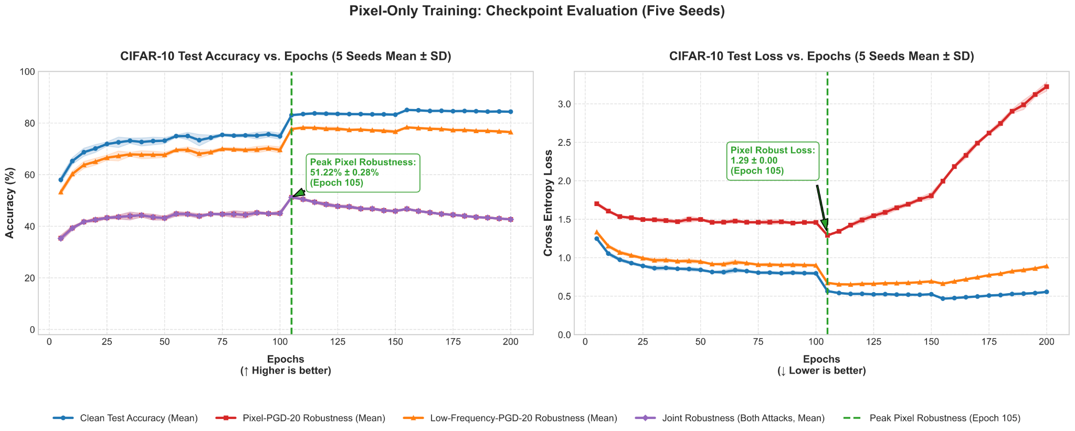

Slide 14
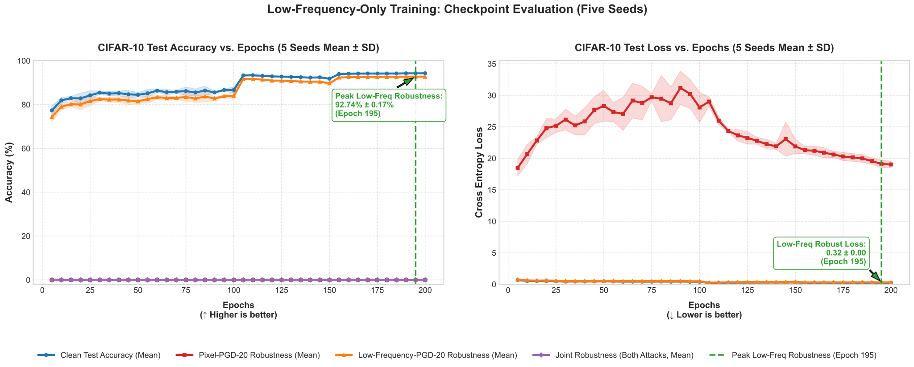

Slide 15
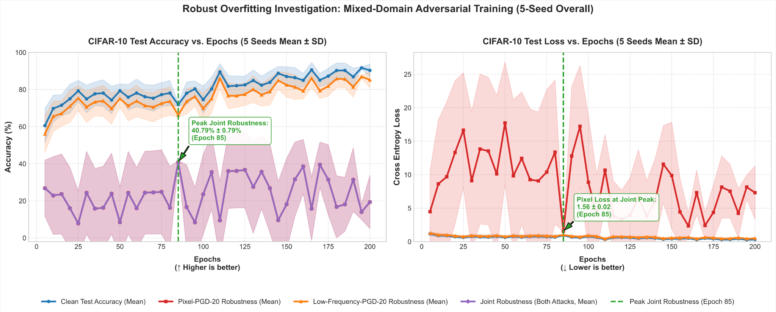

Slide 16
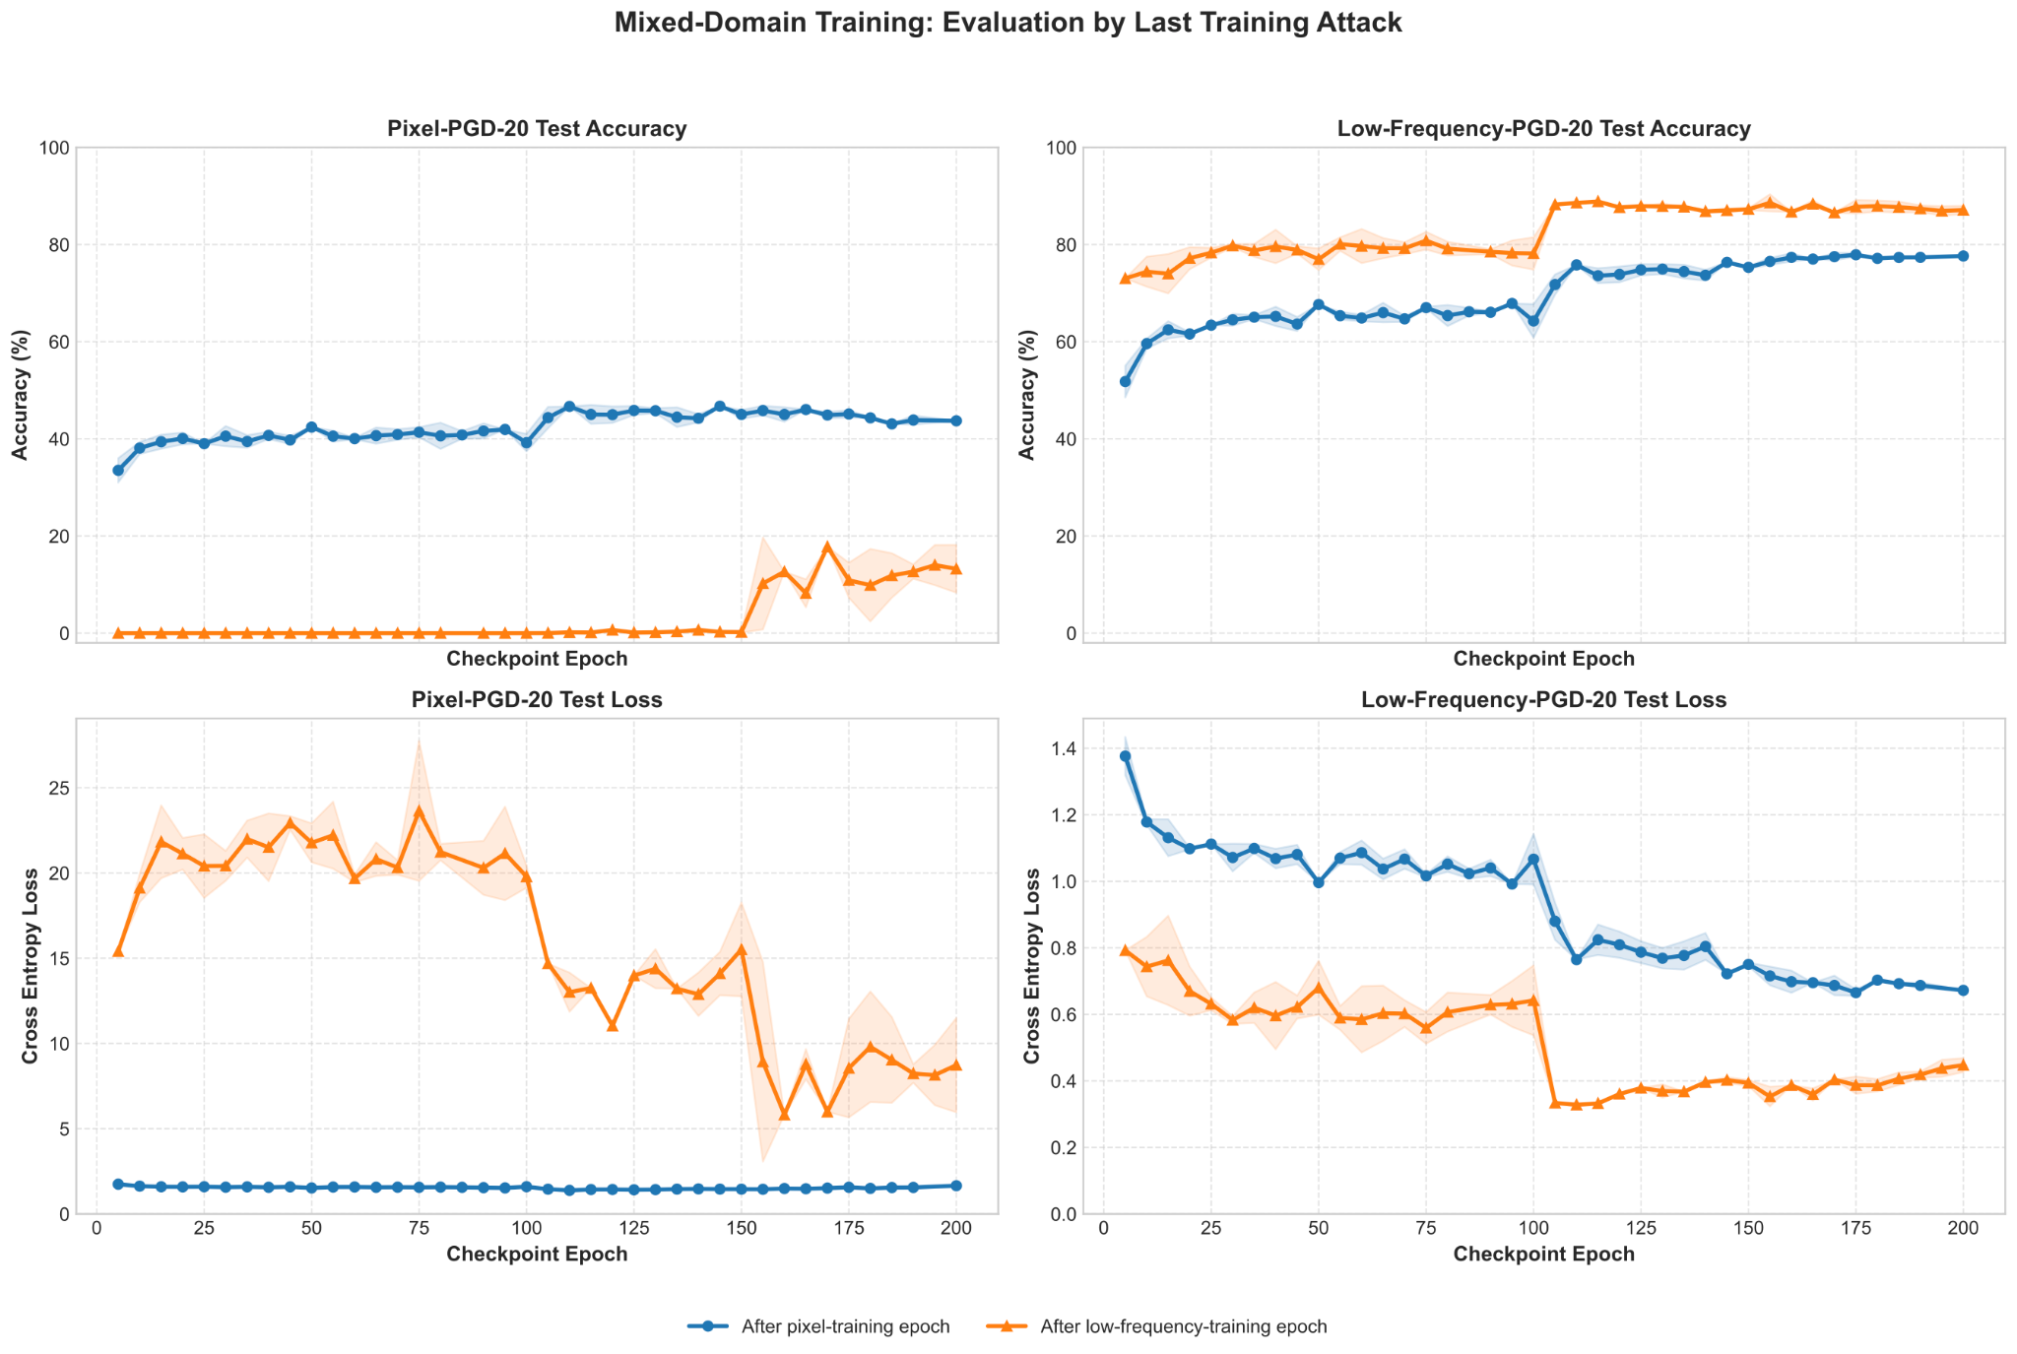

Slide 17
Key Takeaways
[Enter text here]
[Enter text here]
[Enter text here]
[Enter text here]
[Reserved for our research findings]
[Reserved for our research findings]
Notes:
So, to sum everything up:
1. An adversarial example is an input with a tiny, invisible change that makes a model confidently give the wrong answer. That matters, because it means a highly accurate model can still be reliably tricked. And despite common belief that it is nonlinearity fault, which is not, the actual cause is linearity where networks respond so predictably to input changes that many small changes can add up into one large, damaging shift (Goodfellow et al., 1). And we had also seen some visual examples like panda to gibbon, bear to truck, and digit recognitions.
2. So how do we defend against that? Adversarial training: instead of training only on clean examples, you train on a mix of clean and adversarially perturbed ones, so the model learns to resist the noise in the adversarial image. This measurably reduced both clean and adversarial error rates (Goodfellow et al., 5).
3. But adversarial training brings a new problem: robust overfitting. Past a certain point, the model keeps improving on training data, but gets worse on new, unseen data, the opposite of what normally happens in standard training (Rice et al., 1).
4. So the solution is early stopping. Stop training early, and keep the checkpoint that performed best on a validation set, rather than the final model. This simple approach nearly matched the best possible test result, and outperformed several more complex techniques, with no extra data or architecture changes needed (Rice et al., 6-7).
5. [Reserved for our research findings]
6. [Reserved for our research findings]

Slide 18
References
I. J. Goodfellow, J. Shlens, and C. Szegedy. Explaining and Harnessing Adversarial Examples. In International Conference on Learning Representations (ICLR), 2015.
A. Madry, A. Makelov, L. Schmidt, D. Tsipras, and A. Vladu. Towards Deep Learning Models Resistant to Adversarial Attacks. In International Conference on Learning Representations (ICLR), 2018.
L. Rice, E. Wong, and J. Z. Kolter. Overfitting in Adversarially Robust Deep Learning. In Proceedings of the 37th International Conference on Machine Learning, PMLR 119:8093-8104, 2020.
C. Yu, B. Han, L. Shen, J. Yu, C. Gong, M. Gong, and T. Liu. Understanding Robust Overfitting of Adversarial Training and Beyond. In Proceedings of the 39th International Conference on Machine Learning, PMLR 162:25595-25610, 2022.
C. Guo, J. S. Frank, and K. Q. Weinberger. Low Frequency Adversarial Perturbation. In Proceedings of the 35th Uncertainty in Artificial Intelligence Conference, PMLR 115:1127-1137, 2020.
Y. Chen, Q. Ren, and J. Yan. Rethinking and Improving Robustness of Convolutional Neural Networks: A Shapley Value-based Approach in Frequency Domain. In Advances in Neural Information Processing Systems 35, 2022.

Slide 19
References
Q. Bu, D. Huang, and H. Cui. Towards Building More Robust Models with Frequency Bias. In Proceedings of the IEEE/CVF International Conference on Computer Vision, pages 4402-4411, 2023.
F. Tramér and D. Boneh. Adversarial Training and Robustness for Multiple Perturbations. In Advances in Neural Information Processing Systems 32, 2019.
P. Maini, E. Wong, and J. Z. Kolter. Adversarial Robustness Against the Union of Multiple Perturbation Models. In Proceedings of the 37th International Conference on Machine Learning, PMLR 119:6640-6650, 2020.
M. Xie, Y. He, and M. Fang. TaFD: Threat-Aware Frequency Decoupling for Adversarial Robustness against Heterogeneous Attacks. arXiv:2606.17540 [cs.CV], 2026.
K. He, X. Zhang, S. Ren, and J. Sun. Identity Mappings in Deep Residual Networks. In Computer Vision: ECCV 2016, pages 630-645, 2016.
A. Krizhevsky. Learning Multiple Layers of Features from Tiny Images. Technical report, University of Toronto, 2009.

Slide 20

Thank you!
Any Questions?
Researcher: Kaiwen Du
Principal Investigator: Dr. Nicholas Q. Tran
Department of Mathematics and Computer Science

