Slide 1


Welcome to
INTERNSHIP STUDIO
Module 02 | Lesson 03
Control structures (loops, conditions)
WWW.INTERNSHIPSTUDIO.COM

Slide 2

Operators
Operators are used to perform operations on variables and values.
Arithmetic Operators are used with numeric values to perform common mathematical operations
Operator | Name | Example | Explination
+, -, *, / | Addition, Subtraction, Multiplication, Division | x+y | -
% | Modulus | x%y | gives you the remainder, example 15%2 will be 1
** | Exponentiation | x**y | Give you the nth power of any number, example 2**5 will give 32
// | Floor division | x//y | rounds the result down to the nearest whole number, example 15//2 will give 7
WWW.INTERNSHIPSTUDIO.COM

Slide 3
Operators
Operators are used to perform operations on variables and values.
Comparison Operators are used to compare two values
Operator | Name | Example | Explination
== | Equal | x==y | -
!= | Not equal | x!=y | -
>, < | Greater than, Less than | x>y, x<y | -
>=, <= | Greater than or equal to, Less than or equal to | x>=y, x<y | -
WWW.INTERNSHIPSTUDIO.COM

Slide 4
Operators
Operators are used to perform operations on variables and values.
Logical Operators are used to combine conditional statements
Operator | Name | Example | Explination
and | and | x > 5 and x<10 | Returns True if both statements are true
or | or | x > 5 or x<4 | Returns True if one of the statements is true
not | not | not(x > 5 and x<10) | Reverse the result, returns False if the result is true
WWW.INTERNSHIPSTUDIO.COM

Slide 5
Operators
Operators are used to perform operations on variables and values.
Membership Operators are used to test if a sequence is presented in an object:
Operator | Name | Example | Explination
in | in | x in y | Returns True if a sequence with the specified value is present in the object, exmaple "apple" in ["apple", "banana"]
not in | not in | x not in y | Returns True if a sequence with the specified value is not present in the object, exmaple "mango" not in ["apple", "banana"]
WWW.INTERNSHIPSTUDIO.COM

Slide 6
Conditional Statements
if test1:
statement 1
elif test2:
statement 2
else:
statement 3
• Both the elif and else blocks are optional.
WWW.INTERNSHIPSTUDIO.COM

Slide 7
Conditional Statements
a= 10; b=20; c=9
if b > a:
print("b is greater than a")
else:
print("a is greater than b")
a is greater than b
if a > b and a > c:
print("a is greater than b and c")
elif b > a and b > c:
print("b is greater than a and c")
else:
print("a is greater than a and b")
b is greater than a and c
WWW.INTERNSHIPSTUDIO.COM

Slide 8
Loop
Loop is used to iterate over the sequence.
For Loop A for loop is used for iterating over a sequence (that is either a list, a tuple, a dictionary, a set, or a string).
fruits = ["apple", "banana", "cherry"]
for x in fruits:
print(x)
for x in range(6):
print(x)
for x in range(start, end):
print(x)
for x in range(start, end, step_size):
print(x)
WWW.INTERNSHIPSTUDIO.COM

Slide 9
Loop
Loop is used to iterate over the sequence.
While Loop With the while loop we can execute a set of
statements as long as a condition is true.. i = 1 while i<10: print(i) i=i+1
WWW.INTERNSHIPSTUDIO.COM

Slide 10
Loop
Loop is used to iterate over the sequence.
Break statement With the break statement we can stop the loop even if the while condition is true: A = 0 while True: print(A) if A >= 5: break A+ = 1
WWW.INTERNSHIPSTUDIO.COM

Slide 11
Loop
Loop is used to iterate over the sequence.
Continue statement With the continue statement we can stop the current iteration, and continue with the next: i = 1 while i<6: print(i) if i == 3: continue i = i+ 1
WWW.INTERNSHIPSTUDIO.COM

Slide 12
Looping over Strings and Lists
List is a general sequence object while String is a character sequence object.
• Both can be iterated over by a for loop:
WWW.INTERNSHIPSTUDIO.COM

Slide 13
Nested Loops
Loops can be nested just like the if/else statements.
• Indentation is again the key to creating nested loops.
• In a 2 level nested loop with x iterations on the outer
loop and y iterations in the inner loop:
• All statements in the outer loop will be executed x times
• All statements in the inner loop will be executed x*y times
WWW.INTERNSHIPSTUDIO.COM

Slide 14
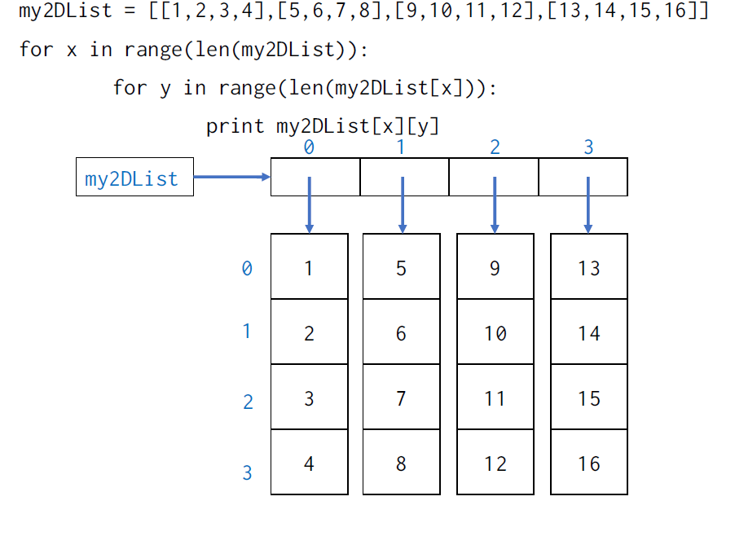
Nested Loops
WWW.INTERNSHIPSTUDIO.COM

