Slide 1


Welcome to
INTERNSHIP STUDIO
Module 05 | Lesson 01
Introduction to artificial neural networks
WWW.INTERNSHIPSTUDIO.COM

Slide 2

What is Artificial Neural Network?
The term "Artificial Neural Network" is derived from Biological neural networks that develop the structure of a human brain. Similar to the human brain that has neurons interconnected to one another, artificial neural networks also have neurons that are interconnected to one another in various layers of the networks. These neurons are known as nodes
WWW.INTERNSHIPSTUDIO.COM

Slide 3
Introduction, or how the brain works
Machine learning involves adaptive mechanisms that enable computers to learn from experience, learn by example and learn by analogy. Learning capabilities can improve the performance of an intelligent system over time. The most popular approaches to machine learning are artificial neural networks and genetic algorithms. This lecture is dedicated to neural networks.
WWW.INTERNSHIPSTUDIO.COM

Slide 4
Concept of Neural Network
A neural network can be defined as a model of reasoning based on the human brain. The brain consists of a densely interconnected set of nerve cells, or basic information-processing units, called neurons.
The human brain incorporates nearly 10 billion neurons and 60 trillion connections, synapses, between them. By using multiple neurons simultaneously, the brain can perform its functions much faster than the fastest computers in existence today.
Each neuron has a very simple structure, but an army of such elements constitutes a tremendous processing power.
A neuron consists of a cell body, soma, a number of fibers called dendrites, and a single long fiber called the axon.
WWW.INTERNSHIPSTUDIO.COM

Slide 5
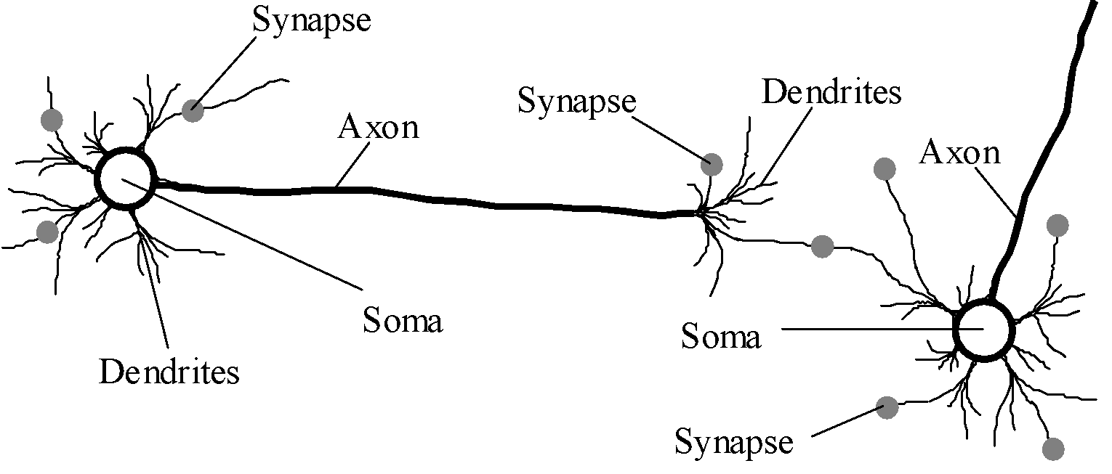
Biological neural network
The human brain incorporates nearly 10 billion neurons and 60 trillion connections, synapses, between them.
A neuron consists of a cell body, soma, a number of fibers called dendrites, and a single long fiber called the axon.
WWW.INTERNSHIPSTUDIO.COM

Slide 6
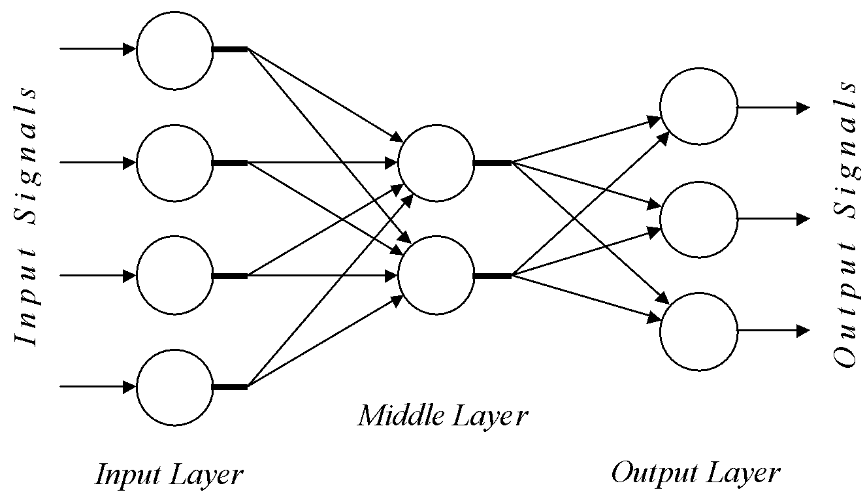
Architecture of a typical artificial neural network
WWW.INTERNSHIPSTUDIO.COM

Slide 7
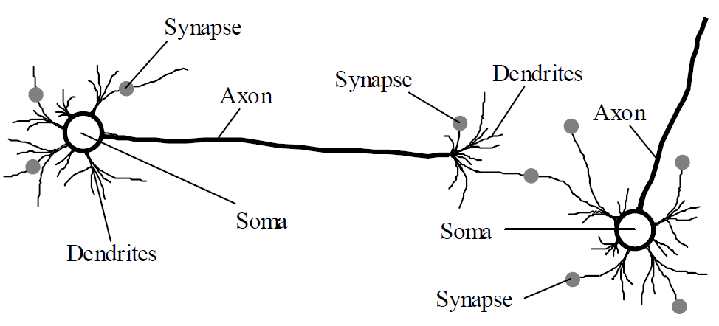
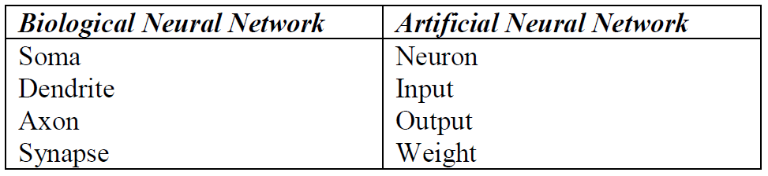
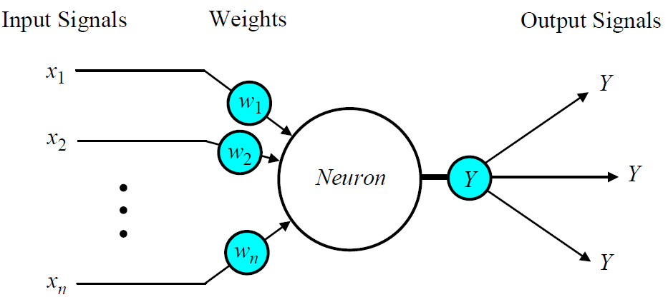
Analogy between biological and
artificial neural networks
WWW.INTERNSHIPSTUDIO.COM

Slide 8
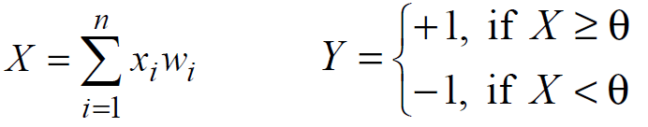
Perceptron Learning
1
2
Sign Function
WWW.INTERNSHIPSTUDIO.COM

Slide 9
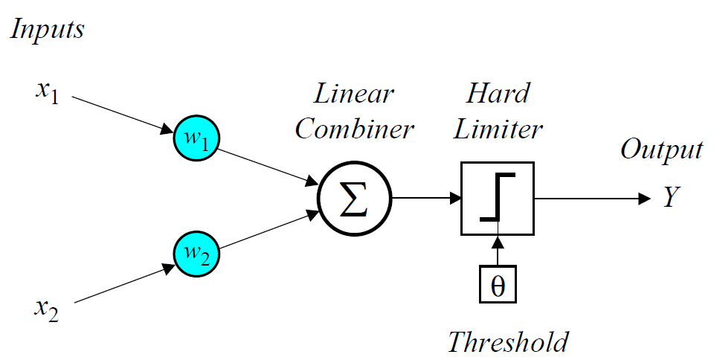
How a perceptron learns
In 1958, Frank Rosenblatt introduced a training algorithm that provided the first procedure for training a simple ANN: a perceptron, inspired by
McCulloch and Pitts neuron model
WWW.INTERNSHIPSTUDIO.COM

Slide 10
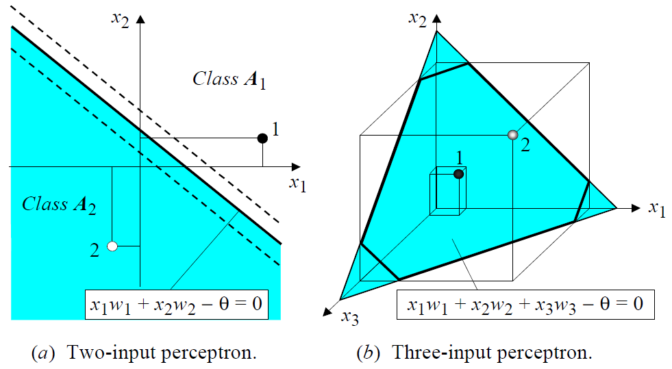
How a perceptron learns
Decision boundary
WWW.INTERNSHIPSTUDIO.COM

Slide 11
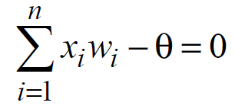
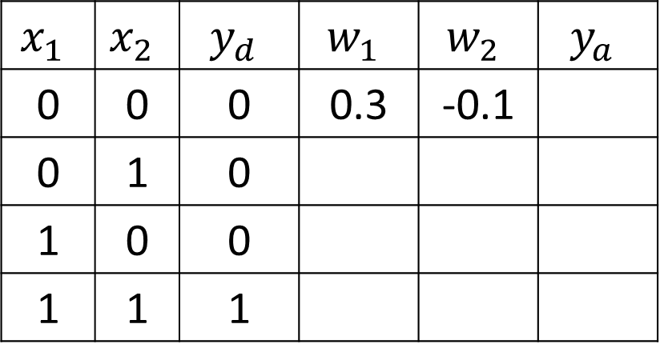
How a perceptron learns
AND Problem
$$x_{1}$$ | $$x_{2}$$ | $$y_{d}$$ | $$w_{1}$$ | $$w_{2}$$ | $$y_{a}$$
0 | 0 | 0 | 0.3 | -0.1
0 | 1 | 0
1 | 0 | 0
1 | 1 | 1
3
1
3
2
Step( )
1
2
Threshold: θ = 0.2; learning rate : α = 0.1; activation function : step
WWW.INTERNSHIPSTUDIO.COM

Slide 12
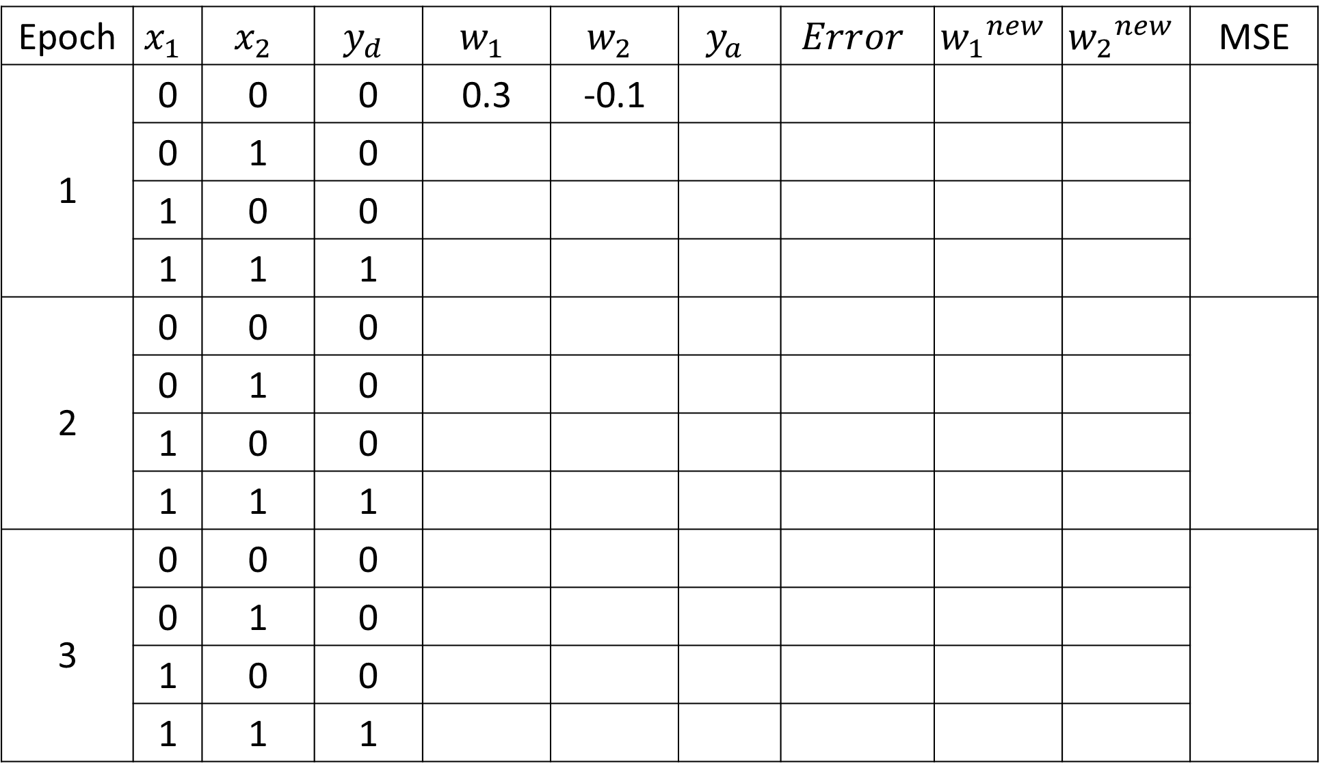
How a perceptron learns
Epoch | $$x_{1}$$ | $$x_{2}$$ | $$y_{d}$$ | $$w_{1}$$ | $$w_{2}$$ | $$y_{a}$$ | $$Error$$ | $${w_{1}}^{new}$$ | $${w_{2}}^{new}$$ | MSE
1 | 0 | 0 | 0 | 0.3 | -0.1
1 | 0 | 1 | 0
1 | 1 | 0 | 0
1 | 1 | 1 | 1
2 | 0 | 0 | 0
2 | 0 | 1 | 0
2 | 1 | 0 | 0
2 | 1 | 1 | 1
3 | 0 | 0 | 0
 | 0 | 1 | 0
 | 1 | 0 | 0
 | 1 | 1 | 1
WWW.INTERNSHIPSTUDIO.COM

Slide 13
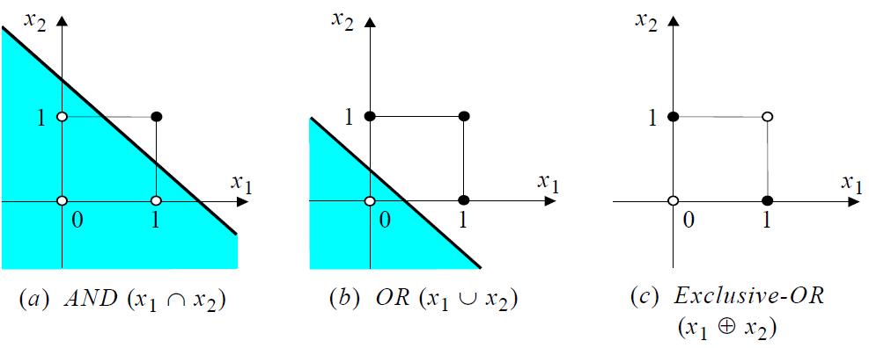
How a perceptron learns : Decision Boundary
WWW.INTERNSHIPSTUDIO.COM

Slide 14
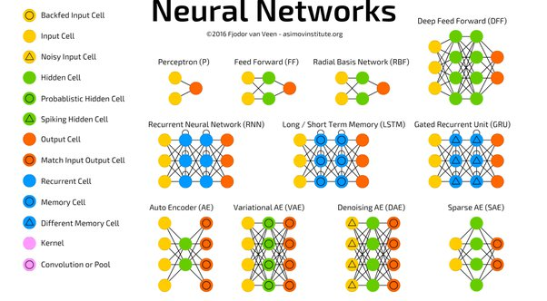
Types of Neural Network
WWW.INTERNSHIPSTUDIO.COM

Slide 15
Advantages of ANN
Parallel processing capability: Artificial neural networks have a numerical value that can perform more than one task simultaneously.
Storing data on the entire network: Data that is used in traditional programming is stored on the whole network, not on a database. The disappearance of a couple of pieces of data in one place doesn't prevent the network from working.
Capability to work with incomplete knowledge: After ANN training, the information may produce output even with inadequate data. The loss of performance here relies upon the significance of missing data.
Having a memory distribution: For ANN is to be able to adapt, it is important to determine the examples and to encourage the network according to the desired output by demonstrating these examples to the network. The succession of the network is directly proportional to the chosen instances, and if the event can't appear to the network in all its aspects, it can produce false output.
WWW.INTERNSHIPSTUDIO.COM

Slide 16
Disadvantages of ANN
Assurance of proper network structure: There is no particular guideline for determining the structure of artificial neural networks. The appropriate network structure is accomplished through experience, trial, and error.
Unrecognized behavior of the network: It is the most significant issue of ANN. When ANN produces a testing solution, it does not provide insight concerning why and how. It decreases trust in the network.
Hardware dependence: Artificial neural networks need processors with parallel processing power, as per their structure. Therefore, the realization of the equipment is dependent.
Difficulty of showing the issue to the network: ANNs can work with numerical data. Problems must be converted into numerical values before being introduced to ANN. The presentation mechanism to be resolved here will directly impact the performance of the network. It relies on the user's abilities.
The duration of the network is unknown: The network is reduced to a specific value of the error, and this value does not give us optimum results.
WWW.INTERNSHIPSTUDIO.COM

