Slide 1


Welcome to
INTERNSHIP STUDIO
Module 05 | Lesson 02
Activation Functions
WWW.INTERNSHIPSTUDIO.COM

Slide 2

What is Activation Function?
It’s just a thing function that you use to get the output of node. It is also known as Transfer Function.
WWW.INTERNSHIPSTUDIO.COM

Slide 3
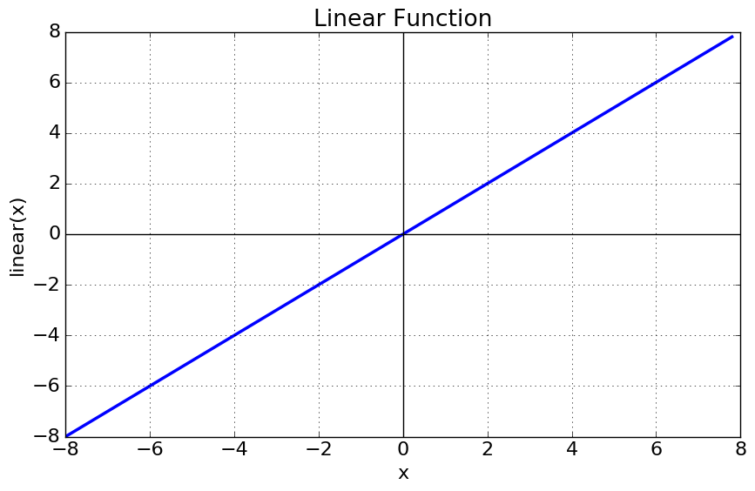
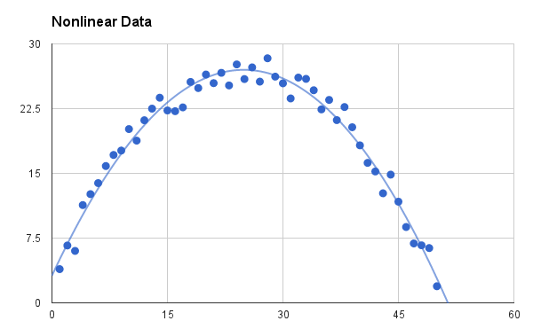
Why we use Activation functions with Neural Networks?
It is used to determine the output of neural network like yes or no. It maps the resulting values in between 0 to 1 or -1 to 1 etc. (depending upon the function).
The Activation Functions can be basically divided into 2 types-
Linear Activation Function
2. Non-linear Activation Functions
WWW.INTERNSHIPSTUDIO.COM

Slide 4
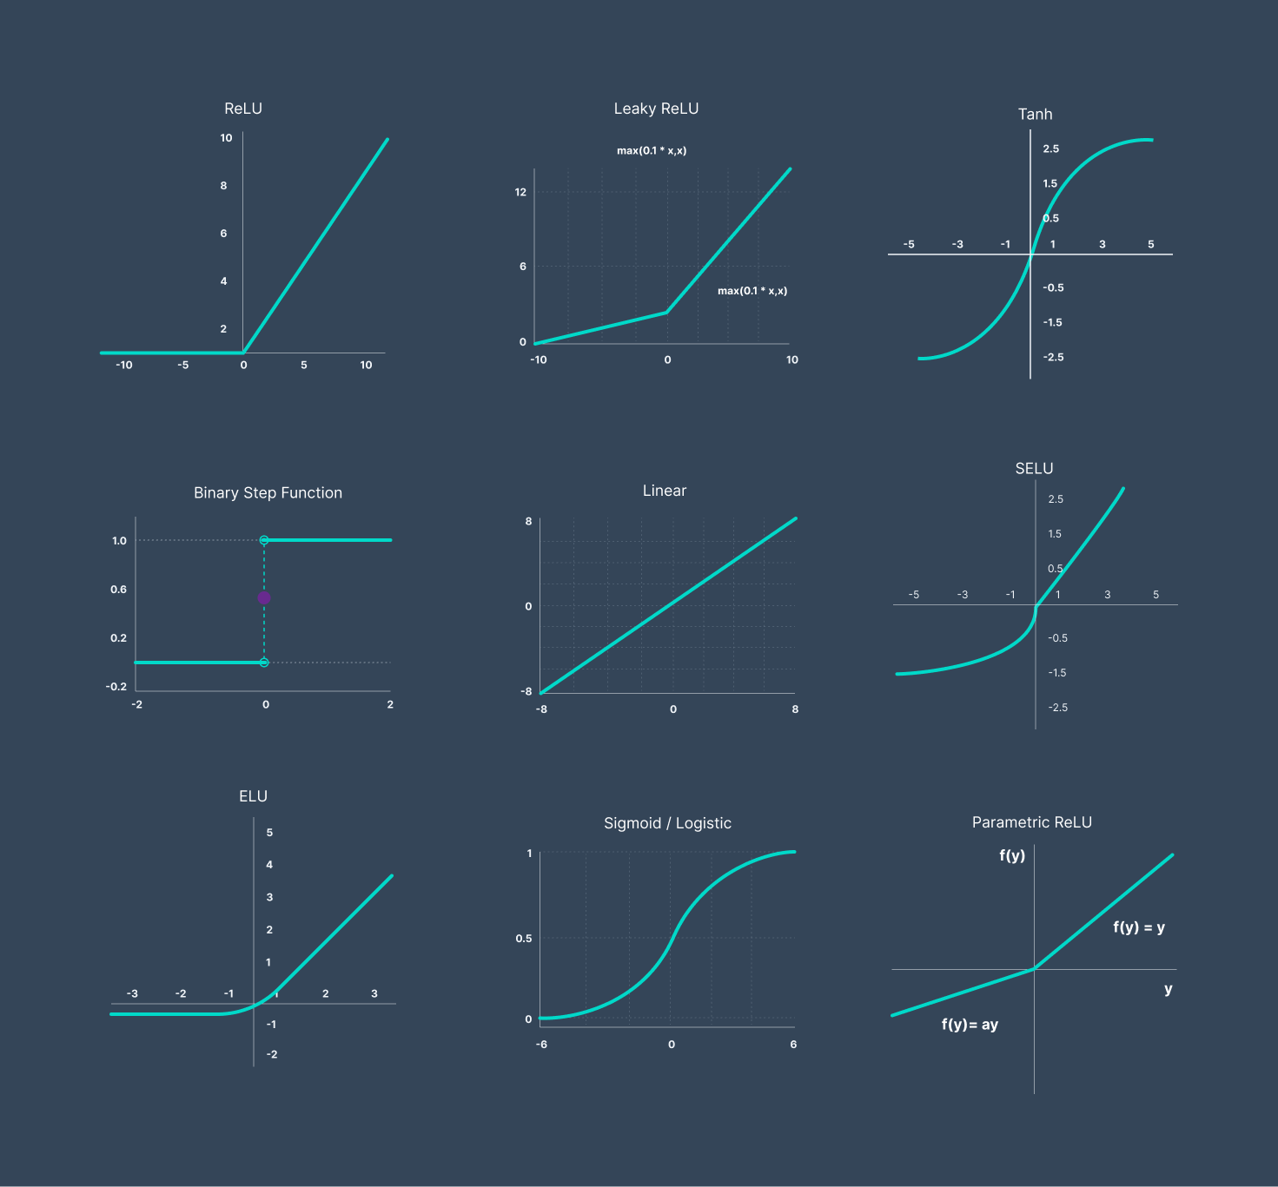
Types of Activation Functions
WWW.INTERNSHIPSTUDIO.COM

Slide 5
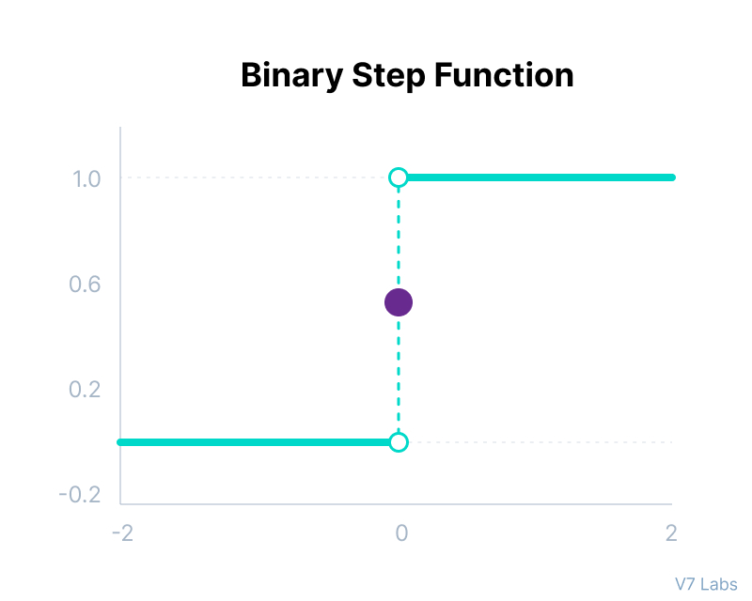
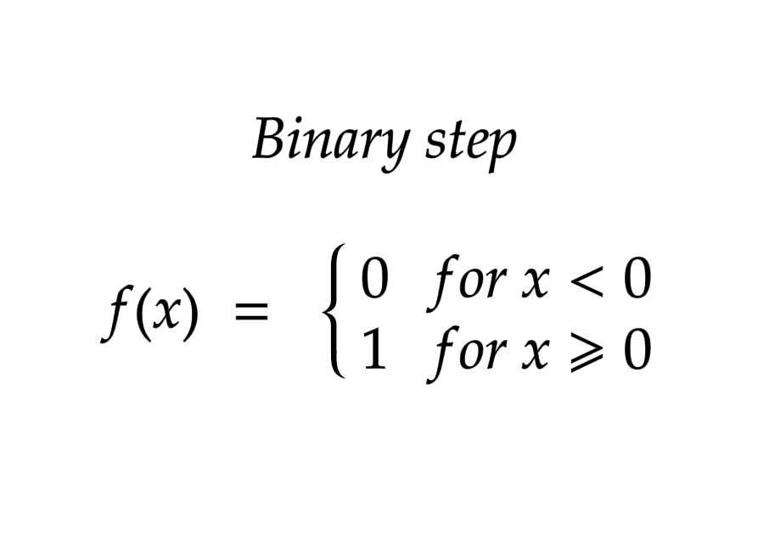
Binary Step Function
WWW.INTERNSHIPSTUDIO.COM

Slide 6
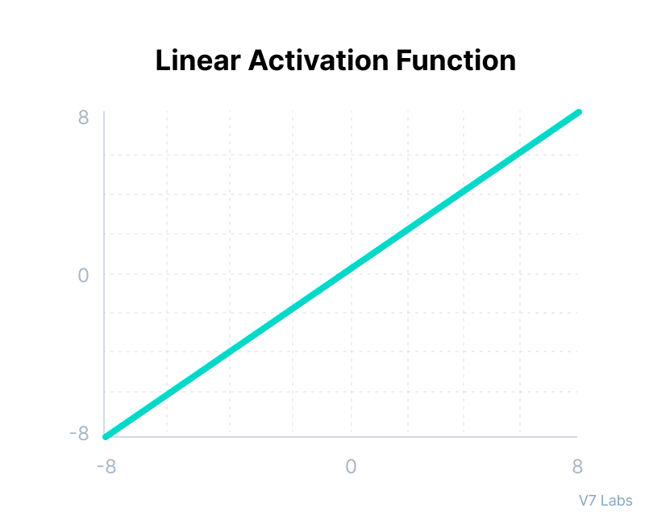
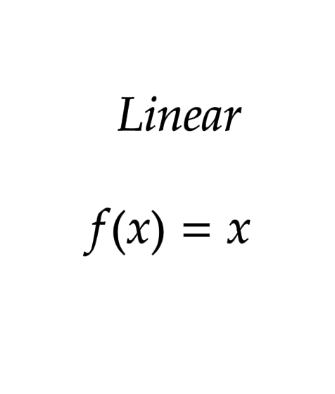
Linear Activation Function
WWW.INTERNSHIPSTUDIO.COM

Slide 7
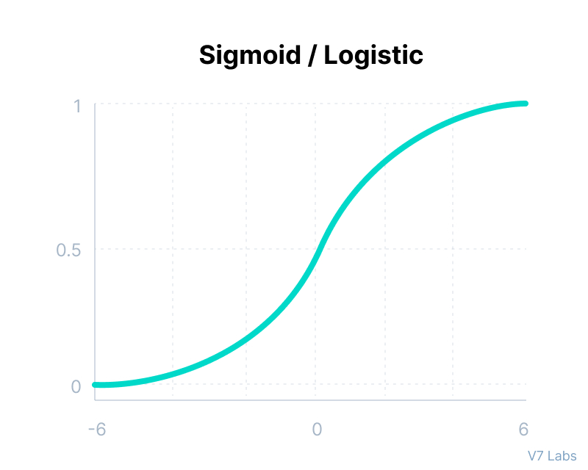
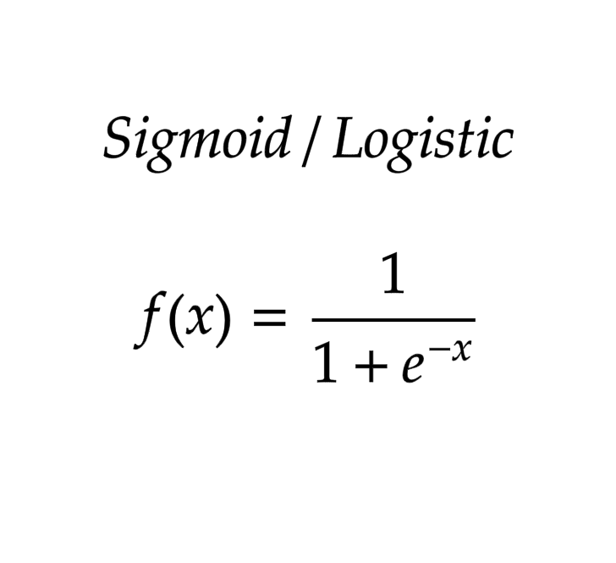
Sigmoid / Logistic Activation Function
WWW.INTERNSHIPSTUDIO.COM

Slide 8
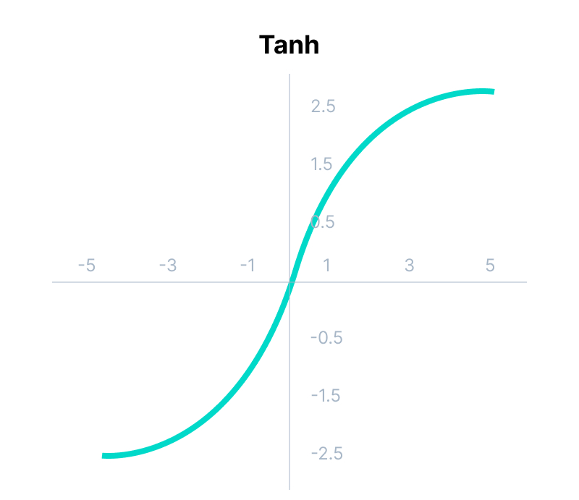
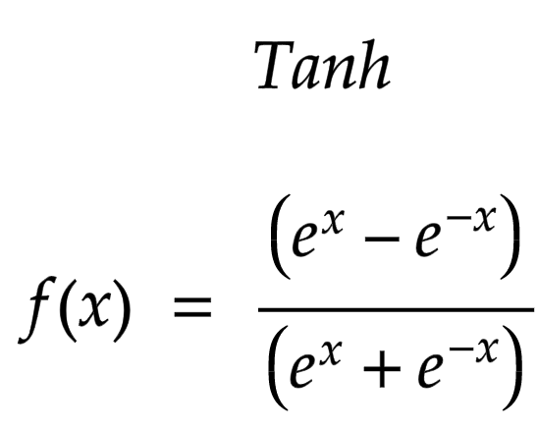
Tanh Function (Hyperbolic Tangent)
WWW.INTERNSHIPSTUDIO.COM

Slide 9
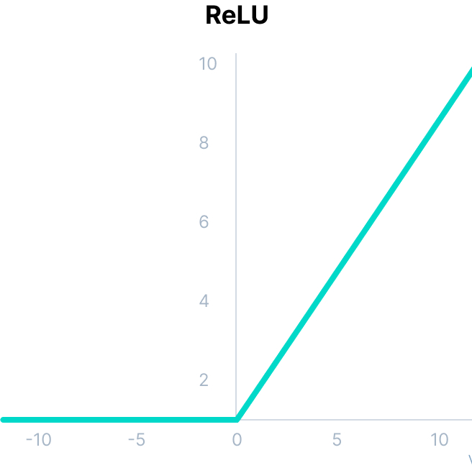
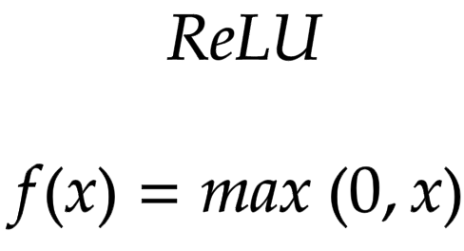
ReLU Function
WWW.INTERNSHIPSTUDIO.COM

Slide 10
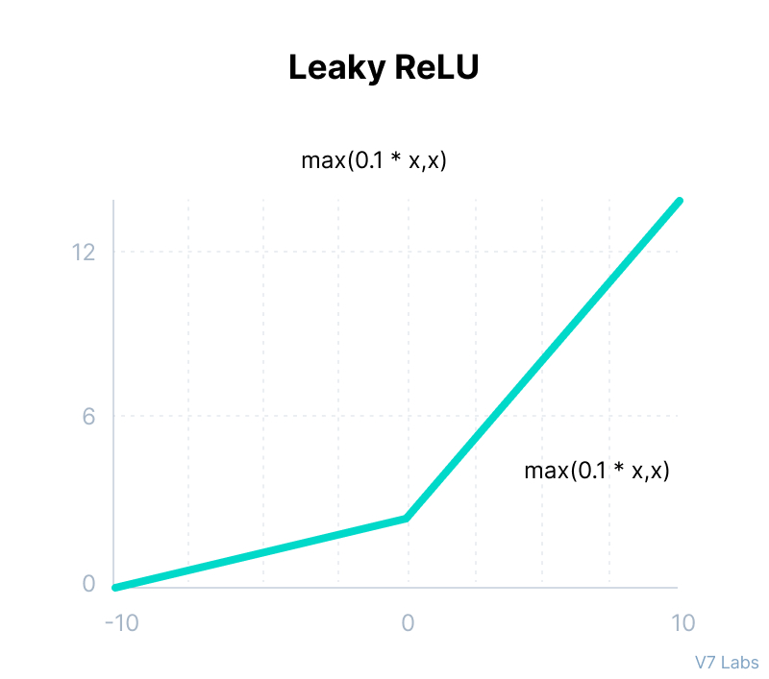
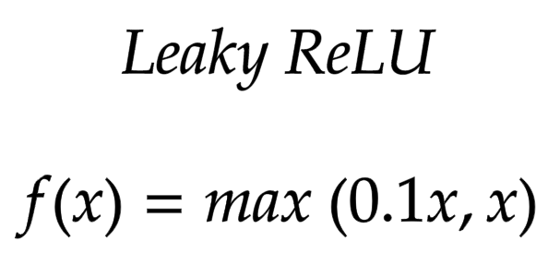
Leaky ReLU Function
WWW.INTERNSHIPSTUDIO.COM

