Slide 1


Welcome to
INTERNSHIP STUDIO
Module 05 | Lesson 03
Backpropagation and optimization algorithms
WWW.INTERNSHIPSTUDIO.COM

Slide 2

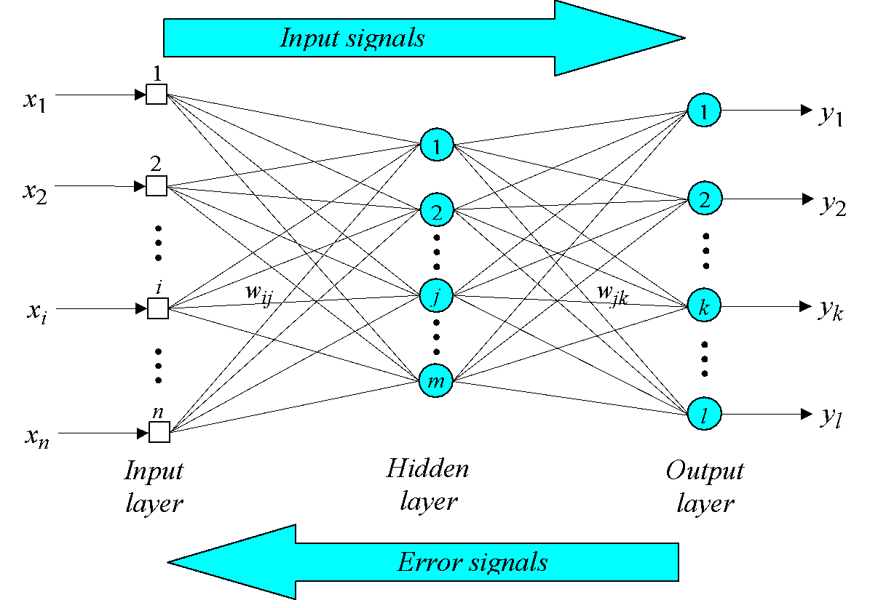
Back-propagation neural network
WWW.INTERNSHIPSTUDIO.COM
WWW.INTERNSHIPSTUDIO.COM

Slide 3
Back-propagation neural network
In a back-propagation neural network, the learning algorithm has two phases.
First, a training input pattern is presented to the network input layer. The network propagates the input pattern from layer to layer until the output pattern is generated by the output layer.
If this pattern is different from the desired output, an error is calculated and then propagated backwards through the network from the output layer to the input layer. The weights are modified as the error is propagated.
WWW.INTERNSHIPSTUDIO.COM

Slide 4
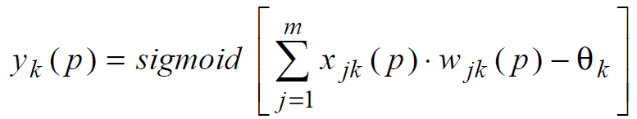


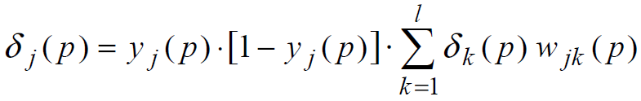




Back-propagation neural network
Neuron output at layer “k”
Error at layer “k”
Error gradient at layer “k”
Error gradient at layer “j”
Change in weight
Change in weight
Weight Updation
Weight Updation
WWW.INTERNSHIPSTUDIO.COM

Slide 5
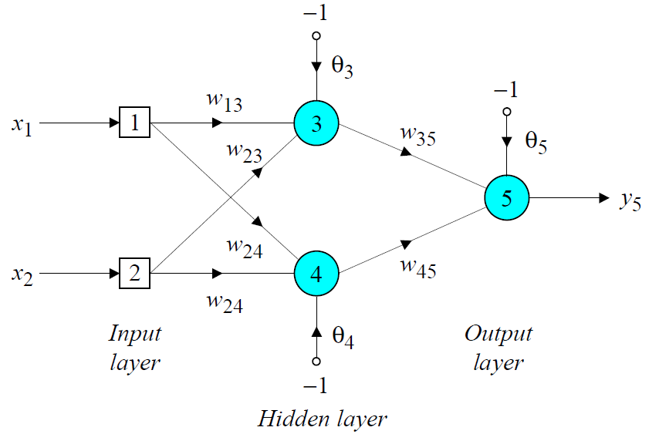

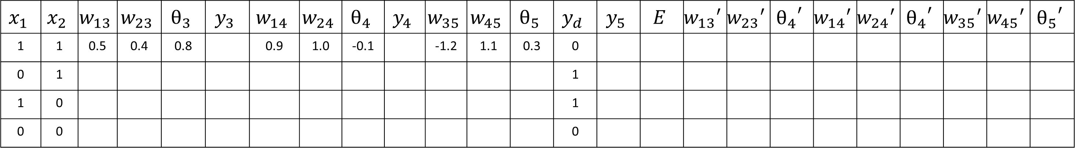
XOR Problem
$$x_{1}$$ | $$x_{2}$$ | $$w_{13}$$ | $$w_{23}$$ | $$θ_{3}$$ | $$y_{3}$$ | $$w_{14}$$ | $$w_{24}$$ | $$θ_{4}$$ | $$y_{4}$$ | $$w_{35}$$ | $$w_{45}$$ | $$θ_{5}$$ | $$y_{d}$$ | $$y_{5}$$ | $$E$$ | $${w_{13}}^{′}$$ | $${w_{23}}^{′}$$ | $${θ_{4}}^{′}$$ | $${w_{14}}^{′}$$ | $${w_{24}}^{′}$$ | $${θ_{4}}^{′}$$ | $${w_{35}}^{′}$$ | $${w_{45}}^{′}$$ | $${θ_{5}}^{′}$$
1 | 1 | 0.5 | 0.4 | 0.8 |  | 0.9 | 1.0 | -0.1 |  | -1.2 | 1.1 | 0.3 | 0
0 | 1 |  |  |  |  |  |  |  |  |  |  |  | 1
1 | 0 |  |  |  |  |  |  |  |  |  |  |  | 1
0 | 0 |  |  |  |  |  |  |  |  |  |  |  | 0
WWW.INTERNSHIPSTUDIO.COM

Slide 6
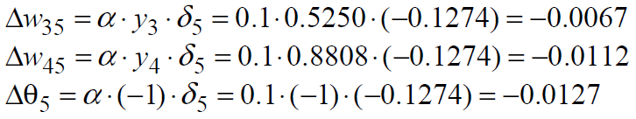
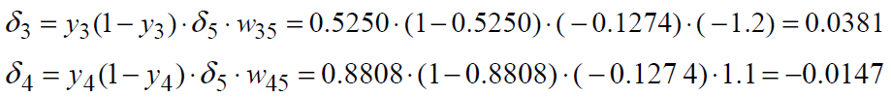
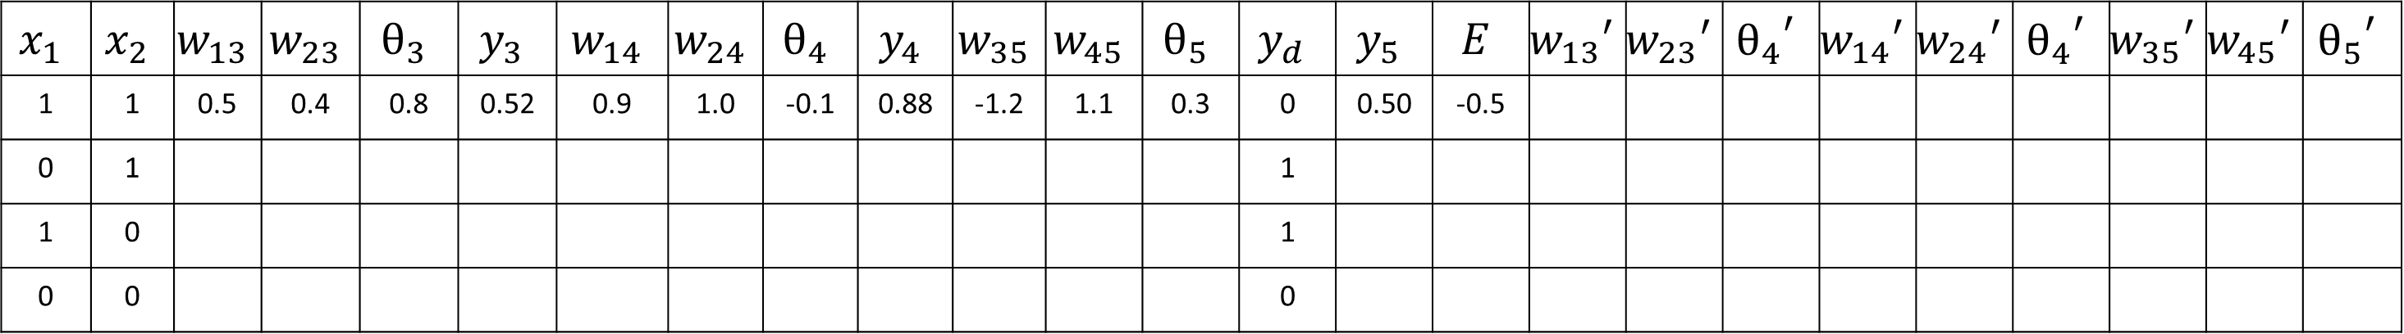
XOR Problem
$$x_{1}$$ | $$x_{2}$$ | $$w_{13}$$ | $$w_{23}$$ | $$θ_{3}$$ | $$y_{3}$$ | $$w_{14}$$ | $$w_{24}$$ | $$θ_{4}$$ | $$y_{4}$$ | $$w_{35}$$ | $$w_{45}$$ | $$θ_{5}$$ | $$y_{d}$$ | $$y_{5}$$ | $$E$$ | $${w_{13}}^{′}$$ | $${w_{23}}^{′}$$ | $${θ_{4}}^{′}$$ | $${w_{14}}^{′}$$ | $${w_{24}}^{′}$$ | $${θ_{4}}^{′}$$ | $${w_{35}}^{′}$$ | $${w_{45}}^{′}$$ | $${θ_{5}}^{′}$$
1 | 1 | 0.5 | 0.4 | 0.8 | 0.52 | 0.9 | 1.0 | -0.1 | 0.88 | -1.2 | 1.1 | 0.3 | 0 | 0.50 | -0.5
0 | 1 |  |  |  |  |  |  |  |  |  |  |  | 1
1 | 0 |  |  |  |  |  |  |  |  |  |  |  | 1
0 | 0 |  |  |  |  |  |  |  |  |  |  |  | 0
WWW.INTERNSHIPSTUDIO.COM

Slide 7
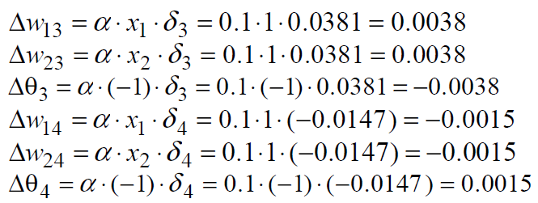
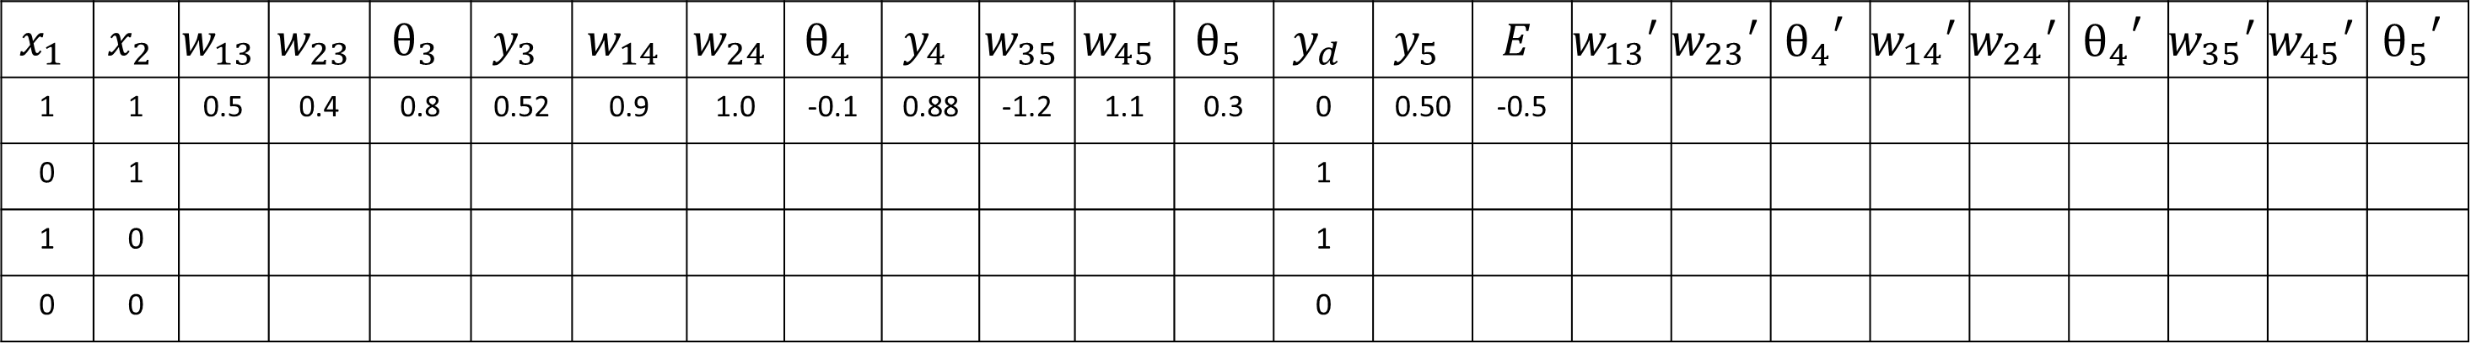
XOR Problem
$$x_{1}$$ | $$x_{2}$$ | $$w_{13}$$ | $$w_{23}$$ | $$θ_{3}$$ | $$y_{3}$$ | $$w_{14}$$ | $$w_{24}$$ | $$θ_{4}$$ | $$y_{4}$$ | $$w_{35}$$ | $$w_{45}$$ | $$θ_{5}$$ | $$y_{d}$$ | $$y_{5}$$ | $$E$$ | $${w_{13}}^{′}$$ | $${w_{23}}^{′}$$ | $${θ_{4}}^{′}$$ | $${w_{14}}^{′}$$ | $${w_{24}}^{′}$$ | $${θ_{4}}^{′}$$ | $${w_{35}}^{′}$$ | $${w_{45}}^{′}$$ | $${θ_{5}}^{′}$$
1 | 1 | 0.5 | 0.4 | 0.8 | 0.52 | 0.9 | 1.0 | -0.1 | 0.88 | -1.2 | 1.1 | 0.3 | 0 | 0.50 | -0.5
0 | 1 |  |  |  |  |  |  |  |  |  |  |  | 1
1 | 0 |  |  |  |  |  |  |  |  |  |  |  | 1
0 | 0 |  |  |  |  |  |  |  |  |  |  |  | 0
WWW.INTERNSHIPSTUDIO.COM

Slide 8
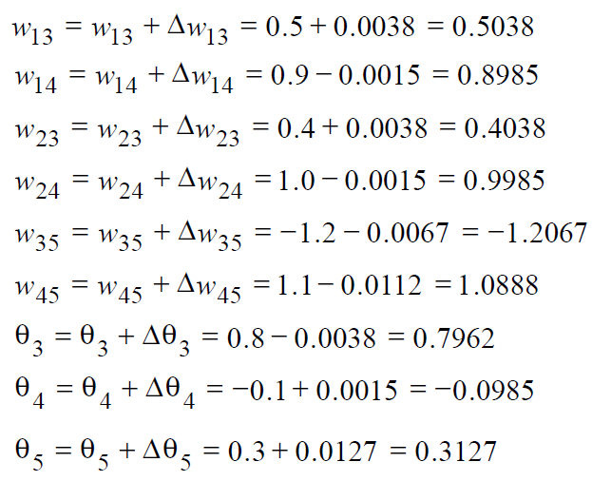
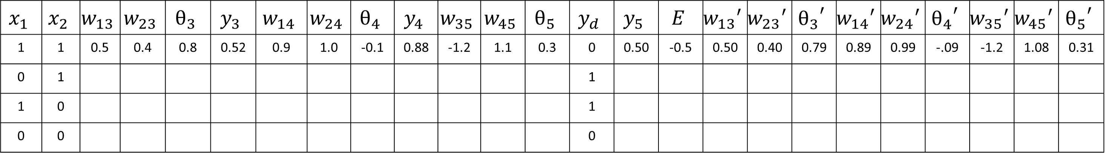
XOR Problem
$$x_{1}$$ | $$x_{2}$$ | $$w_{13}$$ | $$w_{23}$$ | $$θ_{3}$$ | $$y_{3}$$ | $$w_{14}$$ | $$w_{24}$$ | $$θ_{4}$$ | $$y_{4}$$ | $$w_{35}$$ | $$w_{45}$$ | $$θ_{5}$$ | $$y_{d}$$ | $$y_{5}$$ | $$E$$ | $${w_{13}}^{′}$$ | $${w_{23}}^{′}$$ | $${θ_{3}}^{′}$$ | $${w_{14}}^{′}$$ | $${w_{24}}^{′}$$ | $${θ_{4}}^{′}$$ | $${w_{35}}^{′}$$ | $${w_{45}}^{′}$$ | $${θ_{5}}^{′}$$
1 | 1 | 0.5 | 0.4 | 0.8 | 0.52 | 0.9 | 1.0 | -0.1 | 0.88 | -1.2 | 1.1 | 0.3 | 0 | 0.50 | -0.5 | 0.50 | 0.40 | 0.79 | 0.89 | 0.99 | -.09 | -1.2 | 1.08 | 0.31
0 | 1 |  |  |  |  |  |  |  |  |  |  |  | 1
1 | 0 |  |  |  |  |  |  |  |  |  |  |  | 1
0 | 0 |  |  |  |  |  |  |  |  |  |  |  | 0
WWW.INTERNSHIPSTUDIO.COM

Slide 9
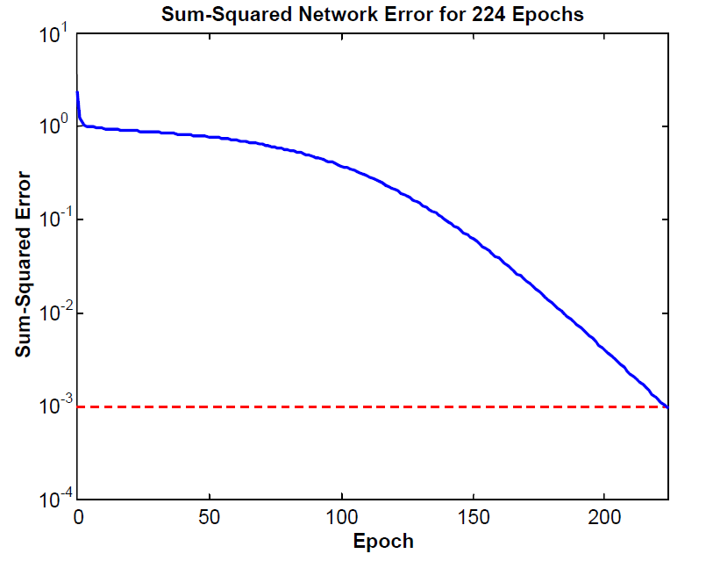
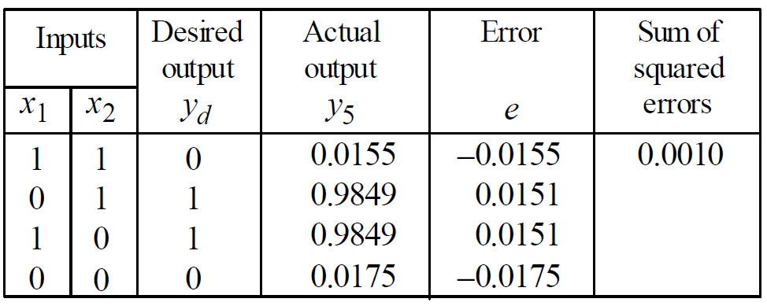
XOR Problem
XOR Problem
WWW.INTERNSHIPSTUDIO.COM

Slide 10
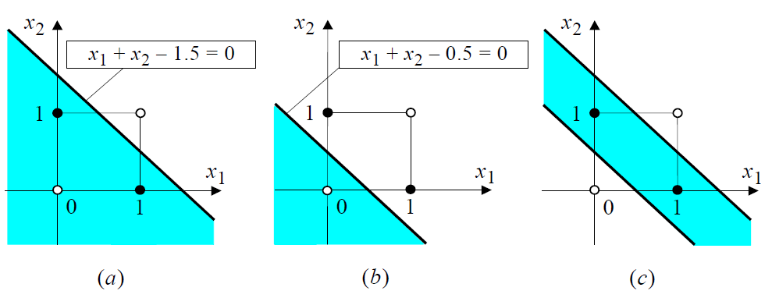
XOR Problem
a) Decision boundary created by hidden neuron 3
b) Decision boundary created by hidden neuron 4
c) Decision boundary created by output neuron 5
WWW.INTERNSHIPSTUDIO.COM

Slide 11
Optimization in ANN
In deep learning, we have the concept of loss, which tells us how poorly the model is performing at that current instant. Now we need to use this loss to train our network such that it performs better. Essentially what we need to do is to take the loss and try to minimize it, because a lower loss means our model is going to perform better. The process of minimizing (or maximizing) any mathematical expression is called optimization.
Optimizers are algorithms or methods used to change the attributes of the neural network such as weights and learning rate to reduce the losses. Optimizers are used to solve optimization problems by minimizing the function.
WWW.INTERNSHIPSTUDIO.COM
Notes:
https://www.kdnuggets.com/2020/12/optimization-algorithms-neural-networks.html

Slide 12
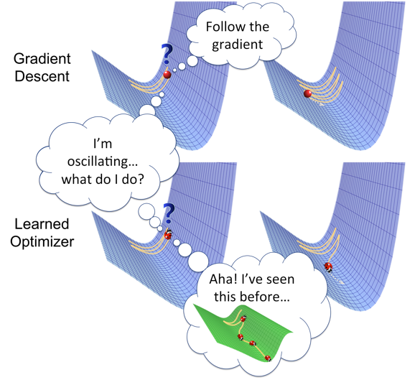
Optimization in ANN
Optimizers are algorithms or methods used to change the attributes of your neural network such as weights and learning rate in order to reduce the losses.
WWW.INTERNSHIPSTUDIO.COM
Notes:
https://towardsdatascience.com/optimizers-for-training-neural-network-59450d71caf6

Slide 13
Types of Optimization algorithms
Gradient Descent
Stochastic Gradient Descent (SGD)
Mini Batch Stochastic Gradient Descent (MB-SGD)
SGD with momentum
Nesterov Accelerated Gradient (NAG)
Adaptive Gradient (AdaGrad)
AdaDelta
RMSprop
Adam
WWW.INTERNSHIPSTUDIO.COM

