Slide 1


Welcome to
INTERNSHIP STUDIO
Module 05 | Lesson 05
Convolutional Neural Networks (CNNs)
WWW.INTERNSHIPSTUDIO.COM

Slide 2

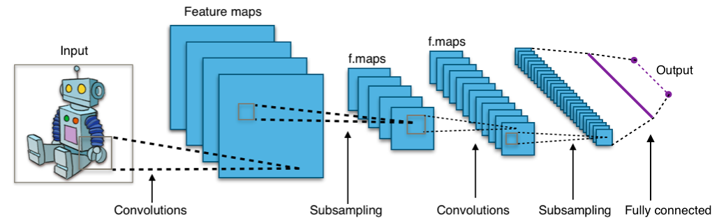
Convolutional neural networks
By Aphex34 - Own work, CC BY-SA 4.0, https://commons.wikimedia.org/w/index.php?curid=45679374
WWW.INTERNSHIPSTUDIO.COM

Slide 3
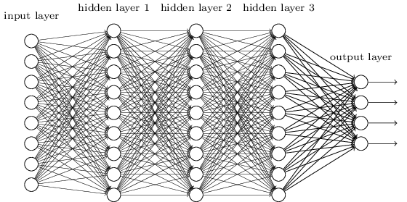
Smaller Network: CNN
We know it is good to learn a small model.
From this fully connected model, do we really need all the edges?
Can some of these be shared?
WWW.INTERNSHIPSTUDIO.COM

Slide 4
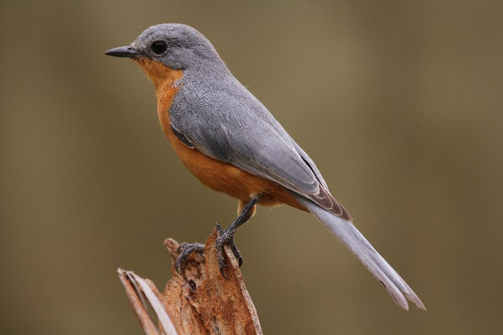
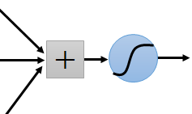
Consider learning an image:
Some patterns are much smaller than the whole image
Can represent a small region with fewer parameters
“beak” detector
WWW.INTERNSHIPSTUDIO.COM

Slide 5
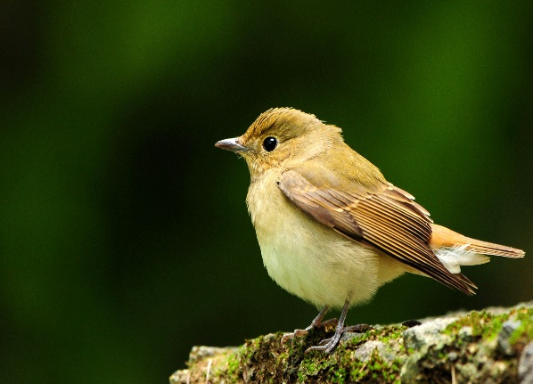
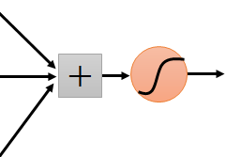
Same pattern appears in different places: They can be compressed! What about training a lot of such “small” detectors and each detector must “move around”.
“upper-left beak” detector
They can be compressed
to the same parameters.
“middle beak” detector
WWW.INTERNSHIPSTUDIO.COM

Slide 6
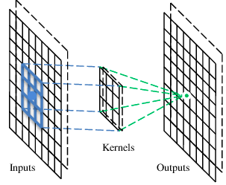
A convolutional layer
A CNN is a neural network with some convolutional layers
(and some other layers). A convolutional layer has a number
of filters that does convolutional operation.
Beak detector
A filter
WWW.INTERNSHIPSTUDIO.COM

Slide 7
Convolution
These are the network parameters to be learned.
1 | -1 | -1
-1 | 1 | -1
-1 | -1 | 1
1 | 0 | 0 | 0 | 0 | 1
0 | 1 | 0 | 0 | 1 | 0
0 | 0 | 1 | 1 | 0 | 0
1 | 0 | 0 | 0 | 1 | 0
0 | 1 | 0 | 0 | 1 | 0
0 | 0 | 1 | 0 | 1 | 0
Filter 1
-1 | 1 | -1
-1 | 1 | -1
-1 | 1 | -1
Filter 2
……
6 x 6 image
Each filter detects a small pattern (3 x 3).
WWW.INTERNSHIPSTUDIO.COM

Slide 8
Convolution
1 | -1 | -1
-1 | 1 | -1
-1 | -1 | 1
Filter 1
stride=1
1 | 0 | 0 | 0 | 0 | 1
0 | 1 | 0 | 0 | 1 | 0
0 | 0 | 1 | 1 | 0 | 0
1 | 0 | 0 | 0 | 1 | 0
0 | 1 | 0 | 0 | 1 | 0
0 | 0 | 1 | 0 | 1 | 0
Dot
product
3
-1
6 x 6 image
WWW.INTERNSHIPSTUDIO.COM

Slide 9
Convolution
1 | -1 | -1
-1 | 1 | -1
-1 | -1 | 1
Filter 1
If stride=2
1 | 0 | 0 | 0 | 0 | 1
0 | 1 | 0 | 0 | 1 | 0
0 | 0 | 1 | 1 | 0 | 0
1 | 0 | 0 | 0 | 1 | 0
0 | 1 | 0 | 0 | 1 | 0
0 | 0 | 1 | 0 | 1 | 0
3
-3
6 x 6 image
WWW.INTERNSHIPSTUDIO.COM

Slide 10
Convolution
1 | -1 | -1
-1 | 1 | -1
-1 | -1 | 1
Filter 1
stride=1
1 | 0 | 0 | 0 | 0 | 1
0 | 1 | 0 | 0 | 1 | 0
0 | 0 | 1 | 1 | 0 | 0
1 | 0 | 0 | 0 | 1 | 0
0 | 1 | 0 | 0 | 1 | 0
0 | 0 | 1 | 0 | 1 | 0
3
-1
-3
-1
-3
1
0
-3
-3
-3
0
1
3
-2
-2
-1
6 x 6 image
WWW.INTERNSHIPSTUDIO.COM
Notes:
W-k+2p)/2s+1

Slide 11
Convolution
-1 | 1 | -1
-1 | 1 | -1
-1 | 1 | -1
Filter 2
stride=1
Repeat this for each filter
1 | 0 | 0 | 0 | 0 | 1
0 | 1 | 0 | 0 | 1 | 0
0 | 0 | 1 | 1 | 0 | 0
1 | 0 | 0 | 0 | 1 | 0
0 | 1 | 0 | 0 | 1 | 0
0 | 0 | 1 | 0 | 1 | 0
3
-1
-3
-1
-1
-1
-1
-1
-3
1
0
-3
-1
-1
-2
1
Feature
Map
-3
-3
0
1
-1
-1
-2
1
3
-2
-2
-1
6 x 6 image
-1
0
-4
3
Two 4 x 4 images
Forming 2 x 4 x 4 matrix
WWW.INTERNSHIPSTUDIO.COM

Slide 12
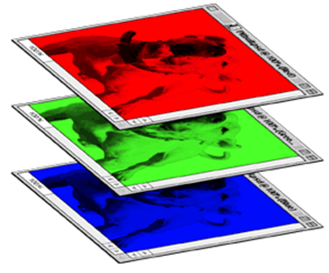
Color image: RGB 3 channels
-1 | 1 | -1
-1 | 1 | -1
-1 | 1 | -1
1 | -1 | -1
-1 | 1 | -1
-1 | -1 | 1
-1 | 1 | -1
-1 | 1 | -1
-1 | 1 | -1
1 | -1 | -1
-1 | 1 | -1
-1 | -1 | 1
-1 | 1 | -1
-1 | 1 | -1
-1 | 1 | -1
1 | -1 | -1
-1 | 1 | -1
-1 | -1 | 1
Filter 1
Filter 2
Color image
1 | 0 | 0 | 0 | 0 | 1
0 | 1 | 0 | 0 | 1 | 0
0 | 0 | 1 | 1 | 0 | 0
1 | 0 | 0 | 0 | 1 | 0
0 | 1 | 0 | 0 | 1 | 0
0 | 0 | 1 | 0 | 1 | 0
1 | 0 | 0 | 0 | 0 | 1
0 | 1 | 0 | 0 | 1 | 0
0 | 0 | 1 | 1 | 0 | 0
1 | 0 | 0 | 0 | 1 | 0
0 | 1 | 0 | 0 | 1 | 0
0 | 0 | 1 | 0 | 1 | 0
1 | 0 | 0 | 0 | 0 | 1
0 | 1 | 0 | 0 | 1 | 0
0 | 0 | 1 | 1 | 0 | 0
1 | 0 | 0 | 0 | 1 | 0
0 | 1 | 0 | 0 | 1 | 0
0 | 0 | 1 | 0 | 1 | 0
WWW.INTERNSHIPSTUDIO.COM

Slide 13
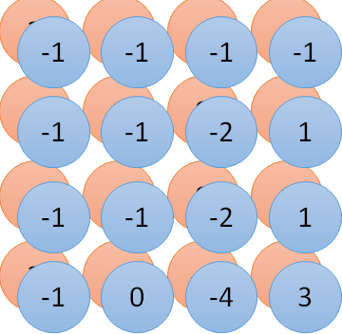
Convolution v.s. Fully Connected
1 | 0 | 0 | 0 | 0 | 1
0 | 1 | 0 | 0 | 1 | 0
0 | 0 | 1 | 1 | 0 | 0
1 | 0 | 0 | 0 | 1 | 0
0 | 1 | 0 | 0 | 1 | 0
0 | 0 | 1 | 0 | 1 | 0
1 | -1 | -1
-1 | 1 | -1
-1 | -1 | 1
-1 | 1 | -1
-1 | 1 | -1
-1 | 1 | -1
convolution
image
1 | 0 | 0 | 0 | 0 | 1
0 | 1 | 0 | 0 | 1 | 0
0 | 0 | 1 | 1 | 0 | 0
1 | 0 | 0 | 0 | 1 | 0
0 | 1 | 0 | 0 | 1 | 0
0 | 0 | 1 | 0 | 1 | 0
Fully-connected
……
……
WWW.INTERNSHIPSTUDIO.COM

Slide 14
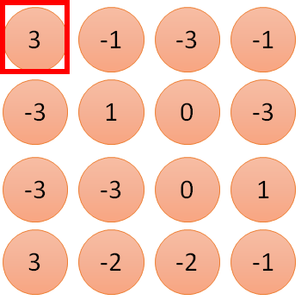
1 | -1 | -1
-1 | 1 | -1
-1 | -1 | 1
1
1
Filter 1
2
0
3
0
3
4:
0
1 | 0 | 0 | 0 | 0 | 1
0 | 1 | 0 | 0 | 1 | 0
0 | 0 | 1 | 1 | 0 | 0
1 | 0 | 0 | 0 | 1 | 0
0 | 1 | 0 | 0 | 1 | 0
0 | 0 | 1 | 0 | 1 | 0
…
0
8
1
9
0
10:
0
…
13
0
6 x 6 image
14
0
Only connect to 9 inputs, not fully connected
fewer parameters!
15
1
16
1
…
WWW.INTERNSHIPSTUDIO.COM

Slide 15
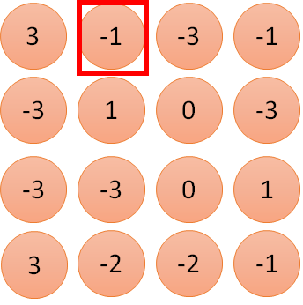
1 | -1 | -1
-1 | 1 | -1
-1 | -1 | 1
1:
1
Filter 1
2:
0
3:
0
3
4:
0
1 | 0 | 0 | 0 | 0 | 1
0 | 1 | 0 | 0 | 1 | 0
0 | 0 | 1 | 1 | 0 | 0
1 | 0 | 0 | 0 | 1 | 0
0 | 1 | 0 | 0 | 1 | 0
0 | 0 | 1 | 0 | 1 | 0
…
7:
0
8:
1
-1
9:
0
10:
0
…
13:
0
6 x 6 image
14:
0
Fewer parameters
15:
1
16:
1
Shared weights
Even fewer parameters
…
WWW.INTERNSHIPSTUDIO.COM

Slide 16
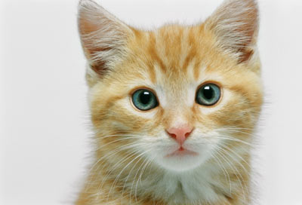
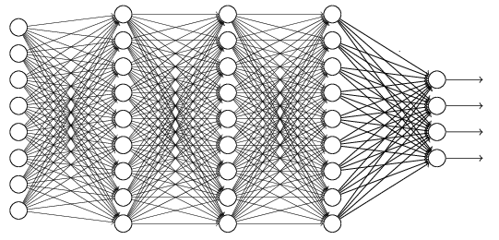
The whole CNN
cat dog ……
Convolution
Max Pooling
Can repeat many times
Fully Connected Feedforward network
Convolution
Max Pooling
Flattened
WWW.INTERNSHIPSTUDIO.COM

Slide 17
Max Pooling
1 | -1 | -1
-1 | 1 | -1
-1 | -1 | 1
-1 | 1 | -1
-1 | 1 | -1
-1 | 1 | -1
Filter 1
Filter 2
3
-1
-3
-1
-1
-1
-1
-1
-3
1
0
-3
-1
-1
-2
1
-3
-3
0
1
-1
-1
-2
1
3
-2
-2
-1
-1
0
-4
3
WWW.INTERNSHIPSTUDIO.COM

Slide 18
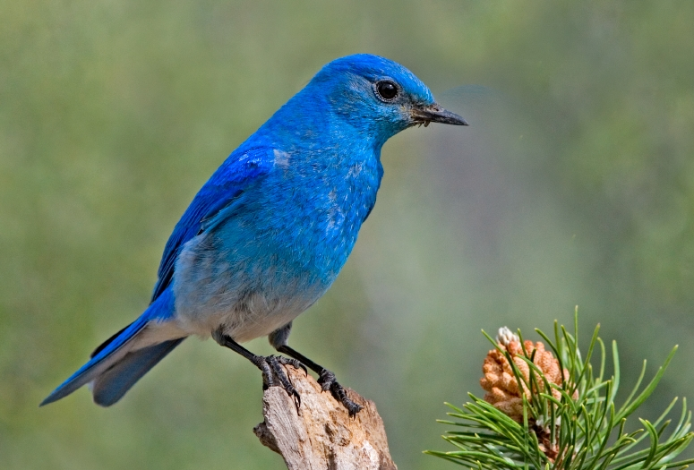

Why Pooling
Subsampling pixels will not change the object
bird
bird
Subsampling
We can subsample the pixels to make image smaller
fewer parameters to characterize the image
WWW.INTERNSHIPSTUDIO.COM

Slide 19
A CNN compresses a fully connected network in two ways:
Reducing number of connections
Shared weights on the edges
Max pooling further reduces the complexity

Slide 20
Max Pooling
New image
but smaller
1 | 0 | 0 | 0 | 0 | 1
0 | 1 | 0 | 0 | 1 | 0
0 | 0 | 1 | 1 | 0 | 0
1 | 0 | 0 | 0 | 1 | 0
0 | 1 | 0 | 0 | 1 | 0
0 | 0 | 1 | 0 | 1 | 0
Conv
3
0
-1
1
Max
Pooling
3
1
0
3
2 x 2 image
6 x 6 image
Each filter
is a channel
WWW.INTERNSHIPSTUDIO.COM

Slide 21
The whole CNN
3
0
-1
1
Convolution
3
1
0
3
Max Pooling
Can repeat many times
A new image
Convolution
Smaller than the original image
The number of channels is the number of filters
Max Pooling
WWW.INTERNSHIPSTUDIO.COM

Slide 22
The whole CNN
cat dog ……
Convolution
Max Pooling
Fully Connected Feedforward network
A new image
Convolution
Max Pooling
Flattened
A new image
WWW.INTERNSHIPSTUDIO.COM

Slide 23
Flattening
3
0
1
3
0
-1
1
3
3
1
-1
0
3
Flattened
1
Fully Connected Feedforward network
0
3
WWW.INTERNSHIPSTUDIO.COM

Slide 24
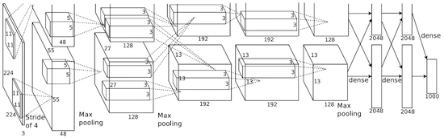
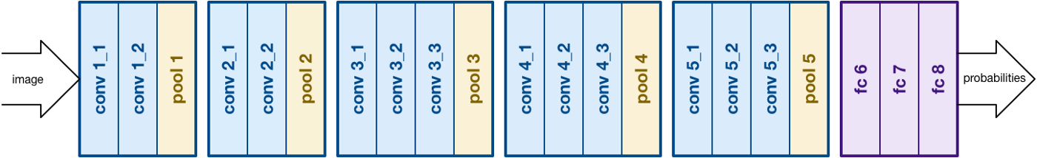
AlexNet
VGG
WWW.INTERNSHIPSTUDIO.COM

Slide 25
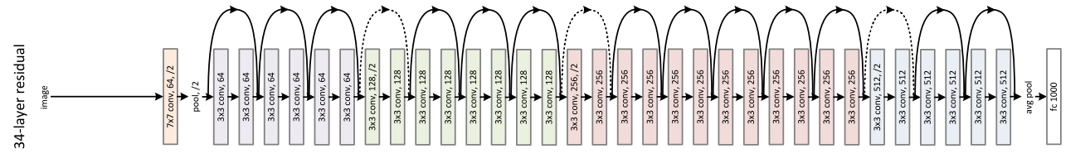
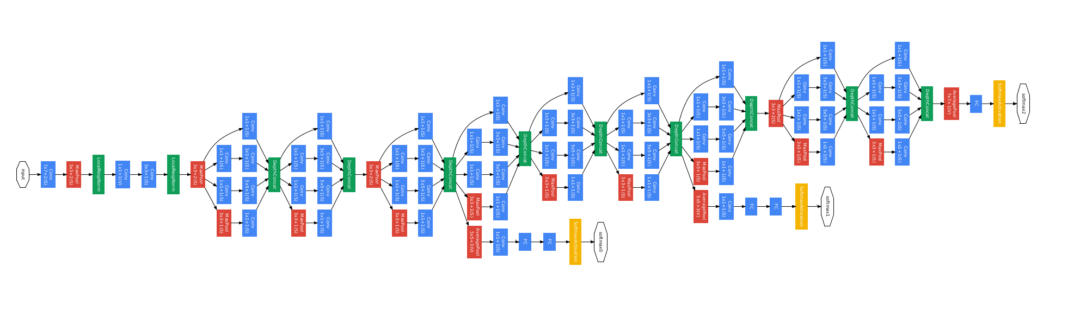
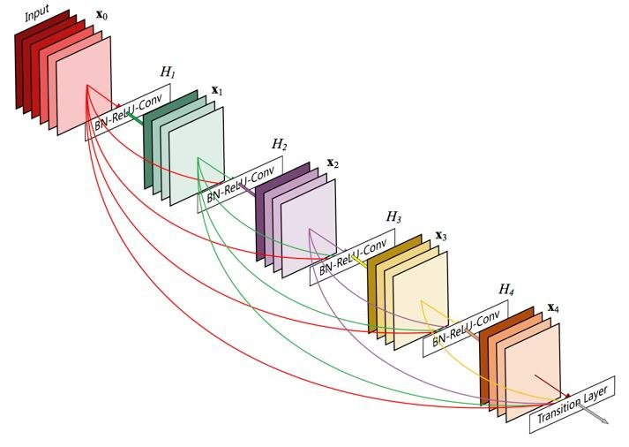
Inception / GoogLeNet
ResNet
DenseNet
WWW.INTERNSHIPSTUDIO.COM

Slide 26
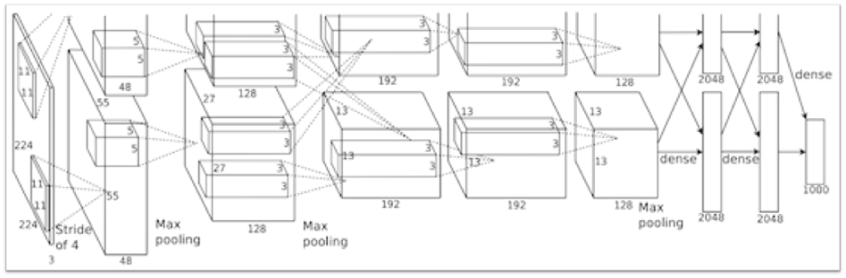
Large-scale CNNs with pre-trained weights
re-initialize and train
For many applications, an existing CNN can be re-used instead of training a new model from scratch
extract features from suitable layer or fine-tune the top layers with new data
Keras contains several models trained with ImageNet:
Xception, VGG16, VGG19, ResNet50, InceptionV3, InceptionResNetV2, MobileNet, DenseNet, NASNet
extracted features
WWW.INTERNSHIPSTUDIO.COM

Slide 27
Some selected applications
Object detection: https://pjreddie.com/darknet/yolo/
Semantic segmentation: https://www.youtube.com/watch?v=qWl9idsCuLQ
Self-driving cars: https://www.youtube.com/watch?v=mCj_C1NOVxw
Human pose estimation: https://www.youtube.com/watch?v=pW6nZXeWlGM
Video recognition: https://valossa.com/
Digital pathology: https://www.aiforia.com/

