Slide 1


Welcome to
INTERNSHIP STUDIO
Module 06 | Lesson 02
Text preprocessing and tokenization
WWW.INTERNSHIPSTUDIO.COM

Slide 2

Text Preprocessing
In any Machine learning task, cleaning or preprocessing the data is as important as model building. Text data is one of the most unstructured forms of available data and when comes to deal with Human language then it’s too complex. Have you ever wondered how Alexa, Siri, Google assistant can understand, process, and respond in Human language. NLP is a technology that works behind it where before any response lots of text preprocessing takes place.
WWW.INTERNSHIPSTUDIO.COM

Slide 3
Text Preprocessing
Some of the common text preprocessing / cleaning steps are:
Lower casing
Removal of Punctuations
Removal of Stopwords
Removal of Frequent words
Removal of Rare words
Stemming
Lemmatization
Removal of emojis
Removal of emoticons
Conversion of emoticons to words
Conversion of emojis to words
Removal of URLs
Removal of HTML tags
Chat words conversion
Spelling correction
WWW.INTERNSHIPSTUDIO.COM

Slide 4
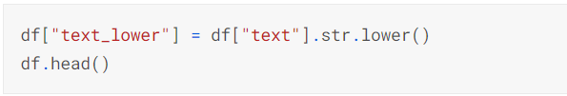
Text Preprocessing
Some of the common text preprocessing / cleaning steps are:
Lower casing: Lower casing is a common text preprocessing technique. The idea is to convert the input text into same casing format so that 'text', 'Text' and 'TEXT' are treated the same way.
Removal of Punctuations: One another common text preprocessing technique is to remove the punctuations from the text data. This is again a text standardization process that will help to treat 'hurray' and 'hurray!' in the same way. We also need to carefully choose the list of punctuations to exclude depending on the use case. For example, the string.punctuation in python contains the following punctuation symbols
!"#$%&\'()*+,-./:;<=>?@[\\]^_{|}~`
WWW.INTERNSHIPSTUDIO.COM

Slide 5

Text Preprocessing
Removal of stopwords: Stopwords are commonly occuring words in a language like 'the', 'a' and so on.
Stemming: Stemming is the process of reducing inflected (or sometimes derived) words to their word stem, base or root form (From Wikipedia). For example, if there are two words in the corpus walks and walking, then stemming will stem the suffix to make them walk. But say in another example, we have two words console and consoling, the stemmer will remove the suffix and make them consol which is not a proper english word.
Lemmatization: Lemmatization is similar to stemming in reducing inflected words to their word stem but differs in the way that it makes sure the root word (also called as lemma) belongs to the language. As a result, this one is generally slower than stemming process. So depending on the speed requirement, we can choose to use either stemming or lemmatization.
Let us use the WordNetLemmatizer in nltk to lemmatize our sentences.
WWW.INTERNSHIPSTUDIO.COM

Slide 6
Text Preprocessing
Part of speech tagging:
Input: ‘You just gave me a scare’
Output: [(‘You’, ‘PRP’), (‘just’, ‘RB’), (‘gave’, ‘VBD’), (‘me’, ‘PRP’), (‘a’, ‘DT’), (‘scare’, ‘NN’)]
Chunking:
Input: ‘the little yellow bird is flying in the sky’
Output:
(S
(NP the/DT little/JJ yellow/JJ bird/NN)
is/VBZ
flying/VBG
in/IN
(NP the/DT sky/NN))
(NP the/DT little/JJ yellow/JJ bird/NN)
(NP the/DT sky/NN)
WWW.INTERNSHIPSTUDIO.COM

Slide 7
Text Normalization
Most NLP tasks need to do text normalization:
Segmenting/tokenizing words in running text
Normalizing word formats
Segmenting sentences in running text

Slide 8
How many words?
I do uh main- mainly business data processing
Fragments, filled pauses
Seuss’s cat in the hat is different from other cats!
Lemma: same stem, part of speech, rough word sense
cat and cats = same lemma
Wordform: the full inflected surface form
cat and cats = different wordforms

Slide 9
How many words?
they lay back on the San Francisco grass and looked at the stars and their
Type: an element of the vocabulary.
Token: an instance of that type in running text.
How many?
15 tokens (or 14)
13 types (or 12)

Slide 10
How many words?
N = number of tokens
V = vocabulary = set of types
|V| is the size of the vocabulary
 | Tokens = N | Types = |V|
Switchboard phone conversations | 2.4 million | 20 thousand
Shakespeare | 884,000 | 31 thousand
Google N-grams | 1 trillion | 13 million

Slide 11
Simple Tokenization in UNIX
(Inspired by Ken Church’s UNIX for Poets.)
Given a text file, output the word tokens and their frequencies
tr -sc "A-Za-z" "\n" < sample.txt
| sort
| uniq –c
1945 A
72 AARON
19 ABBESS
5 ABBOT
... ...
Change all non-alpha to newlines
Sort in alphabetical order
Merge and count each type
25 Aaron
6 Abate
1 Abates
5 Abbess
6 Abbey
3 Abbot
.... …

Slide 12
More counting
Merging upper and lower case
tr "A-Z" "a-z" < sample.txt | tr -sc "A-Za-z" "\n" | sort | uniq –c
Sorting the counts
tr "A-Z" "a-z" < sample.txt | tr -sc "A-Za-z" "\n" | sort | uniq -c | sort -n -r
23243 the
22225 i
18618 and
16339 to
15687 of
12780 a
12163 you
10839 my
10005 in
8954 d
What happened here?

Slide 13
Tokenization is the basic part of document preprocessing
Convert byte sequences into a linear sequence of characters
Trivial with ascii, but not so with Unicode or others
Use ML classifiers or heuristics.
Crucial problem for commercial systems!

Slide 14
Tokenization
Fundamental to Natural Language Processing (NLP), IR, deep Learning and AI
Parsing (chopping up) the document into basic units that are candidates for later indexing
What parts of text to use and what not
Issues with
Punctuation
Numbers
Special characters
Equations
Formula
Languages
Normalization (often by stemming)

Slide 15
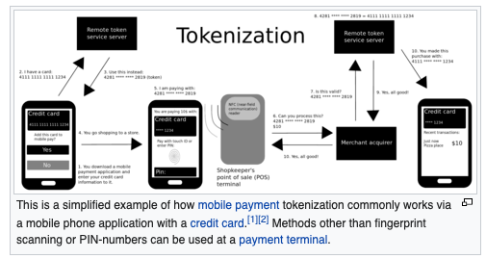
Tokenization
Not the tokenization of how to make data secure

Slide 16

Tokenization
Not the tokenization of how to make data secure

Slide 17
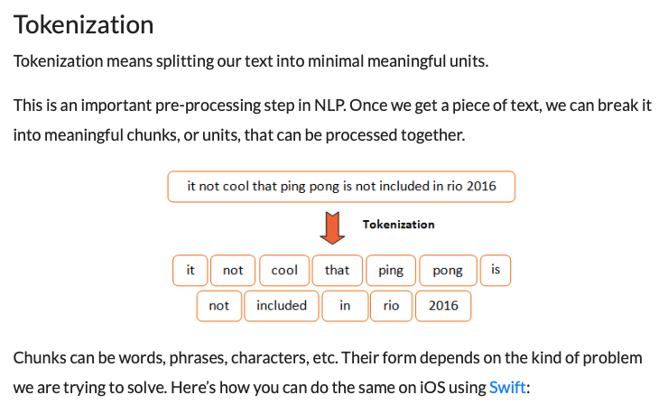
Sometimes called ”parsers”

Slide 18
What tokenization did you use?
For real problems always ask this!
A fundamental question for all text processing
Natural language processing
Text mining
Machine learning and AI
Information retrieval and search

Slide 19
The first step: tokenizing
tr -sc "A-Za-z" "\n" < sample.txt | head
THE
SONNETS
by
William
Shakespeare
From
fairest
creatures
We
...

Slide 20
The second step: sorting
tr -sc "A-Za-z" "\n" < sample.txt | sort | head
A
A
A
A
A
A
A
A
A
...

Slide 21

Natural Language Toolkit (NLTK)
A suite of Python libraries for symbolic and statistical natural language programming
Developed at the University of Pennsylvania
Has its own tokenization
Developed to be a teaching tool and a platform for research NLP prototypes
Data types are packaged as classes
Goal of code is to be clear, rather than fastest performance
Online book: http://www.nltk.org/book/
Authors: Edward Loper, Ewan Kline and Steven Bird

Slide 22
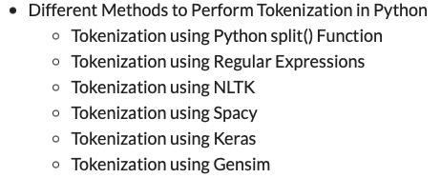
Lots of tokenizers out there

Slide 23
Tokenization example
Input: “Friends, Romans and Countrymen”
Output: Tokens
friends
romans
countrymen
Each such token is now a candidate for an index entry, after further processing
Described below
But what are valid tokens to emit?

Slide 24
Tokenization
Issues in tokenization:
Finland’s capital →
Finland? Finlands? Finland’s?
Hewlett-Packard →
Hewlett and Packard as two tokens?
State-of-the-art: break up hyphenated sequence.
co-education ?
the hold-him-back-and-drag-him-away-maneuver ?
San Francisco: one token or two? How do you decide it is one token?

Slide 25
Numbers
3/12/91
Mar. 12, 1991
55 B.C.
B-52
My PGP key is 324a3df234cb23e
100.2.86.144
Generally, don’t index as text.
Will often index “meta-data” separately
Creation date, format, etc.

Slide 26
Issues in Tokenization
Finland’s capital → Finland Finlands Finland’s ?
what’re, I’m, isn’t → What are, I am, is not
Hewlett-Packard → Hewlett Packard ?
state-of-the-art → state of the art ?
Lowercase → lower-case lowercase lower case ?
San Francisco → one token or two?
m.p.h., PhD. → ??

Slide 27
Tokenization: language issues
French
L'ensemble → one token or two?
L ? L’ ? Le ?
Want l’ensemble to match with un ensemble
German noun compounds are not segmented
Lebensversicherungsgesellschaftsangestellter
‘life insurance company employee’
German information retrieval needs compound splitter

Slide 28
Tokenization: language issues
Chinese and Japanese no spaces between words:
莎拉波娃现在居住在美国东南部的佛罗里达。
莎拉波娃 现在 居住 在 美国 东南部 的 佛罗里达
Sharapova now lives in US southeastern Florida
Further complicated in Japanese, with multiple alphabets intermingled
Dates/amounts in multiple formats
フォーチュン500社は情報不足のため時間あた$500K(約6,000万円)
Katakana
Hiragana
Kanji
Romaji
End-user can express query entirely in hiragana!

Slide 29
Tokenization: Language issues
L'ensemble → one token or two?
L ? L’ ? Le ?
Want ensemble to match with un ensemble
German noun compounds are not segmented
Lebensversicherungsgesellschaftsangestellter
‘life insurance company employee’

